Slide 1

Social Site For Mentally Challenged People
Group No : 4 (B)
Members :
Muhammad Zubair Hasan (201714041)
Shariar Azad (201714037)
Nazifa Hamid (201714044)
Takik Hasan (201714038)
Shahir Abdullah (201714054)

Slide 2
Introduction

Slide 3
Kinds of Information Required
Organization related:
1. Community based residential support.
2. National Health Services residential campus.
3. Non-Govt. organizations basically earn through services and personal assistant's support.
4. There are several structures like community based, charitable organizations, non-profit, profit etc.
User staff related:
1. Generally day to day operation is run by personal assistants who provide mental, physical supports.
2. Since mentally challenged people are generally isolated, it takes a lot of effort from the staffs to gain their trusts.
3. So information regarding their way of interacting with the patients is important for the analyst.

Slide 4
Kinds of Information Required
Workflow Related
Feedback
Data
Patient’s
Records
Family
Social Events
Staff
Interaction
Doctor’s
analysis
Assessment
Patient
Patient
Redefined Medications
Redefined
medications
Report

Slide 5
Sources
External sources :
1. Research papers. We have found some research papers where patient’s behavior was studied closely on different types of methods based on this system
2. National Health services documents.
3. Nonprofit organizations documents.
Internal sources :
1. Family member’s personal assessments.
2. Personal assistant’s interview.
3. Direct interaction with the patient.
4. Doctor’s interview and medication methods.

Slide 6
Approaches Adopted for Information Gathering
Review
doctor’s
records
On-sight
observation
Direct
Engagement
games
Interviewing
Family,
Assistant,
doctor
Data organization

Slide 7
Analysis on Gathered Information
Platform must be a media for mentally challenged people to gather help.
Platform must include emergency contacts for safety of users.
Platform must be easy to use.
Platform must attract and hold user's attention.

Slide 8
Project Leader
Shahriar Azad 201714037
The main idea of our project came from him.
Has extensive knowledge on web development, system architecture.
Has web development experience.

Slide 9
Existing Systems
Existing Systems​ | Description​
Psychological Treatment​ | People seek medical treatment from doctors, counseling with psychiatrists, group therapies and discussion circles.​ But these are real life interaction based and are costly.​
Social site campaigns​ | People share their stories on social media sites such as Facebook, Instagram. Discussion groups also exist on these social sites.​
Blogs ​ | There are many blogs regarding mental health and awareness. These are information based and one-way communication available.​
Helpline​ | There are few social media pages from organizations where people can seek help from trained/skilled personnel. Telephone based helplines from government and non-profit organizations also exist.​

Slide 10
Logical Flowchart of Existing System
Social Sites for all kinds of people:
Updates Profile
Creates Profile
Status Update, Posts Pictures, e-commerce
User
Makes Friends
Logs into profile
Interacts with Friends

Slide 11
Candidate Systems
Candidate Systems​ | Features​ | Hardware​ | Software​
A web based social site for people with mental issues ​ | I. individual profiles for each user​ ii. Audio and video based communication ​ iii. Groups and discussion forums​ iv. Blogs and necessary information to seek medical help from professionals.​ ​ | Computer, Smartphone devices​ | Web browser, easy to use UI, OS​
A mobile app based social site​ | I. Group chat options with audio and video calling​ ii. Notifications and location sharing option​ iii. Groups and discussion forums​ iv. Blogs and articles​ ​ | Smartphone devices​ | Android/iOS​

Slide 12
Characteristics of the Candidate System
Characteristics ​ | A web based social site​ | A mobile app​
User Interface​ | Easy to use required​ | User friendliness required​
Source Language ​ | Python​ | Java​
Source Code​ | Not Available​ | Not Available​
Audio and Video based communication​ | Included​ | Included​
Location sharing ​ | Not included​ | Included​
Navigation​ | Easy to surf through​ | Easy to surf through​
Optimized search option​ | Required​ | Required​
Helpline​ | Not included​ | Included​
Monetization​ | Not required​ | Not required​

Slide 13
Candidate Qualitative Evaluation Matrix:
Evaluation Criteria​ | A Web Based Social Site​ | A Mobile App​
Performance :​ | ​ | ​
Page Loading Speed​ | Excellent ​ | Excellent​
System Accuracy ​ | Very Good​ | Very Good​
Response Time​ | Excellent​ | Excellent​
User-friendly​ | Excellent​ | Excellent​
Memory required​ | Large​ | Small​
Costs:​ | ​ | ​
System Development​ | Good​ | Very Good​
Server Storage​ | Less​ | More​
User training​ | Fair​ | Fair​
Time ​ | Good​ | Very Good​

Slide 14
Candidate Quantitative Evaluation Matrix:
Evaluation Criteria​ | A Web Based Social Site​ | A Mobile App​
Performance :​ | ​ | ​
Page Loading Speed​ | Less than 1s​ | Less than 5s​
System Accuracy ​ | 99% ​ | 99% ​
Response Time​ | Less than 1s​ | Less than 1s​
User-friendly​ | Yes,​ Menu Driven, Interactive​ | Yes,​ Menu Driven, interactive​
Memory required​ | 1 GB​ | 1GB​
Costs:​ | ​ | ​
System Development​ | 40,000 Tk​ | 30,000 Tk​
Server Storage​ | 100 GB​ | 80 GB​
User training​ | 2-3 days​ | 1-2 days​
Time ​ | 3 months​ | 2 months​

Slide 15
Weighted Candidate Evaluation Matrix:
Evaluation Criteria​ | Weighting Factor​ | A Web based ​ |  | A Mobile App​
​ | ​ | Rating​ | Score​ | Rating​ | Score​
Performance :​ | ​ | ​ | ​ | ​ | ​
Page Loading Speed​ | 5​ | 4​ | 20​ | 5​ | 25​
System Accuracy ​ | 2​ | 5​ | 10​ | 5​ | 10​
Response Time​ | 4​ | 4​ | 16​ | 5​ | 20​
User-friendly​ | 5​ | 3​ | 15​ | 4​ | 20​
Memory required​ | 3​ | 2​ | 6​ | 4​ | 12​
Costs:​ | ​ | ​ | ​ | ​ | ​
System Development​ | 5​ | 5​ | 25​ | 5​ | 25​
Server Storage​ | 2​ | 2​ | 4​ | 3​ | 6​
User training​ | 3​ | 1​ | 3​ | 4​ | 12​
Time ​ | 3​ | 4​ | 12​ | 2​ | 6​

Slide 16
Selection of Best Candidate System:
Best Candidate System:
A mobile app based social site for psychologically challenged people.
Reasons:
Can be easier to use, more available since smartphone users are more in number.
Takes less time to develop.
Many features cannot be implemented in the web-based version.

Slide 17
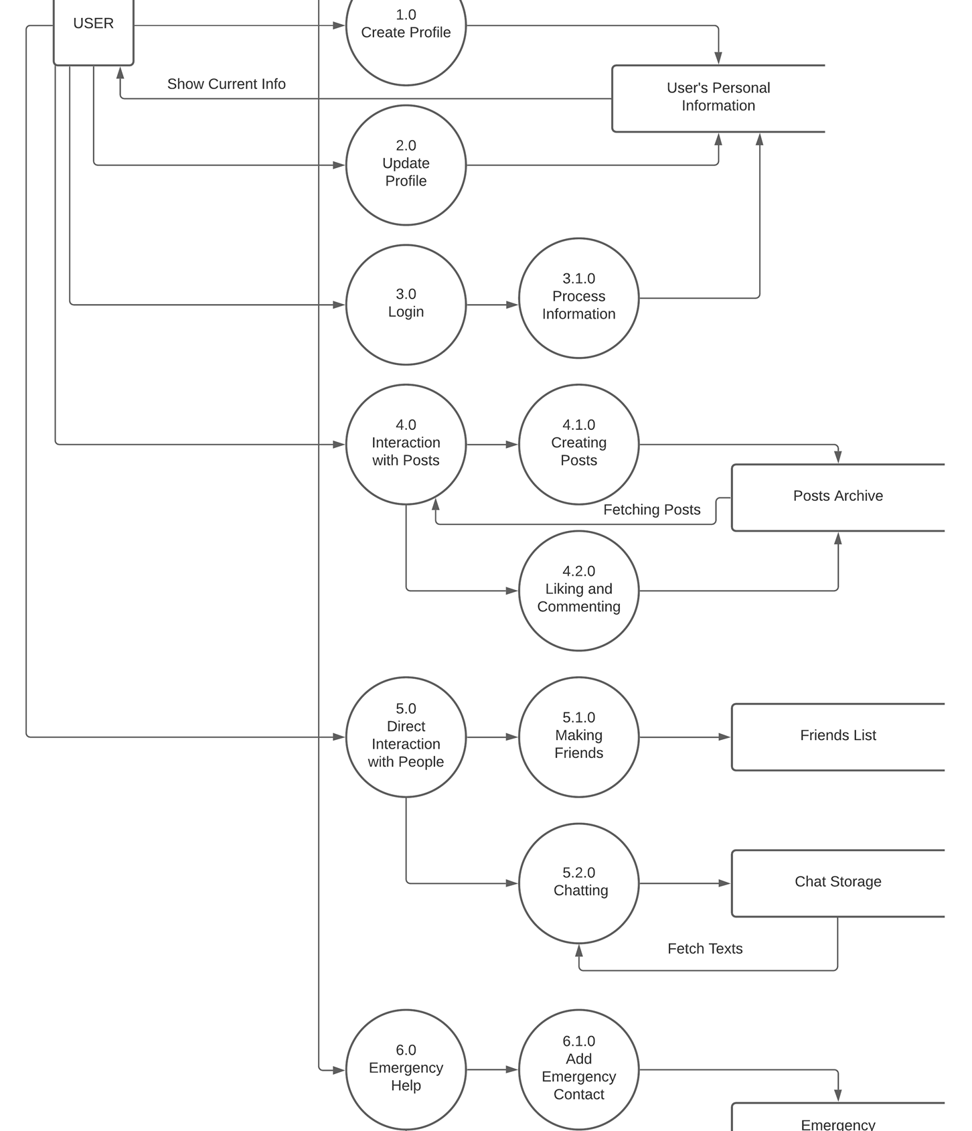
Data flow Diagram of Selected Candidate System

Slide 18
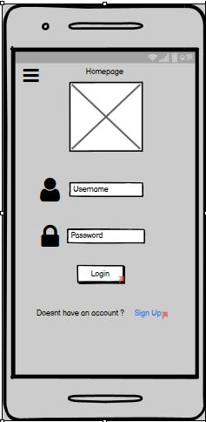
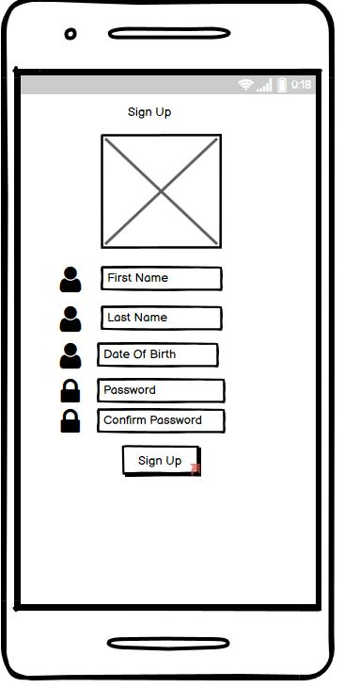
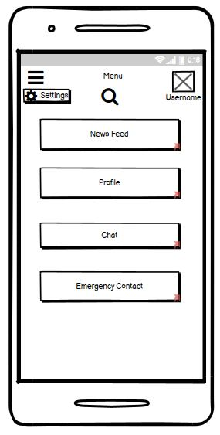
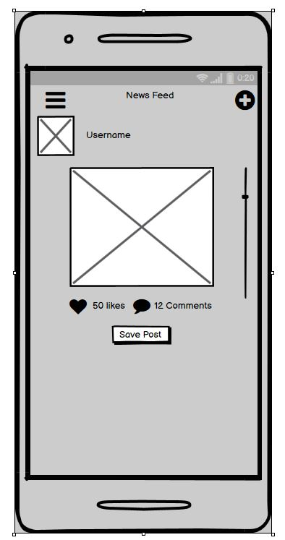
UI

Slide 19
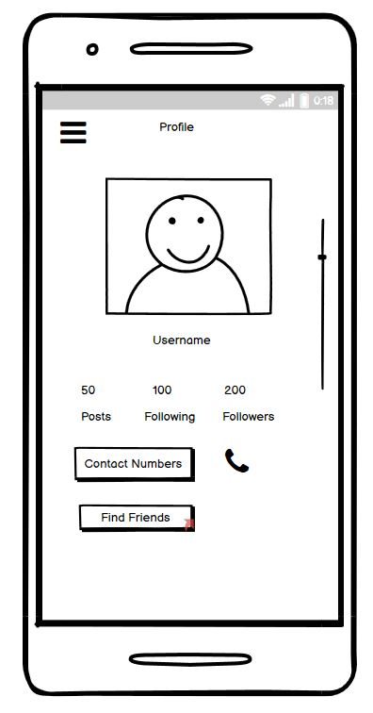
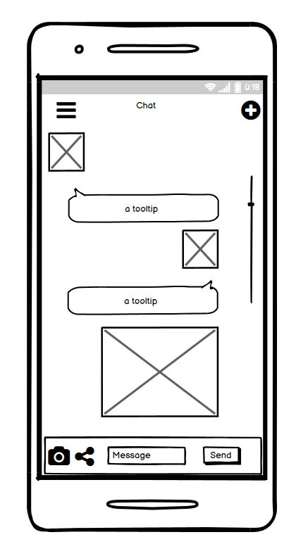
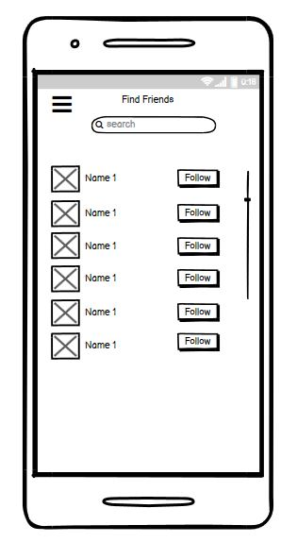
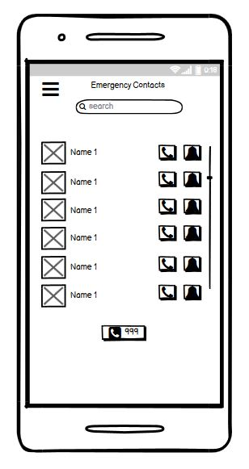
UI

Slide 20
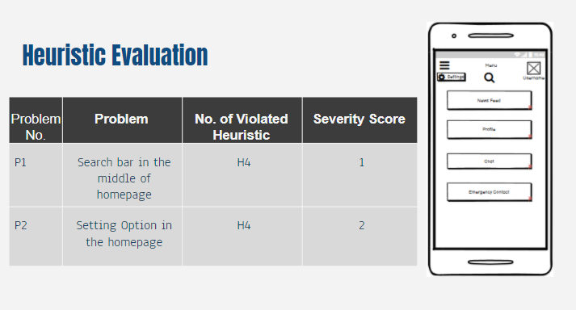
Heuristic Evaluation

Slide 21
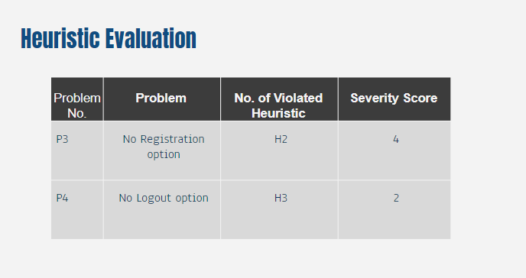
Heuristic Evaluation

Slide 22

Thank You

