Slide 1
Artificial Intelligence #1
COMS W4701
Section 001
Fall 2014
Introduction (Ch. 1)

Slide 2
COMS 4701
Instructor:
Dragomir Radev (radev@cs.columbia.edu)
Class times:
Tu/Th 7:10-8:25
TAs:
Jessica Ouyang (ouyangj@cs.columbia.edu) - head TA
Andrew Mercer-Taylor (ajm2209@columbia.edu)
Guillaume Le Chenadec (gpl2118@columbia.edu)
Xiao Hu (xh2203@columbia.edu)
Nicolas Drezet (nd2421@columbia.edu)
This is section 001. There is also section 002.
Taught by Ansaf Salleb-Aouissi
Meets Th 1:10pm-3:40pm
http://www1.ccls.columbia.edu/~ansaf/4701/syllabus.html

Slide 3
Course Dates
Sep 2 4
Sep 9 11
Sep 16 18
Sep 23 25
Sep 30 Oct 2
Oct 7 9
Oct 14 16
Oct 21 23
Oct 28 30
Nov 4(NO) 6
Nov 11 13
Nov 18 20
Nov 25 27(NO)
Dec 2 4
(26 class days)

Slide 4
Outline for today
Course overview
What is AI?
A brief history
The state of the art
Programming languages

Slide 5
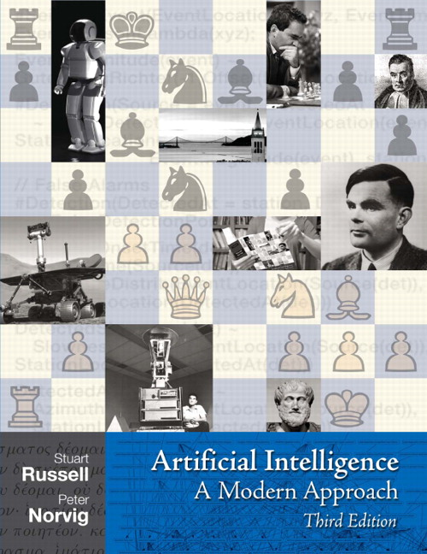
COMS 4701
Course home page:
http://www.cs.columbia.edu/~cs4701/
Textbook:
S. Russell and P. Norvig Artificial Intelligence: A Modern Approach Prentice Hall, 2009, Third Edition

Slide 6
Syllabus
Book chapters
Introduction and Agents (chapters 1,2)
Search (chapters 3,5,6)
Logic (chapters 7,8,9)
Knowledge Representation (chapter 12)
Uncertainty (chapters 13,14)
Learning (chapter 18)
Natural Language Processing (chapter 22,23)

Slide 7
Course information
Official prerequisites:
COMS W3134, W3136, or W3137.
Description:
Provides a broad understanding of the basic techniques for building intelligent computer systems. Topics include state-space problem representations, problem reduction and and-or graphs, game playing and heuristic search, predicate calculus, and resolution theorem proving, AI systems and languages for knowledge representation, machine learning and concept formation and other topics such as natural language processing may be included as time permits.

Slide 8
Grading
Assignments
Survey (not graded)
4 programming projects (60%)
Midterm (15%)
Final (20%)
Class participation (5%)

Slide 9
Programming projects
AI programming
Random text generator (competition)
Search and games
Two-player game (competition)
Constraint satisfaction and Natural Language Processing
Crossword puzzle solver (competition)
Machine learning
Classification (competition)

Slide 10
Practically…
Games
Language
Learning

Slide 11
Games
Single-player
Solitaire, Tetris
Multi-player
Go, chess

Slide 12
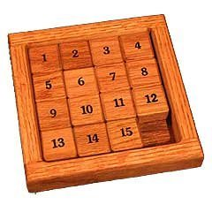
15 Puzzle

Slide 13
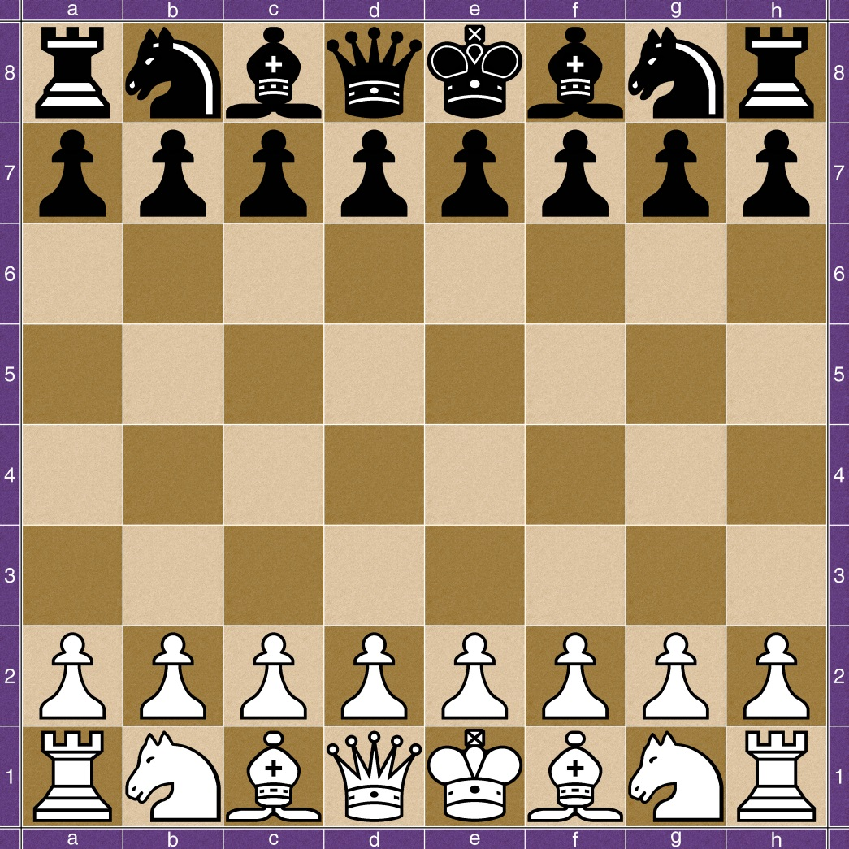
Chess

Slide 14
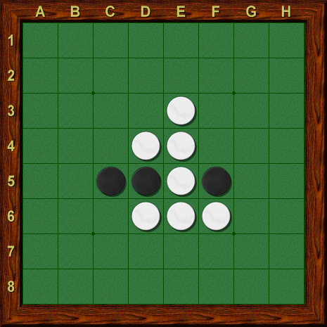
Othello/Reversi

Slide 15
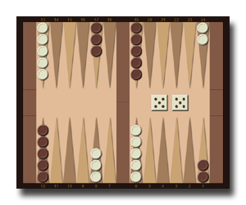
Backgammon

Slide 16
Language
Where is this quote from?
Dave Bowman: Open the pod bay doors, HAL.
HAL: I’m sorry Dave. I’m afraid I can’t do that.

Slide 17
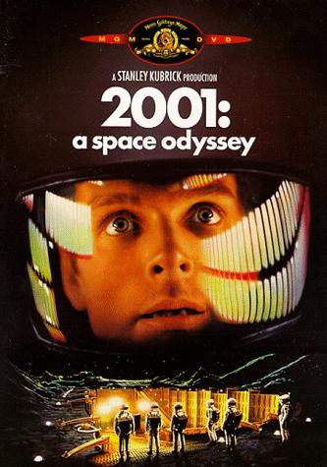
Language
“2001: A Space Odyssey”
1968 film by Stanley Kubrick
based on a joint screenplay with Arthur C. Clarke.

Slide 18
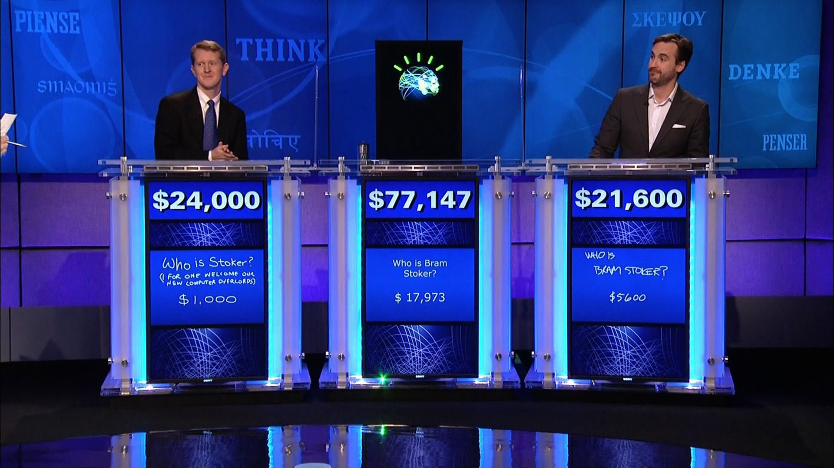
Watson
http://www.geekwire.com/2013/ibm-takes-watson-cloud/

Slide 19
Sample Jeopardy questions
From the competition between the IBM Watson system and two human champions (Ken Jennings and Brad Rutter)
Sample questions:
On December 8, 2008 this national newspaper raised its newsstand price by 25 cents to $1
USA Today
In 2010 this former first lady published the memoir "Spoken From the Heart"
Laura Bush
This person is appointed by a testator to carry out the directions & requests in his will
Executor
Familiarity is said to breed this, from the Latin for "Despise"
Contempt
As of 2010, Croatia & Macedonia are candidates but this is the only former Yugoslav republic in the EU
Slovenia
The ancient "Lion of Nimrud" went missing from this city's national museum in 2003 (along with a lot of other stuff)
Baghdad
It's just a bloody nose! You don't have this hereditary disorder once endemic to European royalty
Haemophilia
It's Michelangelo's fresco on the wall of the Sistine Chapel, Depicting the saved and the damned
The Last Judgement
She "Died in the church and was buried along with her name. Nobody came“
Eleanor Rigby
It's a 4-letter term for a summit; the first 3 letters mean a type of simian
Apex
A camel is a horse designed by this
Committee

Slide 20
Watson’s performance
Watson’s answers: 66 correct and 9 incorrect (e.g., the one in the category “US Cities” about a city with two airports named after a World War II hero and a World War II battle)
Watson's two day winning streak was $77,147. Ken Jennings ended with $24,000 and Brad Rutter with $21,600. Watson donated $500,000 to both World Vision and World Community Grid charities from the $1,000,000 prize.
http://www.quora.com/What-questions-were-asked-in-the-Jeopardy-episode-involving-Watson

Slide 21
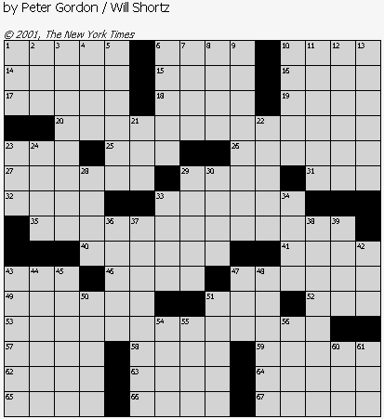
Crossword puzzles

Slide 22
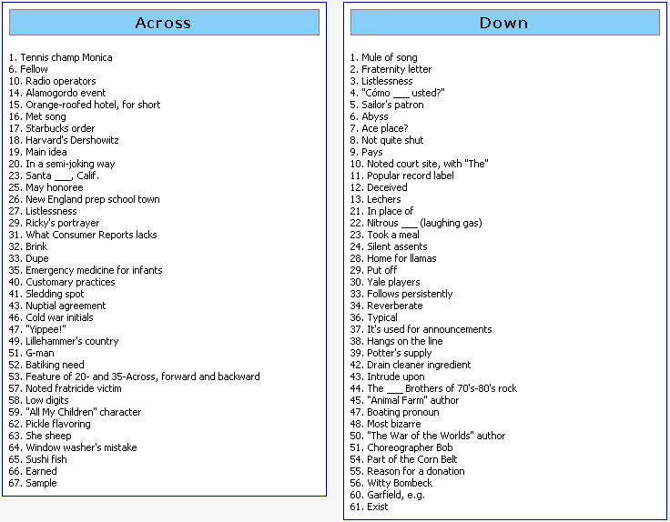

Slide 23
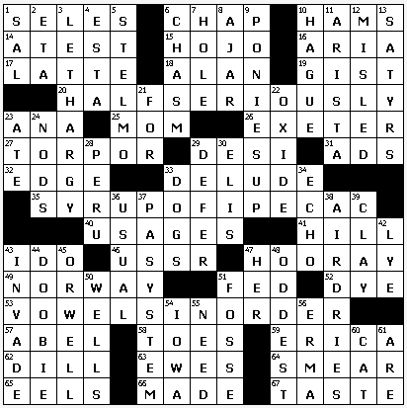

Slide 24
Evaluation
PHIL..SCUBA.IMP PHIL..SCUBA.IMP
OEA-O.NANAS.DOE OUTED.NANAS.DOE
WRM-SR-BBIT.ORE WHITERABBIT.ORE
..IMOUT.ROOSTER ..SUNUP.ROOSTER
GASP.ITNO..AONE GASP.ITNO..AONE
ETA.KNOCKONWOOD ETA.KNOCKONWOOD
AMISH..RELAY... AMISH..RELAY...
REDCAPS.NANETTE REDCAPS.NANETTE
...OKIES..CREED ...OKIES..CREED
AMERICANPIE.LAD AMERICANPIE.LAD
NAVE..WOOL.ALLY NAVE..WOOL.ALLY
ICEDTEA.RETRO.. ICEDTEA.TETRA..
MAN.SILVERBELLS MAN.SILVERBELLS
AWE.ARLEN.ANITA AWE.ARLEN.ANITA
LSD.RESET..AERO LSD.RESET..AERO

Slide 25
Learning
Machine learning:
A subfield of computer science and artificial intelligence that deals with the construction and study of systems that can learn from data, rather than follow only explicitly programmed instructions.
Examples:
Learning to drive an autonomous car in a novel environment
Learning to adjust to a user’s behavior

Slide 26
Programming languages
Most of the programming assignments will be in Python.
One assignment will be in Lisp.
You are expected to learn the basics of Lisp as part of this class.
You are similarly expected to either know Python already or to learn it on your own.
Tutorial materials for both languages will be provided.
The code base will be installed on the CLIC machines
http://www.cs.berkeley.edu/~russell/code/doc/install.html

Slide 27
Submitting assignments
In the absence of a prior emailed authorization from the instructor, you should turn in your assignments electronically by 11:59 PM on the due date. For each day (or fraction of a day) that your submission is late, it will be penalized 10%, for a maximum of 30%. After three days, the assignment will be given a score of zero.
You will need to hand in the source code for the project, relevant documentation, and a script of a test run of your program to show that it actually works on the Clic machines.
This also means that you will need a Clic account.

Slide 28
Integrity policies
Collaboration policy:
You may discuss the course material and the textbook with other students. You may also discuss the *requirements* of the assignments. However, you cannot get help with the assignments and exams themselves in oral or written form from anyone. If you are unsure about this policy, ask the instructors.
Honesty policy:
Please read this page very carefully
http://www.cs.columbia.edu/education/honesty
We will be using high grade plagiarism detection code
Do not copy other people's code or misrepresent it as yours, period.

Slide 29
Logistics
Email:
Send your questions via email to the instructors mailing list. This way it will reach the instructor and all TAs and you will get a reply sooner.
Grading appeals:
If you have a question about your grade on a particular assignment (or exam), write a short email to the TA in charge of that assignment.
Please submit any such requests within a week of receiving your grade.

Slide 30
What is a Computer?
Let’s start with these easier questions….

Slide 31


What is a Hammer?
A hammer is an AMPLIFIER for….

Slide 32
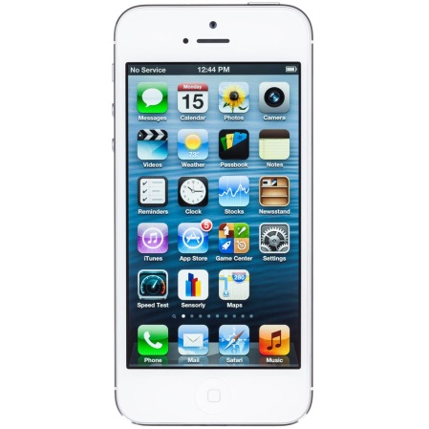

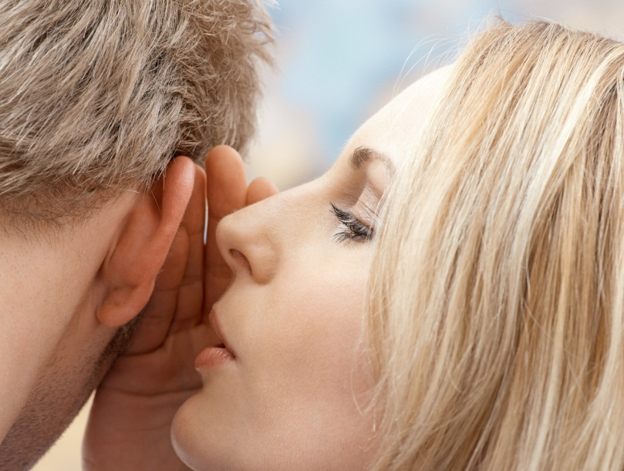
What is a Phone?
A phone is an AMPLIFIER for….

Slide 33
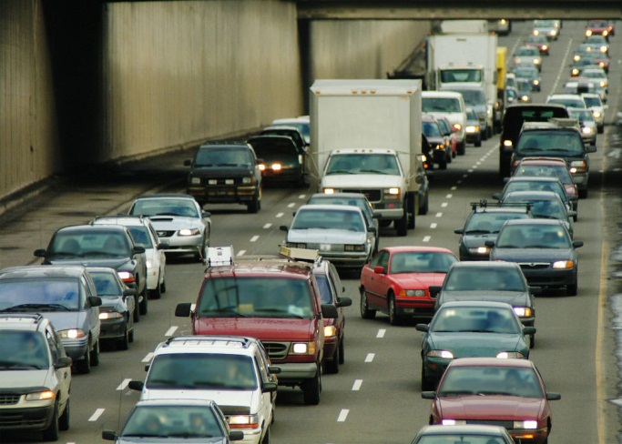

What is a Car?
A car is an AMPLIFIER for….

Slide 34

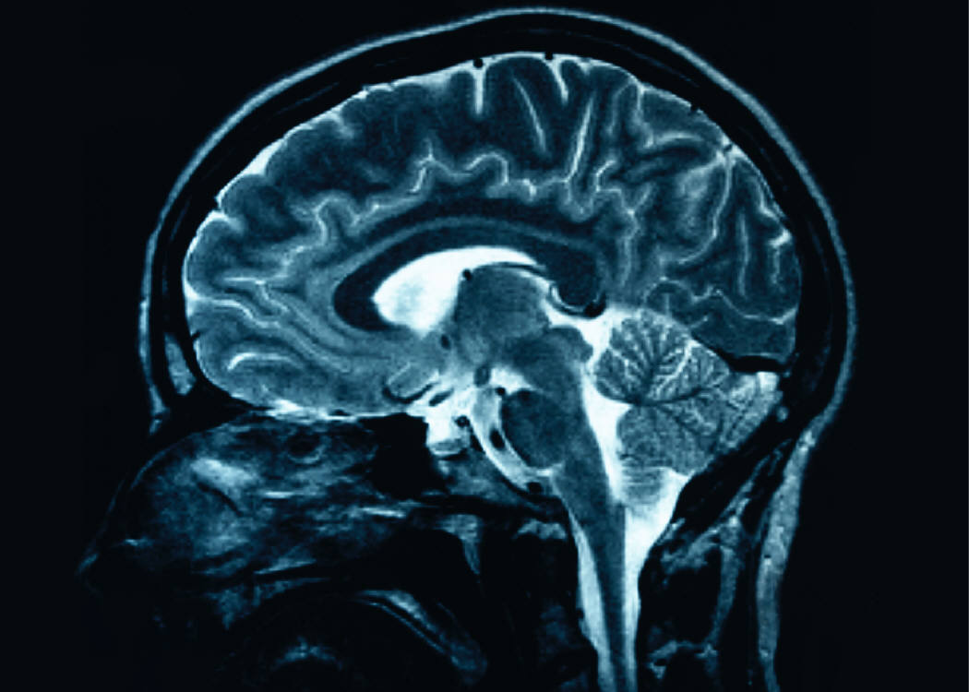
What is a Computer?
A computer is an AMPLIFIER for….

Slide 35
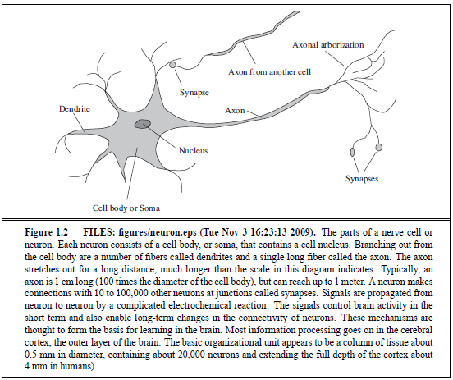

Slide 36
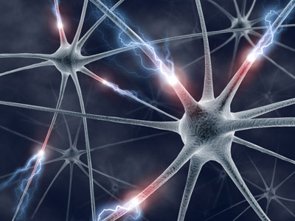
The Brain!
50-100B of these:
10,000’s connections each!
~10B critical pyramidal cells involved with cognition
1000 trillion (1 quadrillion) connections!
Why is it so wrinkled?
More brain surface (cerebral cortex) can fit in our skull
Frontal lobes oversized by mammalian standards
Vision processing oversized
Three times larger than next avg mammal

Slide 37

The Brain!
What does it do?
Remembers stuff:
Semantic memory: General knowledge, trivia and facts are stored in the temporal lobe and the cortex.
Episodic memory: New data and recent events are stored in the prefrontal cortex and the temporal lobe.
Working memory: Information and knowledge required for daily life – such as telephone numbers and learned skills like driving -- are stored in the prefrontal cortex.
Procedural memory: Secondhand skills, things we take for granted, such as walking and cycling, are stored in the cerebellum.

Slide 38
The Mind!
Is it physical?
Where is it?
Is it real or imagined? ☺
Mind-Body Problem
Descartes, Plato, Aristotle, Asian philosophy
Dualism: separate from each other
Monism: rationalists, two aspects of an underlying reality
Let’s just deal with our own reality for now….

Slide 39
What is AI?
Views of AI fall into four categories:
Thinking humanly Thinking rationally
Acting humanly Acting rationally
The textbook advocates "acting rationally"

Slide 40
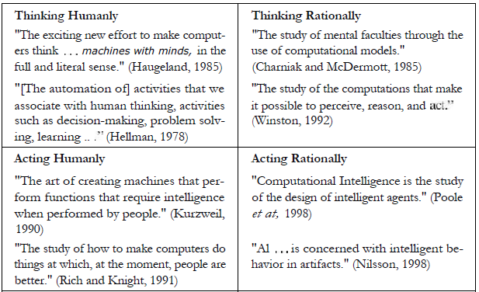
Eight definitions of AI

Slide 41
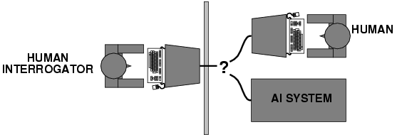
Acting humanly: Turing Test
Turing (1950) "Computing machinery and intelligence":
"Can machines think?" → "Can machines behave intelligently?"
Operational test for intelligent behavior: the Imitation Game
Predicted that by 2000, a machine might have a 30% chance of fooling a lay person for 5 minutes
Anticipated all major arguments against AI in following 50 years
Suggested major components of AI: knowledge, reasoning, language understanding, learning
The total Turing test would also involve vision and robotics

Slide 42
Thinking humanly: cognitive modeling
1960s "cognitive revolution": information-processing psychology
The General Problem Solver – Newell and Simon – they tried not only to solve a problem but also to compare the system’s reasoning process to that of a human
Requires scientific theories of internal activities of the brain
How to validate? Requires
1) Predicting and testing behavior of human subjects (top-down)
or 2) Direct identification from neurological data (bottom-up)
Both approaches (roughly, Cognitive Science and Cognitive Neuroscience) are now distinct from AI

Slide 43
Thinking rationally: "laws of thought"
Aristotle: what are correct arguments/thought processes
Several Greek schools developed various forms of logic: notation and rules of derivation for thoughts; may or may not have proceeded to the idea of mechanization
Direct line through mathematics and philosophy to modern AI
Problems:
Not all intelligent behavior is mediated by logical deliberation
What is the purpose of thinking? What thoughts should I have?

Slide 44
Acting rationally: rational agent
Rational behavior: doing the right thing
The right thing: that which is expected to maximize goal achievement, given the available information
Doesn't necessarily involve thinking – e.g., blinking reflex – but thinking should be in the service of rational action

Slide 45
Rational agents
An agent is an entity that perceives and acts
This course is about designing rational agents
Abstractly, an agent is a function from percept histories to actions:
[f: P* → A]
For any given class of environments and tasks, we seek the agent (or class of agents) with the best performance
Caveat: computational limitations make perfect rationality unachievable
design best program for given machine resources
Example: a polynomial algorithm for an exponential problem

Slide 46
AI prehistory
Philosophy Logic, methods of reasoning, mind as physical system foundations of learning, language, rationality
Mathematics Formal representation and proof algorithms, computation, (un)decidability, (in)tractability, probability
Economics utility, decision theory
Neuroscience physical substrate for mental activity
Psychology phenomena of perception and motor control, experimental techniques
Computer building fast computers engineering
Control theory design systems that maximize an objective function over time
Linguistics knowledge representation, grammar

Slide 47
Abridged history of AI
1943 McCulloch & Pitts: Boolean circuit model of brain
1950 Turing's "Computing Machinery and Intelligence"
1956 Dartmouth meeting: "Artificial Intelligence" adopted
1950s Early AI programs, including Samuel's checkers program, Newell & Simon's Logic Theorist, Gelernter's Geometry Engine
1960s First expert systems (e.g., DENDRAL)
1965 Robinson's complete algorithm for logical reasoning
1966—73 AI discovers computational complexity Neural network research almost disappears
1969—79 Early development of knowledge-based systems (e.g., SHRDLU)
1980-- AI becomes an industry
1986-- Neural networks return to popularity
1987-- AI becomes a science
1989-- Statistical methods, e.g., for NLP (e.g., IBM’s MT system)
1995-- The emergence of intelligent agents
2010-- “Deep Learning”, practical AI (Siri, automated cars)
2010-- Big data, social media

Slide 48
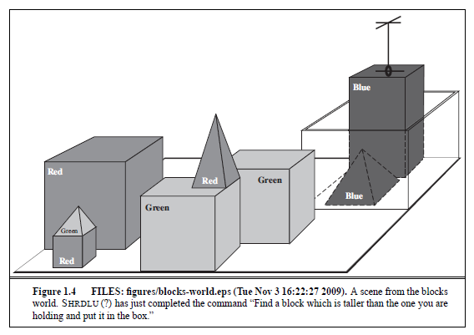

Slide 49
State of the art
Deep Blue defeated the reigning world chess champion Garry Kasparov in 1997
Proved a mathematical conjecture (Robbins conjecture) unsolved for decades
No hands across America (driving autonomously 98% of the time from Pittsburgh to San Diego)
During the 1991 Gulf War, US forces deployed an AI logistics planning and scheduling program that involved up to 50,000 vehicles, cargo, and people
NASA's on-board autonomous planning program controlled the scheduling of operations for a spacecraft
Proverb and Dr. Fill solve crossword puzzles better than most humans
AI Knowledge based system components are embedded in many real-world applications
Jeopardy!! Watson wipes the floor with the humans…in 2011
SIRI
Google Translate
etc.

Slide 50
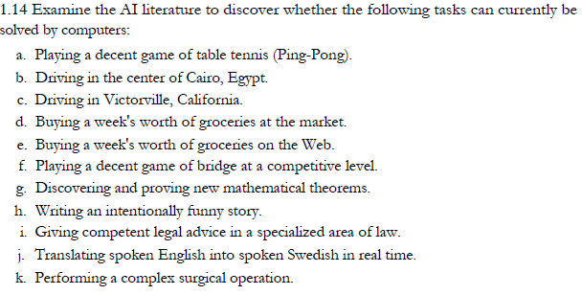
Exercise

Slide 51
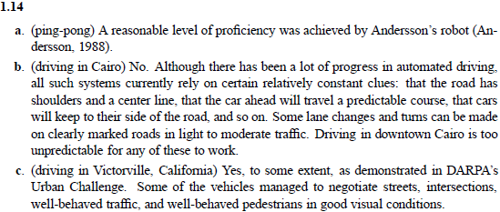
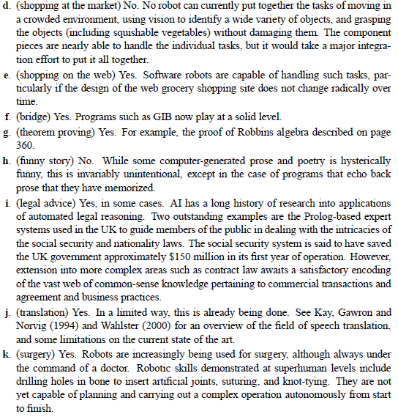

Slide 52
Related courses and journals
Related courses
4705 Natural Language Processing (Collins)
4731 Computer Vision (Nayar)
4733 Robotics (Allen)
4771 Machine Learning (Jebara)
4772 Advanced Machine Learning (Hsu)
6998-4 Speech Recognition (Beigi)
6998 Search Engine Technology
Conferences and journals
IJCAI, AAAI
AISTATS, UAI
ACL, NAACL, EMNLP
ICML, NIPS
AIJ, JAIR, CL, TACL, JMLR

Slide 53
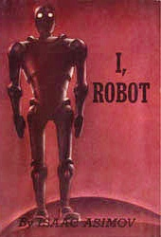
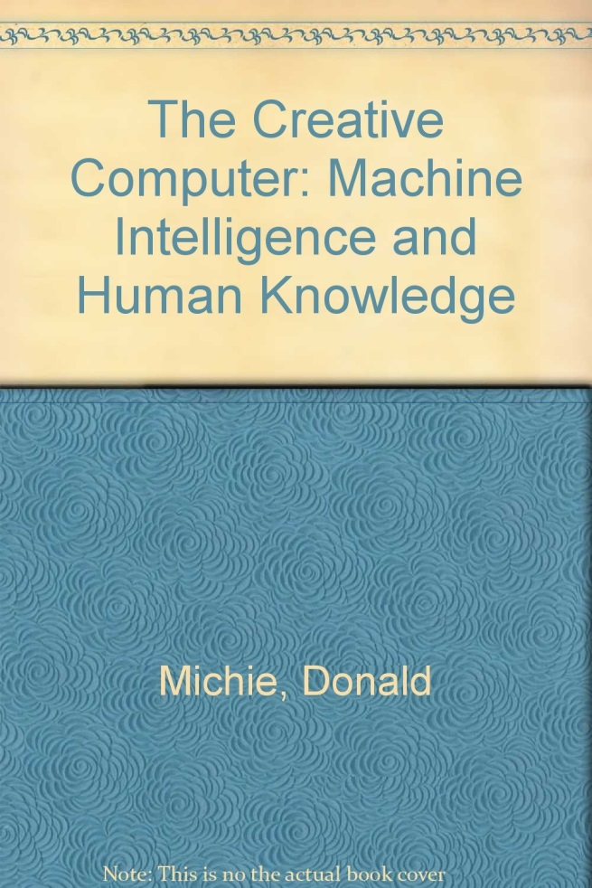

Readings
https://www.goodreads.com/list/show/485.Best_artificial_intelligence_books
http://www.computerworld.com/article/2488478/emerging-technology/ai-gets-its-groove-back.html

