Slide 1
Artificial Intelligence #10
COMS W4701
Fall 2014
Logical Agents (Ch. 7) – part 1/2

Slide 2
Outline
Knowledge-based agents
Wumpus world
Logic in general - models and entailment
Propositional (Boolean) logic
Equivalence, validity, satisfiability
Inference rules and theorem proving
forward chaining
backward chaining
resolution

Slide 3

Knowledge bases
Knowledge base = set of sentences in a formal language
Declarative approach to building an agent (or other system):
Tell it what it needs to know
Then it can Ask itself what to do - answers should follow from the KB
Agents can be viewed at the knowledge level
i.e., what they know, regardless of how implemented
Or at the implementation level
i.e., data structures in KB and algorithms that manipulate them

Slide 4
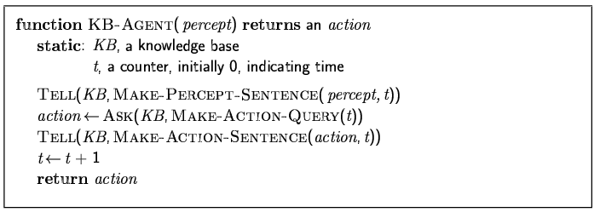
A simple knowledge-based agent
The agent must be able to:
Represent states, actions, etc.
Incorporate new percepts
Update internal representations of the world
Deduce hidden properties of the world
Deduce appropriate actions

Slide 5
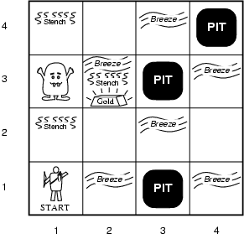
Wumpus World PEAS description
Performance measure
gold +1000, death -1000
-1 per step, -10 for using the arrow
Environment
Squares adjacent to wumpus are smelly
Squares adjacent to pit are breezy
Glitter iff gold is in the same square
Shooting kills wumpus if you are facing it
Shooting uses up the only arrow
Grabbing picks up gold if in same square
Releasing drops the gold in same square
Sensors: Stench, Breeze, Glitter, Bump, Scream
Actuators: Left turn, Right turn, Forward, Grab, Release, Shoot

Slide 6
Example
Minesweeper
http://minesweeperonline.com/#
Battleships
http://www.battleshiponline.org/

Slide 7
Wumpus world characterization
Fully Observable
No – only local perception
Deterministic
Yes – outcomes exactly specified
Episodic
No – sequential at the level of actions
Static
Yes – Wumpus and Pits do not move
Discrete
Yes
Single-agent?
Yes – Wumpus is essentially a natural feature

Slide 8
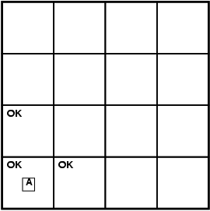
Exploring a wumpus world

Slide 9
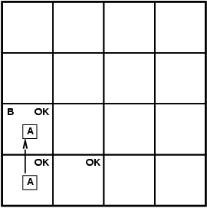
Exploring a wumpus world

Slide 10
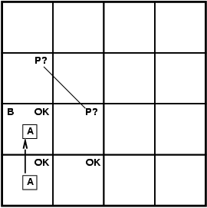
Exploring a wumpus world

Slide 11
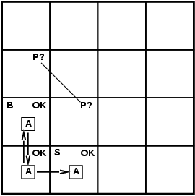
Exploring a wumpus world

Slide 12
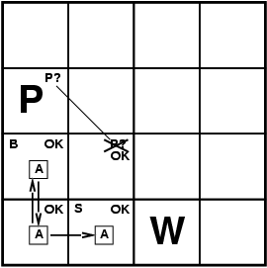
Exploring a wumpus world

Slide 13

Exploring a wumpus world

Slide 14
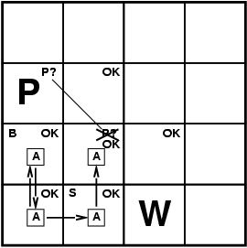
Exploring a wumpus world

Slide 15
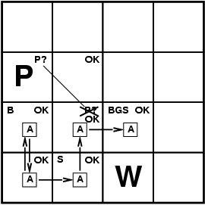
Exploring a wumpus world

Slide 16
Logic in general
Logics are formal languages for representing information such that conclusions can be drawn
Syntax defines the sentences in the language
Semantics define the "meaning" of sentences;
i.e., define truth of a sentence in a world
E.g., the language of arithmetic
x+2 ≥ y is a sentence; x2+y > is not a sentence
x+2 ≥ y is true iff the number x+2 is no less than the number y
x+2 ≥ y is true in a world where x = 7, y = 1
x+2 ≥ y is false in a world where x = 0, y = 6

Slide 17
Entailment
Entailment means that one thing follows from another KB ╞ α
Knowledge base KB entails sentence α if and only if α is true in all worlds where KB is true
E.g., the KB containing “the Giants won” and “the Reds won” entails “Either the Giants won or the Reds won”
E.g., x+y = 4 entails 4 = x+y
Entailment is a relationship between sentences (i.e., syntax) that is based on semantics

Slide 18
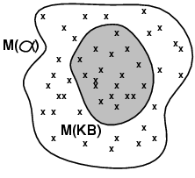
Models
Logicians typically think in terms of models, which are formally structured worlds with respect to which truth can be evaluated
We say m is a model of a sentence α if α is true in m
M(α) is the set of all models of α
Then KB ╞ α iff M(KB) ⊆ M(α)
E.g.
KB = Giants won and Reds won
α = Giants won

Slide 19
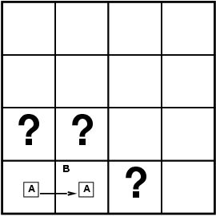
Entailment in the wumpus world
Situation after detecting nothing in [1,1], moving right, breeze in [2,1]
Consider possible models for KB assuming only pits
3 Boolean choices ⇒ 8 possible models

Slide 20
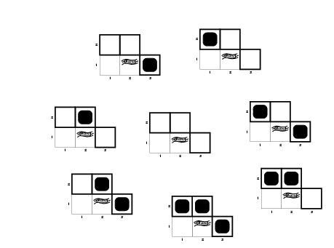
Wumpus models

Slide 21
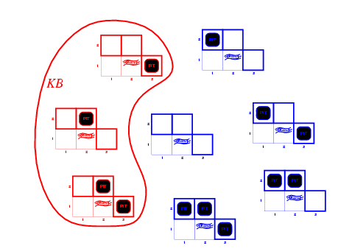
Wumpus models
KB = wumpus-world rules + observations

Slide 22
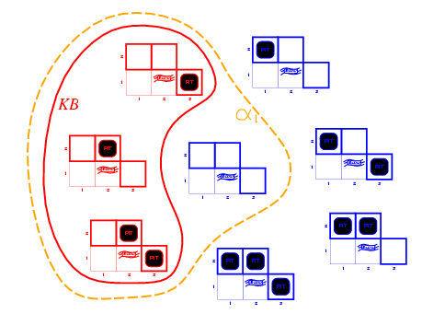
Wumpus models
KB = wumpus-world rules + observations
α₁ = "[1,2] is safe", KB ╞ α₁, proved by model checking

Slide 23
Wumpus models
KB = wumpus-world rules + observations

Slide 24
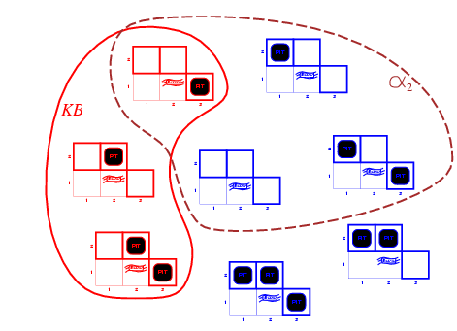
Wumpus models
KB = wumpus-world rules + observations
α₂ = "[2,2] is safe", KB ╞ α₂

Slide 25
Logic problem
There are two types of people on an island:
Knight: Always tells truth.
Knave: Always lies
A says: "B is a knight."
B says: "The two of us are opposite types."
Determine the types of A and B

Slide 26
Logical representation
We can describe the puzzle by the following propositions:
p: A is a knight, tells the truth.
^p: A is a knave, lies.
q: B is a knight, tells the truth.
^q: B is a knave, lies.

Slide 27
Reasoning for p
Suppose p=T:
A tells the truth: "B is a knight."
So B tells the truth.
B said: "The two of us are opposite types.".
So A and B are different types.
This is false, because both A and B are knights.

Slide 28
Reasoning for ^p
Suppose p=F:
A lies. So B is a knave.
So B lies.
B said: "The two of us are opposite types.".
So A and B are the same type.
This holds and we get the conclusion:
Both A and B are knaves.

Slide 29
Inference
KB ├_{i} α = sentence α can be derived from KB by procedure i
Soundness: i is sound if whenever KB ├_{i} α, it is also true that KB╞ α
Completeness: i is complete if whenever KB╞ α, it is also true that KB ├_{i} α
Preview: we will define a logic (first-order logic) which is expressive enough to say almost anything of interest, and for which there exists a sound and complete inference procedure.
That is, the procedure will answer any question whose answer follows from what is known by the KB.

Slide 30
Propositional logic: Syntax
Propositional logic is the simplest logic – illustrates basic ideas
The proposition symbols P₁, P₂ etc are sentences
If S is a sentence, ¬S is a sentence (negation)
If S₁ and S₂ are sentences, S₁ ∧ S₂ is a sentence (conjunction)
If S₁ and S₂ are sentences, S₁ ∨ S₂ is a sentence (disjunction)
If S₁ and S₂ are sentences, S₁ ⇒ S₂ is a sentence (implication)
If S₁ and S₂ are sentences, S₁ ⇔ S₂ is a sentence (biconditional)

Slide 31
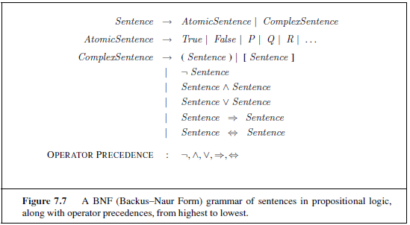

Slide 32
Translating propositions to English
A = Today is a holiday.
B = We are going to the zoo.
B ⇒ A
A ∧ ¬ B
¬ A ⇒ B
¬ B ⇒ A
B ⇒ A

Slide 33
A = Today is a holiday.
B = We are going to the zoo.
B ⇒ A
If we are going to the zoo, then today is a holiday.
A ∧ ¬ B
Today is a holiday and we are not going to the zoo.
¬ A ⇒ ¬ B
If today is not a holiday, then we are not going to the zoo.
¬ B ⇒ ¬ A
If we are not going to the zoo, then today is not a holiday.
B ⇒ A
If we are going to the zoo, then today is a holiday.

Slide 34
Propositional logic: Semantics
Each model specifies true/false for each proposition symbol
E.g. P_{1,2} P_{2,2} P_{3,1}
false true false
With these symbols, 8 possible models, can be enumerated automatically.
Rules for evaluating truth with respect to a model m:
¬S is true iff S is false
S₁ ∧ S₂ is true iff S₁ is true and S₂ is true
S₁ ∨ S₂ is true iff S₁is true or S₂ is true
S₁ ⇒ S₂ is true iff S₁ is false or S₂ is true
i.e., is false iff S₁ is true and S₂ is false
S₁ ⇔ S₂ is true iff S₁⇒S₂ is true andS₂⇒S₁ is true
Simple recursive process evaluates an arbitrary sentence, e.g.,
¬P_{1,2} ∧ (P_{2,2} ∨ P_{3,1}) = true ∧ (true ∨ false) = true ∧ true = true

Slide 35
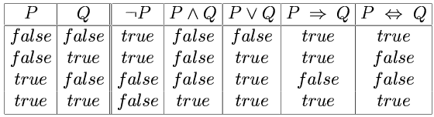
Truth tables for connectives

Slide 36
Wumpus world sentences
Let P_{i,j} be true if there is a pit in [i, j].
Let B_{i,j} be true if there is a breeze in [i, j].
¬ P_{1,1}
¬B_{1,1}
B_{2,1}
"Pits cause breezes in adjacent squares"
B_{1,1} ⇔ (P_{1,2} ∨ P_{2,1})
B_{2,1} ⇔ (P_{1,1} ∨ P_{2,2} ∨ P_{3,1})

Slide 37
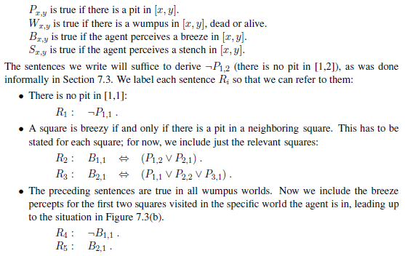

Slide 38
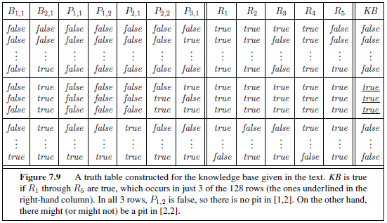
Truth tables for inference

Slide 39
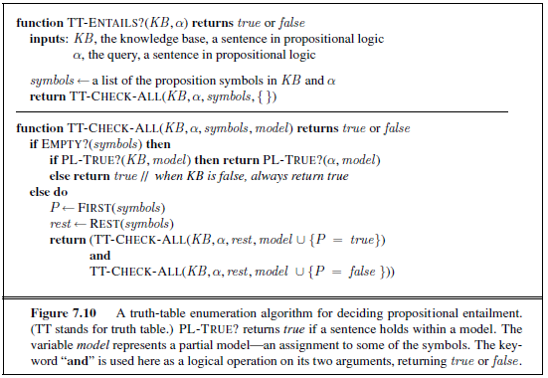
Inference by enumeration
Depth-first enumeration of all models is sound and complete
For n symbols, time complexity is O(2^{n}), space complexity is O(n)

Slide 40
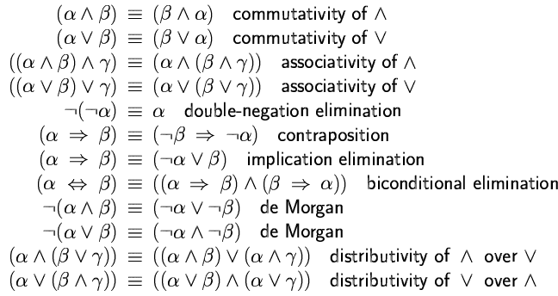
Logical equivalence
Two sentences are logically equivalent iff true in same models: α ≡ ß iff α╞ β and β╞ α

Slide 41
Validity and satisfiability
A sentence is valid if it is true in all models,
e.g., True, A ∨¬A, A ⇒ A, (A ∧ (A ⇒ B)) ⇒ B
Validity is connected to inference via the Deduction Theorem:
KB ╞ α if and only if (KB ⇒ α) is valid
A sentence is satisfiable if it is true in some model
e.g., A∨ B, C
A sentence is unsatisfiable if it is true in no models
e.g., A∧¬A
Satisfiability is connected to inference via the following:
KB ╞ α if and only if (KB ∧¬α) is unsatisfiable

Slide 42
Proof methods
Proof methods divide into (roughly) two kinds:
Natural Deduction: Application of inference rules
Legitimate (sound) generation of new sentences from old
Proof = a sequence of inference rule applications Can use inference rules as operators in a standard search algorithm
Typically require transformation of sentences into a normal form
Model checking
truth table enumeration (always exponential in n)
improved backtracking, e.g., Davis--Putnam-Logemann-Loveland (DPLL)
heuristic search in model space (sound but incomplete)
e.g., min-conflicts-like hill-climbing algorithms

Slide 43
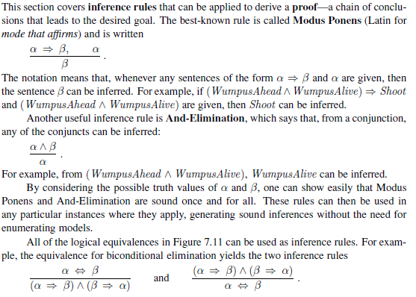

Slide 44
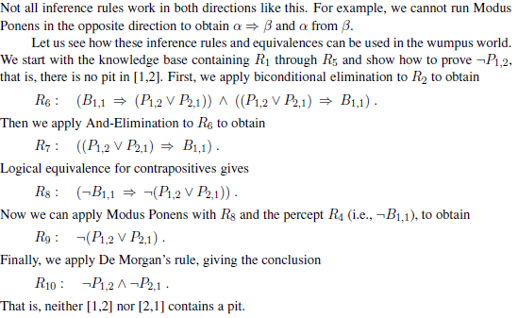

Slide 45
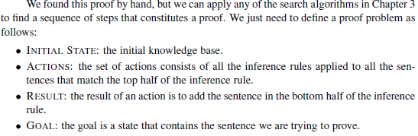

Slide 46
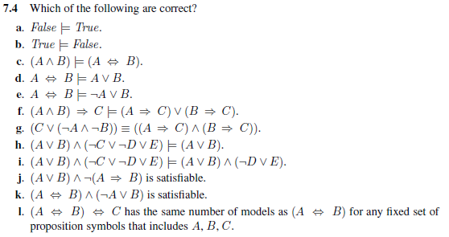

Slide 47
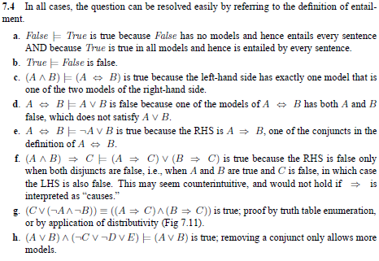
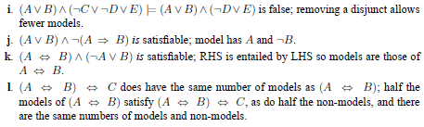

Slide 48
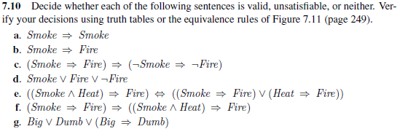

Slide 49


Slide 50
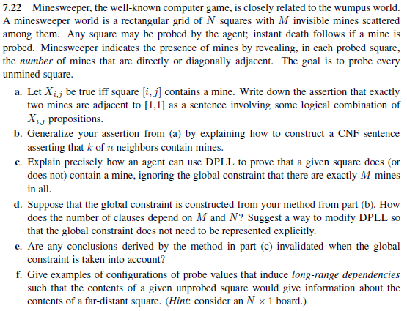

Slide 51
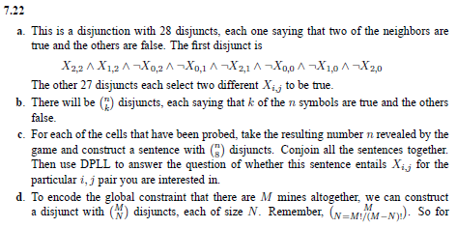
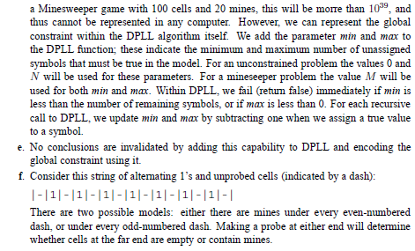

Slide 52
Resolution
Conjunctive Normal Form (CNF)
conjunction of disjunctions of literals
clauses
E.g., (A ∨ ¬B) ∧ (B ∨ ¬C ∨ ¬D)
Resolution inference rule (for CNF):
l_{i} ∨… ∨ l_{k}, m₁ ∨ … ∨ m_{n}
l_{i} ∨ … ∨ l_{i-1} ∨ l_{i+1} ∨ … ∨ l_{k} ∨ m₁ ∨ … ∨ m_{j-1} ∨ m_{j+1} ∨... ∨ m_{n}
where l_{i} and m_{j} are complementary literals.
E.g., P_{1,3} ∨ P_{2,2}, ¬P_{2,2}
P_{1,3}
Resolution is sound and complete for propositional logic

Slide 53
Conversion to CNF
B_{1,1} ⇔ (P_{1,2} ∨ P_{2,1})
Eliminate ⇔, replacing α ⇔ β with (α ⇒ β)∧(β ⇒ α).
(B_{1,1} ⇒ (P_{1,2} ∨ P_{2,1})) ∧ ((P_{1,2} ∨ P_{2,1}) ⇒ B_{1,1})
2. Eliminate ⇒, replacing α ⇒ β with ¬α∨ β.
(¬B_{1,1} ∨ P_{1,2} ∨ P_{2,1}) ∧ (¬(P_{1,2} ∨ P_{2,1}) ∨ B_{1,1})
3. Move ¬ inwards using de Morgan's rules and double-negation:
(¬B_{1,1} ∨ P_{1,2} ∨ P_{2,1}) ∧ ((¬P_{1,2} ∨ ¬P_{2,1}) ∨ B_{1,1})
4. Apply distributivity law (∧ over ∨) and flatten:
(¬B_{1,1} ∨ P_{1,2} ∨ P_{2,1}) ∧ (¬P_{1,2} ∨ B_{1,1}) ∧ (¬P_{2,1} ∨ B_{1,1})

