Slide 1
Artificial Intelligence #11
COMS W4701
Fall 2014
Logical Agents (Ch. 7) – part 2/2

Slide 2
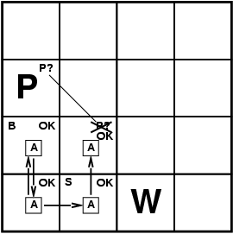
Resolution
Conjunctive Normal Form (CNF)
conjunction of disjunctions of literals
clauses
E.g., (A ∨ ¬B) ∧ (B ∨ ¬C ∨ ¬D)
Resolution inference rule (for CNF):
l_{i} ∨… ∨ l_{k}, m₁ ∨ … ∨ m_{n}
l_{i} ∨ … ∨ l_{i-1} ∨ l_{i+1} ∨ … ∨ l_{k} ∨ m₁ ∨ … ∨ m_{j-1} ∨ m_{j+1} ∨... ∨ m_{n}
where l_{i} and m_{j} are complementary literals.
E.g., P_{1,3} ∨ P_{2,2}, ¬P_{2,2}
P_{1,3}
Resolution is sound and complete for propositional logic

Slide 3
Conversion to CNF
B_{1,1} ⇔ (P_{1,2} ∨ P_{2,1})
Eliminate ⇔, replacing α ⇔ β with (α ⇒ β)∧(β ⇒ α).
(B_{1,1} ⇒ (P_{1,2} ∨ P_{2,1})) ∧ ((P_{1,2} ∨ P_{2,1}) ⇒ B_{1,1})
2. Eliminate ⇒, replacing α ⇒ β with ¬α∨ β.
(¬B_{1,1} ∨ P_{1,2} ∨ P_{2,1}) ∧ (¬(P_{1,2} ∨ P_{2,1}) ∨ B_{1,1})
3. Move ¬ inwards using de Morgan's rules and double-negation:
(¬B_{1,1} ∨ P_{1,2} ∨ P_{2,1}) ∧ ((¬P_{1,2} ∨ ¬P_{2,1}) ∨ B_{1,1})
4. Apply distributivity law (∧ over ∨) and flatten:
(¬B_{1,1} ∨ P_{1,2} ∨ P_{2,1}) ∧ (¬P_{1,2} ∨ B_{1,1}) ∧ (¬P_{2,1} ∨ B_{1,1})

Slide 4
Resolution
Soundness of resolution inference rule:
¬(l_{i} ∨ … ∨ l_{i-1} ∨ l_{i+1} ∨ … ∨ l_{k}) ⇒ l_{i}
¬m_{j} ⇒ (m₁ ∨ … ∨ m_{j-1} ∨ m_{j+1} ∨... ∨ m_{n})
¬(l_{i} ∨ … ∨ l_{i-1} ∨ l_{i+1} ∨ … ∨ l_{k}) ⇒ (m₁ ∨ … ∨ m_{j-1} ∨ m_{j+1} ∨... ∨ m_{n})

Slide 5
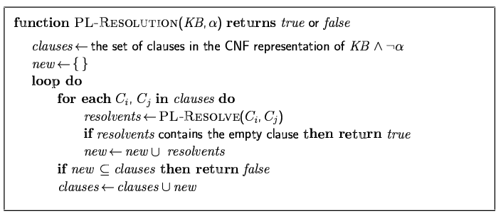
Resolution algorithm
Proof by contradiction, i.e., show KB∧¬α unsatisfiable

Slide 7
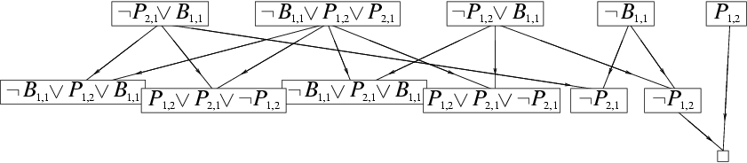
Resolution example
KB = (B_{1,1} ⇔ (P_{1,2}∨ P_{2,1})) ∧¬ B_{1,1} α = ¬P_{1,2}

Slide 8
Forward and backward chaining
Horn Form (restricted)
KB = conjunction of Horn clauses
Horn clause =
proposition symbol; or
(conjunction of symbols) ⇒ symbol
E.g., C ∧ (B ⇒ A) ∧ (C ∧ D ⇒ B)
Modus Ponens (for Horn Form): complete for Horn KBs
α₁, … ,α_{n}, α₁ ∧ … ∧ α_{n} ⇒ β
β
Can be used with forward chaining or backward chaining.
These algorithms are very natural and run in linear time

Slide 9
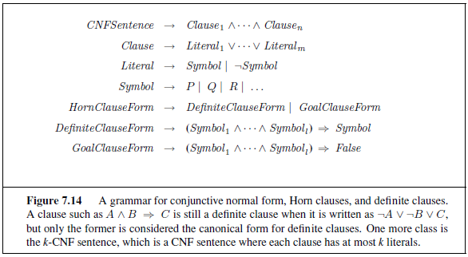
definite clause – exactly one literal is positive
Horn clause – at most one literal is positive

Slide 10
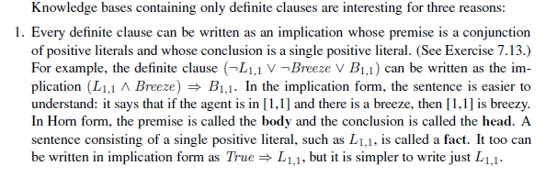
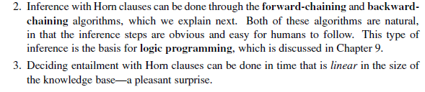

Slide 11
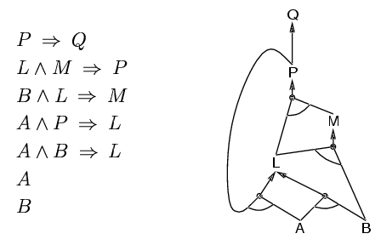
Forward chaining
Idea: fire any rule whose premises are satisfied in the KB,
add its conclusion to the KB, until query is found

Slide 12
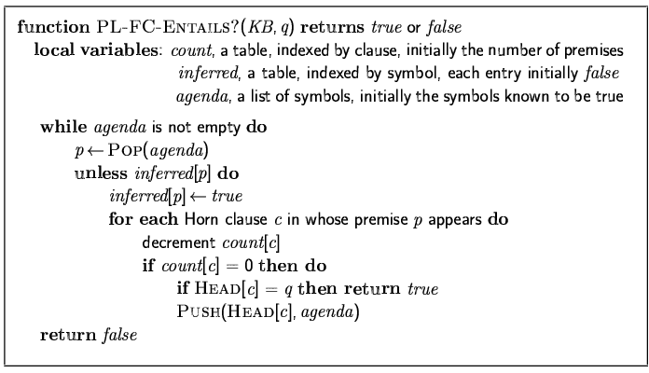
Forward chaining algorithm
Forward chaining is sound and complete for Horn KB

Slide 13
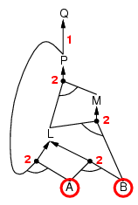
Forward chaining example

Slide 14
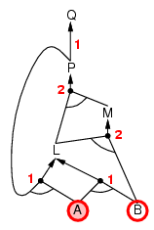
Forward chaining example

Slide 15
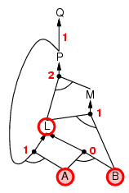
Forward chaining example

Slide 16
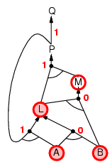
Forward chaining example

Slide 17
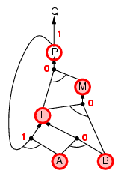
Forward chaining example

Slide 18
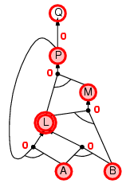
Forward chaining example

Slide 19
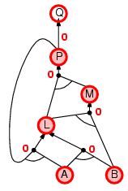
Forward chaining example

Slide 20

Forward chaining example

Slide 21
Proof of completeness
FC derives every atomic sentence that is entailed by KB
FC reaches a fixed point where no new atomic sentences are derived
Consider the final state as a model m, assigning true/false to symbols
Every clause in the original KB is true in m
a₁ ∧ … ∧ a_{k ⇒} b
Hence m is a model of KB
If KB╞ q, q is true in every model of KB, including m

Slide 22
Backward chaining
Idea: work backwards from the query q:
to prove q by BC,
check if q is known already, or
prove by BC all premises of some rule concluding q
Avoid loops: check if new subgoal is already on the goal stack
Avoid repeated work: check if new subgoal
has already been proved true, or
has already failed

Slide 23
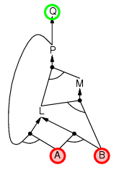
Backward chaining example

Slide 24
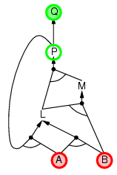
Backward chaining example

Slide 25
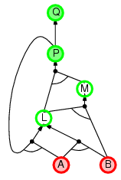
Backward chaining example

Slide 26
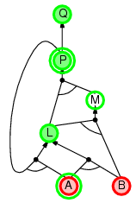
Backward chaining example

Slide 27
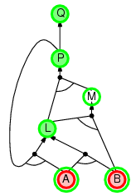
Backward chaining example

Slide 28
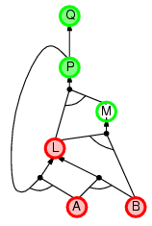
Backward chaining example

Slide 29
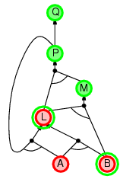
Backward chaining example

Slide 30
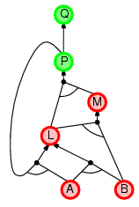
Backward chaining example

Slide 31
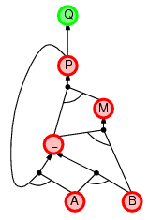
Backward chaining example

Slide 32
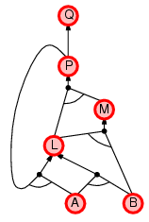
Backward chaining example

Slide 33
Forward vs. backward chaining
FC is data-driven, automatic, unconscious processing,
e.g., object recognition, routine decisions
May do lots of work that is irrelevant to the goal
BC is goal-driven, appropriate for problem-solving,
e.g., Where are my keys? How do I get into a PhD program?
Complexity of BC can be much less than linear in size of KB

Slide 34
Efficient propositional inference
Two families of efficient algorithms for propositional inference:
Complete backtracking search algorithms
DPLL algorithm (Davis, Putnam, Logemann, Loveland)
Incomplete local search algorithms
WalkSAT algorithm

Slide 35
The DPLL algorithm
Determine if an input propositional logic sentence (in CNF) is satisfiable.
Improvements over truth table enumeration:
Early termination
A clause is true if any literal is true.
A sentence is false if any clause is false.
Pure symbol heuristic
Pure symbol: always appears with the same "sign" in all clauses.
e.g., In the three clauses (A ∨ ¬B), (¬B ∨ ¬C), (C ∨ A), A and B are pure, C is impure.
Make a pure symbol literal true.
Unit clause heuristic
Unit clause: only one literal in the clause
The only literal in a unit clause must be true.

Slide 36
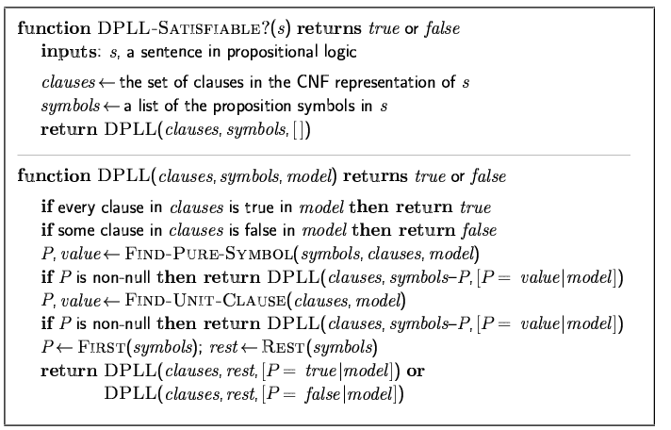
The DPLL algorithm

Slide 37
The WalkSAT algorithm
Incomplete, local search algorithm
Evaluation function: The min-conflict heuristic of minimizing the number of unsatisfied clauses
Balance between greediness and randomness

Slide 38
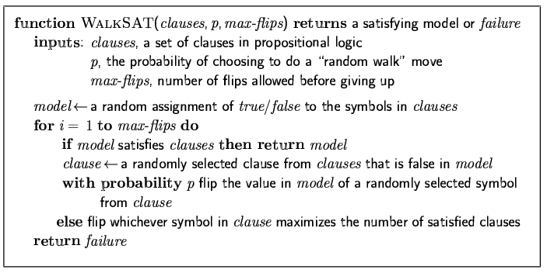
The WalkSAT algorithm

Slide 39
Hard satisfiability problems
Consider random 3-CNF sentences. e.g.,
(¬D ∨ ¬B ∨ C) ∧ (B ∨ ¬A ∨ ¬C) ∧ (¬C ∨ ¬B ∨ E) ∧ (E ∨ ¬D ∨ B) ∧ (B ∨ E ∨ ¬C)
m = number of clauses
n = number of symbols
Hard problems seem to cluster near m/n = 4.3 (critical point)

Slide 40
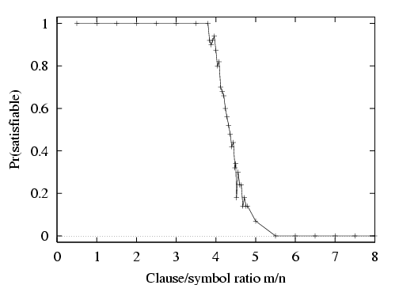
Hard satisfiability problems

Slide 41
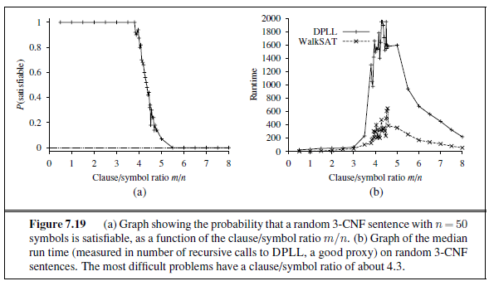
Hard satisfiability problems
Median runtime for 100 satisfiable random 3-CNF sentences, n = 50

Slide 42
Inference-based agents in the wumpus world
A wumpus-world agent using propositional logic:
¬P_{1,1}
¬W_{1,1}
B_{x,y} ⇔ (P_{x,y+1} ∨ P_{x,y-1} ∨ P_{x+1,y} ∨ P_{x-1,y})
S_{x,y} ⇔ (W_{x,y+1} ∨ W_{x,y-1} ∨ W_{x+1,y} ∨ W_{x-1,y})
W_{1,1} ∨ W_{1,2} ∨ … ∨ W_{4,4}
¬W_{1,1} ∨ ¬W_{1,2}
¬W_{1,1} ∨ ¬W_{1,3}
…
64 distinct proposition symbols, 155 sentences
Exactly one wumpus = at least one wumpus AND at most one wumpus

Slide 43
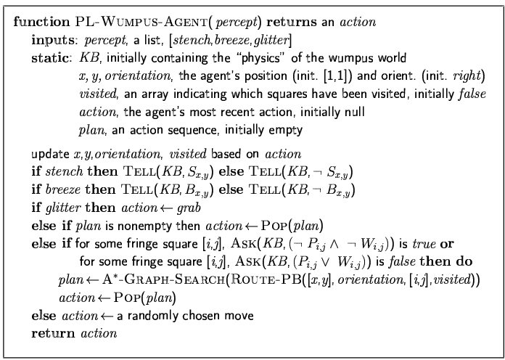

Slide 44
Additional considerations
What if there was no stench in step 3 but there is stench in step 4?
We cannot assert “stench” to the KB at step 3 since “~stench” was already asserted at step 4.
What solution is there?
Stench⁴

Slide 45
Expressiveness limitation of propositional logic
KB contains "physics" sentences for every single square
For every time t and every location [x,y],
L_{x,y} ∧ FacingRight^{t} ∧ Forward^{t} ⇒ L_{x+1,y}
Rapid proliferation of clauses
t
t

Slide 46
Summary
Logical agents apply inference to a knowledge base to derive new information and make decisions
Basic concepts of logic:
syntax: formal structure of sentences
semantics: truth of sentences wrt models
entailment: necessary truth of one sentence given another
inference: deriving sentences from other sentences
soundness: derivations produce only entailed sentences
completeness: derivations can produce all entailed sentences
Wumpus world requires the ability to represent partial and negated information, reason by cases, etc.
Resolution is complete for propositional logic Forward, backward chaining are linear-time, complete for Horn clauses
Propositional logic lacks expressive power

