Slide 1
Artificial Intelligence #12
COMS W4701
Fall 2014
First Order Logic (Ch. 8)

Slide 2
Outline
Why FOL?
Syntax and semantics of FOL
Using FOL
Wumpus world in FOL
Knowledge engineering in FOL

Slide 3
Pros and cons of propositional logic
☺ Propositional logic is declarative
☺ Propositional logic allows partial/disjunctive/negated information
(unlike most data structures and databases)
Propositional logic is compositional:
meaning of B_{1,1} ∧ P_{1,2} is derived from meaning of B_{1,1} and of P_{1,2}
☺ Meaning in propositional logic is context-independent
(unlike natural language, where meaning depends on context)
☹ Propositional logic has very limited expressive power
(unlike natural language)
E.g., cannot say "pits cause breezes in adjacent squares“
except by writing one sentence for each square

Slide 4
First-order logic
Whereas propositional logic assumes the world contains facts,
first-order logic (like natural language) assumes the world contains
Objects: people, houses, numbers, colors, baseball games, wars, …
Relations: red, round, prime, brother of, bigger than, part of, comes between, …
Functions: father of, best friend, one more than, plus, …

Slide 5
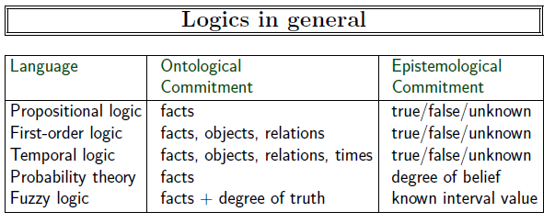

Slide 6
Syntax of FOL: Basic elements
Constants KingJohn, 2, CU,...
Predicates Brother, >,...
Functions Sqrt, LeftLegOf,...
Variables x, y, a, b,...
Connectives ¬, ⇒, ∧, ∨, ⇔
Equality =
Quantifiers ∀, ∃

Slide 7
Atomic sentences
Atomic sentence = predicate (term₁,...,term_{n}) or term₁ = term₂
Term = function (term₁,...,term_{n}) or constant or variable
E.g., Brother(KingJohn,RichardTheLionheart) > (Length(LeftLegOf(Richard)), Length(LeftLegOf(KingJohn)))

Slide 8
Complex sentences
Complex sentences are made from atomic sentences using connectives
¬S, S₁ ∧ S₂, S₁ ∨ S₂, S₁ ⇒ S₂, S₁ ⇔ S₂,
E.g. Sibling(KingJohn,Richard) ⇒ Sibling(Richard,KingJohn)
>(1,2) ∨ ≤ (1,2)
>(1,2) ∧ ¬ >(1,2)

Slide 9
Truth in first-order logic
Sentences are true with respect to a model and an interpretation
Model contains objects (domain elements) and relations among them
Interpretation specifies referents for
constant symbols → objects
predicate symbols → relations
function symbols → functional relations
An atomic sentence predicate(term₁,...,term_{n}) is true
iff the objects referred to by term₁,...,term_{n}
are in the relation referred to by predicate

Slide 10
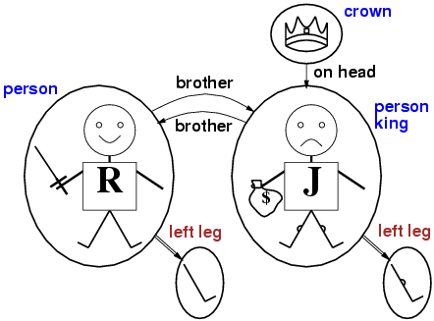
Models for FOL: Example

Slide 11
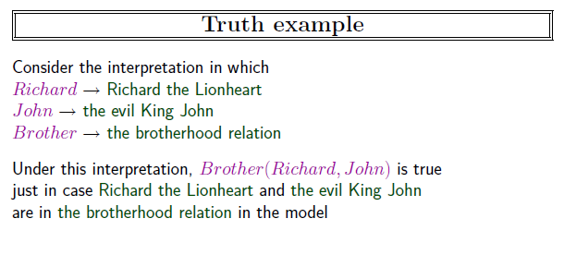

Slide 12
Universal quantification
∀<variables> <sentence>
Everyone at CU is smart:
∀x At(x,CU) ⇒ Smart(x)
∀x P is true in a model m iff P is true with x being each possible object in the model
Roughly speaking, equivalent to the conjunction of instantiations of P
At(KingJohn,CU) ⇒ Smart(KingJohn)
∧ At(Richard,CU) ⇒ Smart(Richard)
∧ At(CU,CU) ⇒ Smart(CU)
∧ ...

Slide 13
A common mistake to avoid
Typically, ⇒ is the main connective with ∀
Common mistake: using ∧ as the main connective with ∀:
∀x At(x,CU) ∧ Smart(x)
means “Everyone is at CU and everyone is smart”

Slide 14
Existential quantification
∃<variables> <sentence>
Someone at CU is smart:
∃x At(x,CU) ∧ Smart(x)$
∃x P is true in a model m iff P is true with x being some possible object in the model
Roughly speaking, equivalent to the disjunction of instantiations of P
At(KingJohn,CU) ∧ Smart(KingJohn)
∨ At(Richard,CU) ∧ Smart(Richard)
∨ At(CU,CU) ∧ Smart(CU)
∨ ...

Slide 15
Another common mistake to avoid
Typically, ∧ is the main connective with ∃
Common mistake: using ⇒ as the main connective with ∃:
∃x At(x,CU) ⇒ Smart(x)
is true if there is anyone who is not at CU!

Slide 16
Properties of quantifiers
∀x ∀y is the same as ∀y ∀x
∃x ∃y is the same as ∃y ∃x
∃x ∀y is not the same as ∀y ∃x
∃x ∀y Loves(x,y)
“There is a person who loves everyone in the world”
∀y ∃x Loves(x,y)
“Everyone in the world is loved by at least one person”
Quantifier duality: each can be expressed using the other
∀x Likes(x,IceCream) ¬∃x ¬Likes(x,IceCream)
∃x Likes(x,Broccoli) ¬∀x ¬Likes(x,Broccoli)

Slide 17
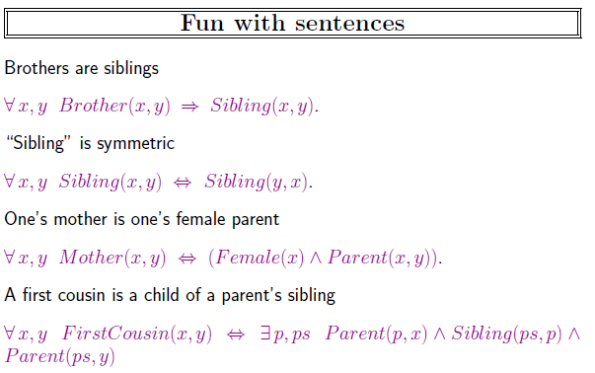

Slide 18
Equality
term₁ = term₂ is true under a given interpretation if and only if term₁ and term₂ refer to the same object
E.g., definition of Sibling in terms of Parent:
∀x,y Sibling(x,y) ⇔ [¬(x = y) ∧ ∃m,f ¬ (m = f) ∧ Parent(m,x) ∧ Parent(f,x) ∧ Parent(m,y) ∧ Parent(f,y)]

Slide 19
Using FOL
The kinship domain:
Brothers are siblings
∀x,y Brother(x,y) ⇔ Sibling(x,y)
One's mother is one's female parent
∀m,c Mother(c) = m ⇔ (Female(m) ∧ Parent(m,c))
“Sibling” is symmetric
∀x,y Sibling(x,y) ⇔ Sibling(y,x)

Slide 20
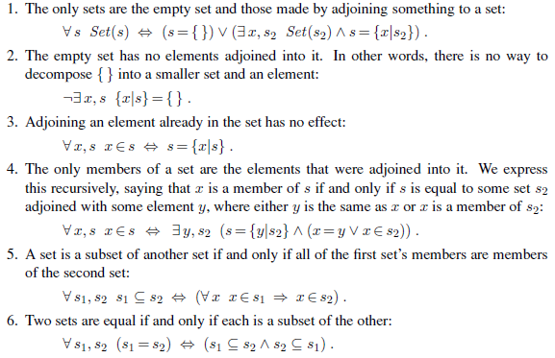
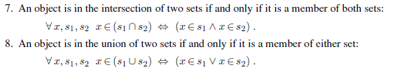

Slide 21
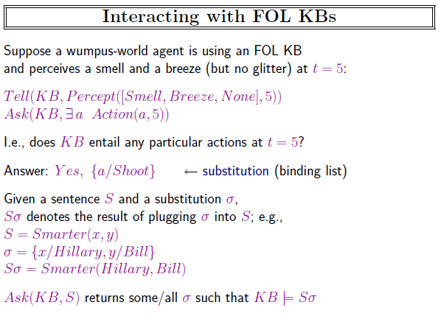

Slide 22
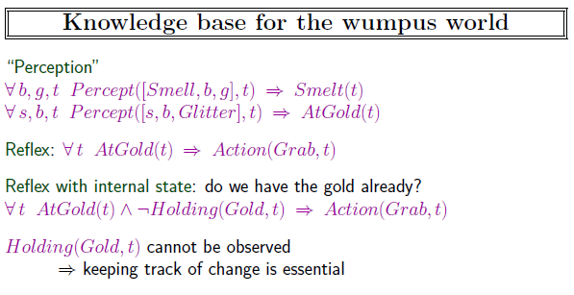

Slide 23
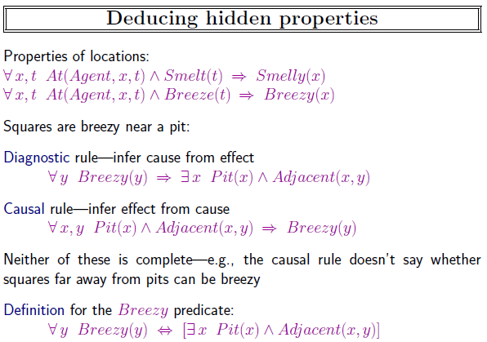

Slide 24
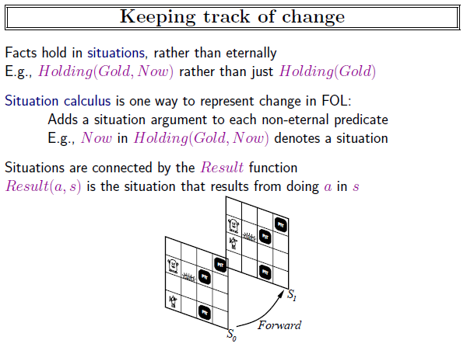

Slide 25
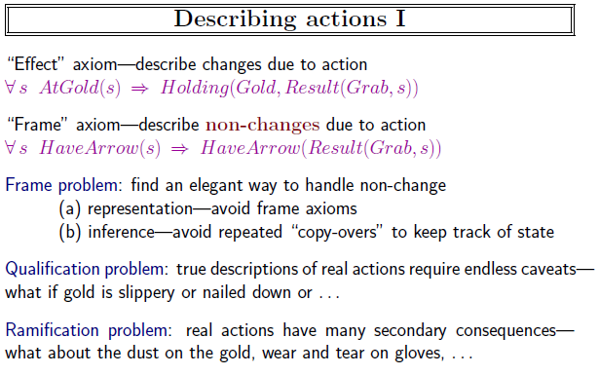

Slide 26
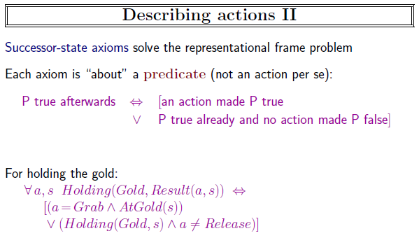

Slide 27
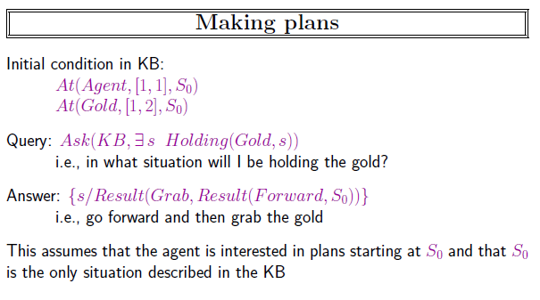

Slide 28
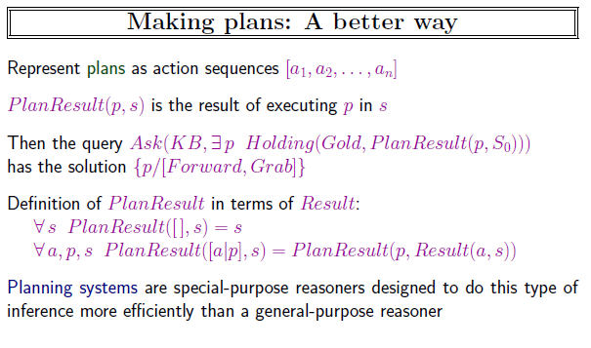

Slide 29
Knowledge engineering in FOL
Identify the task
Assemble the relevant knowledge
Decide on a vocabulary of predicates, functions, and constants
Encode general knowledge about the domain
Encode a description of the specific problem instance
Pose queries to the inference procedure and get answers
Debug the knowledge base

Slide 30
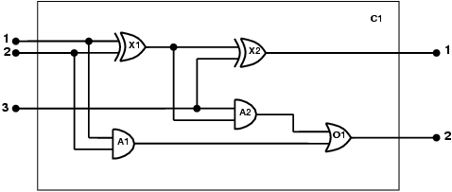
The electronic circuits domain
One-bit full adder

Slide 31

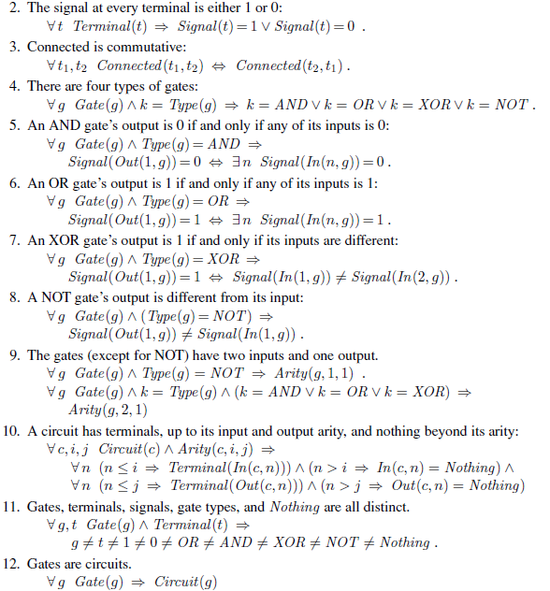

Slide 32
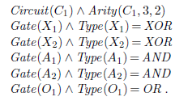
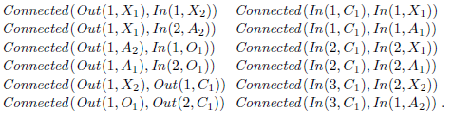
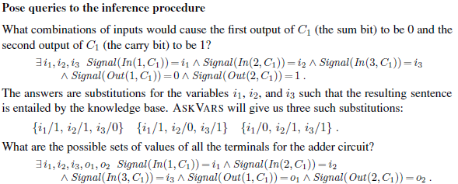

Slide 33
Summary
First-order logic:
objects and relations are semantic primitives
syntax: constants, functions, predicates, equality, quantifiers
Increased expressive power: sufficient to define wumpus world

