Slide 1
Artificial Intelligence #14
COMS W4701
Fall 2014
Knowledge Representation (Ch. 12)

Slide 2
Outline
Ontologies
Categories and objects
Events
Reasoning systems with categories

Slide 3
Knowledge representation
Representing events, time, physical objects, and beliefs
Upper ontology

Slide 4
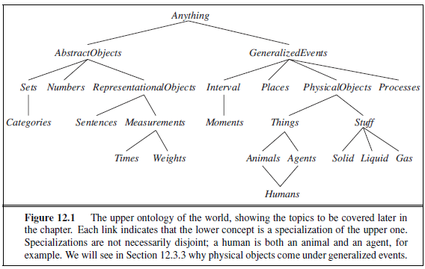
Upper Ontology

Slide 5
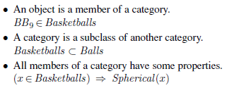

Representing categories

Slide 6


Partitions

Slide 7


PartOf relations

Slide 8

Measurements

Slide 9

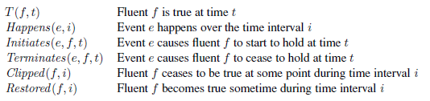
Events

Slide 10

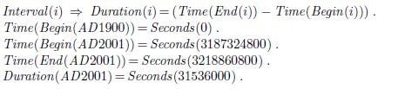

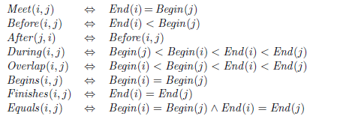

Time Intervals

Slide 11
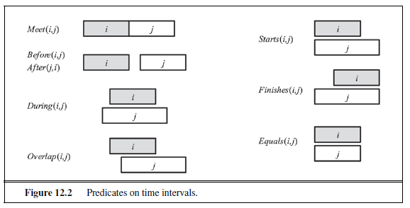

Slide 12
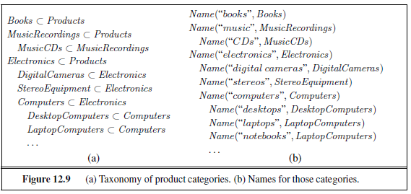


Slide 13
