Slide 1
Artificial Intelligence #15
COMS W4701
Fall 2014
Communication and Language (Ch. 22)

Slide 2
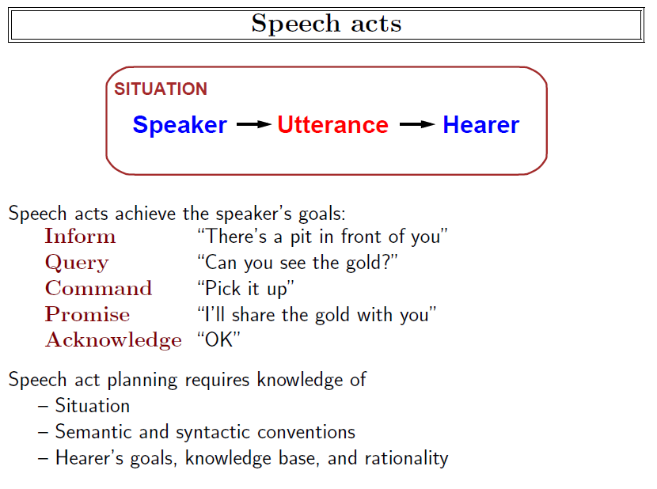

Slide 3
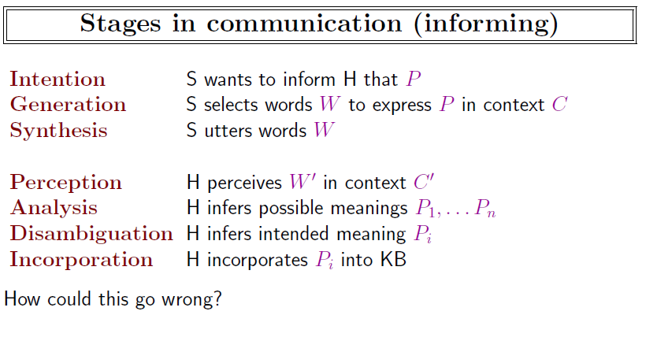

Slide 4
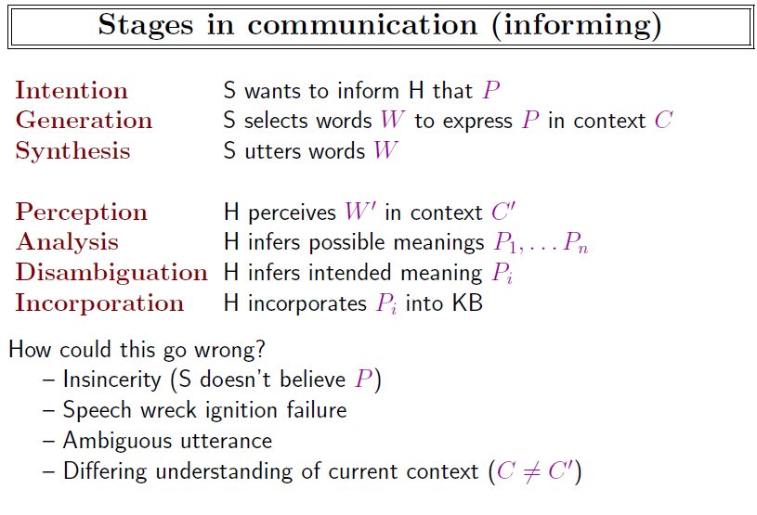

Slide 5
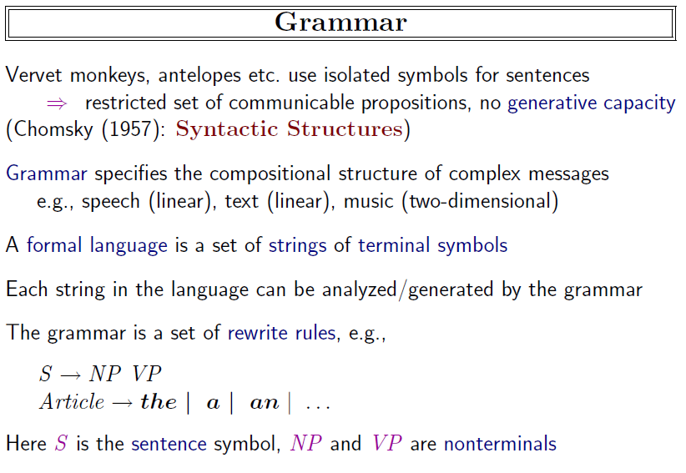

Slide 6
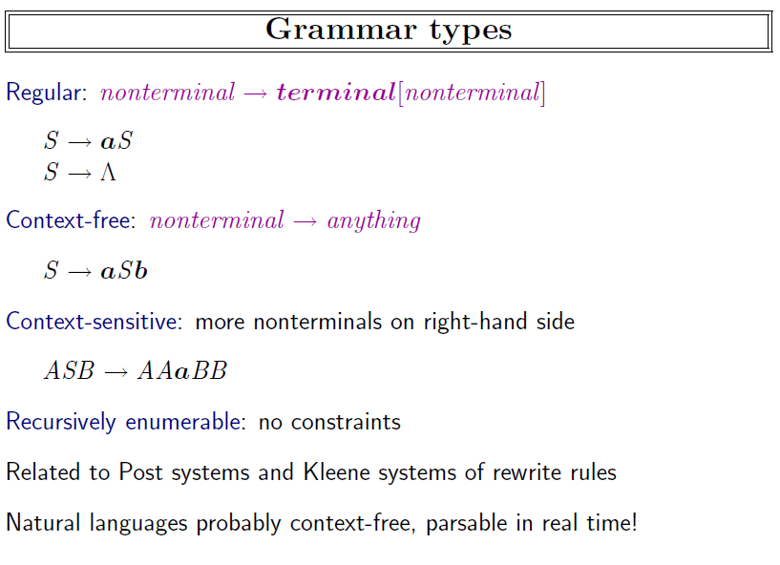

Slide 7
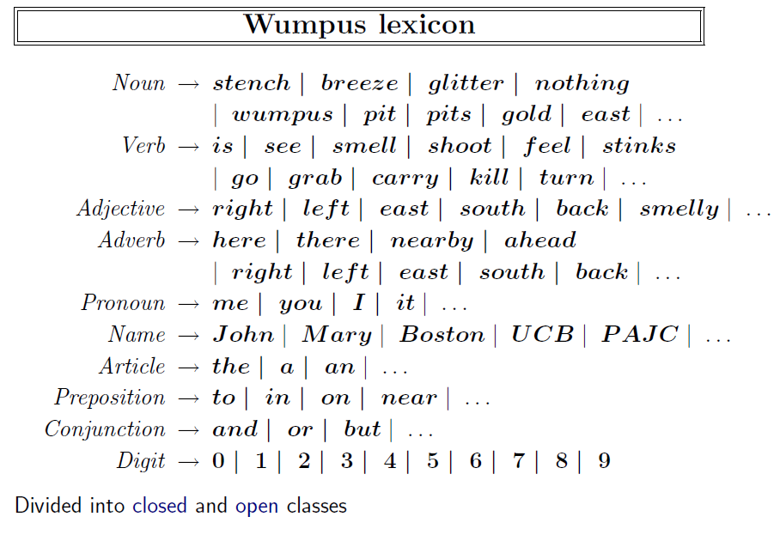

Slide 8
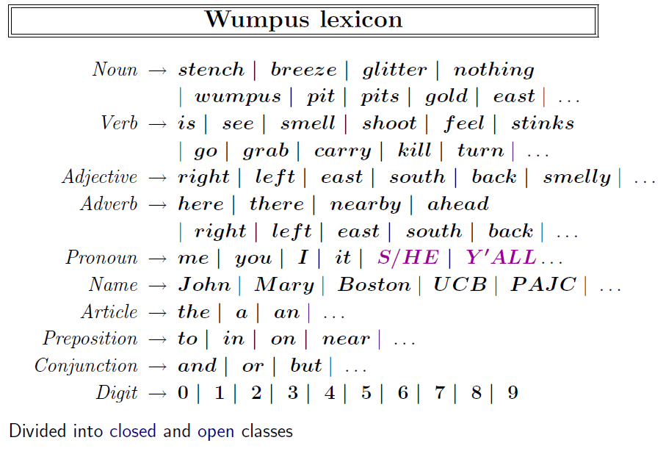

Slide 9
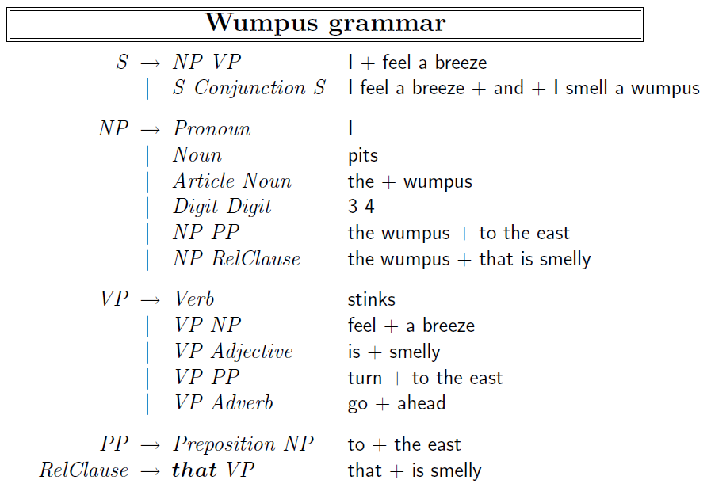

Slide 10
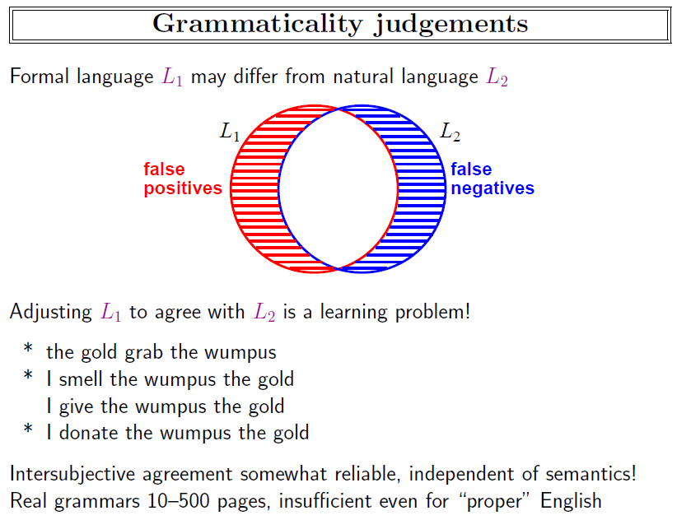

Slide 11
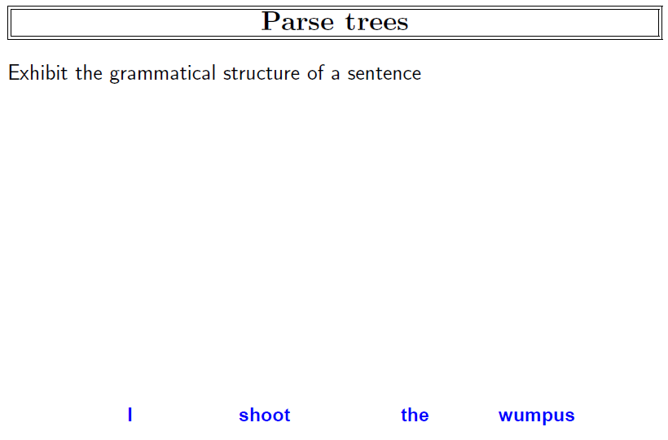

Slide 12
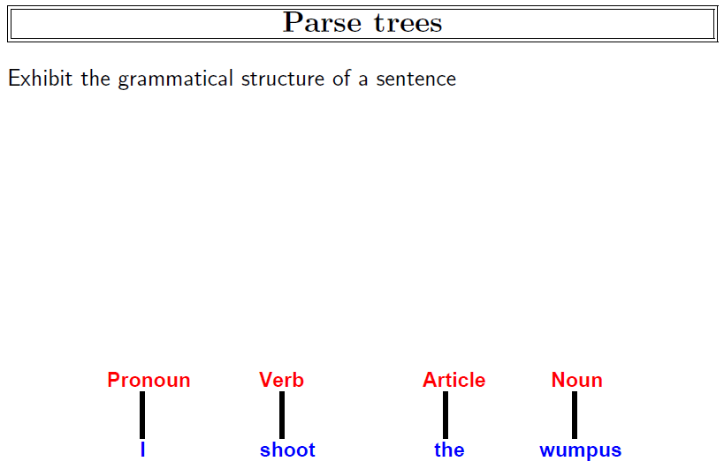

Slide 13
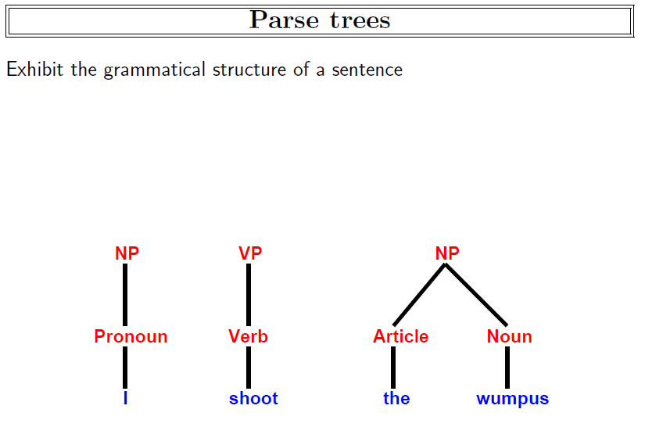

Slide 14
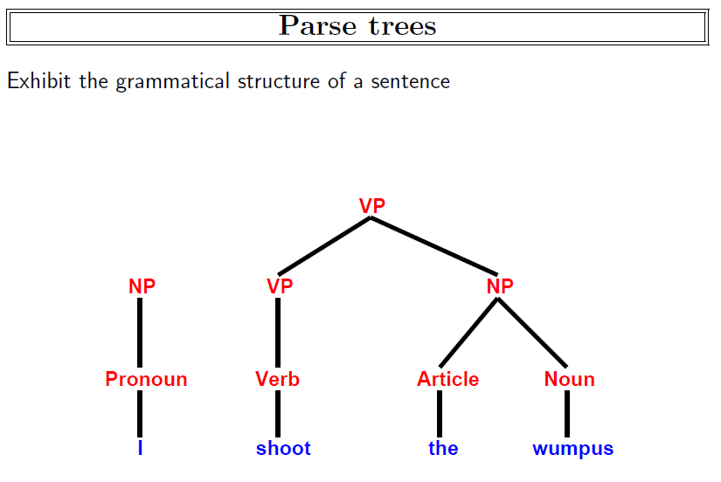

Slide 15
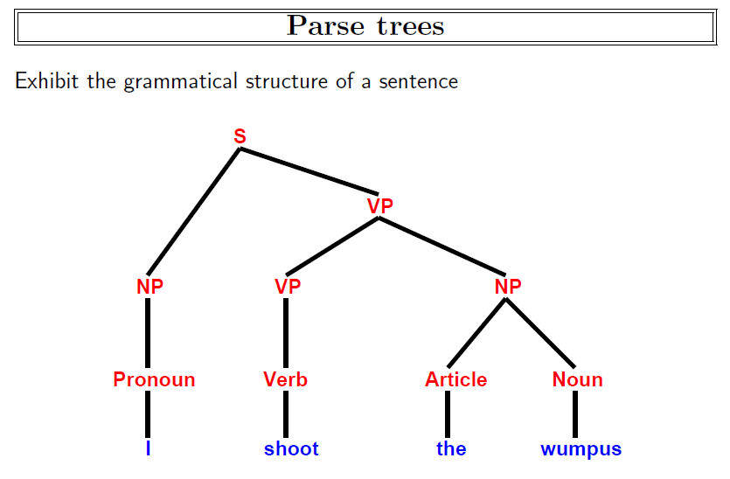

Slide 16
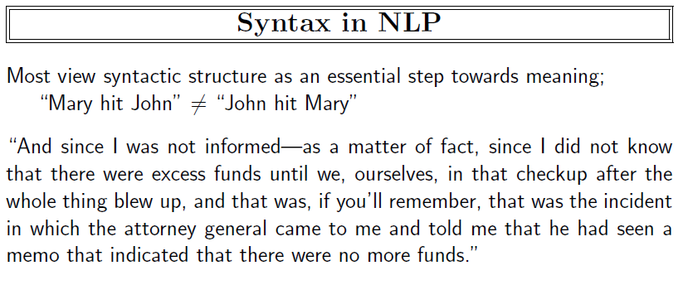

Slide 17
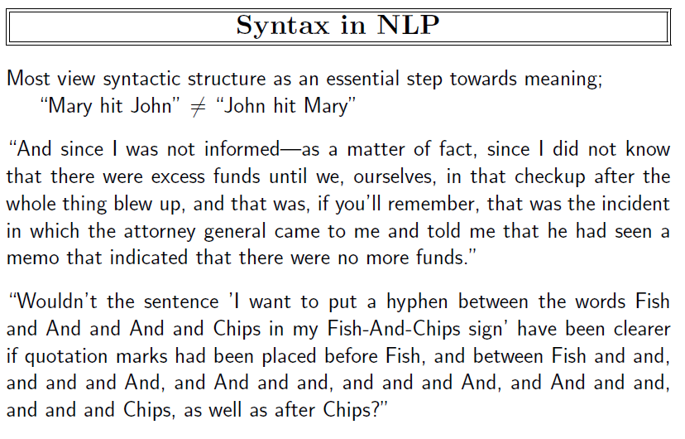

Slide 18
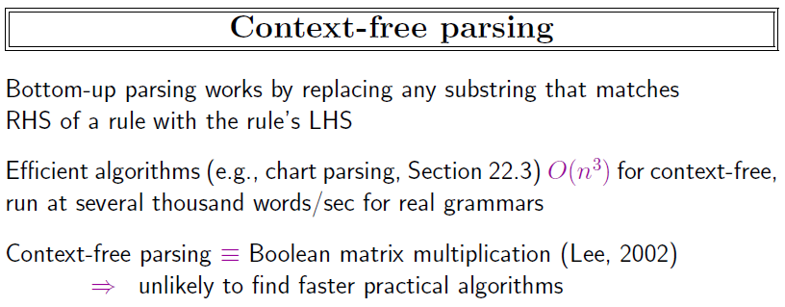

Slide 19
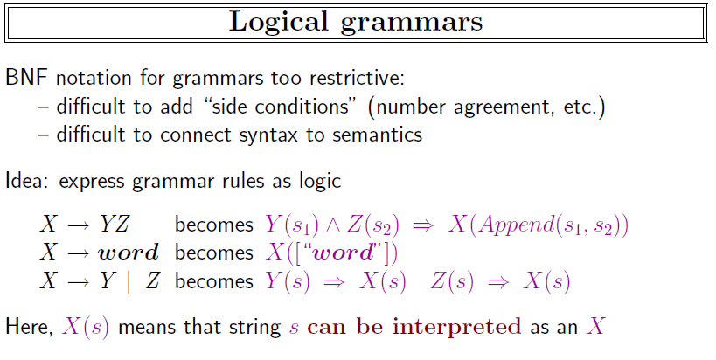

Slide 20
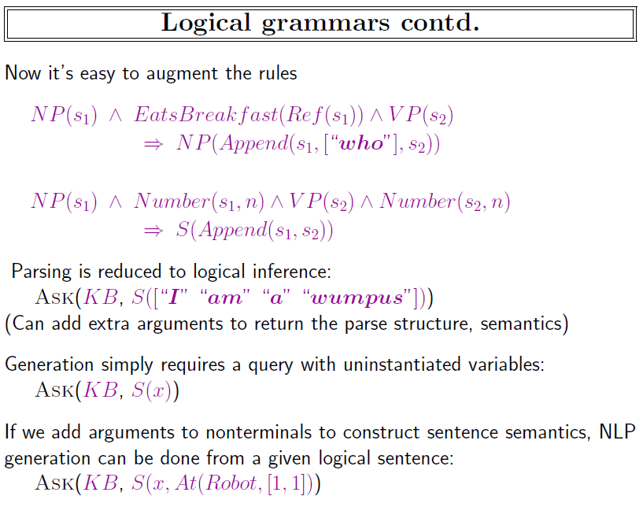

Slide 21
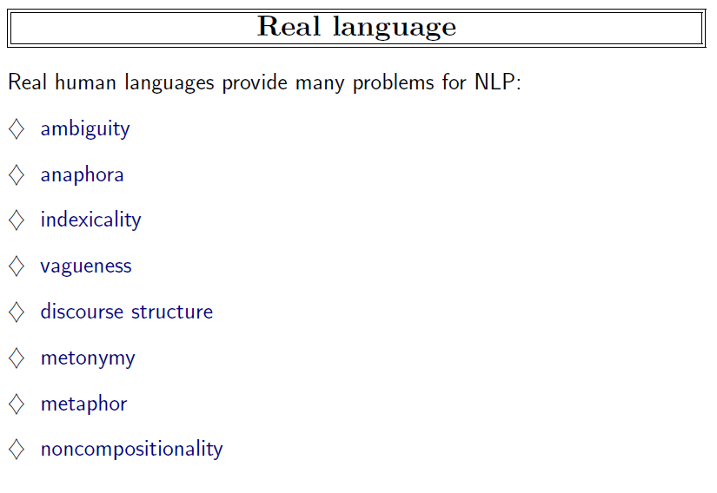

Slide 22
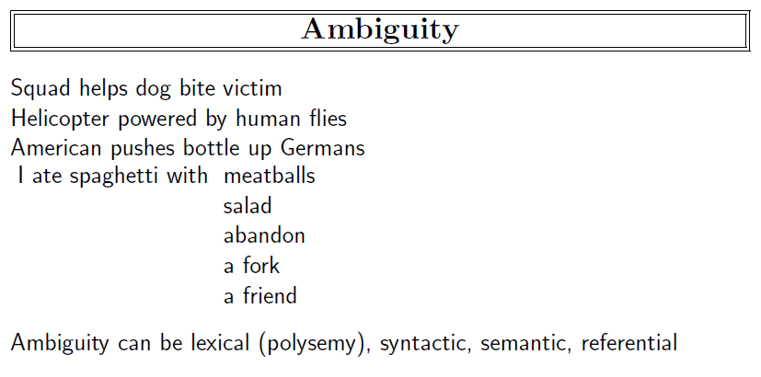

Slide 23
Silly Sentences
Children make delicious snacks
Stolen painting found by tree
I saw the Rockies flying to San Francisco
Court to try shooting defendant
Ban on nude dancing on Governor’s desk
Red tape holds up new bridges
Government head seeks arms
Blair wins on budget, more lies ahead
Local high school dropouts cut in half
Hospitals are sued by seven foot doctors
Dead expected To rise
Miners refuse to work after death
Patient at death's door - doctors pull him through
In America a woman has a baby every 15 minutes. How does she do that?

Slide 24
Ambiguous Recommendations
Lexical ambiguity
 | For a chronically absent employee | A man like him is hard to find.
Notes:
Attribution?

Slide 25
Ambiguous Recommendations
Lexical ambiguity
 | For a chronically absent employee | A man like him is hard to find.
 | For a dishonest employee | He's an unbelievable worker.
 | For a lazy employee | You would indeed be fortunate to get this person to work for you.
 | For the office drunk | Every hour with him was a happy hour.
Notes:
Attribution?

Slide 26
Ambiguous Recommendations
Lexical ambiguity
 | For a chronically absent employee | A man like him is hard to find.
 | For a dishonest employee | He's an unbelievable worker.
 | For a lazy employee | You would indeed be fortunate to get this person to work for you.
 | For the office drunk | Every hour with him was a happy hour.
Structural ambiguity
 | For a chronically absent employee | It seemed her career was just taking off.
 | For a dishonest employee | Her true ability was deceiving.
 | For a stupid employee | I most enthusiastically recommend this candidate with no qualifications whatsoever.
 | For the office drunk | He generally found him loaded with work to do.
Scope ambiguity
 | For an employee who is not worth further consideration as a job candidate | All in all, I cannot say enough good things about this candidate or recommend him too highly.
 | For an employee who is so unproductive that the job is better left unfilled | I can assure you that no person would be better for the job.
Other
 | For a lazy employee | He could not care less about the number of hours he has to put in.
 | For an employee who is not worth further consideration as a job candidate | I would urge you to waste no time in making this candidate an offer of employment.
 | For a stupid employee | There is nothing you can teach a man like him.

Slide 27
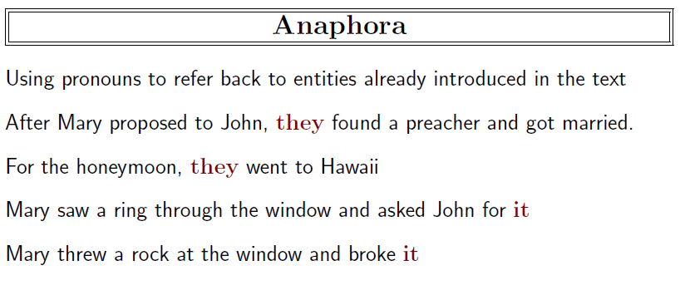

Slide 28
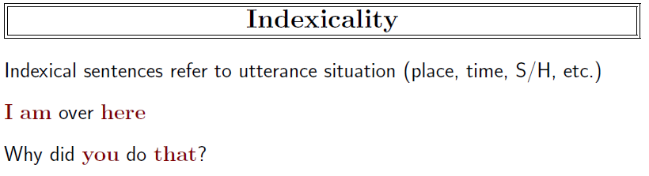

Slide 29
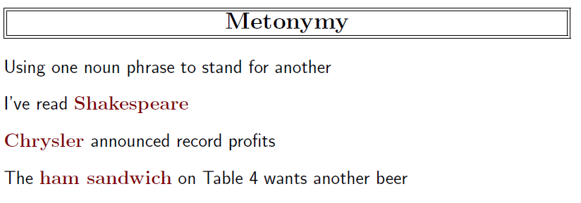

Slide 30
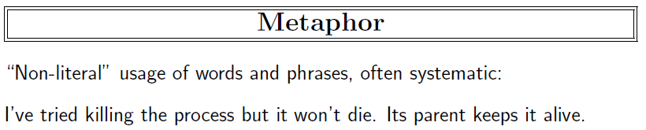

Slide 31
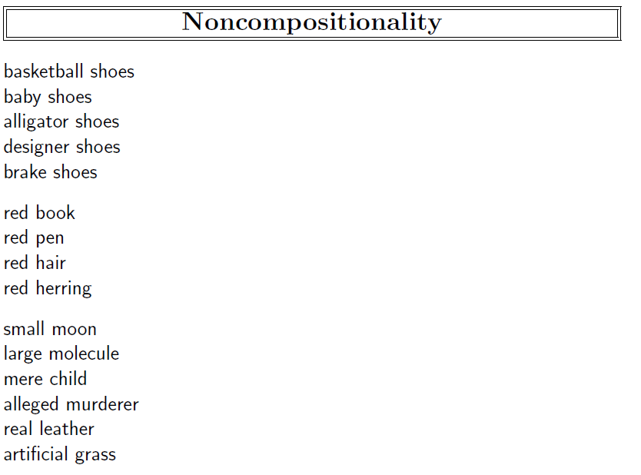

Slide 32
Synonyms and paraphrases
Example: post-close market announcements
The S&P 500 climbed 6.93, or 0.56 percent, to 1,243.72, its best close since June 12, 2001.
The Nasdaq gained 12.22, or 0.56 percent, to 2,198.44 for its best showing since June 8, 2001.
The DJIA rose 68.46, or 0.64 percent, to 10,705.55, its highest level since March 15.

Slide 33
Synonyms
Different words (and also word compounds) can have similar meanings.
For example, the adjectives tepid and lukewarm have very similar meanings and can be substituted for one another (tepid water vs. lukewarm water).
True synonyms are actually relatively rare.
For example, even though big and large are often thought of as synonyms, consider the difference between Big Leagues and Large Leagues. ☺
The verbs sweat and perspire are also near synonyms.
However, they differ in their frequency of use and the type of text in which they are likely to appear.

Slide 34
Polysemy
Polysemy is the property of words to have multiple senses.
For example, the noun book can refer to the following:
A literary work (e.g., “Anna Karenina”)
A stack of pages (e.g., a notebook)
A record of business transactions (think “bookkeeper”)
A record of bets (think “bookmaker”)
A list of buy and sell orders in a financial market

Slide 35
Polysemy
The same word can also have multiple parts of speech, each with its own set of senses. For example, the word book, as a verb can mean “make a reservation for” or “occupy”.
The different senses of the same word don’t have to be equally frequent.
Some of the senses may overlap (e.g., the first two senses of book on the previous slide). That’s partially why different dictionaries list different sets of word senses for the same word.
“My favorite books are Anna Karenina and my father’s checkbook” ☺
Some words can be highly polysemous (e.g., the verb “get” has at least 35 different meanings, according to Wordnet).

Slide 36
Other Semantic Relations
Antonymy (near opposites)
raise-lower
Hypernymy
a deer is a hypernym for elk
Hyponymy (the inverse of hypernymy)
Membership Meronymy:
a flock includes sheep (or birds)
Part Meronymy:
a table has legs

Slide 37
Synsets
Semantic relations hold between word senses, not between words.
Examples:
the antonym of hot can be either mild or cold (or unattractive) depending on the specific sense of hot.
the immediate hypernym of bar can be one of the following, among others: room, musical notation, obstruction, profession, depending on the sense of bar.
The term synset is used to group together all synonyms of the same word. If a word is polysemous, it may be associated with multiple synsets.

Slide 38
Wordnet
Wordnet is a project run by George Miller (1920-2012) and Christiane Fellbaum at Princeton University.
It includes a database of words (mainly nouns and verbs but also adjectives and adverbs) and semantic relations between them.
The main relation is hypernymy, so the overall structure of the database is more tree-like (see next slide).
References:
George A. Miller (1995). WordNet: A Lexical Database for English. Communications of the ACM Vol. 38, No. 11: 39-41.
Christiane Fellbaum (1998, ed.) WordNet: An Electronic Lexical Database. Cambridge, MA: MIT Press.

Slide 39
Tree-like structure of Wordnet
ungulate
even-toed ungulate
odd-toed ungulate
ruminant
equine
okapi
deer
giraffe
mule
horse
zebra
elk
wapiti
caribou
pony

Slide 40
Wordnet Example (1/6)
The noun bar has 11 senses
1. barroom, bar, saloon, ginmill, taproom -- (a room where alcoholic drinks are served over a counter)
2. bar -- (a counter where you can purchase food or drink)
3. bar -- (a rigid piece of metal)
4. measure, bar -- (notation for a repeating pattern of musical beats; written followed by a vertical bar)
5. bar -- (usually metal placed in windows to prevent escape)
6. prevention, bar -- (the act of preventing)
7. bar -- (a unit of pressure equal to a million dynes per square centimeter)
8. bar -- (a submerged (or partly submerged) ridge in a river or along a shore)
9. legal profession, bar, legal community -- (the body of individuals qualified to practice law)
10. cake, bar -- (a block of soap or wax)
11. bar -- ((law) a railing that encloses the part of the courtroom where the the judges and lawyers sit and the case is tried)
The verb bar has 4 senses
1. bar, debar, exclude -- (prevent from entering; keep out; "He was barred from membership in the club")
2. barricade, block, blockade, block off, block up, bar -- (render unsuitable for passage; "block the way"; "barricade the streets")
3. banish, relegate, bar -- (expel, as if by official decree; "he was banished from his own country")
4. bar -- (secure with, or as if with, bars; "He barred the door")

Slide 41
Wordnet Example (2/6)
Sense 1
barroom, bar, saloon, ginmill, taproom
=> room
=> area
=> structure, construction
=> artifact, artefact
=> object, physical object
=> entity, something
Sense 2
bar
=> counter
=> table
=> furniture, piece of furniture, article of furniture
=> furnishings
=> instrumentality, instrumentation
=> artifact, artefact
=> object, physical object
=> entity, something

Slide 42
Wordnet Example (3/6)
Sense 3
bar
=> implement
=> instrumentality, instrumentation
=> artifact, artefact
=> object, physical object
=> entity, something
Sense 4
measure, bar
=> musical notation
=> notation, notational system
=> writing, symbolic representation
=> written communication, written language
=> communication
=> social relation
=> relation
=> abstraction

Slide 43
Wordnet Example (4/6)
Sense 5
bar
=> obstruction, impediment, impedimenta
=> structure, construction
=> artifact, artefact
=> object, physical object
=> entity, something
Sense 6
prevention, bar
=> hindrance, interference, interfering
=> act, human action, human activity
Sense 7
bar
=> pressure unit
=> unit of measurement, unit
=> definite quantity
=> measure, quantity, amount, quantum
=> abstraction

Slide 44
Wordnet Example (5/6)
Sense 8
bar
=> ridge
=> natural elevation, elevation
=> geological formation, geology, formation
=> natural object
=> object, physical object
=> entity, something
=> barrier
=> mechanism
=> natural object
=> object, physical object
=> entity, something

Slide 45
Wordnet Example (6/6)
Sense 9
legal profession, bar, legal community
=> profession, community
=> occupation, vocation, occupational group
=> body
=> gathering, assemblage
=> social group
=> group, grouping
Sense 10
cake, bar
=> block
=> artifact, artefact
=> object, physical object
=> entity, something

Slide 46
External links
EuroWordNet
http://www.illc.uva.nl/EuroWordNet/
Open Thesaurus
http://www.openthesaurus.de/
Freebase
http://www.freebase.com
DBPedia
http://www.dbpedia.org
BabelNet
http://babelnet.org
Various thesauri

