Slide 1
Artificial Intelligence #19
COMS W4701
Fall 2014
Learning from examples (Ch. 18)

Slide 2
Outline
Forms of learning
Supervised learning
Learning decision trees

Slide 3
Learning
Learning is essential for unknown environments,
i.e., when designer lacks omniscience
Learning is useful as a system construction method,
i.e., expose the agent to reality rather than trying to write it down
Learning modifies the agent's decision mechanisms to improve performance

Slide 4
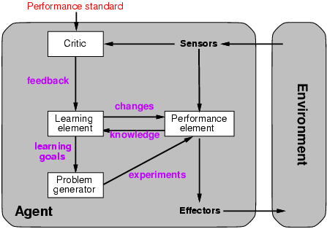
Learning agents

Slide 5
Learning element
Design of a learning element is affected by
Which components of the performance element are to be learned
What feedback is available to learn these components
What representation is used for the components
Type of feedback:
Supervised learning: correct answers for each example
Unsupervised learning: correct answers not given
Reinforcement learning: occasional rewards

Slide 6
Inductive learning
Simplest form: learn a function from examples
f is the target function
An example is a pair (x, f(x))
Problem: find a hypothesis h
such that h ≈ f
given a training set of examples
(This is a highly simplified model of real learning:
Ignores prior knowledge
Assumes examples are given)

Slide 7
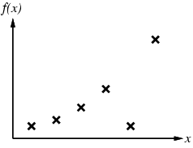
Inductive learning method
Construct/adjust h to agree with f on training set
(h is consistent if it agrees with f on all examples)
E.g., curve fitting:

Slide 8
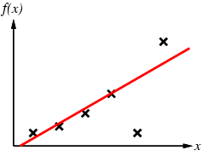
Inductive learning method
Construct/adjust h to agree with f on training set
(h is consistent if it agrees with f on all examples)
E.g., curve fitting:

Slide 9
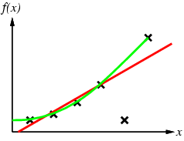
Inductive learning method
Construct/adjust h to agree with f on training set
(h is consistent if it agrees with f on all examples)
E.g., curve fitting:

Slide 10
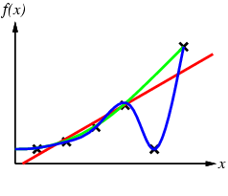
Inductive learning method
Construct/adjust h to agree with f on training set
(h is consistent if it agrees with f on all examples)
E.g., curve fitting:

Slide 11
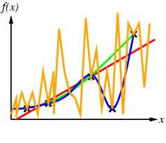
Inductive learning method
Construct/adjust h to agree with f on training set
(h is consistent if it agrees with f on all examples)
E.g., curve fitting:

Slide 12
Inductive learning method
Construct/adjust h to agree with f on training set
(h is consistent if it agrees with f on all examples)
E.g., curve fitting:
Ockham’s razor: prefer the simplest hypothesis consistent with data

Slide 13
Learning decision trees
Problem: decide whether to wait for a table at a restaurant, based on the following attributes:
Alternate: is there an alternative restaurant nearby?
Bar: is there a comfortable bar area to wait in?
Fri/Sat: is today Friday or Saturday?
Hungry: are we hungry?
Patrons: number of people in the restaurant (None, Some, Full)
Price: price range ($, $$, $$$)
Raining: is it raining outside?
Reservation: have we made a reservation?
Type: kind of restaurant (French, Italian, Thai, Burger)
WaitEstimate: estimated waiting time (0-10, 10-30, 30-60, >60)

Slide 14
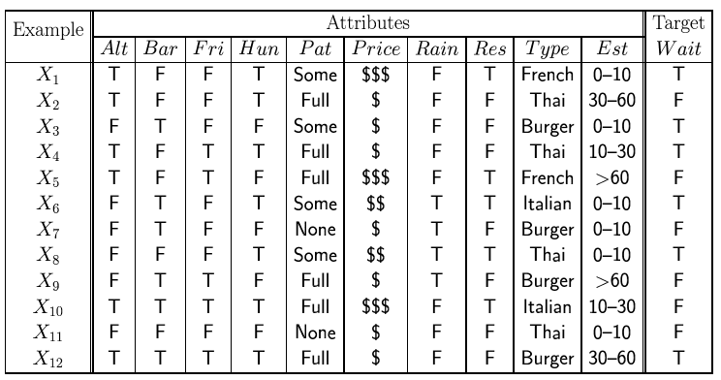
Attribute-based representations
Examples described by attribute values (Boolean, discrete, continuous)
E.g., situations where I will/won't wait for a table:
Classification of examples is positive (T) or negative (F)

Slide 15
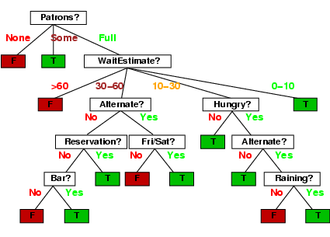
Decision trees
One possible representation for hypotheses
E.g., here is the “true” tree for deciding whether to wait:

Slide 16
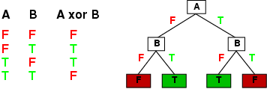
Expressiveness
Decision trees can express any function of the input attributes.
E.g., for Boolean functions, truth table row → path to leaf:
Trivially, there is a consistent decision tree for any training set with one path to leaf for each example (unless f nondeterministic in x) but it probably won't generalize to new examples
Prefer to find more compact decision trees

Slide 17
Hypothesis spaces
How many distinct decision trees with n Boolean attributes?
= number of Boolean functions
= number of distinct truth tables with 2^{n} rows = 2^{2n}
E.g., with 6 Boolean attributes, there are 18,446,744,073,709,551,616 trees

Slide 18
Hypothesis spaces
How many distinct decision trees with n Boolean attributes?
= number of Boolean functions
= number of distinct truth tables with 2^{n} rows = 2^{2n}
E.g., with 6 Boolean attributes, there are 18,446,744,073,709,551,616 trees
How many purely conjunctive hypotheses (e.g., Hungry ∧ ¬Rain)?
Each attribute can be in (positive), in (negative), or out
⇒ 3^{n} distinct conjunctive hypotheses
More expressive hypothesis space
increases chance that target function can be expressed
increases number of hypotheses consistent with training set
⇒ may get worse predictions

Slide 19
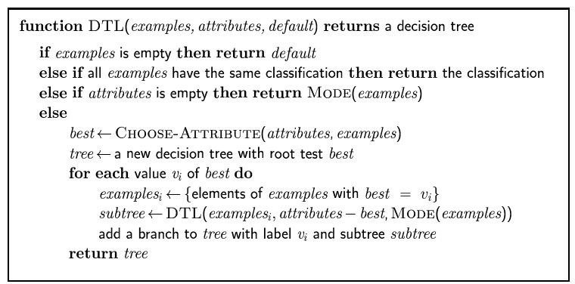
Decision tree learning
Aim: find a small tree consistent with the training examples
Idea: (recursively) choose "most significant" attribute as root of (sub)tree

Slide 20
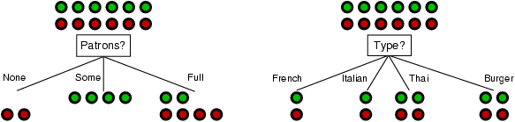
Choosing an attribute
Idea: a good attribute splits the examples into subsets that are (ideally) "all positive" or "all negative"
Patrons? is a better choice

Slide 21
Using information theory
To implement Choose-Attribute in the DTL algorithm
Information Content (Entropy):
I(P(v₁), … , P(v_{n})) = Σ_{i=1} -P(v_{i}) log₂ P(v_{i})
For a training set containing p positive examples and n negative examples:

Slide 22
Information gain
A chosen attribute A divides the training set E into subsets E₁, … , E_{v} according to their values for A, where A has v distinct values.
Information Gain (IG) or reduction in entropy from the attribute test:
Choose the attribute with the largest IG

Slide 23
Information gain
For the training set, p = n = 6, I(6/12, 6/12) = 1 bit
Consider the attributes Patrons and Type (and others too):
Patrons has the highest IG of all attributes and so is chosen by the DTL algorithm as the root

Slide 24
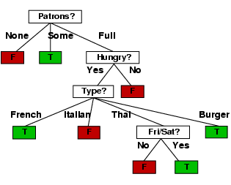
Example contd.
Decision tree learned from the 12 examples:
Substantially simpler than “true” tree---a more complex hypothesis isn’t justified by small amount of data

Slide 25
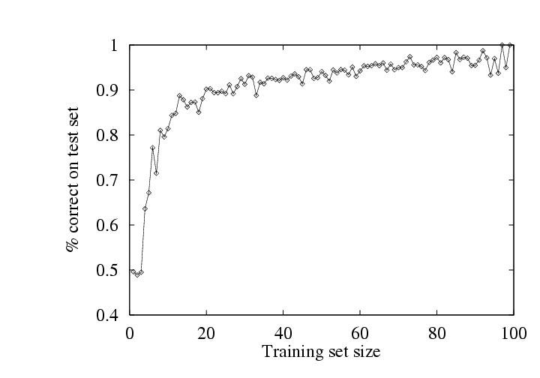
Performance measurement
How do we know that h ≈ f ?
Use theorems of computational/statistical learning theory
Try h on a new test set of examples
(use same distribution over example space as training set)
Learning curve = % correct on test set as a function of training set size

Slide 26
Summary
Learning needed for unknown environments, lazy designers
Learning agent = performance element + learning element
For supervised learning, the aim is to find a simple hypothesis approximately consistent with training examples
Decision tree learning using information gain
Learning performance = prediction accuracy measured on test set

