Slide 1
Artificial Intelligence #20
COMS W4701
Fall 2014
Learning from examples (Ch. 18)

Slide 2
Vector space classification
x2
Class 2
Class 1
x1

Slide 3
Decision surfaces
x2
Class 2
Class 1
x1

Slide 4
Decision trees
x2
Class 2
Class 1
x1

Slide 5
Classification using decision trees
Expected information need
I (s₁, s₂, …, s_{m}) = - p_{i} log (p_{i})
s = data samples
m = number of classes
Σ

Slide 6
RID | Age | Income | student | credit | buys?
1 | <= 30 | High | No | Fair | No
2 | <= 30 | High | No | Excellent | No
3 | 31 .. 40 | High | No | Fair | Yes
4 | > 40 | Medium | No | Fair | Yes
5 | > 40 | Low | Yes | Fair | Yes
6 | > 40 | Low | Yes | Excellent | No
7 | 31 .. 40 | Low | Yes | Excellent | Yes
8 | <= 30 | Medium | No | Fair | No
9 | <= 30 | Low | Yes | Fair | Yes
10 | > 40 | Medium | Yes | Fair | Yes
11 | <= 30 | Medium | Yes | Excellent | Yes
12 | 31 .. 40 | Medium | No | Excellent | Yes
13 | 31 .. 40 | High | Yes | Fair | Yes
14 | > 40 | Medium | no | excellent | no

Slide 7
Decision tree induction
I(s₁,s₂) = I(9,5) = = - 9/14 log 9/14 – 5/14 log 5/14 = = 0.940

Slide 8
Entropy and information gain
Σ
S_{1j} + … + s_{mj}
E(A) = I (s_{1j},…,s_{mj})
s
Entropy = expected information based on the partitioning into
subsets by A
Gain (A) = I (s₁,s₂,…,s_{m}) – E(A)

Slide 9
Entropy
Age <= 30 s₁₁ = 2, s₂₁ = 3, I(s₁₁, s₂₁) = 0.971
Age in 31 .. 40 s₁₂ = 4, s₂₂ = 0, I (s₁₂,s₂₂) = 0
Age > 40 s₁₃ = 3, s₂₃ = 2, I (s₁₃,s₂₃) = 0.971

Slide 10
Entropy (cont’d)
E (age) = 5/14 I (s11,s21) + 4/14 I (s12,s22) + 5/14 I (S13,s23) = 0.694
Gain (age) = I (s1,s2) – E(age) = 0.246
Gain (income) = 0.029, Gain (student) = 0.151, Gain (credit) = 0.048

Slide 11
Final decision tree
age
> 40
student
31 .. 40
credit
yes
no
yes
excellent
fair
no
yes
no
yes

Slide 12
Other techniques
Bayesian classifiers
X: age <=30, income = medium, student = yes, credit = fair
P(yes) = 9/14 = 0.643
P(no) = 5/14 = 0.357

Slide 13
Example
P (age < 30 | yes) = 2/9 = 0.222 P (age < 30 | no) = 3/5 = 0.600 P (income = medium | yes) = 4/9 = 0.444 P (income = medium | no) = 2/5 = 0.400 P (student = yes | yes) = 6/9 = 0.667 P (student = yes | no) = 1/5 = 0.200 P (credit = fair | yes) = 6/9 = 0.667 P (credit = fair | no) = 2/5 = 0.400

Slide 14
Example (cont’d)
P (X | yes) = 0.222 x 0.444 x 0.667 x 0.667 = 0.044
P (X | no) = 0.600 x 0.400 x 0.200 x 0.400 = 0.019
P (X | yes) P (yes) = 0.044 x 0.643 = 0.028
P (X | no) P (no) = 0.019 x 0.357 = 0.007
Answer: yes/no?

Slide 15
Linear boundary
x2
topic2
topic1
x1

Slide 16
Vector space classifiers
Using centroids
Boundary = line that is equidistant from two centroids

Slide 17
Generative models: knn
Assign each element to the closest cluster
K-nearest neighbors
Very easy to program
Tessellation; nonlinearity
Issues: choosing k, b?
Demo:
http://www-2.cs.cmu.edu/~zhuxj/courseproject/knndemo/KNN.html

Slide 18
Linear separators
Two-dimensional line:
w₁x₁+w₂x₂=b is the linear separator
w₁x₁+w₂x₂>b for the positive class
In n-dimensional spaces:

Slide 19
Example 1
x2
topic2
topic1
x1

Slide 20
Example 2
Classifier for “interest” in Reuters-21578
b=0
If the document is “rate discount dlr world”, its score will be 0.67*1+0.46*1+ (-0.71)*1+(-0.35)*1= 0.05>0
w_{i} | x_{i} | w_{i} | x_{i}
0.70 | prime | -0.71 | dlrs
0.67 | rate | -0.35 | world
0.63 | interest | -0.33 | sees
0.60 | rates | -0.25 | year
0.46 | discount | -0.24 | group
0.43 | bundesbank | -0.24 | dlr
Example from MSR

Slide 21
Example: perceptron algorithm
Input:
Algorithm:
Output:

Slide 22
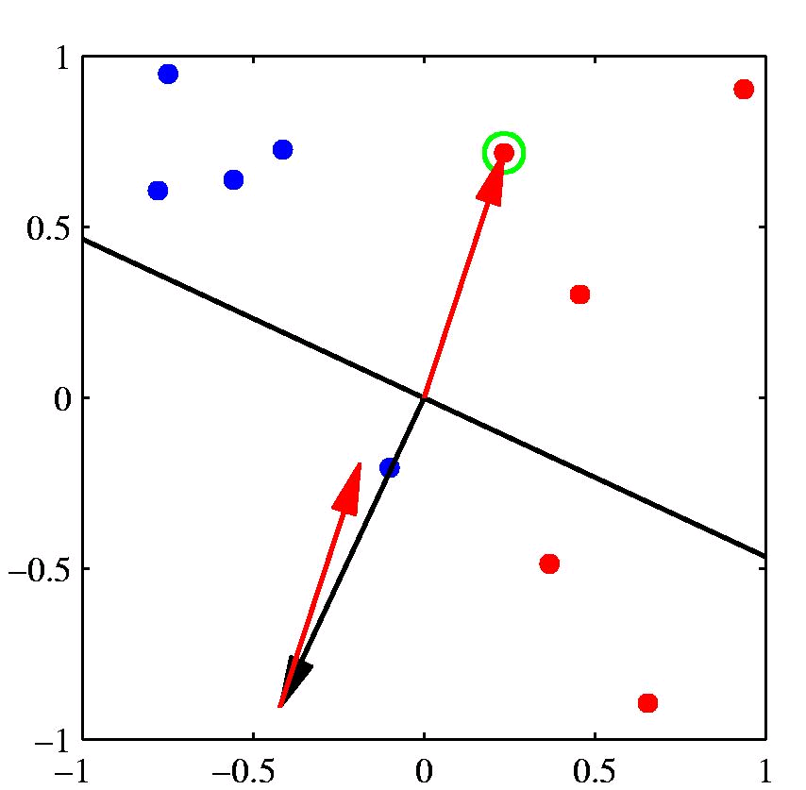
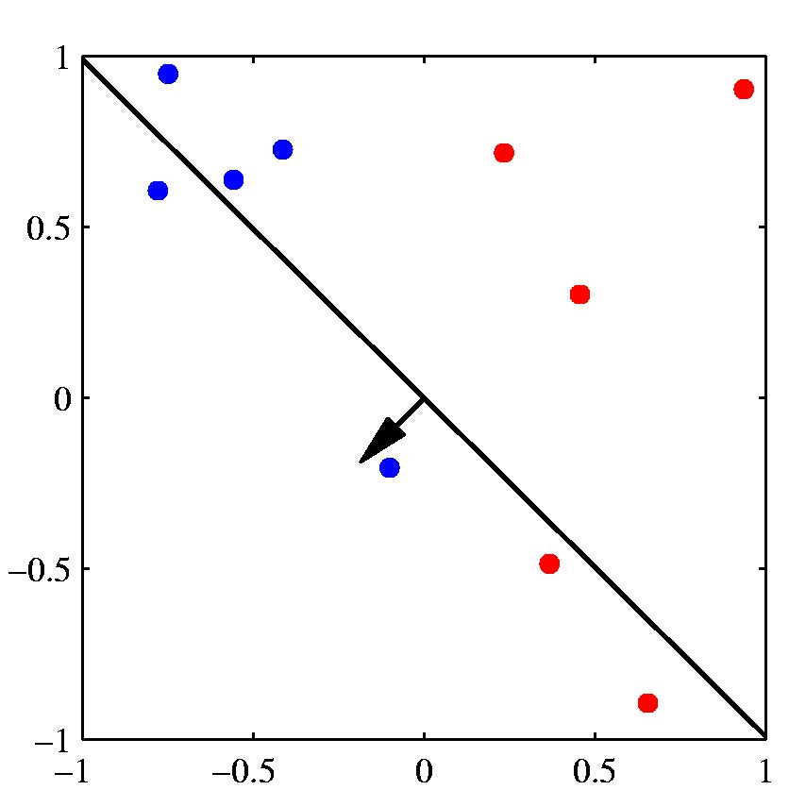
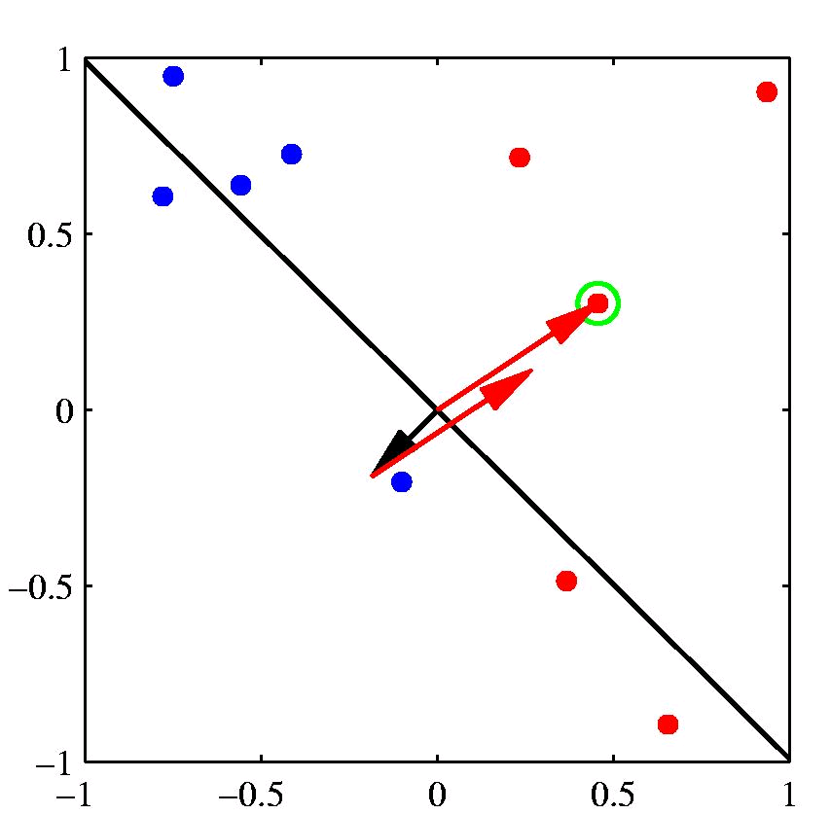
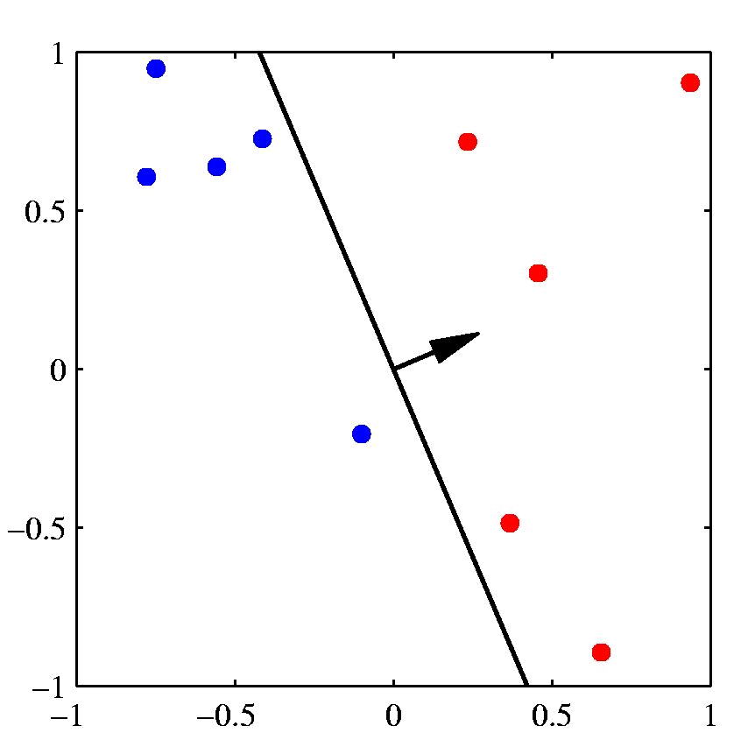
[Slide from Chris Bishop]

Slide 23
Linear classifiers
What is the major shortcoming of a perceptron?
How to determine the dimensionality of the separator?
Bias-variance tradeoff (example)
How to deal with multiple classes?
Any-of: build multiple classifiers for each class
One-of: harder (as J hyperplanes do not divide R^{M} into J regions), instead: use class complements and scoring

Slide 24
Support vector machines
Introduced by Vapnik in the early 90s.

Slide 25
Issues with SVM
Soft margins (inseparability)
Kernels – non-linearity

Slide 26
Need for Kernels
Sentences (or documents, or words) can be represented as vectors in many different ways, depending on the type of similarity that needs to be computed.
In document retrieval, word order may often be ignored (the so-called “bag of words” approach). For example, “… cat … dog” may be considered the same as “… dog … cat”.
In sentence retrieval word order may matter, e.g., compare “Utopia invades Asgård” and “Asgård invades Utopia”. A bag of words approach, however, will treat these two sentences as the same.

Slide 27
The Basic Idea behind Kernels
o
x
o
x
o
x
x

Slide 28
The Basic Idea behind Kernels
o
x
o
x
o
x
x

Slide 29
The Basic Idea behind Kernels
φ
φ(o)
φ(o)
o
x
φ(o)
o
x
o
φ(x)
φ(x)
x
x
φ(x)
φ(x)

Slide 30
The Basic Idea behind Kernels
φ
φ(o)
φ(o)
o
x
φ(o)
o
x
o
φ(x)
φ(x)
x
x
φ(x)
φ(x)

Slide 31
Example
(mapping to a higher-dimensional space)

Slide 32
The kernel trick
Polynomial kernel:
Sigmoid kernel:
RBF kernel:
Many other kernels are useful for IR: e.g., string kernels, subsequence kernels, tree kernels, etc.

Slide 33
SVM (Cont’d)
Evaluation:
SVM > knn > decision tree > NB
Implementation
Quadratic optimization
Use toolkit (e.g., Thorsten Joachims’s svmlight)

Slide 34
Unigram kernels
A unigram kernel is essentially the same as a bag of words
For example, we can split the sentence “Utopia invades Asgård” into the three unigrams:
“Utopia”
“invades”
“Asgård”
Similarly, we can split “Asgård invades Utopia” into:
“Asgård”
“invades”
“Utopia”
However, the vector representations of the two sentences will be identical (<1,1,1>) and therefore their cosine similarity will be computed as 1.

Slide 35
Bigram kernels
Using a bigram kernel, we can split the sentence “Utopia invades Asgård” into the two bigrams:
“Utopia invades”
“invades Asgård”
Similarly, we can split “Asgård invades Utopia” into:
“Asgård invades”
“invades Utopia”
Using this representation, the vectors corresponding to the two sentences are <1,1,0,0> and <0,0,1,1>, respectively, and their cosine similarity is 0.

Slide 36
Longer n-grams
N-grams for n>2 can also be used for measuring similarity.
Longer n-grams (shingles) are particularly useful in Information Retrieval, for fast retrieval of similar documents.
In NLP, people use n-gram similarity methods for the evaluation of
machine translation (BLEU – Papineni et al.)
text summarization (ROUGE – Lin et al.)
In both cases, an automatically generated text (a translation or a summary) is compared against a set of reference sentences which are intended

Slide 37
BLEU Example
One hundred artists from 16 countries will exhibit 270 pieces of artistic work made on porcelain in the Palace of Arts in Cairo in a an exhibition inaugurated earlier this week and that will last for two weeks.
One hundred artists from 61 states are exhibiting 270 pieces of porcelain artwork at the Arts Palace in Cairo, as part of a two-week exhibition that opened at the beginning of this week.
100 artists from 16 countries are exhibiting 270 pieces of work on porcelain in Cairo's Arts Palace as part of a 2-week exhibition, which opened at the beginning of the week.
One hundred artists from 16 countries will display 270 pieces of art works undertaken on porcelain in the Palace of Arts in Cairo in an exhibition opened at the beginning of this week and which will continue for two weeks.
A hundred artists from 16 countries will exhibit 270 pieces of artistic works that are made on Porcelain in the arts palace in Cairo in a an exhibition inaugurated earlier this week, which will last for two weeks.
One hundred artists from 61 countries exhibited 270 types of art pieces done on porcelain in the Cultural Palace of Cairo, in an exhibition that was inaugurated at the beginning of the current week. The exhibition would last two weeks.
One hundred artists from 16 countries will exhibit 270 works of art made with porcelain in the Arts Castle in Cairo in an exhibition that opened earlier this week and will last for two weeks.
A hundred artists from 16 countries are displaying 270 porcelain art pieces in an exhibition that opened early in the week, and will continue over a span of two weeks.
A hundred artists from 16 countries display 270 artistic porcelain pieces at the Palace of Arts in Cairo, in an exhibition that was opened earlier this week and continuing for two weeks.

Slide 38
Letter and Substring Kernels
Letter n-grams can be used for various applications such as spelling correction, language recognition, and named entity recognition.
For example, the word stop can be represented as the subset of all of its substrings: s, t, o, p, st, to, op, sto, top, and stop.
In this representation, sim(stop,stops) > sim(stop,plot), even though all three words are different.
Notes:
Character n-grams (Stanford papers)

Slide 39
Subsequences
Unlike a substring, a subsequence doesn’t need to consist of contiguous words (or letters).
comp, cotr, opter, cpute – all of these are letter-based) subsequences of computer
Subsequence kernels (of words, not letters) are most useful for measuring similarity between sentences.
Notes:
Character n-grams (Stanford papers)

Slide 40
Question
On the next slide, you will see a set of published headlines relating the same scientific study published in 2009. The study suggests that Wolfgang Amadeus Mozart may have died of complications caused by strep throat.
Take the time to read all these headlines. What interesting (class-related) observations can you make based on your reading?
What kernels would be most appropriate for clustering all these headlines together? In other words, these kernels should assign high pairwise similarity scores for the headlines in the group.
Notes:
Character n-grams (Stanford papers)

Slide 41
Did Mozart die of strep throat?
what killed mozart? study suggests strep infection
what killed mozart? strep, study suggests
what killed mozart? study suggest it might have been a strep infection
wstc/wnlk local news what killed mozart? a new theory emerges
strep throat may have led to mozart's death
mozart done in by strep throat?
study says mozart died of strep throat
dutch researchers suggest 'super-bug' as cause of mozart's death
new theory on what killed mozart
what killed mozart? study suggests strep
study suggests strep infection killed mozart
'strep throat may have killed mozart'
what killed mozart? study suggests strep
what killed mozart? study hints at complications from strep infection
what killed mozart? study suggests just strep throat
study suggests mozart died of strep infection
strep throat may have killed mozart
did strep throat kill mozart?
mozart may have died from strep throat: study
strep throat theory in mozart's death
medical study suggests mozart died of strep
mozart died of strep throat?
infection killed mozart?
did strep infection kill mozart?
did a strep infection cause mozart's death?
mozart may have died from strep
study reviews mozart's death
infection killed mozart - report
mozart's killer revealed: it was not salieri
infection killed mozart, says study
did poison or strep infection kill mozart?
mozart may have died from strep throat, says study
cause of mozart's death revealed
mozart died from strep
what really killed mozart? possibly strep
mozart may have been killed by strep throat

Slide 42
Answer to Question
Observations
All sentences have Mozart
The syntax varies a lot (e.g., passive/active)
They all have some word related to dying (e.g., “kill/die/disease”)
Suggestions
Ngram kernel will probably not work very well here
Some semantic information should be encoded in the kernel
Possibly, use word2vec

Slide 43
Dependencies
likes
John
apples
green

Slide 44
Dependencies
green
apple
green: modifier, child
apple: head, parent

Slide 45
Dependency Structure
Unionized workers are usually better paid than their non-union counterparts.
1 2 3 4 5 6 7 8 9 10

Slide 46
Other notations
VBN
nsubjpass
prep
auxpass
advmod
advmod
NNS
VBP
RB
RBR
IN
amod
poss
JJ
NNS
poss
amod
PRP$
JJ
Unionized workers are usually better paid than their non-union counterparts.
1 2 3 4 5 6 7 8 9 10

Slide 47
The dependency tree kernel
likes
John
apples
green
likes
likes
likes
John
apples
apples
John
apples
green
green
likes
likes
John
apples
apples
green

Slide 48
The Syntactic Tree Kernel
Note that siblings are not split up (Collins and Duffy, 2002)
Notes:
REPLACE!
Children are not split up

