Slide 1
Artificial Intelligence #5
COMS W4701
Fall 2014
Problem Solving and Search (Ch. 3)

Slide 2
Outline
Problem-solving agents
Problem types
Problem formulation
Example problems
Basic search algorithms

Slide 3
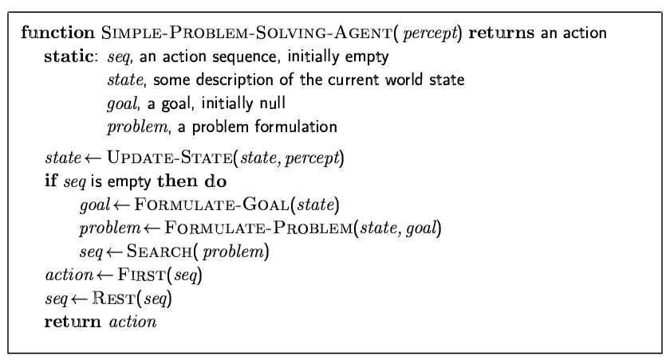
Problem-solving agents

Slide 4
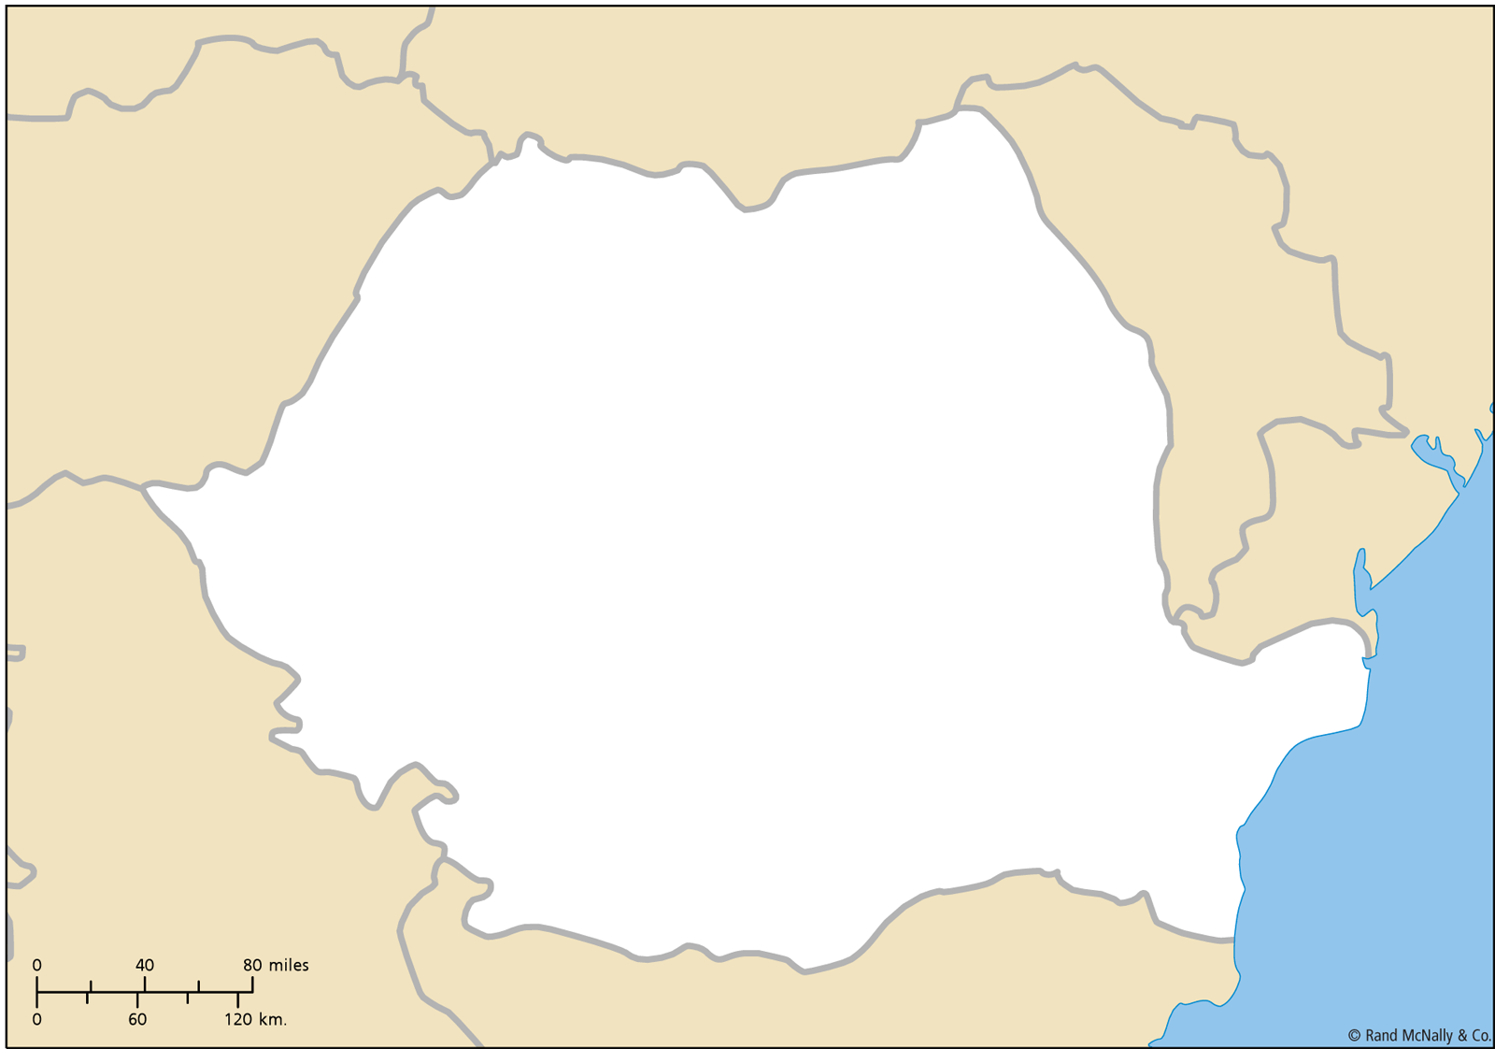

Slide 5
Example: Romania
On holiday in Romania; currently in Arad.
Flight leaves tomorrow from Bucharest
Formulate goal:
be in Bucharest
Formulate problem:
states: various cities
actions: drive between cities
Find solution:
sequence of cities, e.g., Arad, Sibiu, Fagaras, Bucharest

Slide 6
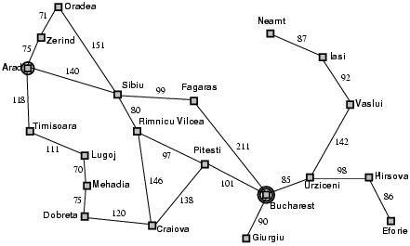
Example: Romania

Slide 7
Problem types
Deterministic, fully observable → single-state problem
Agent knows exactly which state it will be in; solution is a sequence
Non-observable → sensorless problem (conformant problem)
Agent may have no idea where it is; solution is a sequence
Nondeterministic and/or partially observable → contingency problem
percepts provide new information about current state
often interleave search, execution
Unknown state space → exploration problem

Slide 8
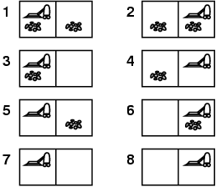
Example: vacuum world
Single-state, start in #5. Solution?

Slide 9
Example: vacuum world
Single-state, start in #5. Solution? [Right, Suck]
Sensorless, start in {1,2,3,4,5,6,7,8} e.g., Right goes to {2,4,6,8} Solution?

Slide 10
Example: vacuum world
Sensorless, start in {1,2,3,4,5,6,7,8} e.g., Right goes to {2,4,6,8} Solution? [Right,Suck,Left,Suck]
Contingency
Nondeterministic: Suck may dirty a clean carpet
Partially observable: location, dirt at current location.
Percept: [L, Clean], i.e., start in #5 or #7 Solution?

Slide 11
Example: vacuum world
Sensorless, start in {1,2,3,4,5,6,7,8} e.g., Right goes to {2,4,6,8} Solution? [Right,Suck,Left,Suck]
Contingency
Nondeterministic: Suck may dirty a clean carpet
Partially observable: location, dirt at current location.
Percept: [L, Clean], i.e., start in #5 or #7 Solution? [Right, if dirt then Suck]

Slide 12
Single-state problem formulation
A problem is defined by four items:
initial state e.g., "at Arad"
actions or successor function S(x) = set of action–state pairs
e.g., S(Arad) = {<Arad → Zerind, Zerind>, … }
goal test, can be
explicit, e.g., x = "at Bucharest"
implicit, e.g., Checkmate(x)
path cost (additive)
e.g., sum of distances, number of actions executed, etc.
c(x,a,y) is the step cost, assumed to be ≥ 0
A solution is a sequence of actions leading from the initial state to a goal state

Slide 13
Selecting a state space
Real world is absurdly complex
→ state space must be abstracted for problem solving
(Abstract) state = set of real states
(Abstract) action = complex combination of real actions
e.g., "Arad → Zerind" represents a complex set of possible routes, detours, rest stops, etc.
For guaranteed realizability, any real state "in Arad“ must get to some real state "in Zerind"
(Abstract) solution =
set of real paths that are solutions in the real world
Each abstract action should be "easier" than the original problem

Slide 14
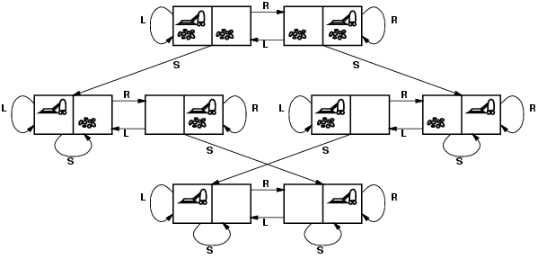
Vacuum world state space graph
states?
actions?
goal test?
path cost?

Slide 15
Vacuum world state space graph
states? integer dirt and robot location
actions? Left, Right, Suck
goal test? no dirt at all locations
path cost? 1 per action

Slide 16
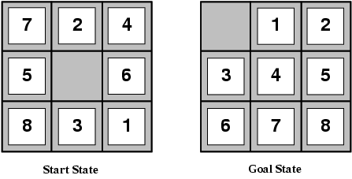
Example: The 8-puzzle
states?
actions?
goal test?
path cost?

Slide 17
Example: The 8-puzzle
states? locations of tiles
actions? move blank left, right, up, down
goal test? = goal state (given)
path cost? 1 per move [Note: optimal solution of n-Puzzle family is NP-hard]

Slide 18
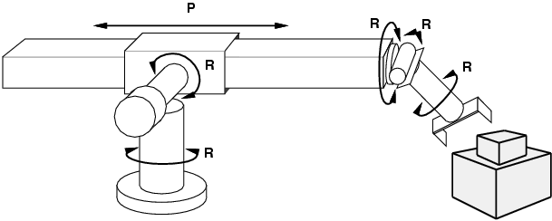
Example: robotic assembly
states?: real-valued coordinates of robot joint angles parts of the object to be assembled
actions?: continuous motions of robot joints
goal test?: complete assembly
path cost?: time to execute

Slide 19
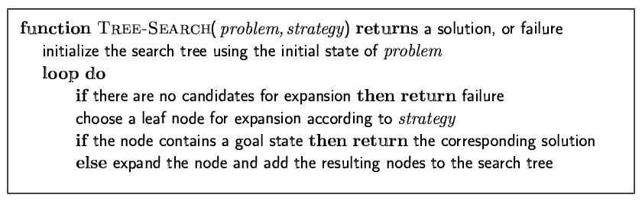
Tree search algorithms
Basic idea:
offline, simulated exploration of state space by generating successors of already-explored states (a.k.a.~expanding states)

Slide 20
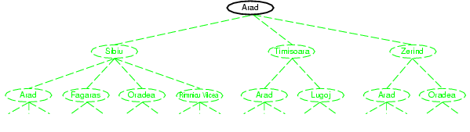
Tree search example

Slide 21
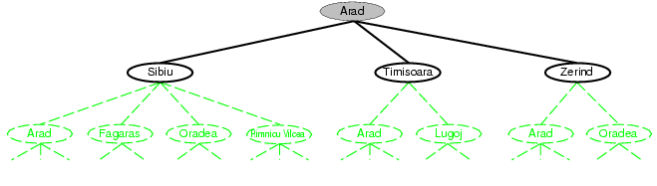
Tree search example

Slide 22
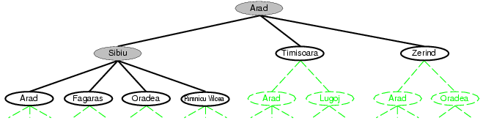
Tree search example

Slide 23
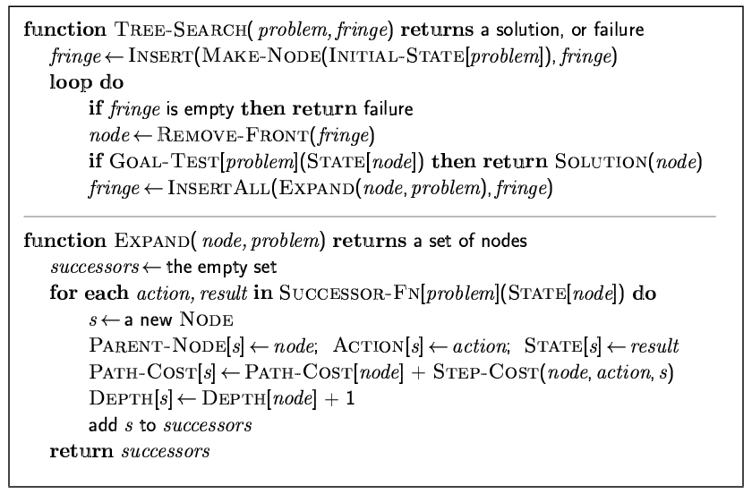
Implementation: general tree search

Slide 24
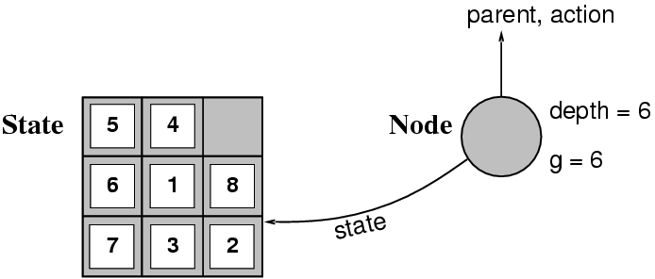
Implementation: states vs. nodes
A state is a (representation of) a physical configuration
A node is a data structure constituting part of a search tree includes state, parent node, action, path cost g(x), depth
The Expand function creates new nodes, filling in the various fields and using the SuccessorFn of the problem to create the corresponding states.

Slide 25
Search strategies
A search strategy is defined by picking the order of node expansion
Strategies are evaluated along the following dimensions:
completeness: does it always find a solution if one exists?
time complexity: number of nodes generated
space complexity: maximum number of nodes in memory
optimality: does it always find a least-cost solution?
Time and space complexity are measured in terms of
b: maximum branching factor of the search tree
d: depth of the least-cost solution
m: maximum depth of the state space (may be ∞)

Slide 26
Uninformed search strategies
Uninformed search strategies use only the information available in the problem definition
Breadth-first search
Uniform-cost search
Depth-first search
Depth-limited search
Iterative deepening search

Slide 27
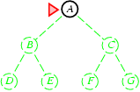
Breadth-first search
Expand shallowest unexpanded node
Implementation:
fringe is a FIFO queue, i.e., new successors go at end

Slide 28
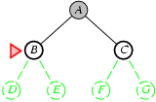
Breadth-first search
Expand shallowest unexpanded node
Implementation:
fringe is a FIFO queue, i.e., new successors go at end

Slide 29
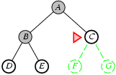
Breadth-first search
Expand shallowest unexpanded node
Implementation:
fringe is a FIFO queue, i.e., new successors go at end

Slide 30
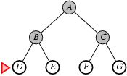
Breadth-first search
Expand shallowest unexpanded node
Implementation:
fringe is a FIFO queue, i.e., new successors go at end

Slide 31
Properties of breadth-first search
Complete? Yes (if b is finite)
Time? 1+b+b²+b³+… +b^{d} + b(b^{d}-1) = O(b^{d+1})
Space? O(b^{d+1}) (keeps every node in memory)
Optimal? Yes (if cost = 1 per step)
Space is the bigger problem (more than time)

Slide 32
Uniform-cost search
Expand least-cost unexpanded node
Implementation:
fringe = queue ordered by path cost
Equivalent to breadth-first if step costs all equal
Complete? Yes, if step cost ≥ ε
Time? # of nodes with g ≤ cost of optimal solution, O(b^{ceiling(C*/ ε)}) where C* is the cost of the optimal solution
Space? # of nodes with g ≤ cost of optimal solution, O(b^{ceiling(C*/ ε)})
Optimal? Yes – nodes expanded in increasing order of g(n)

Slide 33
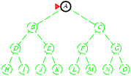
Depth-first search
Expand deepest unexpanded node
Implementation:
fringe = LIFO queue, i.e., put successors at front

Slide 34
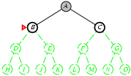
Depth-first search
Expand deepest unexpanded node
Implementation:
fringe = LIFO queue, i.e., put successors at front

Slide 35
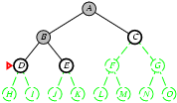
Depth-first search
Expand deepest unexpanded node
Implementation:
fringe = LIFO queue, i.e., put successors at front

Slide 36
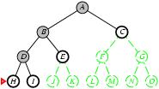
Depth-first search
Expand deepest unexpanded node
Implementation:
fringe = LIFO queue, i.e., put successors at front

Slide 37
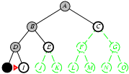
Depth-first search
Expand deepest unexpanded node
Implementation:
fringe = LIFO queue, i.e., put successors at front

Slide 38
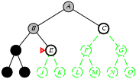
Depth-first search
Expand deepest unexpanded node
Implementation:
fringe = LIFO queue, i.e., put successors at front

Slide 39
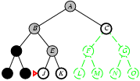
Depth-first search
Expand deepest unexpanded node
Implementation:
fringe = LIFO queue, i.e., put successors at front

Slide 40
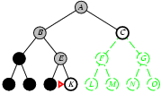
Depth-first search
Expand deepest unexpanded node
Implementation:
fringe = LIFO queue, i.e., put successors at front

Slide 41
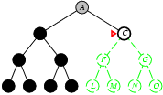
Depth-first search
Expand deepest unexpanded node
Implementation:
fringe = LIFO queue, i.e., put successors at front

Slide 42
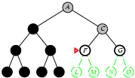
Depth-first search
Expand deepest unexpanded node
Implementation:
fringe = LIFO queue, i.e., put successors at front

Slide 43
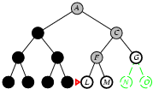
Depth-first search
Expand deepest unexpanded node
Implementation:
fringe = LIFO queue, i.e., put successors at front

Slide 44
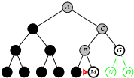
Depth-first search
Expand deepest unexpanded node
Implementation:
fringe = LIFO queue, i.e., put successors at front

Slide 45
Properties of depth-first search
Complete? No: fails in infinite-depth spaces, spaces with loops
Modify to avoid repeated states along path
→ complete in finite spaces
Time? O(b^{m}): terrible if m is much larger than d
but if solutions are dense, may be much faster than breadth-first
Space? O(bm), i.e., linear space!
Optimal? No

Slide 46
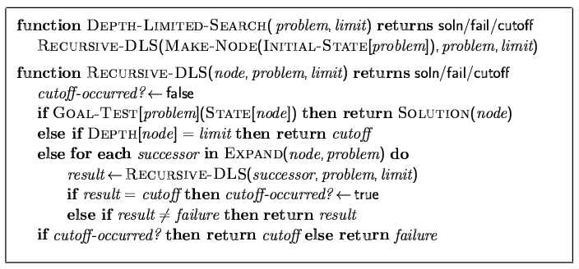
Depth-limited search
= depth-first search with depth limit l,
i.e., nodes at depth l have no successors
Recursive implementation:

Slide 47
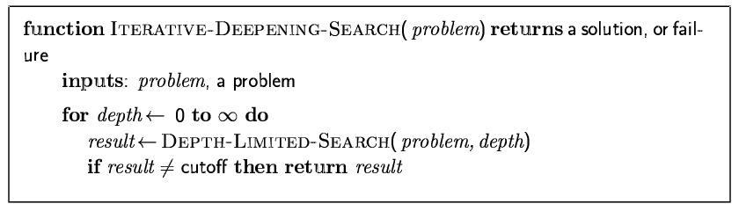
Iterative deepening search

Slide 48
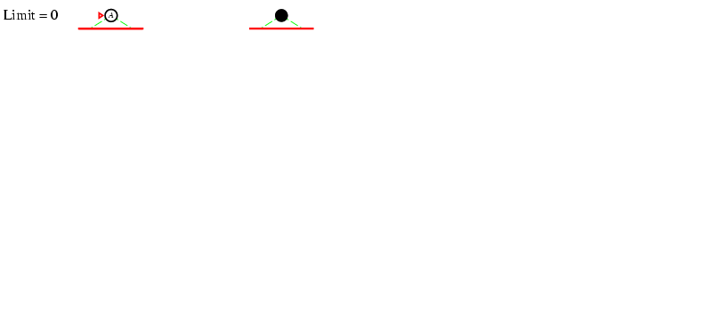
Iterative deepening search l =0

Slide 49
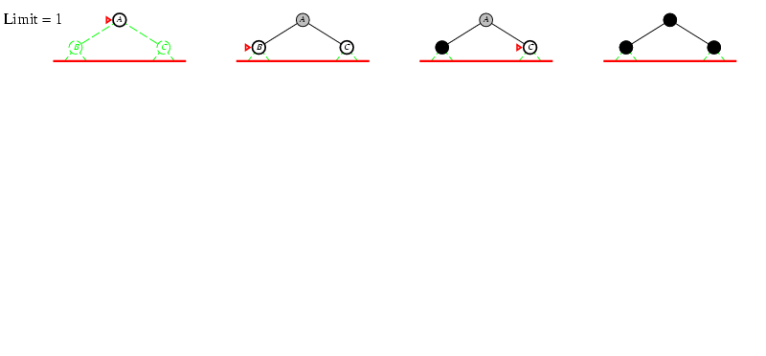
Iterative deepening search l =1

Slide 50
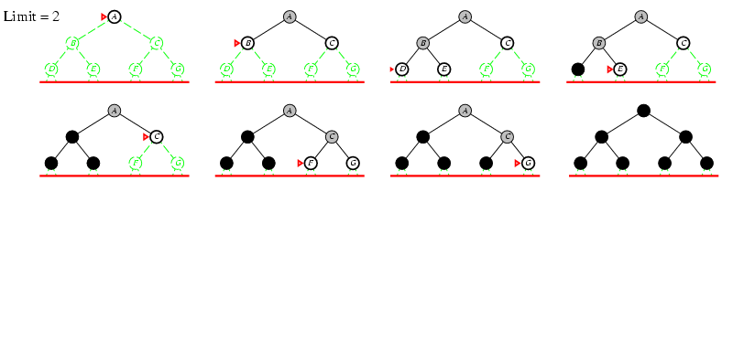
Iterative deepening search l =2

Slide 51
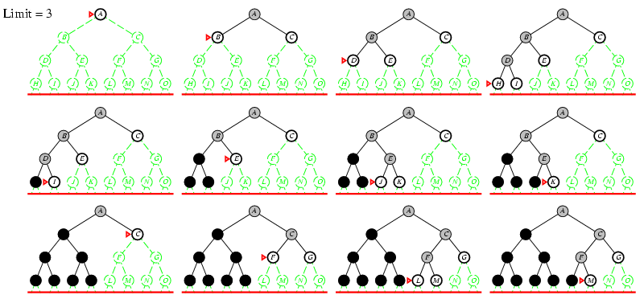
Iterative deepening search l =3

Slide 52
Iterative deepening search
Number of nodes generated in a depth-limited search to depth d with branching factor b:
N_{DLS} = b⁰ + b¹ + b² + … + b^{d-2} + b^{d-1} + b^{d}
Number of nodes generated in an iterative deepening search to depth d with branching factor b:
N_{IDS} = (d+1)b⁰ + d b^¹ + (d-1)b^² + … + 3b^{d-2} +2b^{d-1} + 1b^{d}
For b = 10, d = 5,
N_{DLS} = 1 + 10 + 100 + 1,000 + 10,000 + 100,000 = 111,111
N_{IDS} = 6 + 50 + 400 + 3,000 + 20,000 + 100,000 = 123,456
Overhead = (123,456 - 111,111)/111,111 = 11%

Slide 53
Properties of iterative deepening search
Complete? Yes
Time? (d+1)b⁰ + d b¹ + (d-1)b² + … + b^{d} = O(b^{d})
Space? O(bd)
Optimal? Yes, if step cost = 1

Slide 54
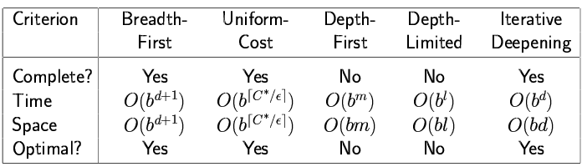
Summary of algorithms

Slide 55
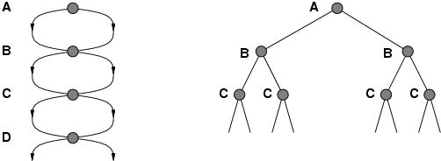
Repeated states
Failure to detect repeated states can turn a linear problem into an exponential one!

Slide 56
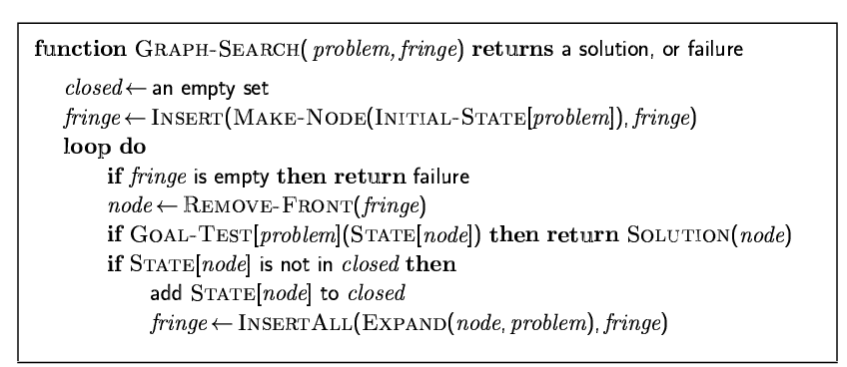
Graph search

Slide 57
Summary
Problem formulation usually requires abstracting away real-world details to define a state space that can feasibly be explored
Variety of uninformed search strategies
Iterative deepening search uses only linear space and not much more time than other uninformed algorithms

