Slide 1
Artificial Intelligence #7
COMS W4701
Fall 2014
Advanced Search (Ch 4) 2

Slide 2
Outline
Local search algorithms
Hill-climbing search
Simulated annealing search
Local beam search
Genetic algorithms

Slide 3
Local search algorithms
In many optimization problems, the path to the goal is irrelevant; the goal state itself is the solution
State space = set of "complete" configurations
Find configuration satisfying constraints, e.g., n-queens
In such cases, we can use local search algorithms
keep a single "current" state, try to improve it

Slide 4

Example: n-queens
Put n queens on an n × n board with no two queens on the same row, column, or diagonal

Slide 5
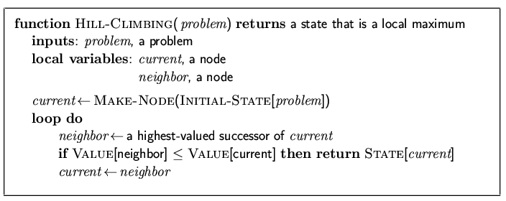
Hill-climbing search
"Like climbing Everest in thick fog with amnesia"

Slide 6
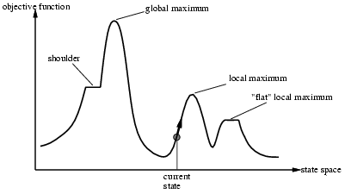
Hill-climbing search
Problem: depending on initial state, can get stuck in local maxima

Slide 7
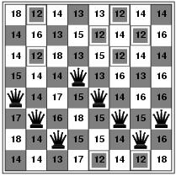
Hill-climbing search: 8-queens problem
h = number of pairs of queens that are attacking each other, either directly or indirectly
h = 17 for the above state

Slide 8
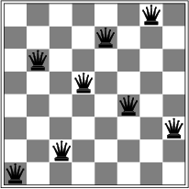
Hill-climbing search: 8-queens problem
A local minimum with h = 1

Slide 9
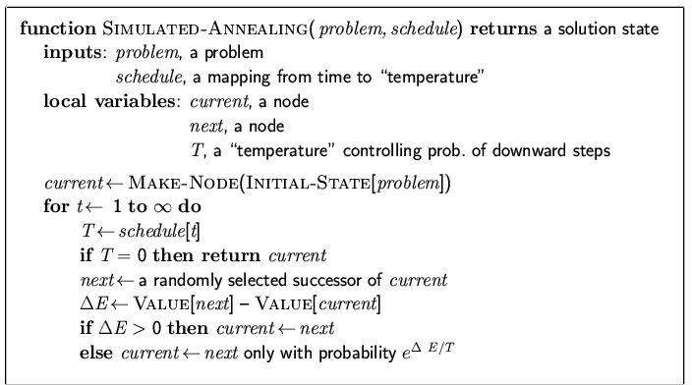
Simulated annealing search
Idea: escape local maxima by allowing some "bad" moves but gradually decrease their frequency

Slide 10
Properties of simulated annealing search
One can prove: If T decreases slowly enough, then simulated annealing search will find a global optimum with probability approaching 1
Widely used in VLSI layout, airline scheduling, etc.

Slide 11
Local beam search
Keep track of k states rather than just one
k is called the beam width
Start with k randomly generated states
At each iteration, all the successors of all k states are generated
If any one is a goal state, stop; else select the k best successors from the complete list and repeat.

Slide 12
Genetic algorithms
A successor state is generated by combining two parent states
Start with k randomly generated states (population)
A state is represented as a string over a finite alphabet (often a string of 0s and 1s)
Evaluation function (fitness function). Higher values for better states.
Produce the next generation of states by selection, crossover, and mutation.

Slide 13
Genetic algorithms contd.
What is the fitness function?
How is an individual represented?
Using a string over a finite alphabet.
Each element of the string is a gene.
How are individuals selected?
Randomly, with probability of selection proportional to fitness
Usually, selection is done with replacement.
How do individuals reproduce?
Through crossover and mutation

Slide 14
GA Pseudocode
Choose initial population (usually random)
Repeat (until terminated)
Evaluate each individual's fitness
Select pairs to mate
Replenish population (next-generation)
Apply crossover
Apply mutation
Check for termination criteria

Slide 15
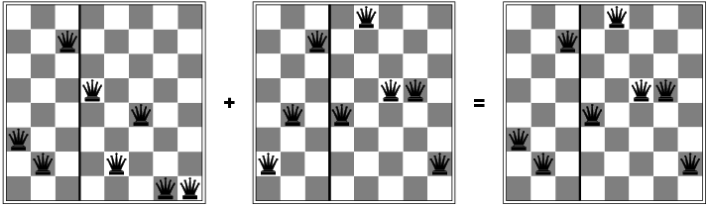
Genetic algorithms

Slide 16
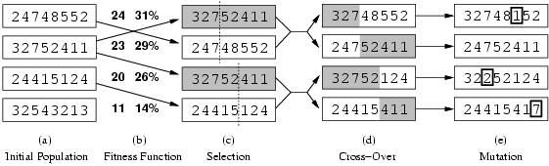
Genetic algorithms
Fitness function: number of non-attacking pairs of queens (min = 0, max = 8 × 7/2 = 28)
24/(24+23+20+11) = 31%
23/(24+23+20+11) = 29% etc.

Slide 17
Replacement
Simple or generational GAs replace entire population
Steady state or online GAs use different replacement schemes:
Replace worst
Replace best
Replace parent
Replace random
Replace most similar

