Slide 1
Artificial Intelligence #8
COMS W4701
Fall 2014
Adversarial Search (Ch 5)

Slide 2
Outline
Games
Optimal decisions
Alpha-beta pruning

Slide 3
Outline
Imperfect decisions
Stochastic games
Partially observable games
State-of-the art game programs

Slide 4
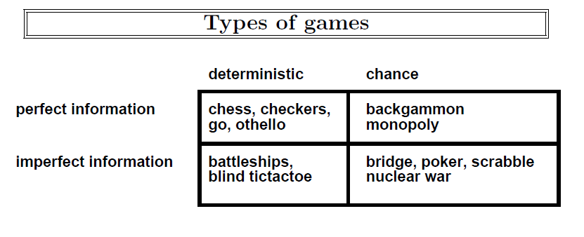

Slide 5
Games vs. search problems
"Unpredictable" opponent → specifying a move for every possible opponent reply
Time limits → unlikely to find goal, must approximate

Slide 6
Minimax Search
Core of many computer games
Pertains primarily to:
Turn based games
Two players
Players with “perfect knowledge”

Slide 7
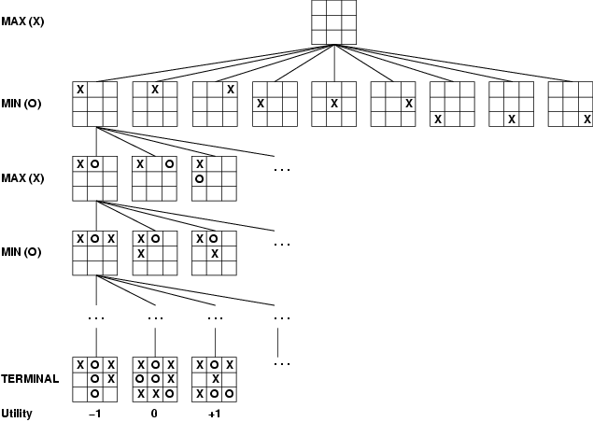
Game tree (2-player, deterministic, turns)

Slide 8
Game Tree
Nodes are states
Edges are decisions
Levels are called “plys”

Slide 9
Naïve Approach
Given a game tree, what would be the most straightforward playing approach?
Any potential problems?

Slide 10
Minimax
Minimizing the maximum possible loss
Choose move which results in best state
Select highest expected score for you
Assume opponent is playing optimally too
Will choose lowest expected score for you

Slide 11
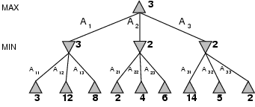
Minimax
Perfect play for deterministic games
Idea: choose move to position with highest minimax value = best achievable payoff against best play
E.g., 2-ply game:

Slide 12
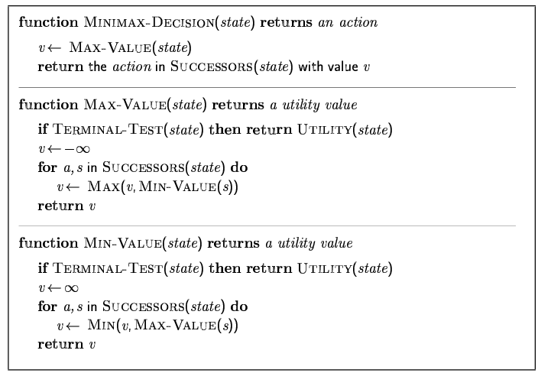
Minimax algorithm

Slide 13
Properties of minimax
Complete? Yes (if tree is finite)
Optimal? Yes (against an optimal opponent)
Time complexity? O(b^{m})
Space complexity? O(bm) (depth-first exploration)
For chess, b ≈ 35, m ≈100 for "reasonable" games → exact solution completely infeasible

Slide 14
Resource limits
Suppose we have 100 secs, explore 10⁴ nodes/sec → 10⁶ nodes per move
Standard approach:
cutoff test:
e.g., depth limit (perhaps add quiescence search)
evaluation function
= estimated desirability of position

Slide 15
Evaluation Functions
Assign a utility score to a state
Different for players?
Usually a range of integers
[-1000,+1000]
+infinity for win
-infinity for loss

Slide 16
Cutting Off Search
How to score a game before it ends?
You have to fudge it!
Use a heuristic function to approximate state’s utility

Slide 17
Cutting off search
MinimaxCutoff is identical to MinimaxValue except
Terminal? is replaced by Cutoff?
Utility is replaced by Eval
Does it work in practice?
b^{m} = 10⁶, b=35 → m=4
4-ply lookahead is a hopeless chess player!
4-ply ≈ human novice
8-ply ≈ typical PC, human master
12-ply ≈ Deep Blue, Kasparov
(A computer program which evaluates no further than its own legal moves plus the legal responses to those moves is searching to a depth of two-ply. )

Slide 18
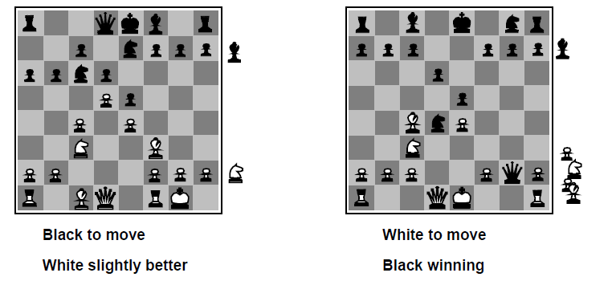

Slide 19
Example Evaluation Function
For chess, typically linear weighted sum of features
Eval(s) = w₁ f₁(s) + w₂ f₂(s) + … + w_{n} f_{n}(s)
e.g., w₁ = 9 with
f₁(s) = (number of white queens) – (number of black queens), etc.

Slide 20
Evaluating States
Assuming an ideal evaluation function, how would you make a move?
Is this a good strategy with a bad function?

Slide 21
Look Ahead
Instead of only evaluating immediate future, look as far ahead as possible

Slide 22
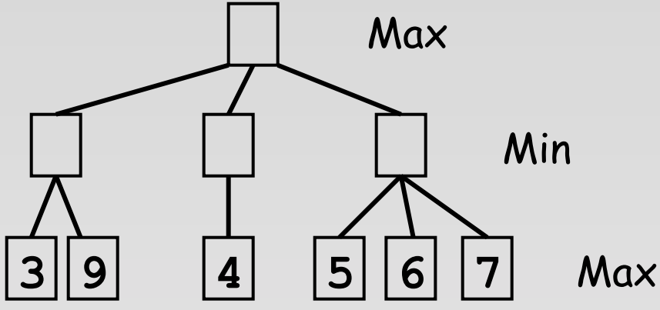
Look Ahead

Slide 23
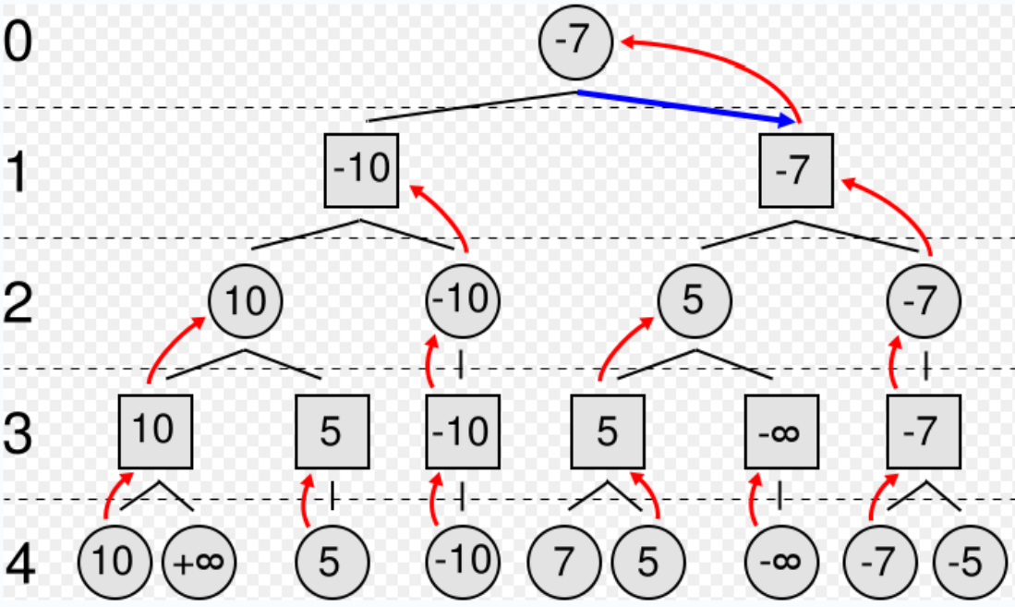
Bubbling Up
Looking ahead allows utility values to “bubble up” to root of search tree

Slide 24
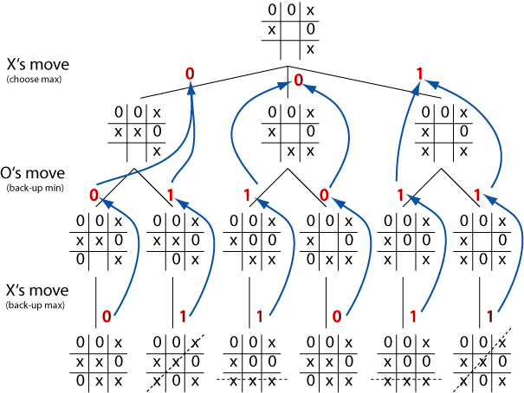

Slide 25
Minimax Algorithm
BESTMOVE function
Inputs:
Board state
Depth bound
Explores search tree to specified depth
Output:
Best move

Slide 26
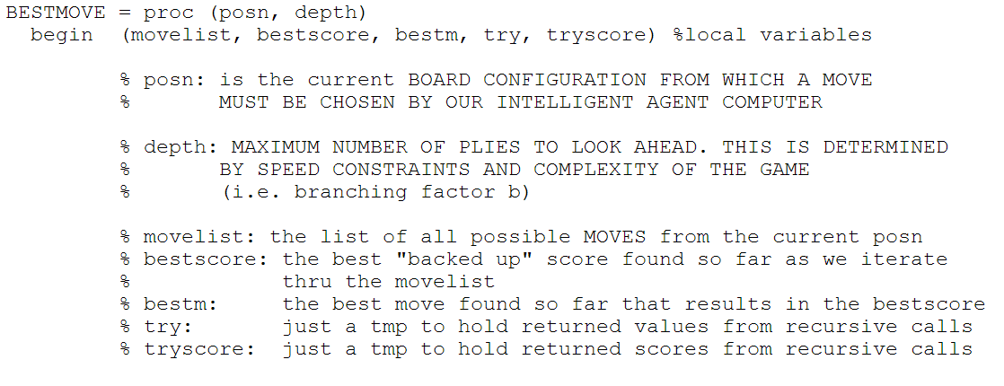
Minimax Algorithm

Slide 27
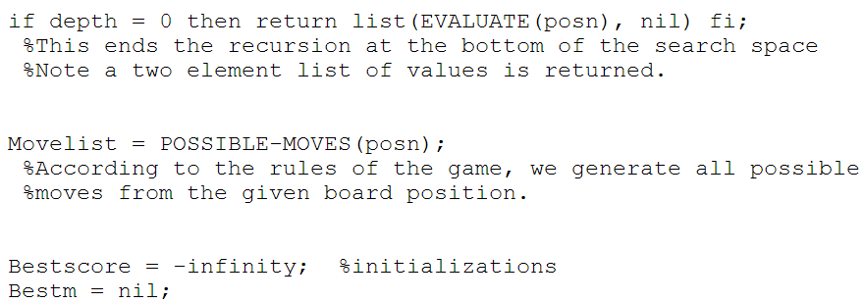
Minimax Algorithm

Slide 28
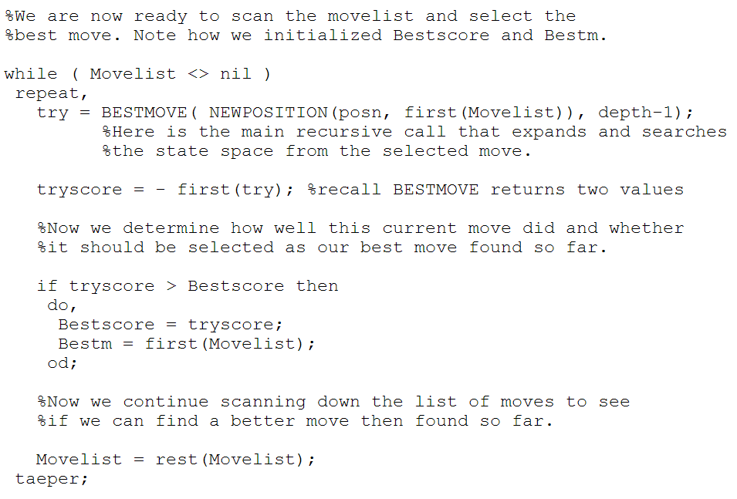
Minimax Algorithm

Slide 29
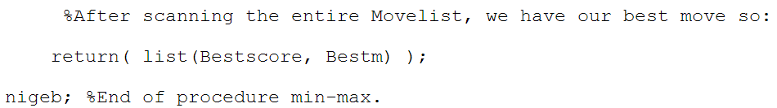
Minimax Algorithm

Slide 30
Minimax Algorithm
Did you notice anything missing?

Slide 31
Minimax Algorithm
Did you notice anything missing?
Where were Max-Value and Min-Value?

Slide 32
Minimax Algorithm
Did you notice anything missing?
Where were Max-Value and Min-Value?
What is going on here?

Slide 33
Minimax Algorithm
Did you notice anything missing?
Where were Max-Value and Min-Value?
What is going on here?

Slide 34
Be Careful!
Things to worry about?

Slide 35
Complexity
What is the space complexity of depth-bounded Minimax?

Slide 36
Complexity
What is the space complexity of depth-bounded Minimax?
Board size s
Depth d
Possible moves m

Slide 37
Complexity
What is the space complexity of depth-bounded Minimax?
Board size s
Depth d
Possible moves m
O(ds+m)
Board positions can be released as bubble up

Slide 38
Minimax Algorithm
Did I just do your project for you?

Slide 39
Minimax Algorithm
Did I just do your project for you?
No!

Slide 40
Minimax Algorithm
Did I just do your project for you?
No!
You need to create:
Evaluation function
What else?

Slide 41
Recap
What is a zero sum game?
What is a game tree?
What is Minimax?
Why is it called that?
What is its space complexity?
How can the Minimax algorithm be simplified?
Will this work for all games?

Slide 42
Next Up
Recall that minimax will produce optimal play against an optimal opponent if entire tree is searched
Is the same true if a cutoff is used?

Slide 43
Horizon Effect
Your algorithm searches to depth n
What happens if:
Evaluation(s) at depth n is very positive
Evaluation(s) at depth n+1 is very negative
Or:
Evaluation(s) at depth n is very negative
Evaluation(s) at depth n+1 is very positive
Will this ever happen in practice?

Slide 44
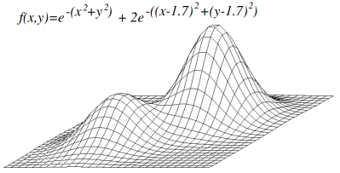
Local Maxima Problem

Slide 45
Search Limitation Mitigation
Sometimes it is useful to look deeper into game tree
We could peak past the horizon…
But how can you decide what nodes to explore?
Quiescence search

Slide 46
Quiescence Search
Human players have some intuition about move quality
“Interesting vs “boring”
“Promising” vs “dead end”
“Noisy” vs “quiet”
Expand horizon for potential high impact moves
Quiescence search adds this to Minimax

Slide 47
Quiescence Search
Additional search performed on leaf nodes
if looks_interesting(leaf_node):
extend_search_depth(leaf_node)
else:
normal_evaluation(leaf_node)

Slide 48
Quiescence Search
What constitutes an “interesting” state?
Moves that substantially alter game state
Moves that cause large fluctuations in evaluation function output
Chess example: capture moves
Must be careful to prevent indefinite extension of search depth
Chess: checks vs captures

Slide 49
Search Limitation Mitigation
Do you always need to search the entire tree?
No!
Sometimes it is useful to look less deeply into tree
But how can you decide what branches to ignore?
Tree pruning

Slide 50
Tree Pruning
Moves chosen under assumption of optimal adversary
You know the best move so far
If you find a branch with a worse move, is there any point in looking further?
Thought experiment: bag game

Slide 51
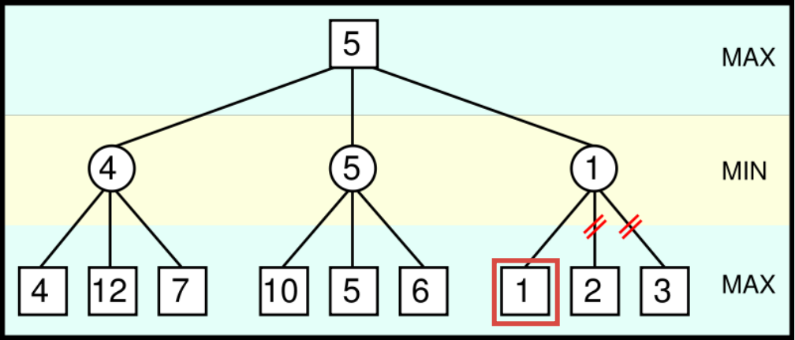
Pruning Example

Slide 52
Alpha-Beta Pruning
During Minimax, keep track of two additional values
Alpha
Your best score via any path
Beta
Opponent’s best score via any path

Slide 53
Alpha-Beta Pruning
Max player (you) will never make a move that could lead to a worse score for you
Min player (opponent) will never make a move that could lead to a better score for you
Stop evaluating a branch whenever:
A value greater than beta is found
A value less than alpha is found

Slide 54
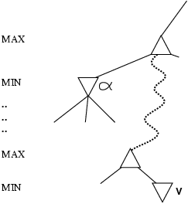
Why is it called α-β?
α is the value of the best (i.e., highest-value) choice found so far at any choice point along the path for max
If v is worse than α, max will avoid it
→ prune that branch
Define β similarly for min

Slide 55
Alpha-Beta Pruning
Based on observation that for all viable paths utility value n will be α <= n <= β

Slide 56

Alpha-Beta Pruning
Initially, α = -infinity, β=infinity

Slide 57

Alpha-Beta Pruning
As the search tree is traversed, the possible utility value window shrinks as
Alpha increases
Beta decreases

Slide 58

Alpha-Beta Pruning
Once there is no longer any overlap in the possible ranges of alpha and beta, it is safe to conclude that the current node is a dead end

Slide 59
Minimax algorithm

Slide 60
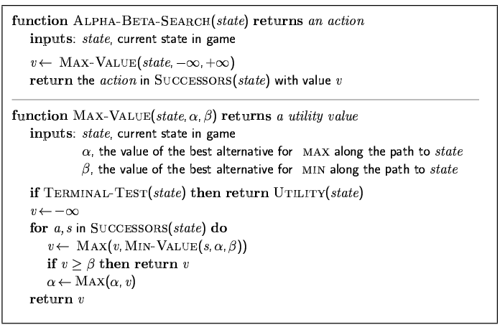
The α-β algorithm

Slide 61
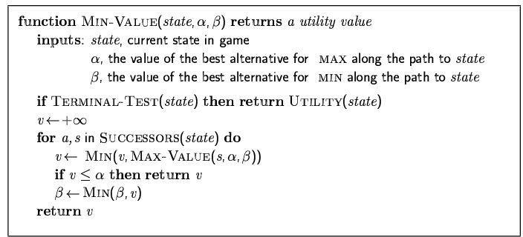
The α-β algorithm

Slide 62
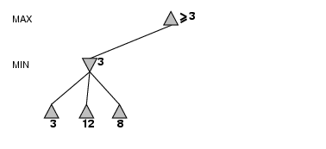
α-β pruning example

Slide 63
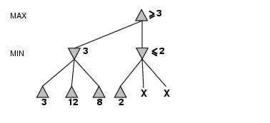
α-β pruning example

Slide 64
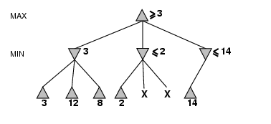
α-β pruning example

Slide 65
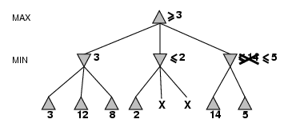
α-β pruning example

Slide 66
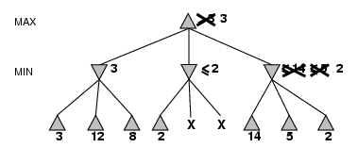
α-β pruning example

Slide 67
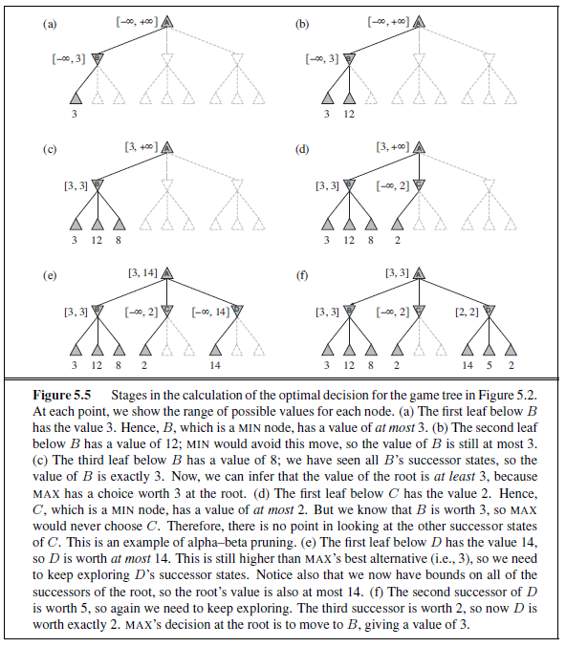

Slide 68
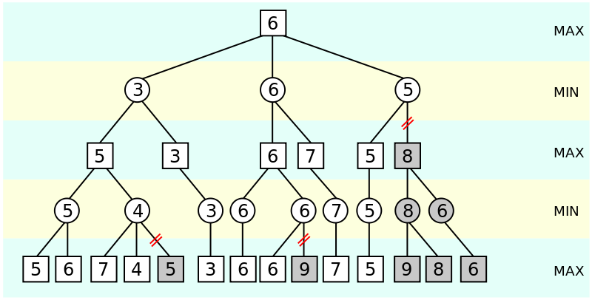
Another α-β Pruning Example

Slide 69
Minimax Pseudocode

Slide 70
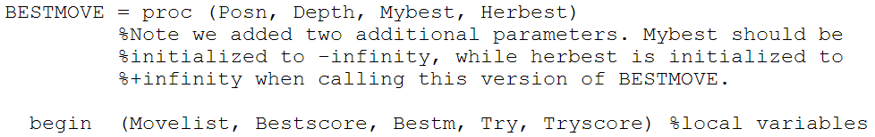
Alpha-Beta Pseudocode

Slide 71
Minimax Pseudocode

Slide 72
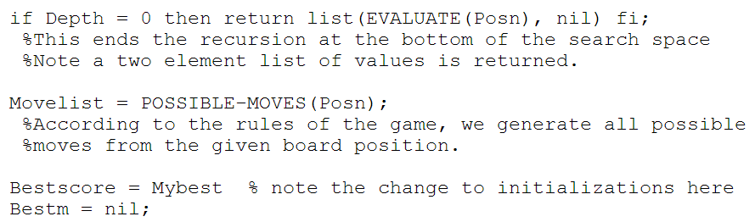
Alpha-Beta Pseudocode

Slide 73
Minimax Pseudocode

Slide 74
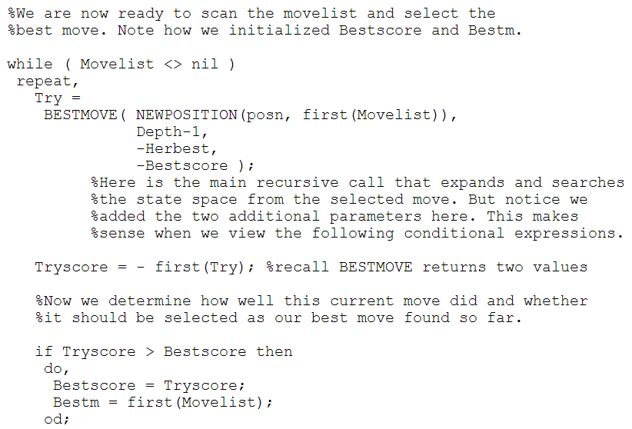
Alpha-Beta Pseudocode

Slide 75
Minimax Algorithm

Slide 76
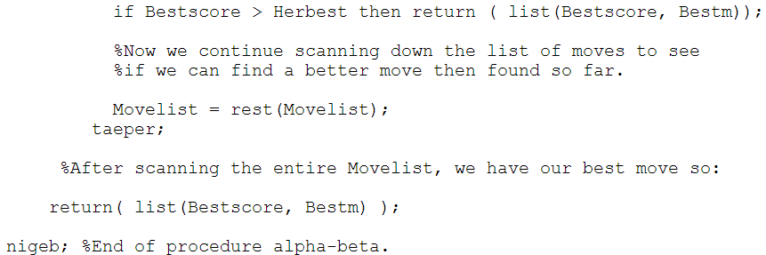
Alpha-Beta Pseudocode

Slide 77
Tree Pruning vs Heuristics
Search depth cut off may affect outcome of algorithm
How about pruning?

Slide 78
Move Ordering
Does the order in which moves are listed have any impact of alpha-beta?

Slide 79
Move Ordering
Techniques for improving move ordering
Apply evaluation function to nodes prior to expanding children
Search in descending order
But sacrifices search depth
Cache results of previous algorithm

Slide 80
Properties of α-β
Pruning does not affect final result
Good move ordering improves effectiveness of pruning
With "perfect ordering," time complexity = O(b^{m/2})
→ doubles depth of search
A simple example of the value of reasoning about which computations are relevant (a form of metareasoning)

Slide 81
Deterministic games in practice
Checkers: Chinook ended 40-year-reign of human world champion Marion Tinsley in 1994. Used a pre-computed endgame database defining perfect play for all positions involving 8 or fewer pieces on the board, a total of 444 billion positions.
Chess: Deep Blue defeated human world champion Garry Kasparov in a six-game match in 1997. Deep Blue searches 200 million positions per second, uses very sophisticated evaluation, and undisclosed methods for extending some lines of search up to 40 ply.
Othello: human champions refuse to compete against computers, who are too good.
Go: human champions refuse to compete against computers, who are too bad. In go, b > 300, so most programs use pattern knowledge bases to suggest plausible moves.

Slide 82
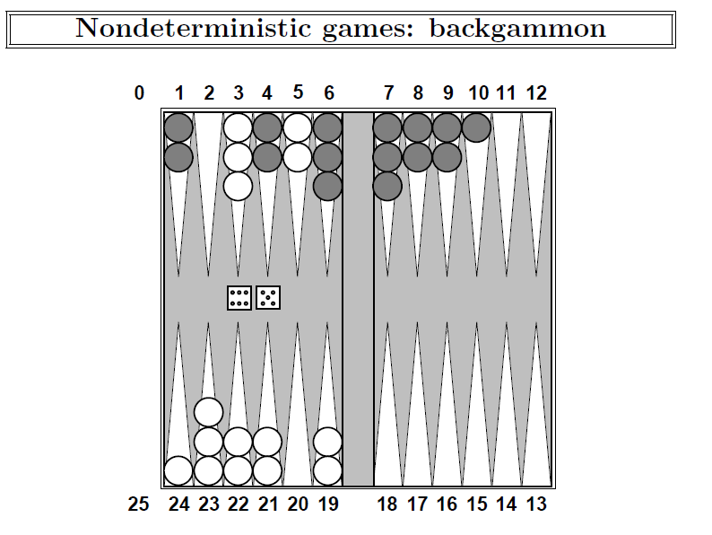

Slide 83
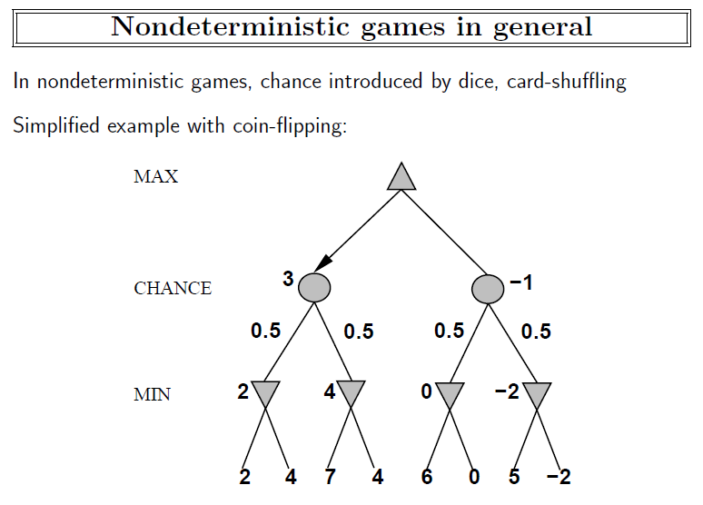

Slide 84
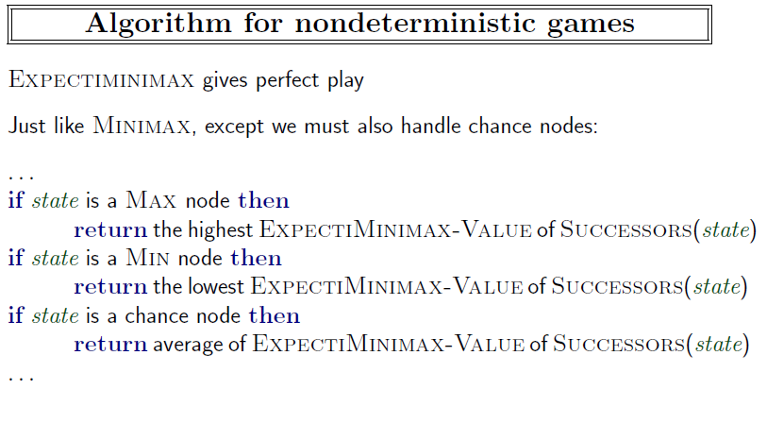

Slide 85
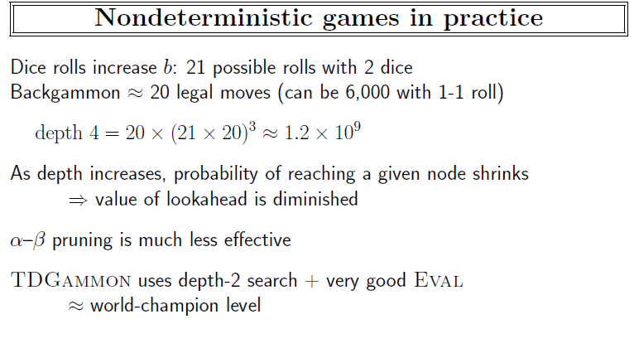

Slide 86
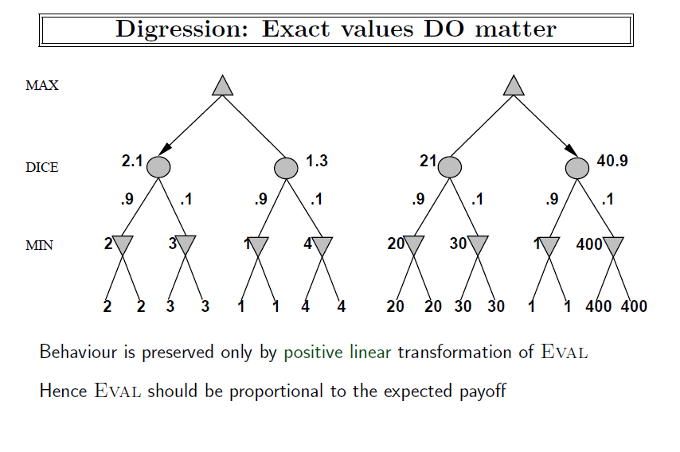

Slide 87
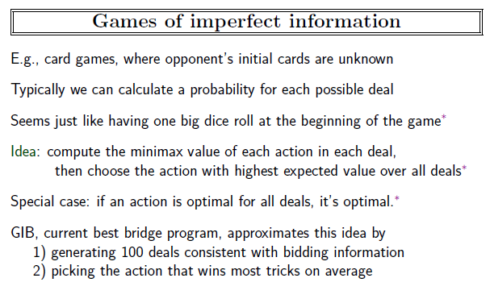

Slide 88
Summary
Games are fun to work on!
They illustrate several important points about AI
perfection is unattainable → must approximate
good idea to think about what to think about

