Slide 1
Artificial Intelligence #9
COMS W4701
Fall 2014
Constraint Satisfaction (Ch. 6)

Slide 2
Outline
Definition
Inference
Backtracking search
Local search
The structure of problems
Examples: sudoku, crosswords

Slide 3
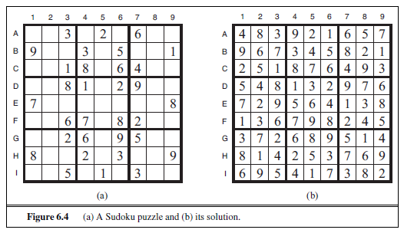
Sudoku

Slide 4
Sudoku

Slide 5
Constraint satisfaction problems (CSPs)
Standard search problem:
state is a "black box“ – any data structure that supports successor function, heuristic function, and goal test
CSP:
state is defined by variables X_{i} with values from domain D_{i}
goal test is a set of constraints specifying allowable combinations of values for subsets of variables
Simple example of a formal representation language
Allows useful general-purpose algorithms with more power than standard search algorithms

Slide 6
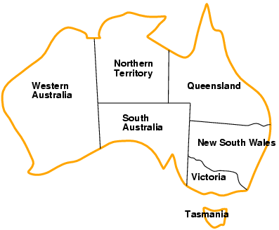
Example: Map-Coloring
Variables WA, NT, Q, NSW, V, SA, T
Domains D_{i} = {red,green,blue}
Constraints: adjacent regions must have different colors
e.g., WA ≠ NT, or (WA,NT) in {(red,green),(red,blue),(green,red), (green,blue),(blue,red),(blue,green)}

Slide 7
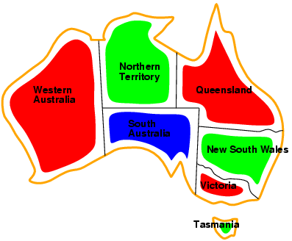
Example: Map-Coloring
Solutions are complete and consistent assignments, e.g., WA = red, NT = green,Q = red,NSW = green,V = red,SA = blue,T = green

Slide 8
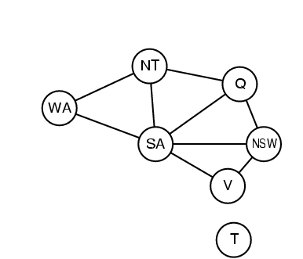
Constraint graph
Binary CSP: each constraint relates two variables
Constraint graph: nodes are variables, arcs are constraints

Slide 9
Varieties of CSPs
Discrete variables
finite domains:
n variables, domain size d → O(d^{n}) complete assignments
e.g., Boolean CSPs, incl.~Boolean satisfiability (NP-complete)
infinite domains:
integers, strings, etc.
e.g., job scheduling, variables are start/end days for each job
need a constraint language, e.g., StartJob₁ + 5 ≤ StartJob₃
Continuous variables
e.g., start/end times for Hubble Space Telescope observations
linear constraints solvable in polynomial time by linear programming

Slide 10
Varieties of constraints
Unary constraints involve a single variable,
e.g., SA ≠ green
Binary constraints involve pairs of variables,
e.g., SA ≠ WA
Higher-order constraints involve 3 or more variables,
e.g., cryptarithmetic column constraints

Slide 11
Puzzle
T W O
+ T W O
-------
F O U R

Slide 12
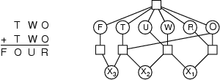
Example: Cryptarithmetic
Variables: F T U W R O X₁ X₂ X₃
Domains: {0,1,2,3,4,5,6,7,8,9}
Constraints: Alldiff (F,T,U,W,R,O)
O + O = R + 10 · X₁
X₁ + W + W = U + 10 · X₂
X₂ + T + T = O + 10 · X₃
X₃ = F, T ≠ 0, F ≠ 0

Slide 13
Solution
734+734=1468

Slide 14
Real-world CSPs
Assignment problems
e.g., who teaches what class
Timetabling problems
e.g., which class is offered when and where?
Transportation scheduling
Factory scheduling
Notice that many real-world problems involve real-valued variables

Slide 15
Standard search formulation (incremental)
Let's start with the straightforward approach, then fix it
States are defined by the values assigned so far
Initial state: the empty assignment { }
Successor function: assign a value to an unassigned variable that does not conflict with current assignment
→ fail if no legal assignments
Goal test: the current assignment is complete
This is the same for all CSPs
Every solution appears at depth n with n variables → use depth-first search
Path is irrelevant, so can also use complete-state formulation
b = (n - l )d at depth l, hence n! · d^{n} leaves

Slide 16
Backtracking search
Variable assignments are commutative, i.e.,
[ WA = red then NT = green ] same as [ NT = green then WA = red ]
Only need to consider assignments to a single variable at each node
→ b = d and there are d^{n} leaves
Depth-first search for CSPs with single-variable assignments is called backtracking search
Backtracking search is the basic uninformed algorithm for CSPs
Can solve n-queens for n ≈ 25

Slide 17
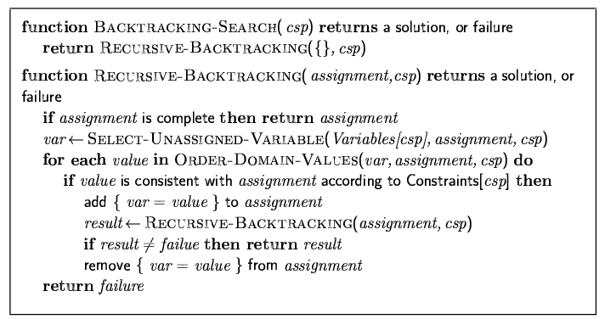
Backtracking search

Slide 18

Backtracking example

Slide 19
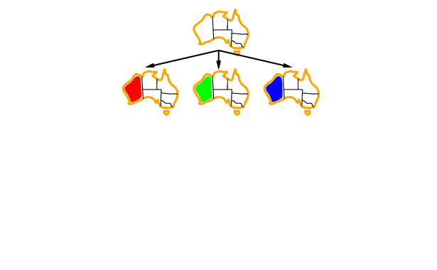
Backtracking example

Slide 20
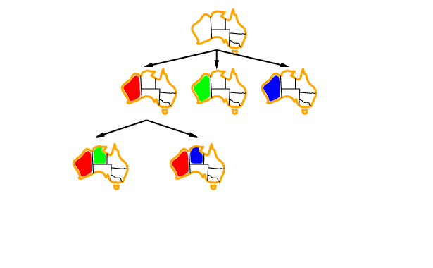
Backtracking example

Slide 21
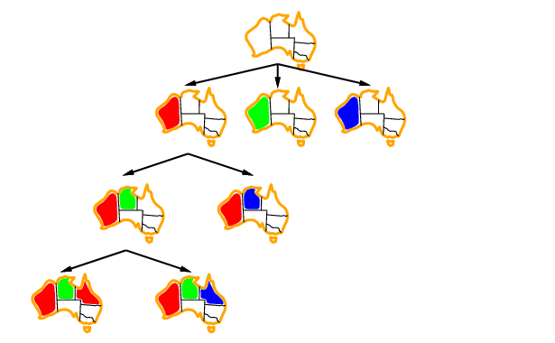
Backtracking example

Slide 22
Improving backtracking efficiency
General-purpose methods can give huge gains in speed:
Which variable should be assigned next?
In what order should its values be tried?
Can we detect inevitable failure early?

Slide 23

Most constrained variable
Most constrained variable:
choose the variable with the fewest legal values
a.k.a. minimum remaining values (MRV) heuristic

Slide 24

Most constraining variable
Tie-breaker among most constrained variables
Most constraining variable:
choose the variable with the most constraints on remaining variables

Slide 25
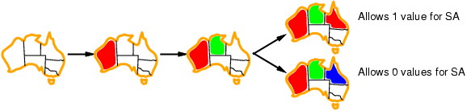
Least constraining value
Given a variable, choose the least constraining value:
the one that rules out the fewest values in the remaining variables
Combining these heuristics makes 1000 queens feasible

Slide 26
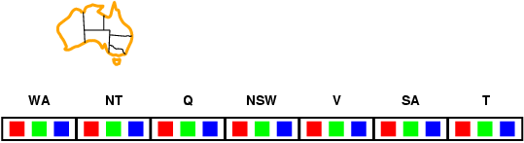
Forward checking
Idea:
Keep track of remaining legal values for unassigned variables
Terminate search when any variable has no legal values

Slide 27
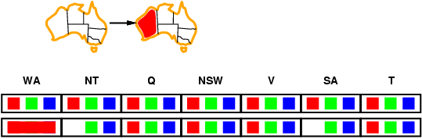
Forward checking
Idea:
Keep track of remaining legal values for unassigned variables
Terminate search when any variable has no legal values

Slide 28
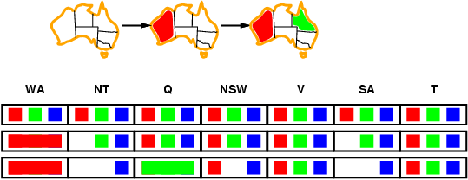
Forward checking
Idea:
Keep track of remaining legal values for unassigned variables
Terminate search when any variable has no legal values

Slide 29
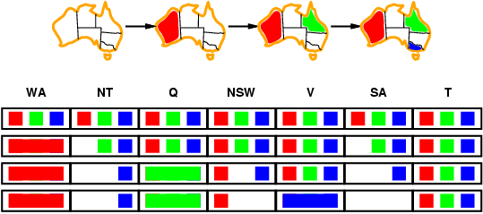
Forward checking
Idea:
Keep track of remaining legal values for unassigned variables
Terminate search when any variable has no legal values

Slide 30
Constraint propagation
Forward checking propagates information from assigned to unassigned variables, but doesn't provide early detection for all failures:
NT and SA cannot both be blue!
Constraint propagation repeatedly enforces constraints locally

Slide 31
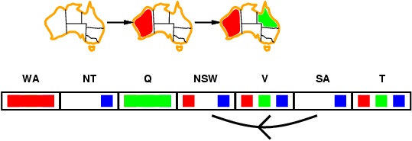
Arc consistency
Simplest form of propagation makes each arc consistent
X →Y is consistent iff
for every value x of X there is some allowed y

Slide 32
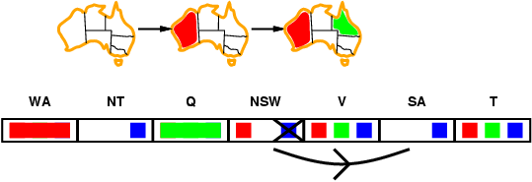
Arc consistency
Simplest form of propagation makes each arc consistent
X →Y is consistent iff
for every value x of X there is some allowed y

Slide 33
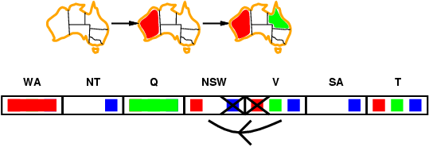
Arc consistency
Simplest form of propagation makes each arc consistent
X →Y is consistent iff
for every value x of X there is some allowed y
If X loses a value, neighbors of X need to be rechecked

Slide 34
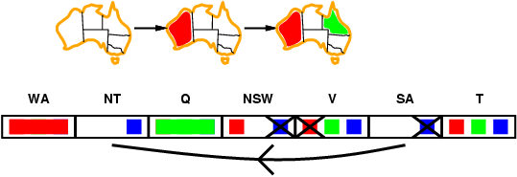
Arc consistency
Simplest form of propagation makes each arc consistent
X →Y is consistent iff
for every value x of X there is some allowed y
If X loses a value, neighbors of X need to be rechecked
Arc consistency detects failure earlier than forward checking
Can be run as a preprocessor or after each assignment

Slide 35
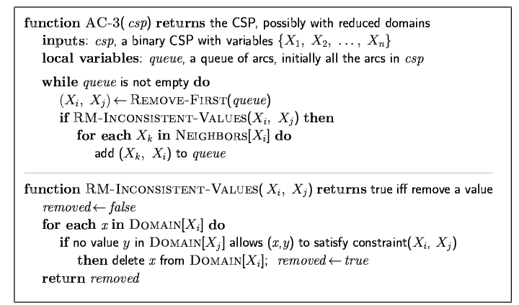
Arc consistency algorithm AC-3
Time complexity: O(n²d³)

Slide 36
Local search for CSPs
Hill-climbing, simulated annealing typically work with "complete" states, i.e., all variables assigned
To apply to CSPs:
allow states with unsatisfied constraints
operators reassign variable values
Variable selection: randomly select any conflicted variable
Value selection by min-conflicts heuristic:
choose value that violates the fewest constraints
i.e., hill-climb with h(n) = total number of violated constraints

Slide 37
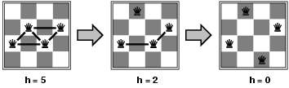
Example: 4-Queens
States: 4 queens in 4 columns (4⁴ = 256 states)
Actions: move queen in column
Goal test: no attacks
Evaluation: h(n) = number of attacks
Given random initial state, can solve n-queens in almost constant time for arbitrary n with high probability (e.g., n = 10,000,000)

Slide 38
Simple csp example
vars=['Alex','Bob'] # We will define our vars to be undergrads, Alex and Bob
domains={'Alex':[1,2,3,4],'Bob':[1,2,3,4]} # Alex and Bob are both in year 1...4
neighbors={'Alex':['Bob'],'Bob':['Alex']} # Specify that Alex is affected by Bob & vice versa
def constraints(A, a, B, b): # Constraint: Alex is 3 years ahead of Bob
# Fail if Alex isn't 3 years ahead of Bob
if (A=='Alex' and B=='Bob' and a - b <> 3):
return False
# Fail if Bob isn't 3 years behind Alex
# (nb: we cover all possible input with logical consistency)
if (B=='Alex' and A =='Bob' and b - a <> 3):
return False
return True
csp=CSP(vars, domains, neighbors, constraints) # Get a CSP object that defines this problem
assignments=min_conflicts(csp) # Solve the CSP with the min conflicts algorithm
print assignments # Should observe that Bob: 1 Alex: 4
Example by Andrew Mercer-Taylor

Slide 39
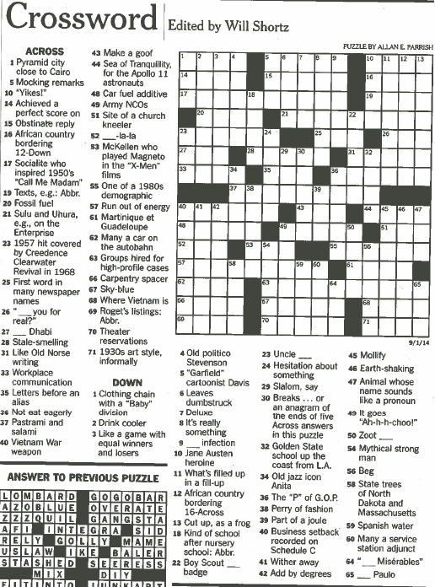

Slide 40
Crossword clues
Pyramid city close to Cairo (4)
__ Dhabi (3)
McKellen who plays Magneto in the “X-Men” franchise (3)
Martinique et Guadeloupe (4)
Many a car on the Autobahn (4)
Mythical strong man (5)

Slide 41
Crossword clues
19th out of 24 (3) TAU
The continents, e.g., (6) SEPTET
Made bats (9) DRIVENMAD
Runners in the cold (5) NOSES
Quit stalling (7) DOITNOW
Oktoberfest quaff (4) BIER
Out-of-the way way (6) DETOUR
Rubber from Arabia (7) ALADDIN
One inspiring love of poetry (5) ERATO
Lab report (3) ARF
Year John Dryden died (4) MDCC
One spinning one's wheels (6) POTTER
It's bigger than a family (5) ORDER
Some loaves (4) RYES
The Beatles' "P.S. I Love You", e.g. (5) BSIDE
Maximally hip (7) COOLEST

Slide 42
Crossword clues
Early third-century year (4) CCIV
When the day's done, to Denis (4) NUIT
Cover with new shingles (6) REROOF
Puncture preceder (3) ACU
Suffix with miss and dismiss (3) IVE
Nurse (3) SIP
Politician with a like button? (3) IKE
Beyond piqued (5) ANGRY
Ones trapped in boxes of their own making? (5) MIMES
Quince, e.g., (6) NUMERO
"Celeste Aida," for one (4) ARIA
Take a shot? (6) IMBIBE
Long sentence (4) LIFE
Hyundai and Kia (5) AUTOS
Suffix with shepherd (3) ESS
"Thank you," in Hawaii (6) MAHALO

Slide 43
Crossword clues
2,502, to ancient Romans (5) MMDII
___ Beach, S.C. (6) MYRTLE
Sierra ___ (5) LEONE
Canoodling in a restaurant, e.g. (abbr.) (3) PDA
New Orleans-to-Detroit dir. (3) NNE
Harry Potter's Hedwig, e.g., (3) OWL
Mothers with pride? (9) LIONESSES
Platinum, for example (5) METAL
Work undercover, in a way (3) SPY
Helper, in brief (4) ASST
Intro to physics? (4) META
Cronus and Hyperion (6) TITANS
Shrek or Fiona (5) OGRES
Electrican, often (5) WIRER
Lion, sometimes (6) ROARER

Slide 44
Crossword clues
Plasm preceder (4) ECTO
Prefix with scope (6) STETHO
Overshoot, say (4) MISS
Gait (4) PACE
Medical suffix (3) OMA
Fox tail? (4) TROT
Honda model (6) ACCORD
What losses do to fans (6) SADDEN
Largest city in Nebraska (5) OMAHA
"Owner of a Lonely Heart" band (3) YES
Fire antonym (4) HIRE
Chemists' org (3) AIC
"Titanic actor Billy (4) ZANE
Former South African president (5) BOTHA

Slide 45
Constraint Satisfaction Problem
(X, D, C)
X is set of variables = (X₁, … , X_{k})
D is set of domains = (D₁, … , D_{k})
Each D_{i} is set of allowed values for X_{i}
C is set of constraints
C_{i} = <participants, relation>
Example by Steven Wilson

Slide 46
For the Crosswords Problem
(X, D, C)
X is the set of entries that must be filled
D is set of candidate answers
C enforces intersections
D₁=
FRODO,
MERRY,
GOLUM
X₁
D₂=
DRAW,
FIRE,
SHOT
X₂
C = ( <X₁,X₂>,
X₁[1]=X₂[1] OR X₁[1]=“” OR X₂[1]=“”)

Slide 47
Minimum Conflicts Heuristic
Choose v ϵ D_{i} with lowest number of conflicts
Otherwise randomly
Continue to reassign conflicted variables
D₁=
FRODO,
MERRY,
GOLUM
X₁
D₂=
DRAW,
FIRE,
SHOT
F
X₂
R
O
C = ( <X₁,X₂>,
X₁[1]=X₂[1] OR X₁[1]=“” OR X₂[1]=“”)
D
O

Slide 48
What to do with conflicts?
Back off one answer at a time
Choose x = answer with lowest ranking
Set x to blank
Repeat until no conflicts left

Slide 49

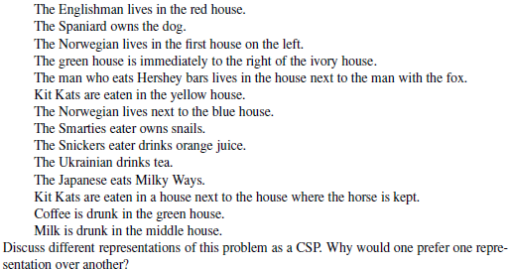

Slide 50
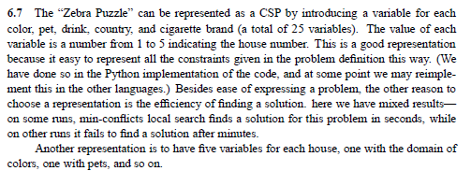

Slide 51


Linear programs: example
We make reproductions of two paintings
maximize 3x + 2y
subject to
4x + 2y ≤ 16
x + 2y ≤ 8
x + y ≤ 5
x ≥ 0
y ≥ 0
Painting 1 sells for $30, painting 2 sells for $20
Painting 1 requires 4 units of blue, 1 green, 1 red
Painting 2 requires 2 blue, 2 green, 1 red
We have 16 units blue, 8 green, 5 red

Slide 52
Solving the linear program graphically
maximize 3x + 2y
subject to
4x + 2y ≤ 16
x + 2y ≤ 8
x + y ≤ 5
x ≥ 0
y ≥ 0
8
6
4
optimal solution: x=3, y=2
2
0
2
4
6
8

Slide 53
Modified LP
maximize 3x + 2y
subject to
4x + 2y ≤ 15
x + 2y ≤ 8
x + y ≤ 5
x ≥ 0
y ≥ 0
Optimal solution: x = 2.5, y = 2.5
Solution value = 7.5 + 5 = 12.5
Half paintings?

Slide 54
Integer (linear) program
maximize 3x + 2y
subject to
4x + 2y ≤ 15
x + 2y ≤ 8
x + y ≤ 5
x ≥ 0, integer
y ≥ 0, integer
8
optimal IP solution: x=2, y=3
(objective 12)
6
4
optimal LP solution: x=2.5, y=2.5
(objective 12.5)
2
0
2
4
6
8

Slide 55
Mixed integer (linear) program
maximize 3x + 2y
subject to
4x + 2y ≤ 15
x + 2y ≤ 8
x + y ≤ 5
x ≥ 0
y ≥ 0, integer
8
optimal IP solution: x=2, y=3
(objective 12)
6
optimal LP solution: x=2.5, y=2.5
(objective 12.5)
4
2
optimal MIP solution: x=2.75, y=2
(objective 12.25)
0
2
4
6
8

Slide 56
Solving linear/integer programs
Linear programs can be solved efficiently
Simplex, ellipsoid, interior point methods…
(Mixed) integer programs are NP-hard to solve
Quite easy to model many standard NP-complete problems as integer programs (try it!)
Search type algorithms such as branch and bound
Standard packages for solving these
GNU Linear Programming Kit, CPLEX, …
LP relaxation of (M)IP: remove integrality constraints
Gives upper bound on MIP (~admissible heuristic)

Slide 57
Satisfiability as an integer program
(x₁ OR x₂ OR NOT(x₄)) AND (NOT(x₂) OR NOT(x₃)) AND …
becomes
for all x_{j}, 0 ≤ x_{j} ≤ 1, x_{j} integer (shorthand: x_{j} in {0,1})
x₁ + x₂ + (1-x₄) ≥ 1
(1-x₂) + (1-x₃) ≥ 1
…
Solving integer programs is at least as hard as satisfiability, hence NP-hard (we have reduced SAT to IP)
Try modeling other NP-hard problems as (M)IP!

Slide 58
Solving the integer program with DFS branch and bound
trick: for integer x and k, either x ≤ k
or x ≥ k+1
maximize 3x + 2y
subject to
4x + 2y ≤ 15
x + 2y ≤ 8
x + y ≤ 5
x ≥ 3
y ≥ 2
maximize 3x + 2y
subject to
4x + 2y ≤ 15
x + 2y ≤ 8
x + y ≤ 5
x ≥ 3
y ≤ 1
x ≥ 4
maximize 3x + 2y
subject to
4x + 2y ≤ 15
x + 2y ≤ 8
x + y ≤ 5
x ≥ 3
maximize 3x + 2y
subject to
4x + 2y ≤ 15
x + 2y ≤ 8
x + y ≤ 5
LP solution: x=3, y=1.5, obj = 12
LP solution: infeasible
LP solution: infeasible
maximize 3x + 2y
subject to
4x + 2y ≤ 15
x + 2y ≤ 8
x + y ≤ 5
x ≥ 3
y ≤ 1
maximize 3x + 2y
subject to
4x + 2y ≤ 15
x + 2y ≤ 8
x + y ≤ 5
x ≥ 3
y ≤ 1
x ≤ 3
maximize 3x + 2y
subject to
4x + 2y ≤ 15
x + 2y ≤ 8
x + y ≤ 5
x ≤ 2
LP solution: x=2.5, y=2.5, obj = 12.5
LP solution: x=3.25, y=1, obj = 11.75
LP solution: x=2, y=3, obj = 12
LP solution: x=3, y=1, obj = 11
if LP solution is integral, we are done

Slide 59
Again with a more fortunate choice
maximize 3x + 2y
subject to
4x + 2y ≤ 15
x + 2y ≤ 8
x + y ≤ 5
x ≥ 3
maximize 3x + 2y
subject to
4x + 2y ≤ 15
x + 2y ≤ 8
x + y ≤ 5
LP solution: x=3, y=1.5, obj = 12
done!
maximize 3x + 2y
subject to
4x + 2y ≤ 15
x + 2y ≤ 8
x + y ≤ 5
x ≤ 2
LP solution: x=2.5, y=2.5, obj = 12.5
LP solution: x=2, y=3, obj = 12

Slide 60
Summary
CSPs are a special kind of problem:
states defined by values of a fixed set of variables
goal test defined by constraints on variable values
Backtracking = depth-first search with one variable assigned per node
Variable ordering and value selection heuristics help significantly
Forward checking prevents assignments that guarantee later failure
Constraint propagation (e.g., arc consistency) does additional work to constrain values and detect inconsistencies
Iterative min-conflicts is usually effective in practice

