Slide 1
Recreate Figure 1: Overview of workflow
Utilized formatted data provided by group
Filter out hybrids and then subset data into processing genotypes
Imputed missing data
Paper mentioned package in R, but no code or indication of parameters they used. Needed to guess
Format data to run PCA using base R package
Plot the data using codes
- Market class they provided was post analysis vs. pre and post analysis

Slide 2
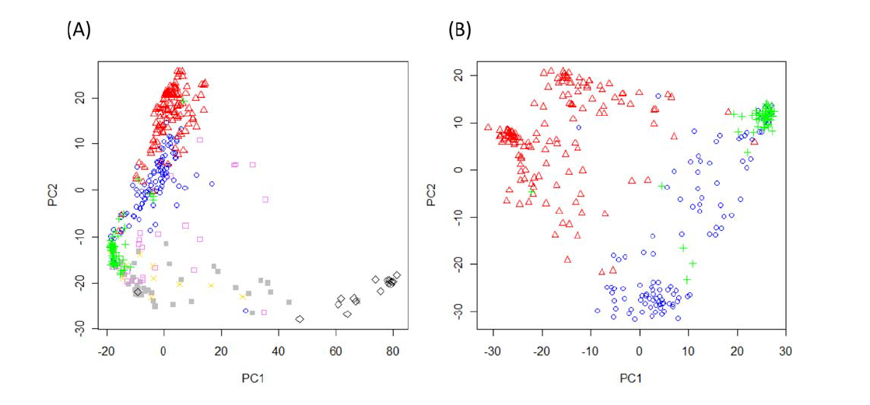
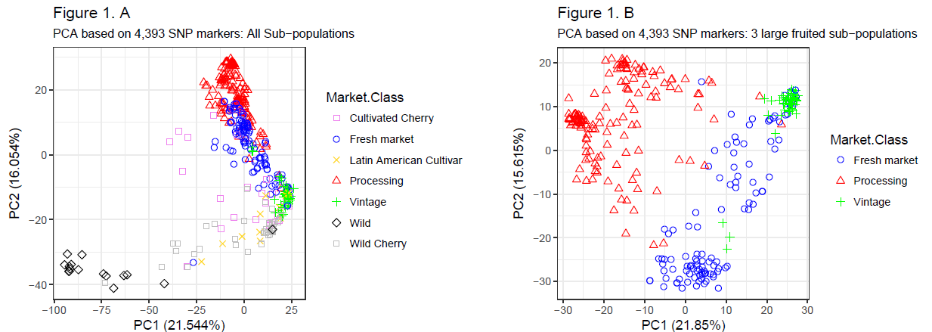
Recreate Figure 1: Results

Slide 3
Confirm results w/Structure Analysis: Overview of workflow
Utilized formatted data provided by group
Filter out hybrids and then subset data into processing genotypes
Convert genotype data file into .ped format (plink, Purcell, et. al 2007, Amer. J Human Gen)
Use plink to convert files to .bed format
Send .bed files to linux server to run Admixture (Alexander, et. al 2009, Genome Research)
Import .Q files into R for data manipulation

Slide 4
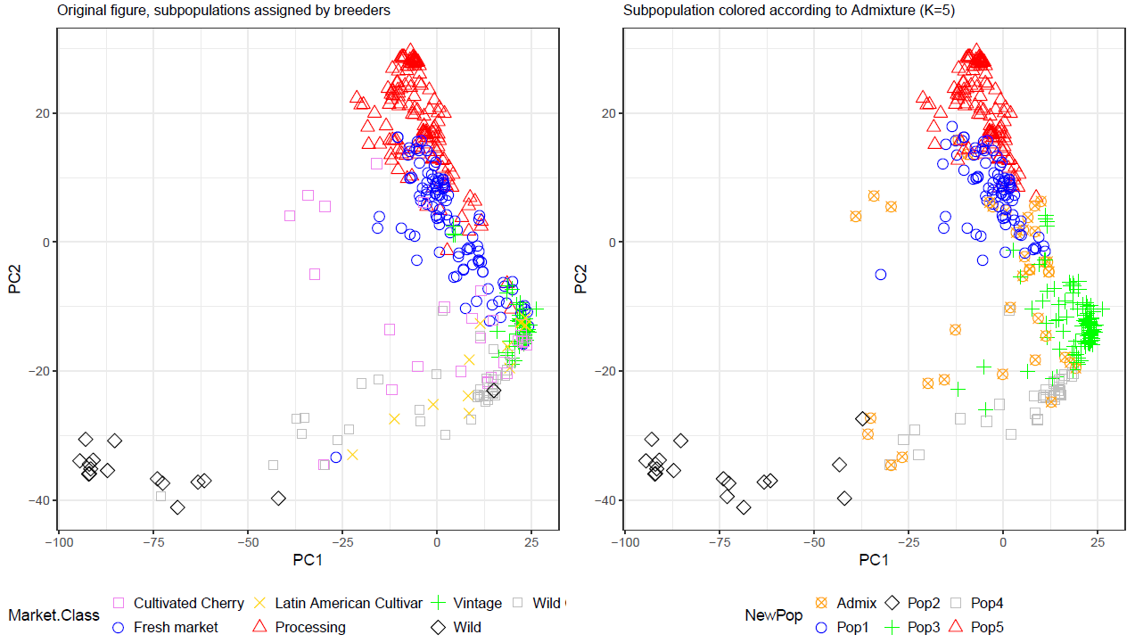
Confirm results w/Structure Analysis: Results: Full Dataset

Slide 5
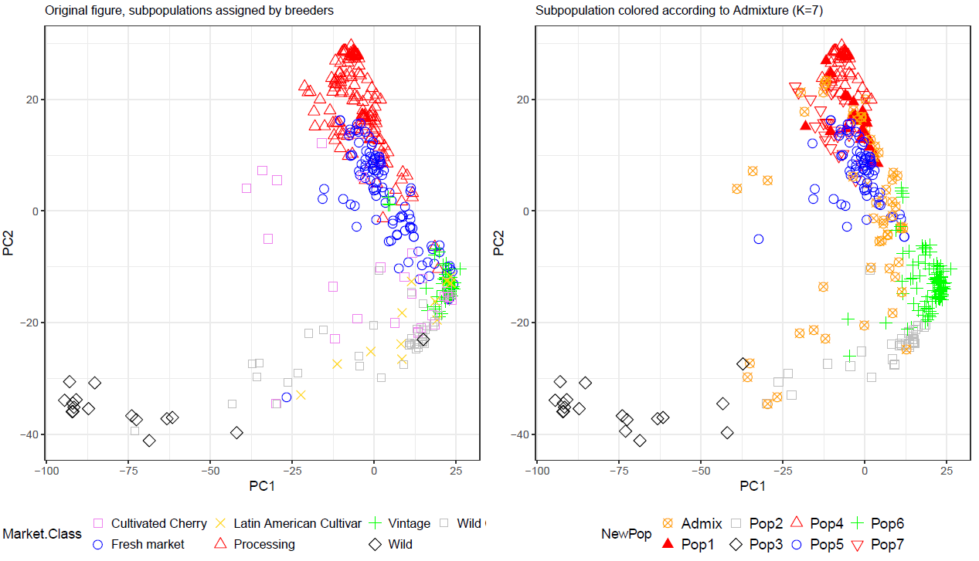
Confirm results w/Structure Analysis: Results: Full Dataset

Slide 6
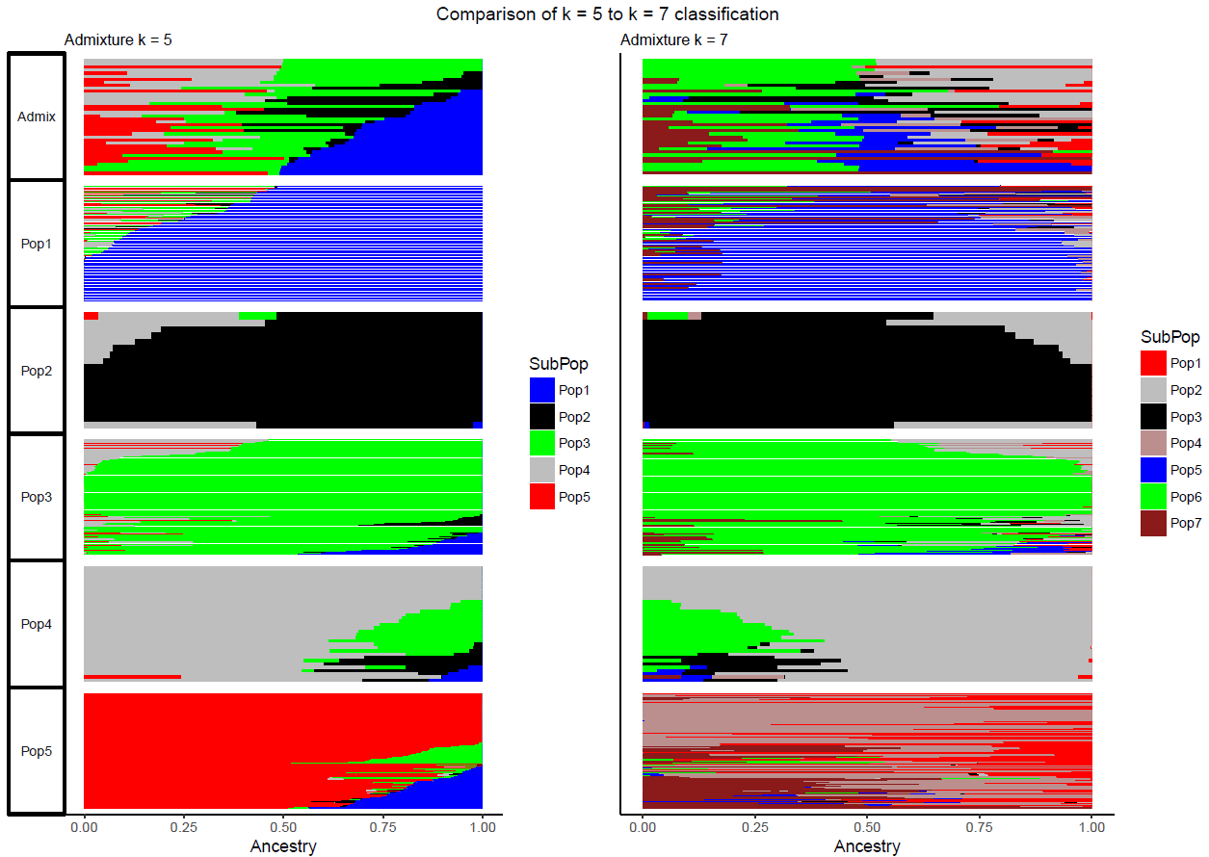
Confirm results w/Structure Analysis: Results: Full Dataset

Slide 7
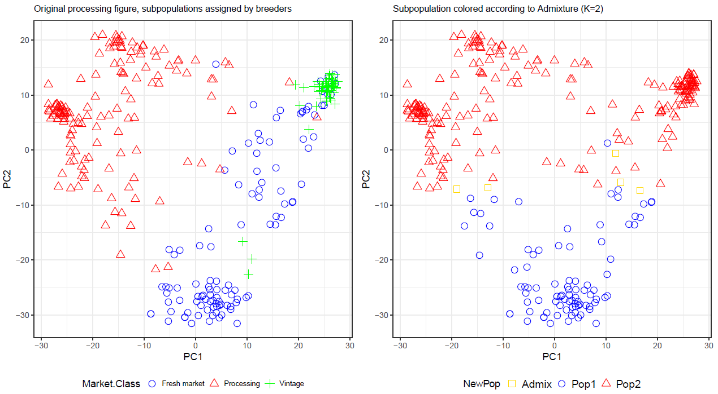
Confirm results w/Structure Analysis: Results: Processing Dataset

Slide 8
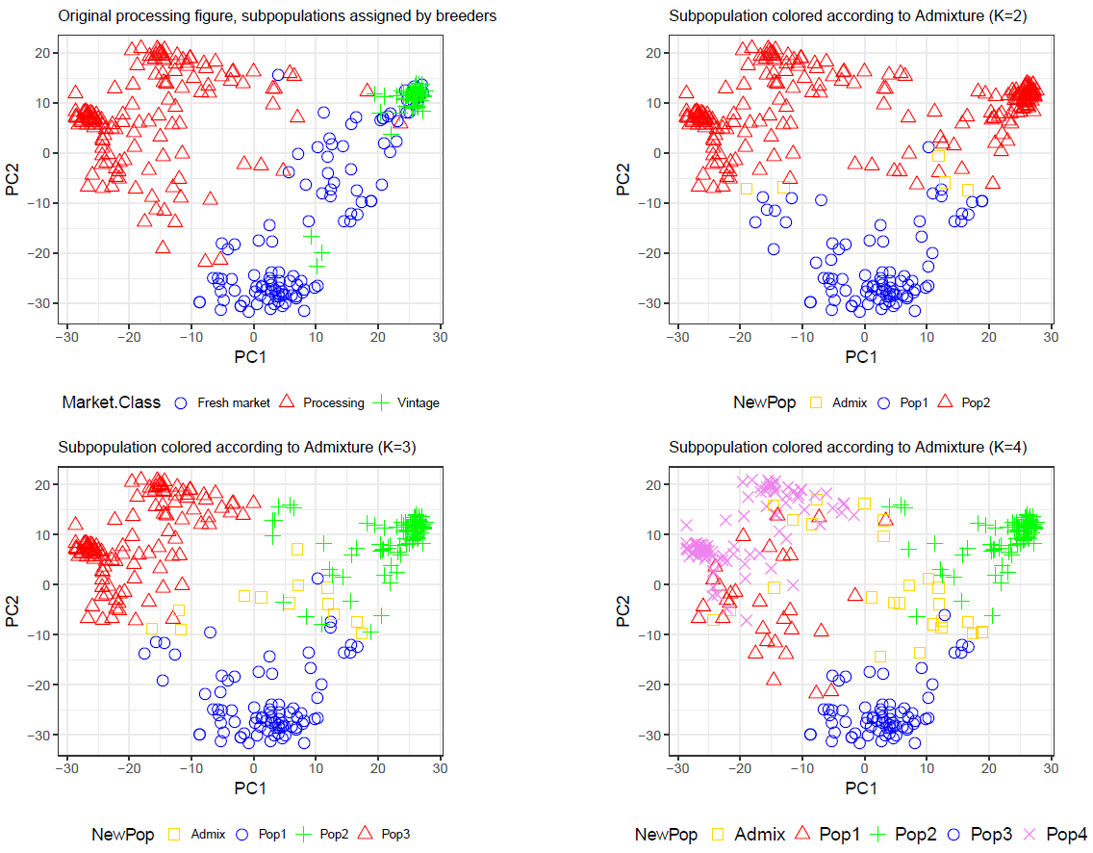
Confirm results w/Structure Analysis: Results: Processing Dataset

