Slide 1
Recreation of High-Density SNP Genotyping of Tomato Reveals Patterns of Genetic Variation Due to Breeding
Matthew

Slide 2
Introduction
Array-based genotyping platforms permit rapid scoring of several thousand markers in parallel
Maize array → 49,585 SNPs produced two genetic linkage maps with 20,913 and 14,524 markers, respectively
SolCAP array → 7,720 SNPs produced 3,503 markers in EXPEN 2000 and 4,491 markers in EXPIM 2012
Notes:
SNP data from such arrays can also be a resource for germplasm management in breeding programs and has a role in genomic selection strategies for crop improvement.

Slide 3
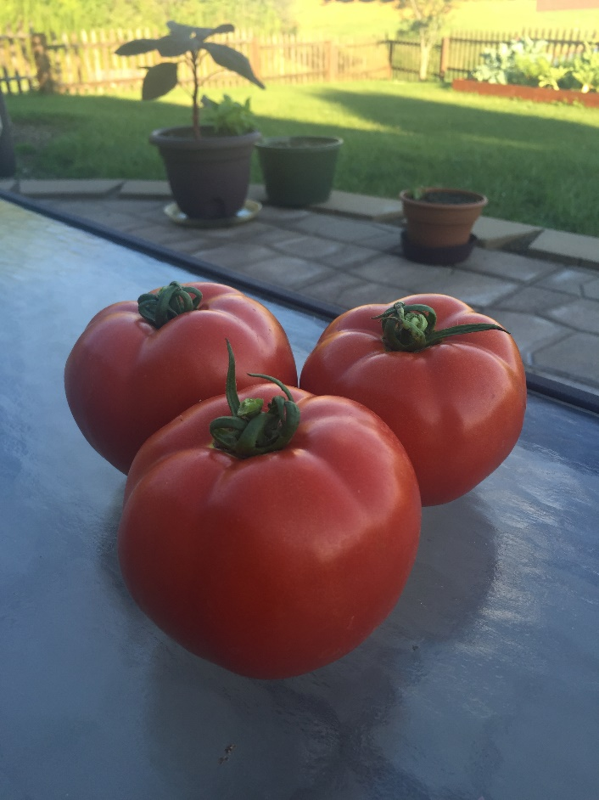
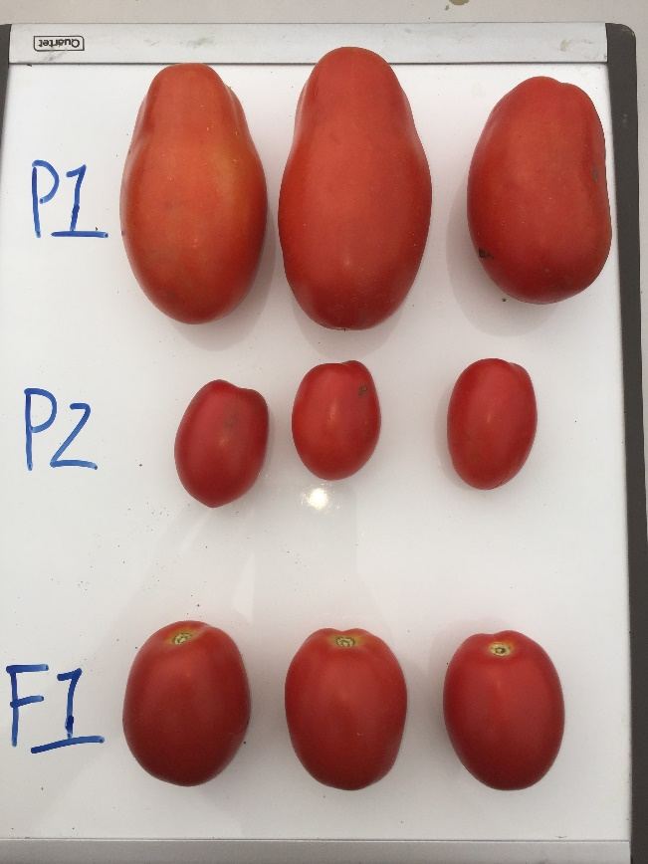
Fresh Market & Processing Grape
Breeding for distinct market classes has led to genetic differentiation in contemporary germplasm
Notes:
Processing and field-grown fresh market tomatoes are now distinct sub-populations

Slide 4
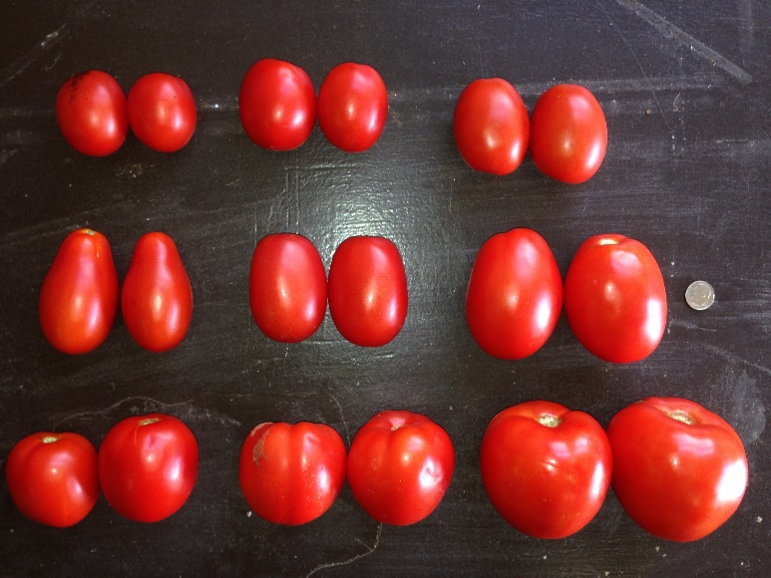
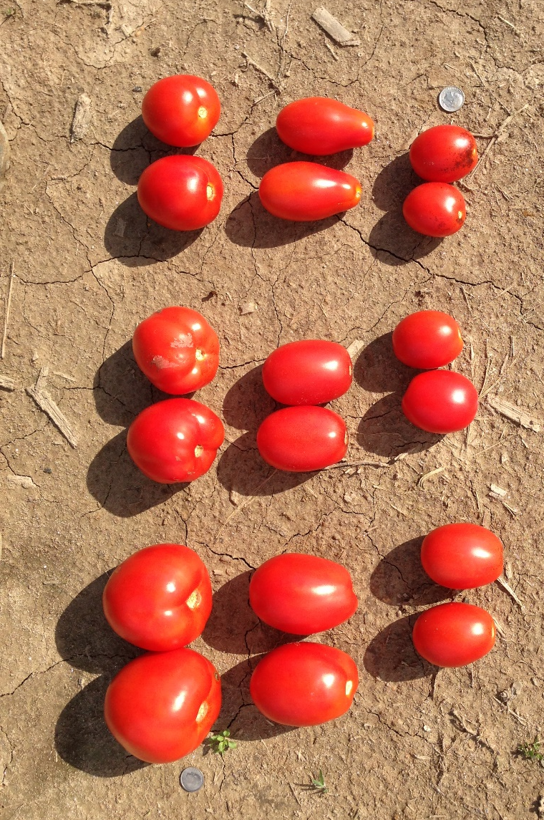
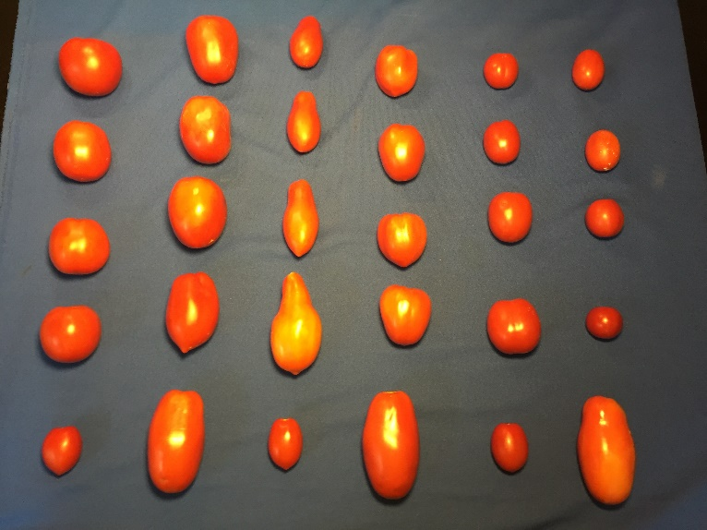
Multi

Slide 5
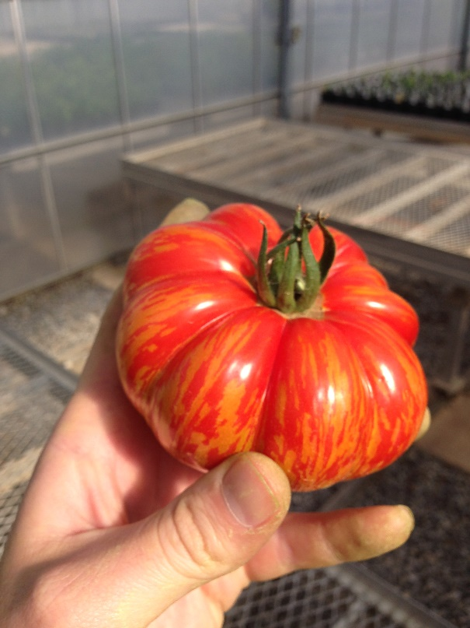
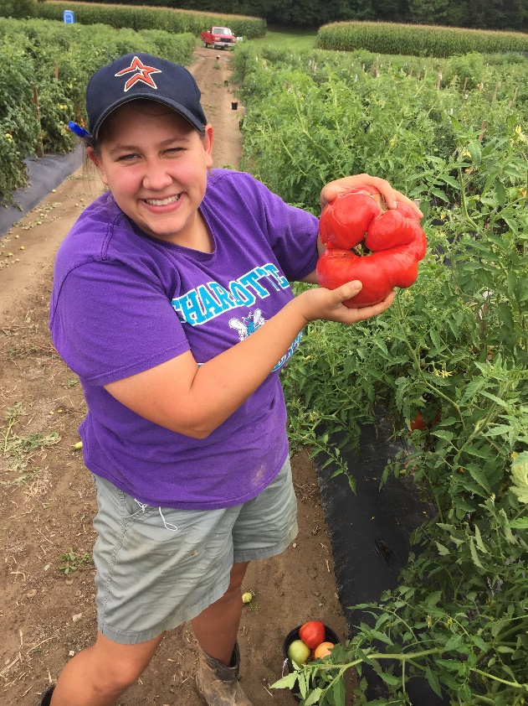
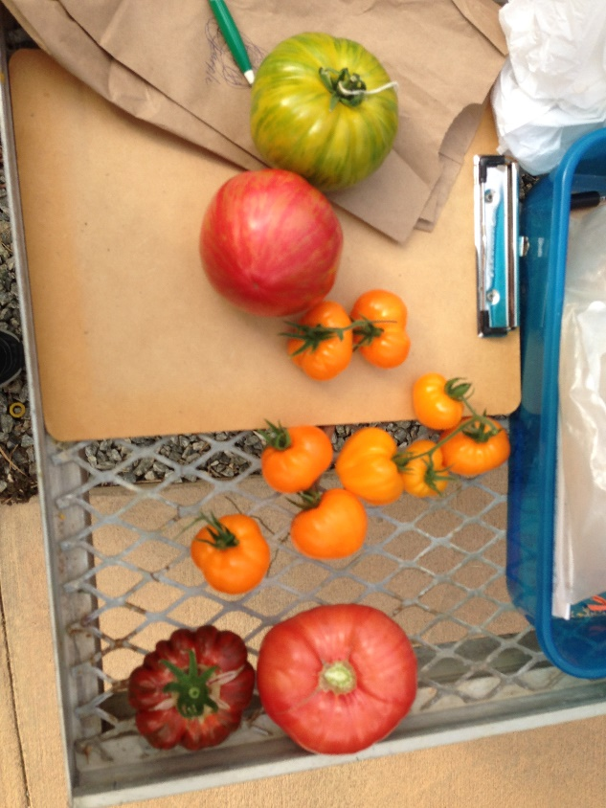
Retros

Slide 6
Objectives
Investigate genetic variation on the tomato genome due to contemporary breeding
Conduct population level analysis based on the germplasm panel
Identify sub-populations by analyzing SNP genotypes from the array
Investigate patterns of linkage disequilibrium (LD) within each chromosome in three subpopulations (processing, fresh market, and vintage)

Slide 7
Recreate Figure 1: Overview of workflow
Utilized formatted data provided by group
Filter out hybrids and then subset data into processing genotypes
Imputed missing data
Paper mentioned package in R, but no code or indication of parameters they used. Needed to guess
Format data to run PCA using base R package
Plot the data using codes
- Market class they provided was post analysis vs. pre and post analysis

Slide 8
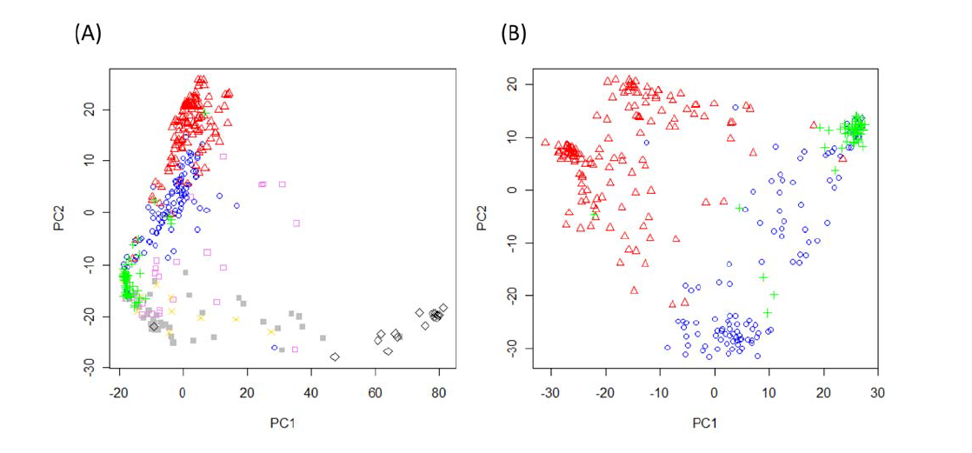
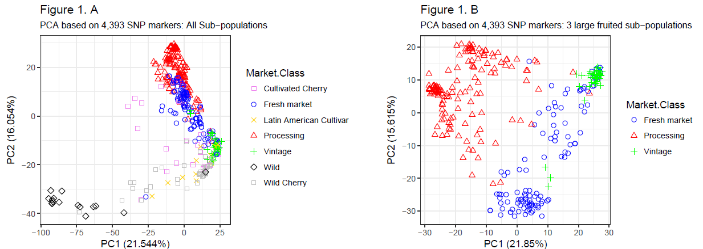
Recreate Figure 1: Results
ORIGINAL
Recreated

Slide 9
Confirm results w/Structure Analysis: Overview of workflow
Utilized formatted data provided by group
Filter out hybrids and then subset data into processing genotypes
Convert genotype data file into .ped format (plink, Purcell, et. al 2007, Amer. J Human Gen)
Use plink to convert files to .bed format
Send .bed files to linux server to run Admixture (Alexander, et. al 2009, Genome Research)
Import .Q files into R for data manipulation

Slide 10
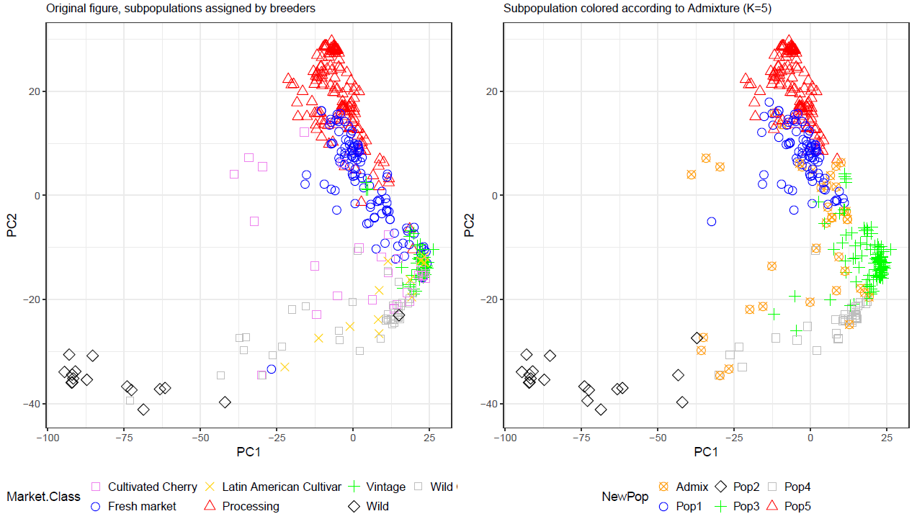
Confirm results w/Structure Analysis: Results: Full Dataset

Slide 11
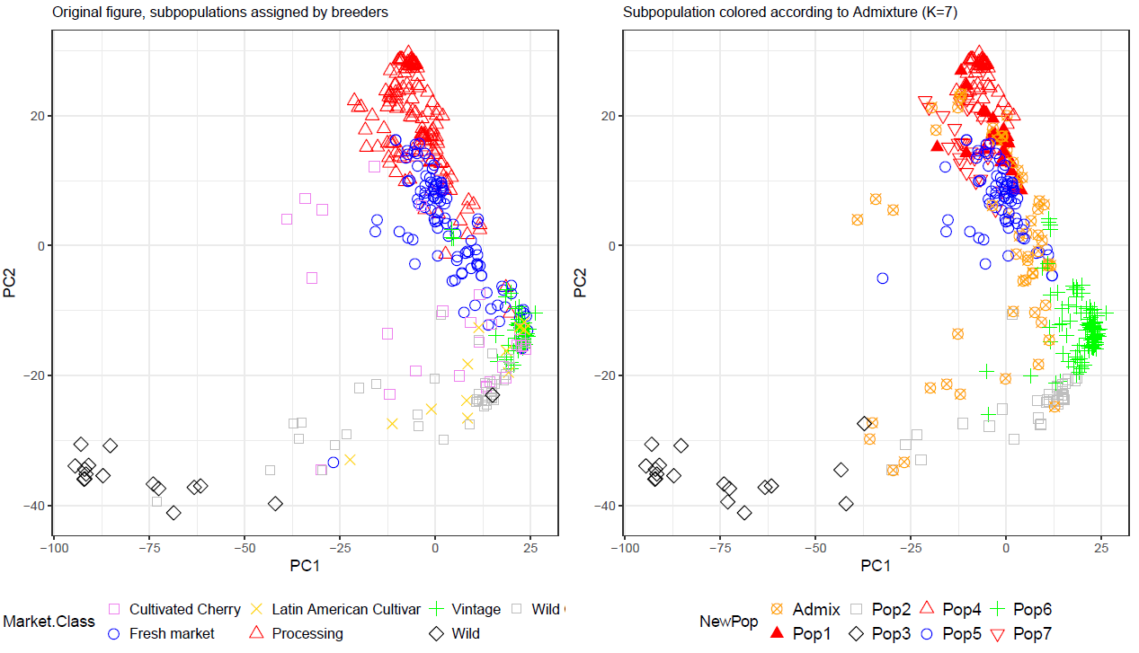
Confirm results w/Structure Analysis: Results: Full Dataset

Slide 12
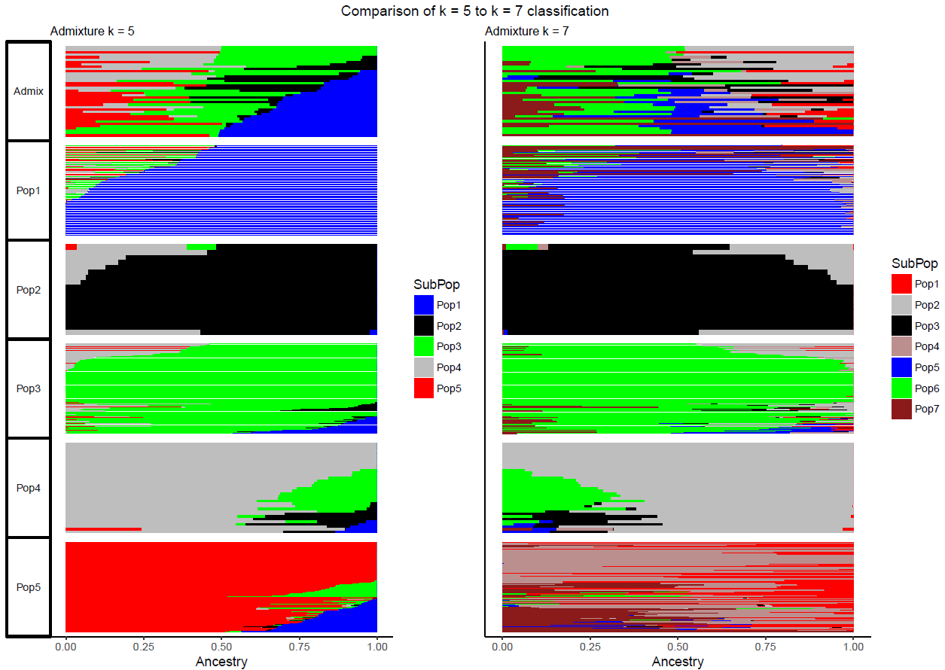
Confirm results w/Structure Analysis: Results: Full Dataset

Slide 13
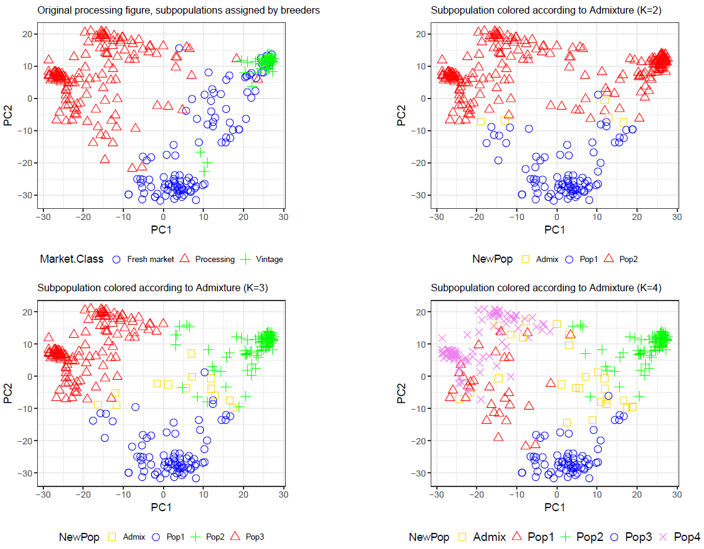
Confirm results w/Structure Analysis: Results: Processing Dataset

