Slide 1

Seasonal Agriculture Performance Analysis
Major Project • Data Analytics
Albi Jose UKF College of Engineering & Technology
AICTE STU ID : STU6a6859e7633581785223655

Slide 2

PROBLEM STATEMENT
Agricultural performance can vary across seasons due to environmental conditions, farming practices, resource availability and market conditions.
Raw agricultural data does not clearly show how performance changes between Kharif, Rabi and Zaid seasons.
The project analyzes the dataset to identify meaningful seasonal patterns, relationships and variations in agricultural performance.
The findings can support evidence-based interpretation and better seasonal agricultural planning.

Slide 3
PROJECT DESCRIPTION
The dataset contains 4,000 farm-level observations and 28 variables covering crops, seasons, geographical areas, environmental conditions, farming practices, resource usage and economic outcomes.
The project follows a simple data analytics workflow:
Data Loading → Data Cleaning → Exploratory Analysis → Statistical Analysis → Visualization → Interpretation.

Slide 4

WHO ARE THE END USERS?
Farmers — compare seasonal crop performance and resource usage.
Agricultural planners — understand seasonal and regional variations.
Agricultural businesses — evaluate crop profitability and production patterns.
Data analysts and researchers — explore relationships within agricultural data.
Students and researchers — use the project as a practical Data Analytics case study.

Slide 5

TECHNOLOGY USED
Python — programming and data analysis
Pandas — data loading, cleaning, grouping and analysis
NumPy — numerical processing
Matplotlib — data visualization
Seaborn — statistical visualization
Google Colab — notebook development and execution
CSV — Seasonal Agriculture Performance Dataset

Slide 6
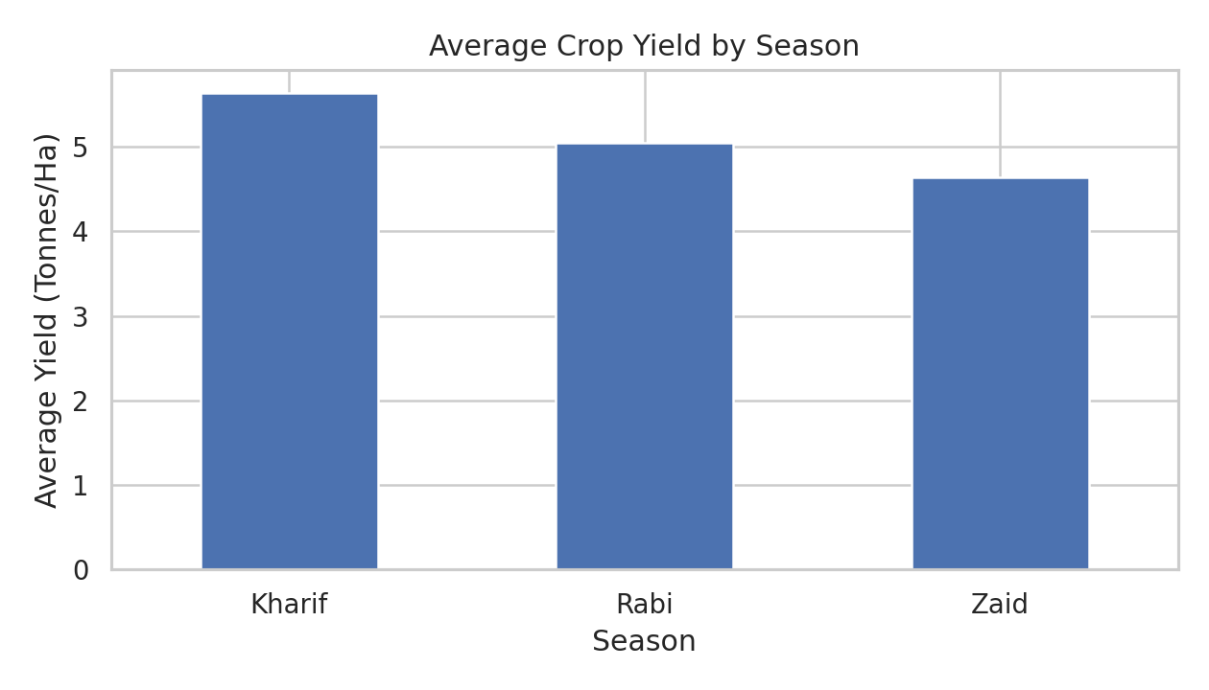
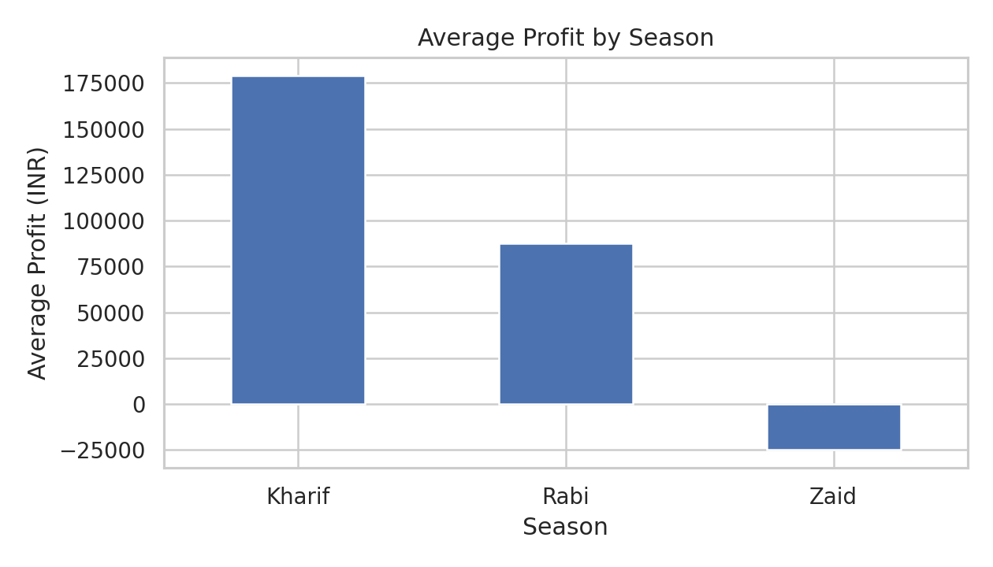
RESULTS • Seasonal Performance
df.groupby('Season')['Yield_Tonnes_Ha'].mean() df.groupby('Season')['Profit_INR'].mean()
Key Finding: Kharif recorded the highest average yield and profit; Zaid recorded negative average profit.

Slide 7
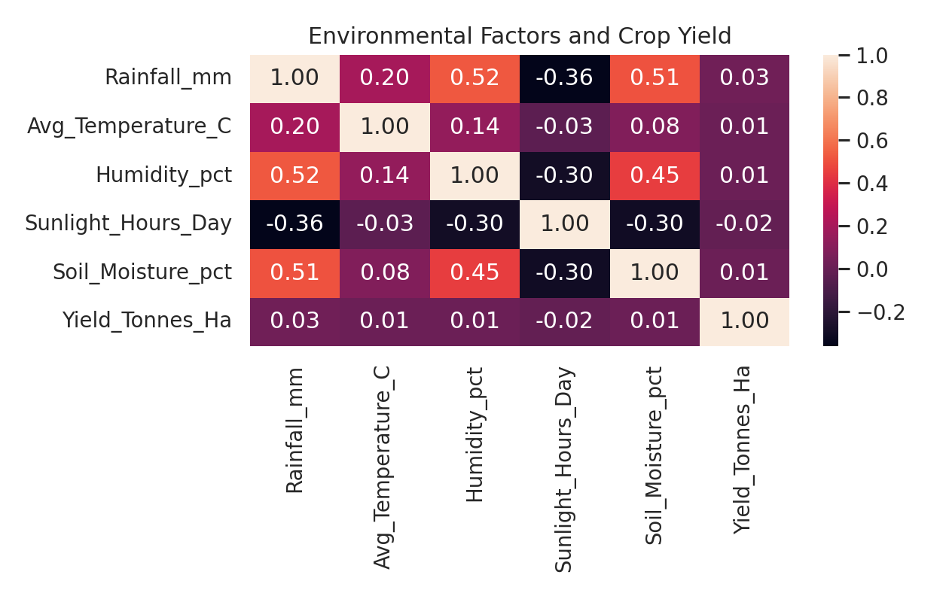
RESULTS • Environmental Analysis
Key Observation Environmental variables showed very weak linear correlations with crop yield.
df[['Rainfall_mm', 'Avg_Temperature_C', 'Humidity_pct', 'Sunlight_Hours_Day', 'Soil_Moisture_pct', 'Yield_Tonnes_Ha']].corr()
Key Finding: Environmental variables showed very weak linear correlations with crop yield.

Slide 8
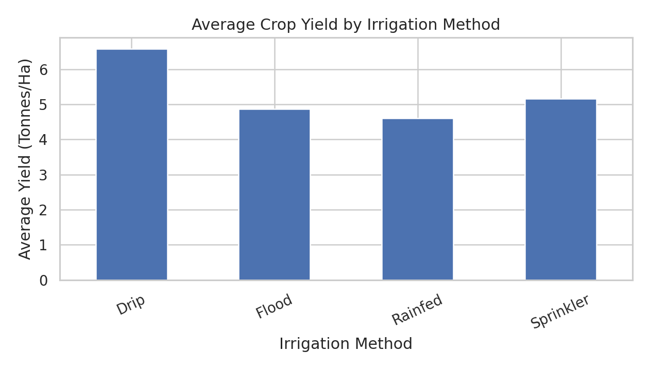
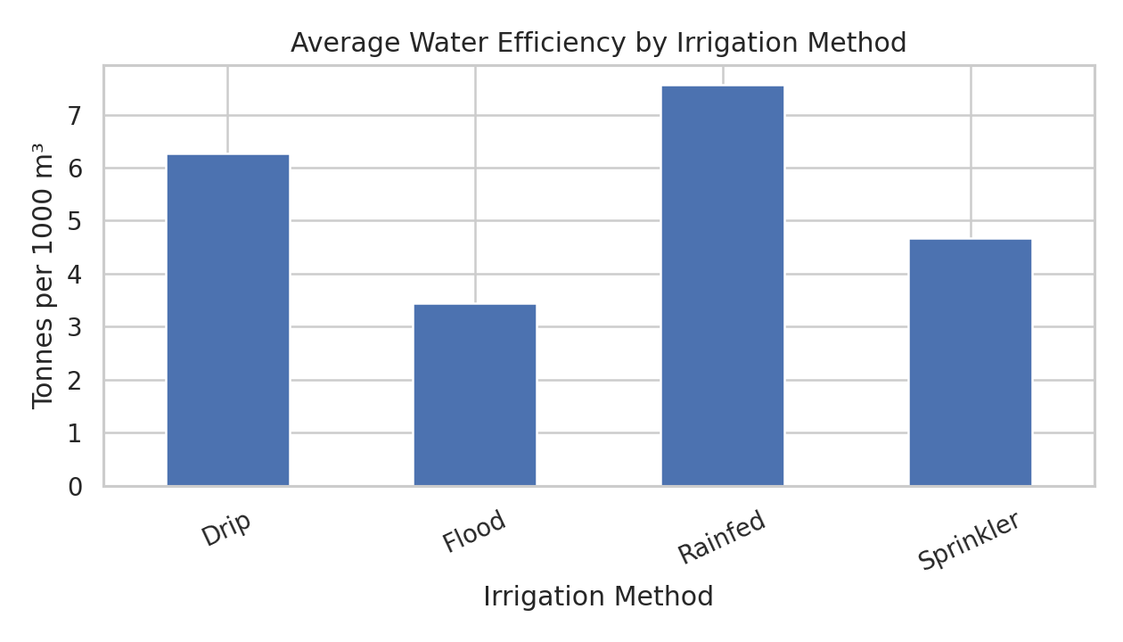
RESULTS • Irrigation & Water
df.groupby('Irrigation_Method')['Yield_Tonnes_Ha'].mean() df.groupby('Irrigation_Method')['Water_Efficiency_t_per_1000m3'].mean()
Key Finding: Drip showed the highest average yield, while Rainfed showed the highest average water efficiency.

Slide 9
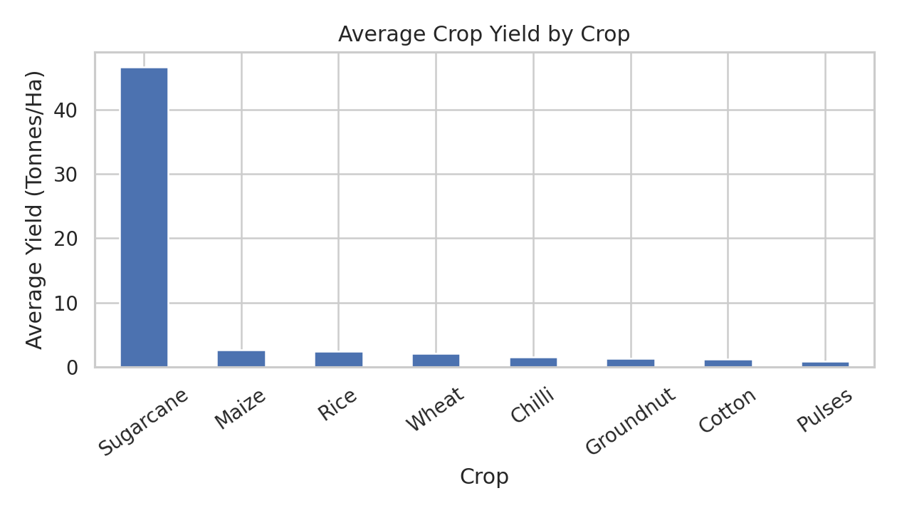
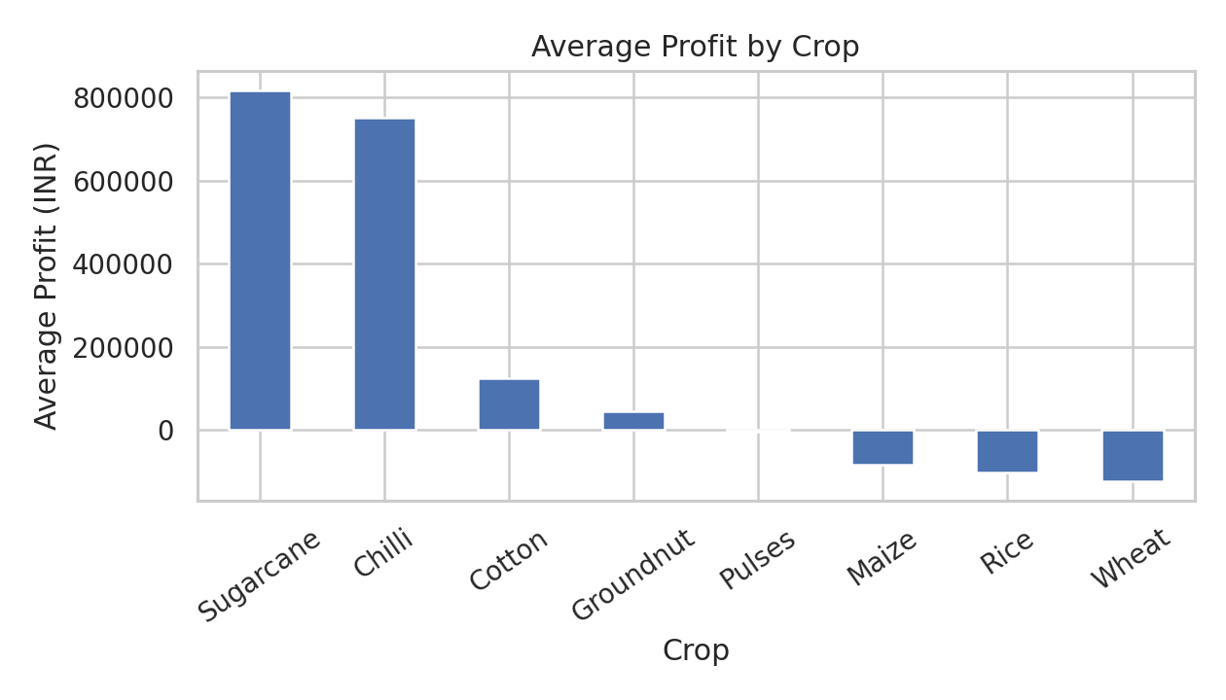
RESULTS • Crop Performance
df.groupby('Crop')['Yield_Tonnes_Ha'].mean() df.groupby('Crop')['Profit_INR'].mean()
Key Finding: Sugarcane recorded the highest average yield and profit in the dataset.

Slide 10
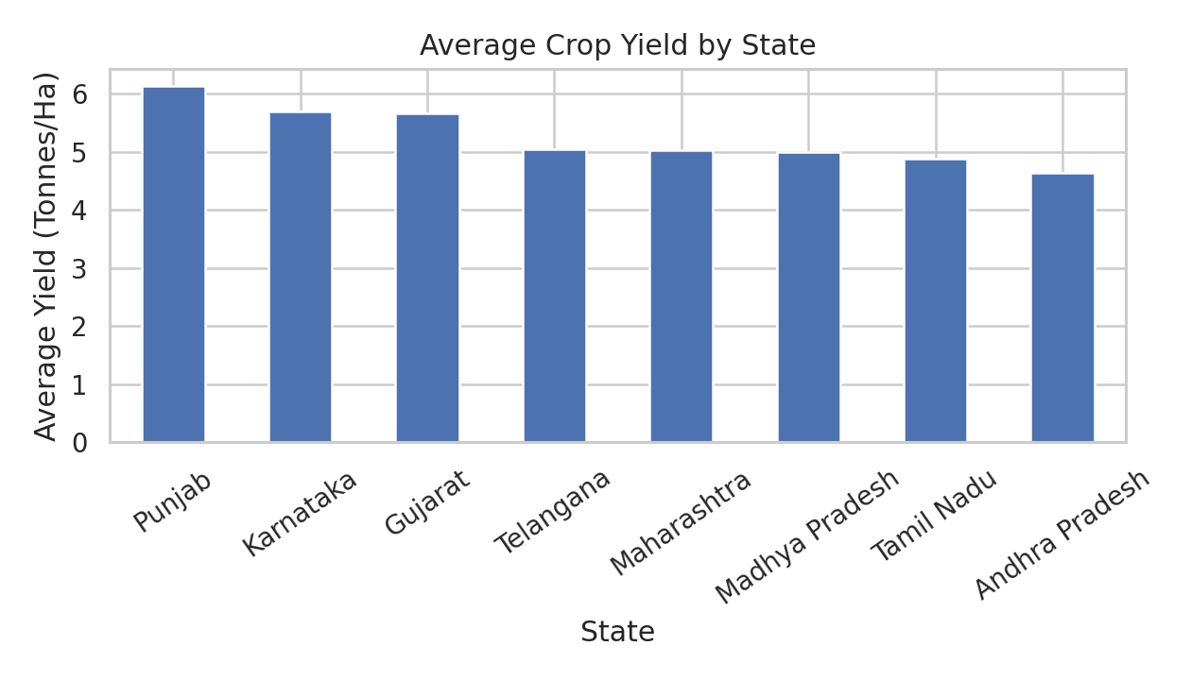
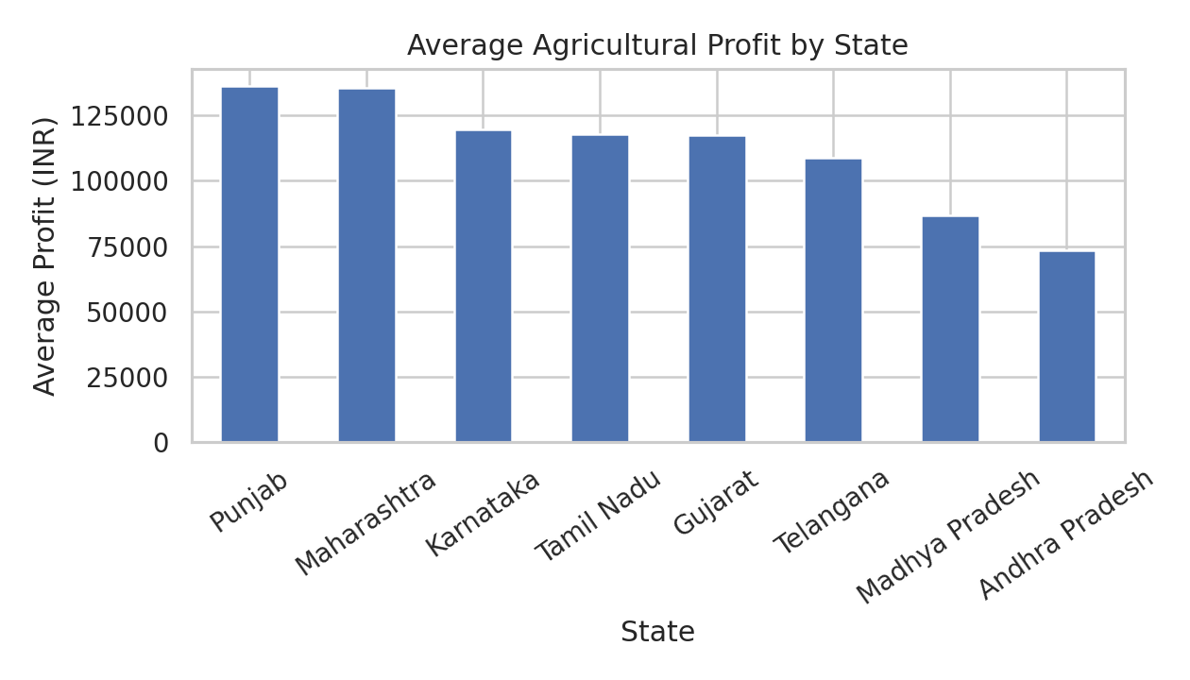
Key Finding: Punjab recorded the highest average yield and was among the highest-profit states.
RESULTS • Regional Performance
df.groupby('State')['Yield_Tonnes_Ha'].mean() df.groupby('State')['Profit_INR'].mean()

Slide 11
Future Scope
Develop interactive dashboards for seasonal agricultural monitoring.
Use larger and more diverse datasets to validate the observed patterns.
Apply predictive models to estimate yield and profitability.
Integrate real-time weather and soil data for improved seasonal planning.
Develop crop-specific recommendations using additional agricultural information.

Slide 12
GitHub Link
GitHub Repository [https://github.com/me-AlB-i/Seasonal-Agriculture-Performance-Analysis-] Recommended contents: • Colab/Jupyter notebook • README • Project presentation • Dataset reference

Slide 13

VOIS Course Completion Certificate Course: Data Visualization

Slide 14
Thank You
.
.

