Slide 1
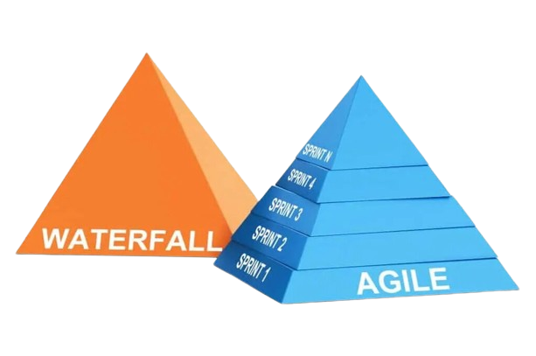
Software Development
(Waterfall to Agile)

Slide 2
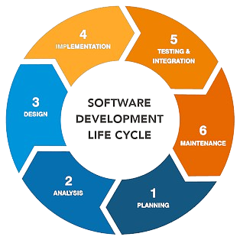
Traditional Software Development
SDLC a structured approach to software development, breaking the process into key phases: Planning, Design, Development, Testing, Deployment, and Maintenance.

Slide 3
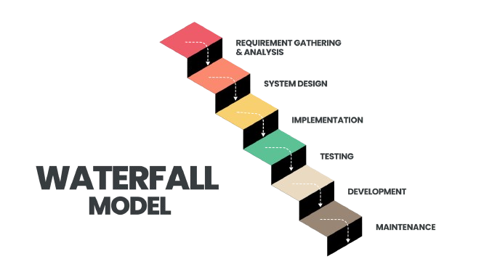
The Old Guard
Waterfall Model: A sequential process where each phase must be completed before the next begins.
Pros: Easy to understand, clear milestones.
Cons: Inflexible to changes, issues detected late.

Slide 4

The Turning Point, Challenges with Waterfall
Rigid structure leads to delayed feedback, costly changes, and difficulty adapting to new requirements.

Slide 5

Rise of Agile (Game Changer)
Agile: An iterative approach emphasizing flexibility, customer collaboration, and frequent delivery of small, functional pieces of software.

Slide 6
Agile vs. Waterfall
Waterfall: Linear, plan-driven, less adaptive.
Agile: Iterative, value-driven, highly adaptive.

Slide 7

Agile Manifesto
Agile Manifesto: Focuses on individuals and interactions, working software, customer collaboration, and responding to change over rigid processes.

Slide 8

Agile Frameworks
Scrum: Emphasizes roles (Scrum Master, Product Owner, Team) and sprints for delivering work.
Kanban: Uses visual boards for workflow management and continuous delivery.
Lean: Focuses on efficiency and reducing waste in the development process.

Slide 9

Agile in Action
Companies using Agile report faster delivery, better collaboration, and improved quality.

Slide 10
Transitioning to Agile
Transition Steps: Start with training, pilot projects, and gradually shift culture.
Challenges: Expect resistance to change and alignment issues with existing processes.

Slide 11

Summary
The journey from SDLC and Waterfall to Agile highlights the need for adaptability in modern software development.

