Slide 1
DATA ANALYTICS • TASK 4
Customer Churn:\nExecutive Analytics Capstone
Where should a subscription team focus first to reduce avoidable churn?
CUSTOMERS
CHURNED
SAMPLE CHURN RATE
15
7
46.7%
Decision proposal: run a small, measured retention pilot—not a broad rollout.
SYNTHETIC SAMPLE • DESCRIPTIVE, NOT PREDICTIVE
1

Slide 2
01 • DECISION CONTEXT
What the data can—and cannot—tell us
The supplied file contains 15 synthetic customer records and 11 fields; 7 are labelled churned.
• Primary decision: which customer groups should receive proactive retention outreach first?
• Observed sample churn is 46.7% (7 of 15); treat this only as a sample description.
• Quality checks: 0 missing cells, 0 duplicate customer IDs, and no negative tenure, charges, or support-ticket counts detected.
• Schema note: this file differs from the brief’s simplified field list; analysis uses the columns actually supplied.
• No records were removed. “Extreme” values were not auto-deleted because no domain thresholds were provided.
SYNTHETIC SAMPLE • DESCRIPTIVE, NOT PREDICTIVE
2

Slide 3
02 • FIVE DECISION-RELEVANT INSIGHTS
Five signals worth testing first
These are descriptive associations in a tiny sample, not causal explanations or a validated churn model.
1
Contract type
Month-to-Month: 6/6 churned (100%); One Year and Two Year: 0% in this sample.
2
Subscription plan
Basic: 5/7 churned (71.4%); Pro: 2/4 (50%); Enterprise: 0/4.
3
Support load
Churned customers averaged 4.3 tickets vs 1.0 among retained customers.
4
Payment method
Debit Card: 2/2 churned; UPI: 3/4 (75%). Possible friction signal, confounded by other segments.
5
Early tenure
All 4 customers with tenure ≤6 months churned; use onboarding-stage outreach as a test hypothesis.
SYNTHETIC SAMPLE • DESCRIPTIVE, NOT PREDICTIVE
3

Slide 4
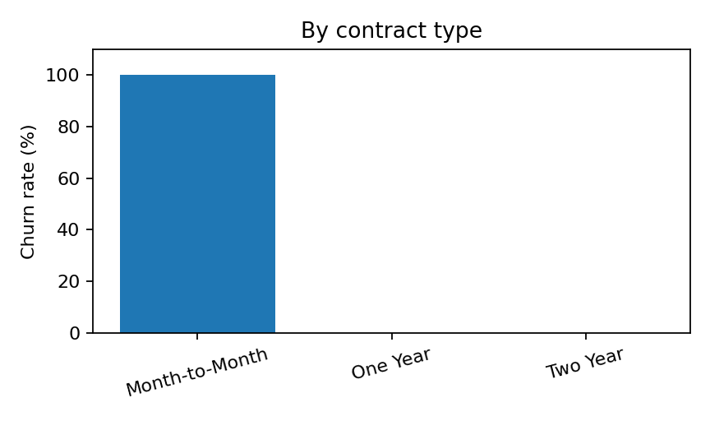
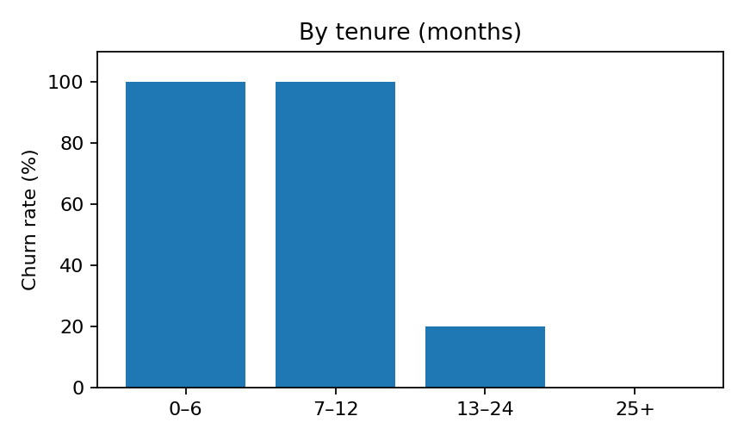
03 • SEGMENT VIEW
Risk is concentrated in short contracts and early tenure
Observed rates are unstable because the segment counts are very small.
Month-to-month: 6 customers, 6 churned.
Tenure ≤6 months: 4 customers, 4 churned.
Recommendation: prioritize these segments for a controlled pilot, but validate on a larger cohort.
SYNTHETIC SAMPLE • DESCRIPTIVE, NOT PREDICTIVE
4

Slide 5
04 • EXPECTED IMPACT
Estimate impact as a scenario—not a promise
The dataset has no intervention history, margins, or causal estimates; financial impact cannot be reliably inferred.
• Pilot audience: eligible month-to-month customers in their first 6 months, with recent support activity where available.
• Planning assumption: test a 5–15 percentage-point absolute churn reduction versus a comparable holdout group.
• For every 100 comparable customers reached, that scenario equates to 5–15 additional retained customers if the effect is real.
• Revenue illustration only: at the sample’s Basic monthly charge (₹49.99), 5–15 retained customers represent roughly ₹250–₹750 in one month of gross billings—not profit or lifetime value.
• Do not scale unless the measured difference is credible, costs are acceptable, and guardrails show no increase in complaints or opt-outs.
SYNTHETIC SAMPLE • DESCRIPTIVE, NOT PREDICTIVE
5

Slide 6
05 • ACTION PLAN
Run a 30-day retention pilot with a holdout
A simple test can distinguish useful outreach from a pattern that is only noise.
• 1. Build the target cohort: month-to-month customers in first 6 months; flag customers with 3+ support tickets for a service-recovery review.
• 2. Randomly assign eligible customers to outreach vs. business-as-usual holdout; keep offer and contact rules consistent.
• 3. Outreach: resolve open issues first, explain plan options transparently, and offer help—not an automatic discount.
• 4. Primary metric: 30-day churn rate difference (treatment minus holdout), reported with group sizes and uncertainty.
• 5. Guardrails: complaint rate, opt-outs, support resolution time, offer cost, and retained gross margin.
• 6. Repeat on a larger, more representative cohort before scaling.
SYNTHETIC SAMPLE • DESCRIPTIVE, NOT PREDICTIVE
6

Slide 7
06 • LIMITATIONS & MEASUREMENT
What would change the decision?
Use the result as a prioritisation hypothesis, not as a predictive score.
• Only 15 synthetic rows: one customer changes a segment rate substantially; no statistical generalisation is justified.
• Cross-tabs overlap: contract type, plan, tenure, and payment method may describe the same customers, so effects cannot be separated here.
• No observation dates, outreach history, customer profitability, complaint details, or reason-for-churn field.
• The data are cross-sectional/descriptive; association does not establish causation. No model was trained or validated.
• Next measurement: track treatment/holdout 30-day churn, with denominators, confidence intervals, and intervention cost; then review after enough cases accrue.
SYNTHETIC SAMPLE • DESCRIPTIVE, NOT PREDICTIVE
7

Slide 8
EXECUTIVE TAKEAWAY
Focus the first test on early-tenure, month-to-month customers.
The sample points to a clear hypothesis, but not proof: validate with a controlled retention experiment before committing budget.
WHO
Month-to-month, ≤6-month tenure; service-recovery flag for 3+ tickets
WHAT
Helpful retention outreach after resolving outstanding support issues
MEASURE
30-day churn difference vs. holdout + cost and customer-experience guardrails
Appendix files: cleaning log + five-insight table are included alongside this deck.
SYNTHETIC SAMPLE • DESCRIPTIVE, NOT PREDICTIVE
8

