Slide 1
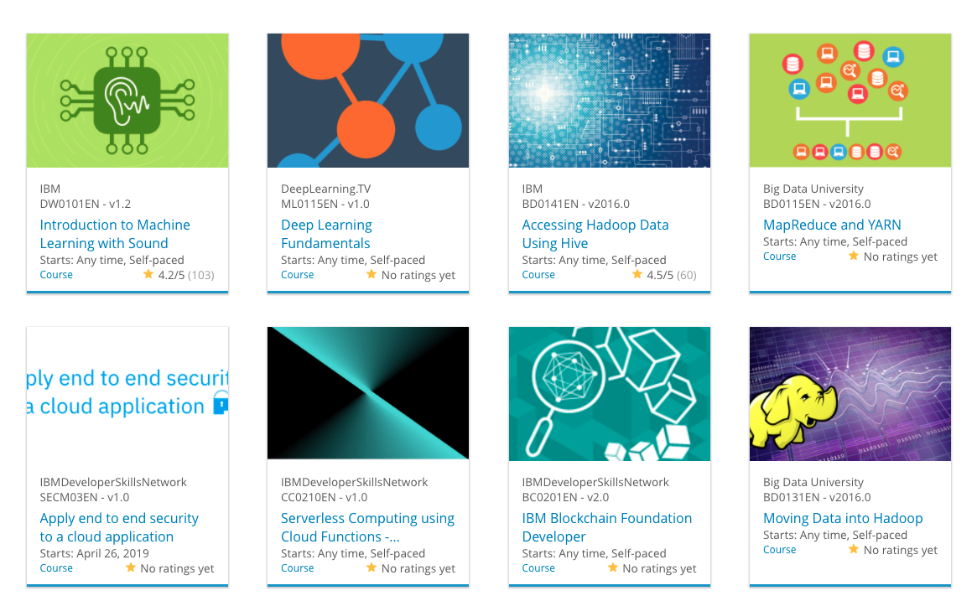

Build a Personalized Online Course Recommender System with Machine Learning
Sayeed Hassan
04-24-2025

Slide 2
Outline
Introduction and Background
Exploratory Data Analysis
Content-based Recommender System using Unsupervised Learning
Collaborative-filtering based Recommender System using Supervised learning
Conclusion
Appendix

Slide 3
Introduction
Project background and context:
With the rise of online learning platforms, users are often overwhelmed by the sheer number of courses available. Learners struggle to find courses that match their interests, goals, and prior knowledge. A personalized course recommender system can improve user engagement and help individuals make informed learning decisions. Our project builds a recommendation engine that suggests relevant courses to users based on their interactions, course content, and similarity metrics.
Problem states and hypotheses Problem Statement: How can we recommend personalized online courses to users based on their previous activity, preferences, and course content to enhance the learning experience?
Hypotheses:
If users have audited or completed some courses, we can recommend similar courses using content-based filtering.
If users share similar preferences, collaborative filtering models can predict what a user might like based on similar users' behavior.
Dimensionality reduction techniques (e.g., PCA) and clustering can help group similar courses and learners for scalable recommendations.
Hybrid models like matrix factorization or neural networks can improve accuracy by combining content and user behavior.

Slide 4
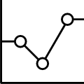
Exploratory Data Analysis

Slide 5
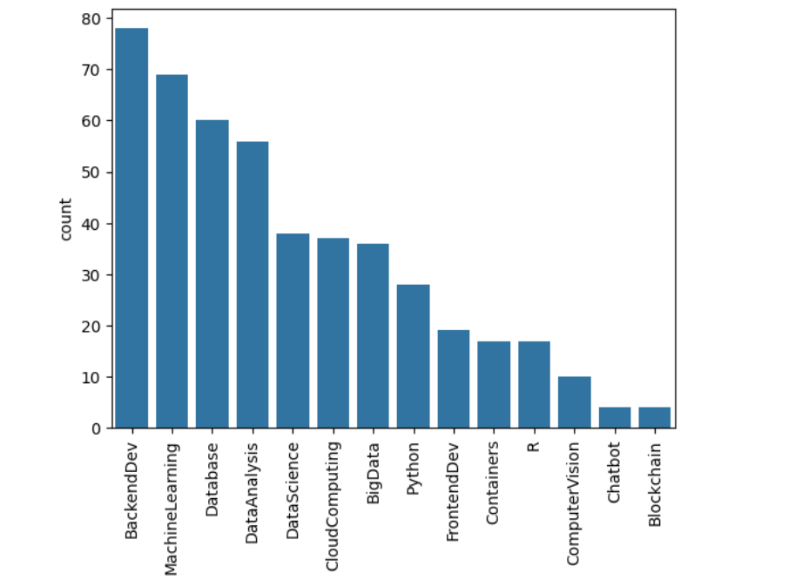
Course counts per genre
The barchart depicts the course counts for each genre.
BackendDev Genre is most popular with counts more than 75, followed by Machine Learning with 69 counts and so on.

Slide 6
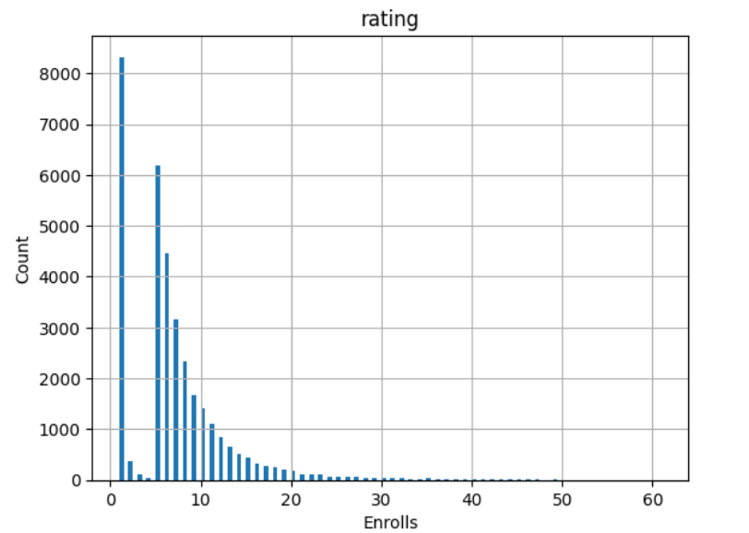
Course enrollment distribution
The Barchart shows how many users rated how many courses.
More than 8000 users rated/enrolled just one course and more than 2000 users rated/enrolled 10 courses.
As the Barchart shows; the number of users decreases with increase in enrollments.

Slide 7
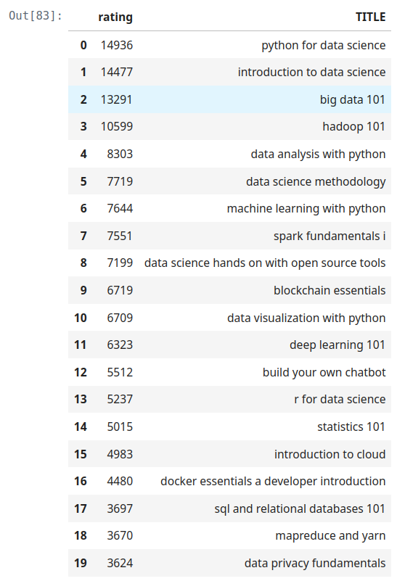
20 most popular courses
'Python for data science' is the most popular course, followed by 'introduction to data science', 'big data 101' and so on.
'data privacy fundamentals' is the least popular course among top 20 courses.

Slide 8
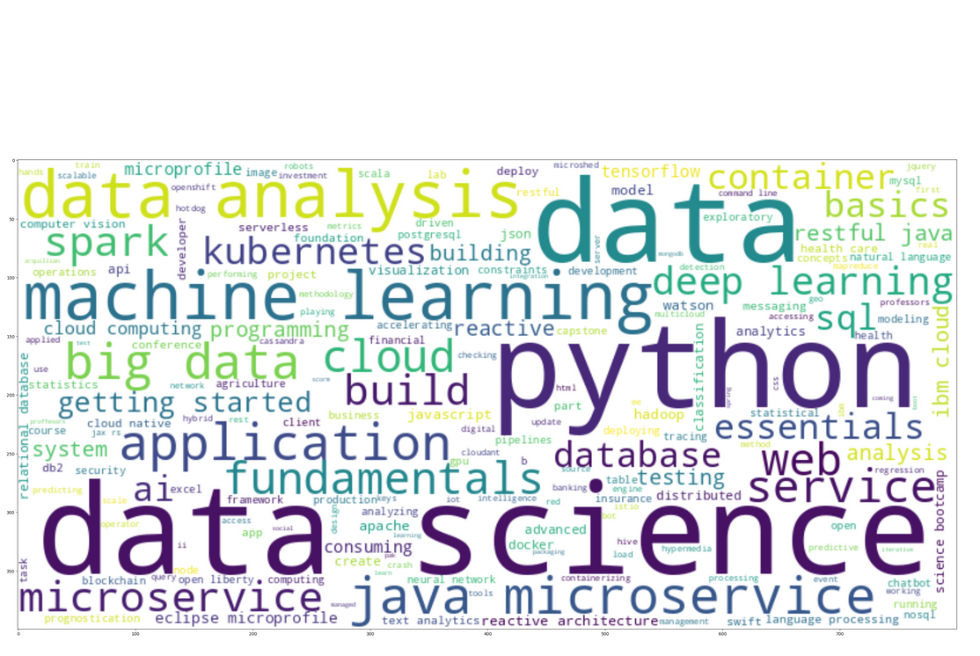
Word cloud of course titles
Most popular keywords in courses are: data science, python, data, machine learning.
This gives a general understanding that the course in the dataset are focused on demanding IT skills.

Slide 9
Content-based Recommender System using Unsupervised Learning
Cluster2
Cluster1

Slide 10
Flowchart of content-based recommender system using user profile and course genres
1. Get the user_profile vector/matrix, if user_profile_df given directly. Else, multiply rating_vector/matrix with course_genre_matrix to get user_profile vector/matrix.
2. From the users_df, get the enrolled courses for each user.
3. Get unknown courses from set of all_courses difference enrolled_courses
4. Get the course_genre_matrix for only unknown courses.
5. Get score: dot product of unknown_course_matrix . test_user_vector/matrix
User profile df
Users df
Unknown course matrix from users df
Dot product. user profile matrix and unknown course matrix
Recommendation score
Filter top scores

Slide 11
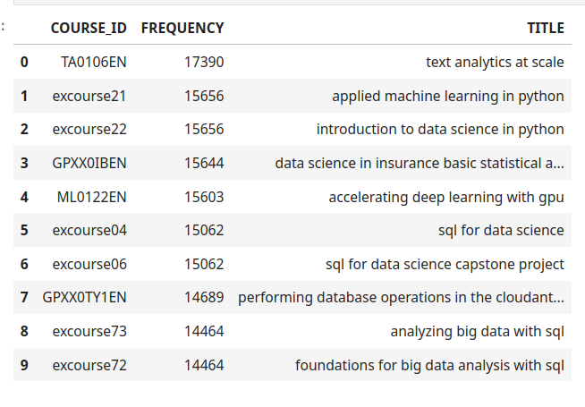
Evaluation results of user profile-based recommender system
Tope recommendation score is for 'excourse72' with recommendation score of 165.
On average, 60 new/unseen courses have been recommended per user (in the test user dataset)

Slide 12
Flowchart of content-based recommender system using course similarity
Get the similarity_df and courses_df.
2. From the courses_df separate enrolled_courses and unenrolled_courses.
3. Get similarity values for each enrolled_course with all unenrolled_courses, this will give similarity matrix of enrolled_courses with related with unenrolled_courses.
4. Apply a threshhold similarity value above which the similarity value for any unenrolled_course will be the recommended course for that enrolled_course.
Separate Enrolled courses and unenrolled courses
Get Similarity values from similarity_matrix of enrolled courses with unenrolled courses
Apply a threshhold for similarity values
Recommended courses
Similarity_df,
Courses_df

Slide 13
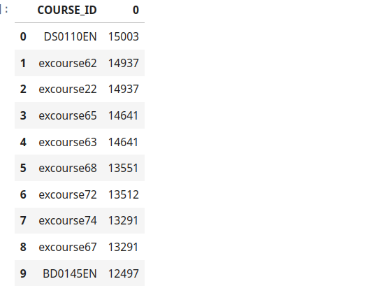
Evaluation results of course similarity based recommender system
Similarity threshold = 0.6
On average, 9 new/unseen courses have been recommended per user (in the test user dataset)
What are the most frequently recommended courses? Return the top-10 commonly recommended courses

Slide 14
Flowchart of clustering-based recommender system
Perform standard_scalar on user profile df to standardized user profile matrix.
Apply k_means clustering on user profile matrix, and get cluster labels.
Get the popular courses from the clusters with highest counts of enrollments.
Generate recommendations for the user.
User_profile_df
Standardization
Apply k_means with n_clusters=8
Get popular courses from clusters
Generate recommendations

Slide 15
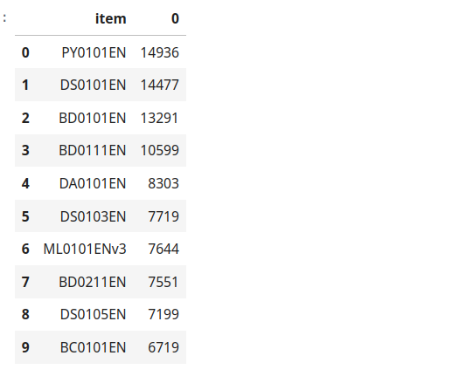
Evaluation results of clustering-based recommender system
Hyper-parameters: n_clusters =8 is the best hyper_parameter value.
For PCA feature selection, 8 principal components explained accumulated_variance_ratio of 90%
On average, 7 new/unseen courses have been recommended per user (in the test user dataset)
What are the most frequently recommended courses? Return the top-10 commonly recommended courses

Slide 16
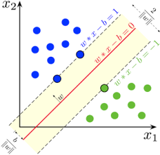
Collaborative-filtering Recommender System using Supervised Learning

Slide 17
Flowchart of KNN based recommender system
Convert user_ratings dense df into sparse(pivot) form.
Save it into .csv format and then load with Dataset.load_from_file from Reader file.
Split dataset into training and test sets.
Perform KNN basic model on training set. And check its accuracy with RMSE metric on test set.
Get top K similar users/items.
Convert Sparse user_ratings_df into csv format
Load the ratings_csv_file with Reader
Split dataset intp Train-test sets
Perform KNN based collaborative filtering
Get top K similar Users/Items

Slide 18
Flowchart of NMF based recommender system
Convert user_ratings dense df into sparse(pivot) form.
Save it into .csv format and then load with Dataset.load_from_file from Reader file.
Split dataset into training and test sets.
4. Perform NMF model training with latent_features(n_factors) = 32. And check its accuracy with RMSE metric on test set.
Get top K similar users/items.
Convert Sparse user_ratings_df into csv format
Load the ratings_csv_file with Reader
Split dataset intp Train-test sets
Perform NMF based collaborative filtering
Get top similar Users/Items

Slide 19
Flowchart of Neural Network Embedding based recommender system
Encode the ratings DF into encoded data, in which user, item ID's are encoded as indices.
Generate train, test, validation datasets from the encoded dataset.
With embedding size = 16, create a recommendation net model, with user_embedding, user_bias, item_embedding and item_bias layers.
Compile model with loss=MSE, optimizer=Adam, metric=RMSE.
Fit model with 10 epochs.
Encoded df
Generate train, test, validation datasets
Create recommendation net model
Compile and fit the model
Get top similar courses

Slide 20
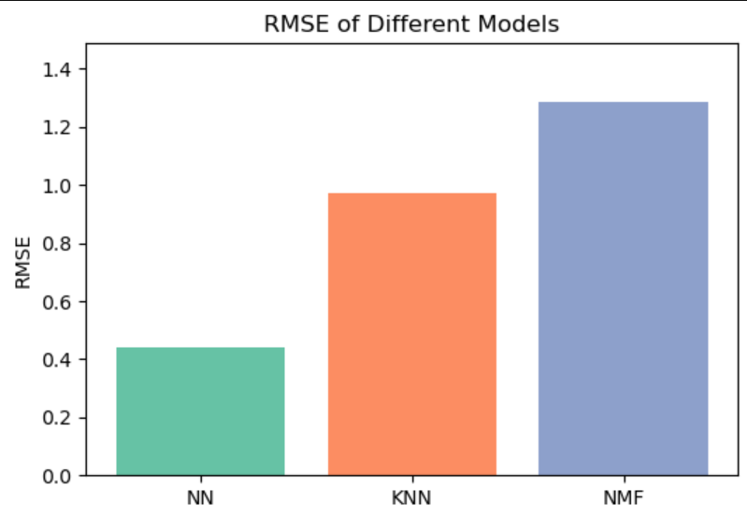
Compare the performance of collaborative-filtering models
Barchart visualizing the performance metric (such as RMSE) of different collaborative-filtering models built.
Neural Networks model has lowest root mean square error with RMSE about 0.44

Slide 21
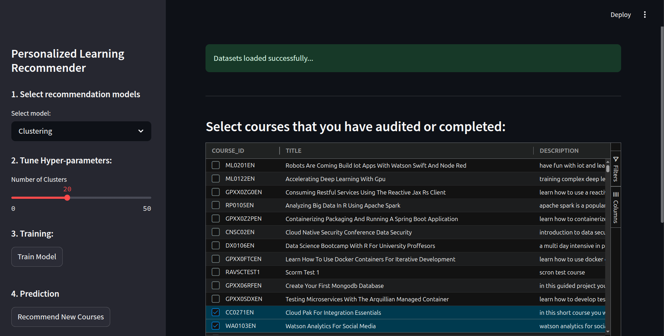
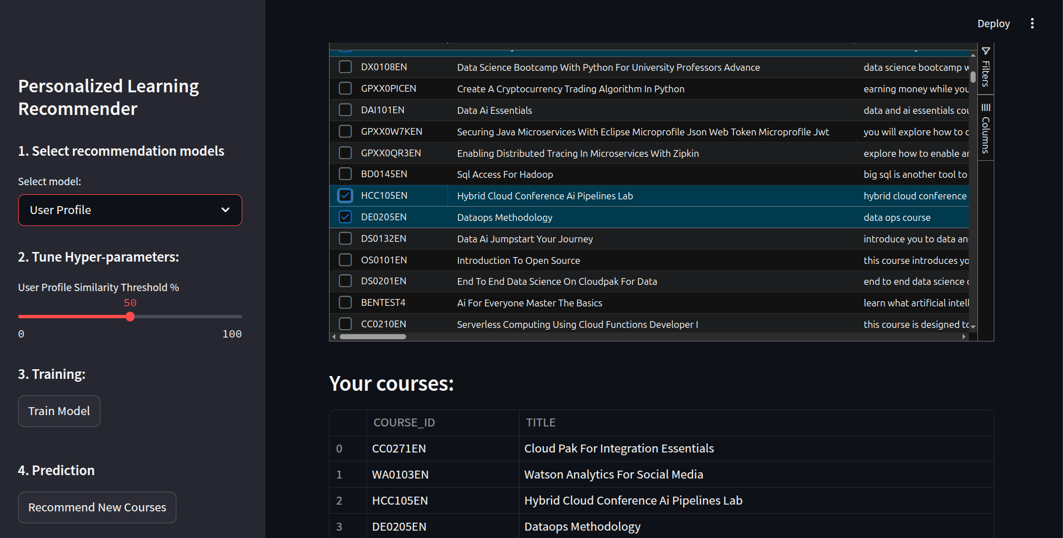
Optional: Build a course recommender system app with Streamlit

Slide 22
Developed a Personalized Course Recommendation System Using multiple models tailored to different user behavior and content similarity.
Incorporated Both Collaborative and Content-Based Filtering
Collaborative: KNN, NMF, Neural Networks, etc.
Content-based: Course Similarity, User Profile
Implemented Advanced Models for Enhanced Accuracy
Regression and Classification using Embedding Features
PCA-based Clustering for dimensionality reduction
Performance Evaluated with Metrics like RMSE
Demonstrated effectiveness of Neural Networks and KNN with lower RMSE values.
User-Friendly Interface via Streamlit App Enables users to select completed courses and receive tailored recommendations instantly.
Conclusions

Slide 23
Appendix
Libraries used:
Python, Pandas, NumPy, Scikit-learn, Surprise, TensorFlow, Streamlit, AgGrid
Data Sources:
ratings.csv, course_processed.csv, sim.csv, courses_bows.csv
Models:
Course Similarity, User Profile, Clustering (w/ & w/o PCA),
KNN, NMF, Neural Network,
Regression & Classification (Embedding-based)
Evaluation Metric:
Root Mean Squared Error (RMSE) for collaborative models
Score Thresholding for ranking relevance

