Slide 1
Spring Framework
Open source frameworks for developing enterprise applications.

Slide 2
Spring Framework
It provides:
Lightweight IOC container for lifecycle and dependency management of objects
Aspect Oriented Programming [AOP]
Support for remote technologies such as RMI, HTTP, web services and so on.
Support for persistence layer, which provides integration with various standards such as JPA [Java Persistence API], JDBC, JMS and third party APIs such as Hibernate , Top Link, JDO.
MVC web application framework.

Slide 3
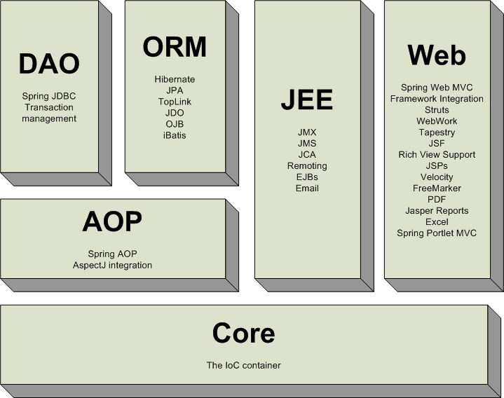

Slide 4
Spring Framework Architecture
The Spring Framework architecture allows being selective about which of its modules are going to be used in the application being developed. This means the developer is free to choose the required modules or features and eliminate the modules which are of no use.

Slide 5
Spring Framework Modules
Each of the modules that comprise the Spring framework can stand on its own or be implemented jointly with one or more of the others.

Slide 6
Why Spring ?
Spring is light weight. If Developers do not need to use all of its services, they should be allowed to choose the ones they desire to use and implement.
Spring achieves the loose coupling through dependency injection and interface based programming.
Declarative programming through aspects.
Boilerplate reduction through templates.

Slide 7
Core Parts of the Spring Framework
POJO: Development with Plain Old Java Objects
Dependency Injection [DI]: Loose coupling
Aspect-Oriented Programming [AOP]: Declarative programming
Templates: code reduction

Slide 8
Pojos
The Spring framework allows using loosely coupled POJOs to develop the applications. The Spring framework wires [creating associations between application components] application services to the POJOs by intercepting the execution context or injecting service objects to the POJOs at runtime.

Slide 9
Dependency Injection [DI] aka Inversion of Control [IOC]
It is one of the best ways to implement loosely coupled applications. Using DI, the framework acts as an object factory to build service objects and injects those service objects to application POJOs, based on some runtime configuration. From the application developer’s point of view , the client POJO automatically obtains the correct service object, when it is required.

Slide 10
Dependency Injection [DI] aka Inversion of Control [IOC]
DI makes the code significantly simpler, easier to understand and easier to test. The IOC container manages the POJOs and its dependencies in the application. The application defines the dependency and these dependencies are then satisfied at runtime by the IOC container as follows:
A caller asks the container for an object with a specific name or of a specific type.
The container injects these objects by other objects, via either constructors, or properties.

Slide 11
Advantages of DI
Objects are not expected to create or obtain their dependencies. Dependencies are injected into the objects that need them.
Classes are no longer required to be coupled to any specific implementation, which is the key benefit of DI , Loose Coupling. Since an object only knows about its dependencies by their interface, the dependency can thus be swapped out with a different implementation without the depending object knowing the difference.

Slide 12
How does DI work ?
In spring , there are many ways to wire components together , but a common approach has always been via XML. Typically , the container is configured by loading XML files with some runtime configuration containing bean definitions which provide the information required to create the beans.

Slide 13
AOP
Applications are usually made up of several components, each responsible for a specific piece of functionality. Often, these components are also carry additional responsibility [such as logging ,transaction management and security] beyond their core functionality which overlaps the existing business logic. These additional responsibility or services are commonly referred to as “cross-cutting concerns” because they tend to cut across multiple components in an application.

Slide 14
AOP
Aop isolates the cross-cutting concerns from the application code so that they can be easily reused in various different applications.

Slide 15
Templates: code reduction
In case of JDBC we need to write lot of repetitive code we little or no change. i.e boilerplate code.

Slide 16
Templates: code reduction
e.g. To insert a single record into the database table ,program does the following:
1. defines the Connection and PreparedStatement parameters
2. opens the Connection
3. Prepares the statement
4. Binds the parameters to the Prepared Statement
5. executes the statement
6. handles any exception
7. closes the PreparedStatement
8. closes the Connection
9. handles any exception
In case of JDBC above code is required to manage the resources and handle exceptions.
This code makes the application hard to maintain, as the same code is written over and over again to accomplish common and otherwise simple task. This also makes the application potentially bugs-prone.

Slide 17
Templates: code reduction
Spring comes to the rescue by offering templates.
Spring helps eliminate repetitive code by encapsulating it in templates. Spring’s JDBCTemplate as well as HibernateTemplate or SqlSessionTemplate makes it possible to perform database operations without all of the traditional JDBC or hibernate or mybatis code respectively.

