Slide 1
API
API (application programming interface) is a set of rules and mechanisms by which one application or component interacts with the others. API can return data that you need for your application in a convenient format (e.g. JSON or XML).

Slide 2
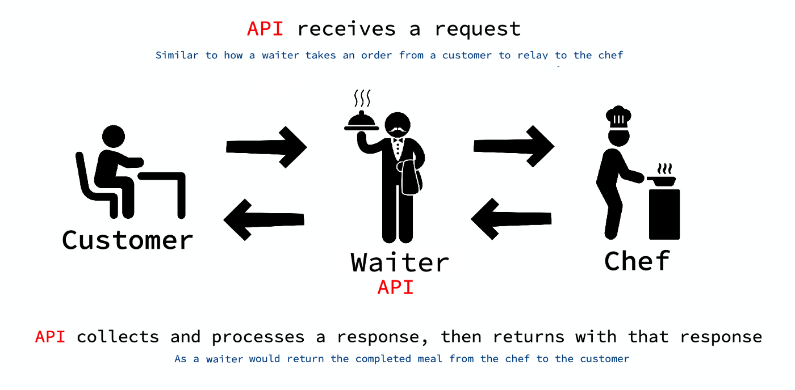
API in real life

Slide 3
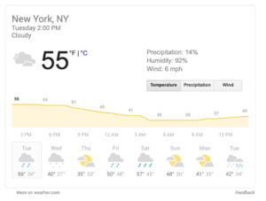
API in real life
Weather data on Google Search
Google source this information from a third party. They do so by means of an API, which sends them the latest weather details in a way that’s easy for them to reformat.
Google utilizes APIs to display relevant data from user search queries.

Slide 4
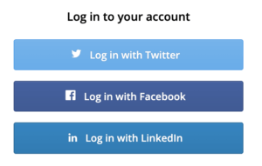
API in real life
Log-in Using Facebook/Twitter/Google/Github
Whenever you try to access any new application for the first time e.g. https://zoom.us/signin
It asks you to authenticate yourself either by creating your sign up into zoom’s application or use facebook or google etc. So that means we are using facebook or google apis to authenticate outselves. What zoom application does is it integrates these apis (facebook and google ) into their own application.

Slide 5
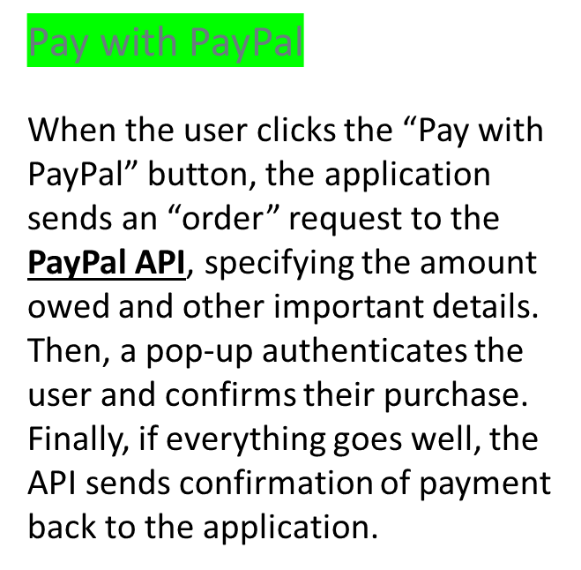
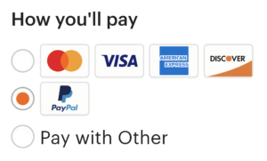
API in real life
Most online stores offer Paypal and other payment methods, utilizing API connections to these services.

Slide 6
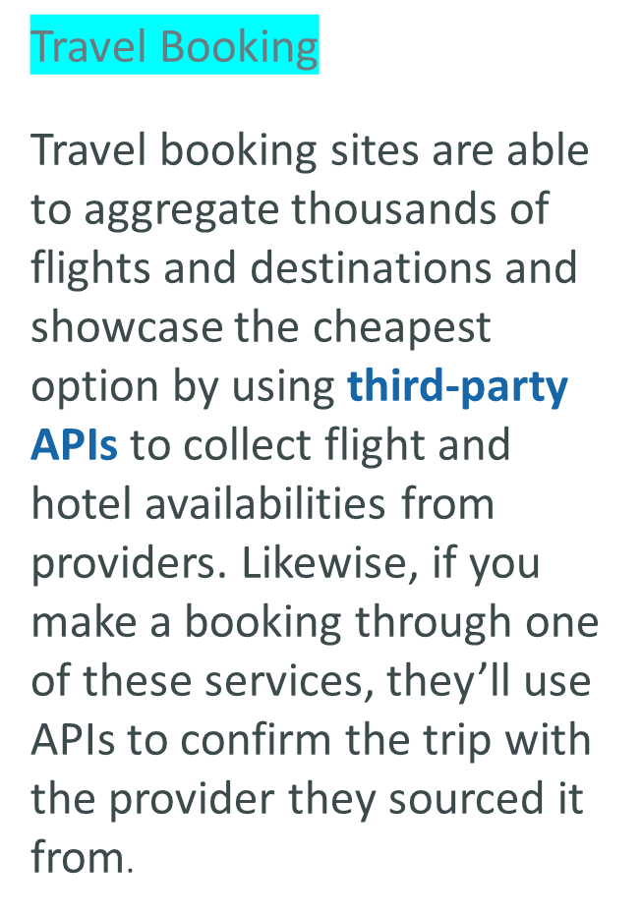
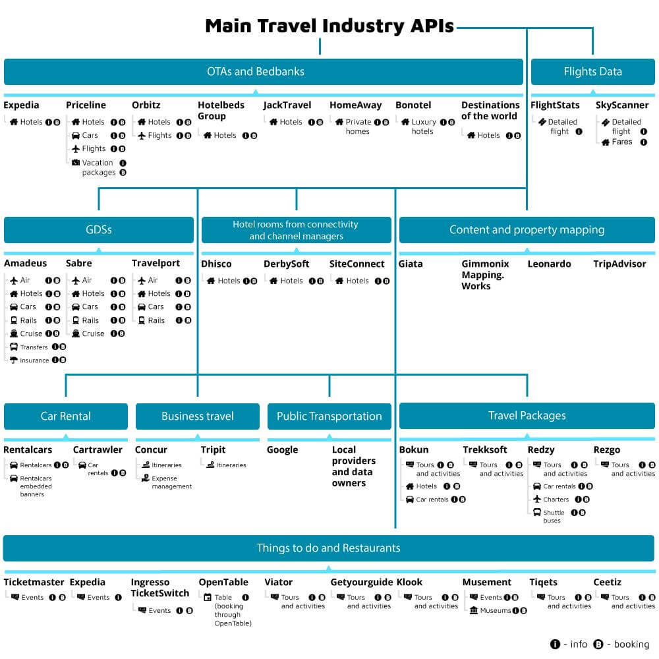
API in real life

Slide 7

API in real life
Twitter Bots
TinyCareBot: Sends hourly reminders to drink water, stretch, get fresh air, and more.
Grammar Police: Identifies common grammar mistakes made by its followers.
Netflix Bot: Tweets when new content is released on Netflix.
TinyCareBot, a Twitter bot, uses the Twitter API to automate posts.

Slide 8
REST API
In the web services terms, REpresentational State Transfer (REST) is a stateless client-server architecture in which the web services are viewed as resources and can be identified by their URIs. Web services client uses that URI to access the resource.

Slide 9
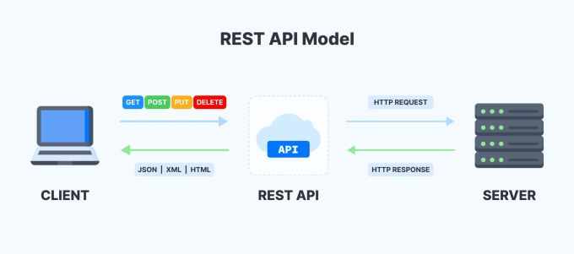
REST API

Slide 10
Meaning of Representational State Transfer
REST stands for Representational State Transfer, a term coined by Roy Fielding in 2000. It is an architecture style for designing loosely coupled applications over the network, that is often used in the development of web services.
Meaning of REST:- Whatever the data is there on server is called as resource. While sending this resource from server to client , resource is not sent directly, its representation is sent. The resource is still there on the server. That’s why it is known as “Representational”. “state” means state of the resource which is on the server at a specific time, e.g. current temperature is 5 and tha can be changed in future. “Transfer” means resource is transferring from server to client.

Slide 11
Advantages of RESTful Web Services
Fast: RESTful Web Services are fast because there is no strict specification like SOAP. It consumes less bandwidth and resource.
Language and Platform independent: RESTful web services can be written in any programming language and executed in any platform.
Permits different data format: RESTful web service permits different data format such as Plain Text, HTML, XML and JSON.

Slide 12
Stateless meaning in REST
As per the REST architecture , the server doesn’t store any state about the client session on the server side. Stateless means that every HTTP request happens in complete isolation.

Slide 13
HTTP methods used in REST
GET: Retrieves one or more resources identified by the request URI and it can cache the information receive.
POST: Create a resource from the submission of a request and response is not cacheable in this case.
PUT: Update an existing resource on the server specified by the request URI.
DELETE: Delete an existing resource on the server specified by the request URI.
GET, PUT, DELETE methods (except “Post”) are also known as Idempotent (safe) methods. Applying an operation once or applying it multiple times has the same effect.

Slide 14
API Endpoint
API endpoint is a location from applications can access the resource. It’s a point where two piece of softwares can communicate to each other. In REST API we follow some standard structure for an API endpoint.
<Protocol>://<Domain>/api/<Resource Path>
Here “Protocol” can be http, https etc.
Domain can be a different level of domain e.g. domain , subdomain etc.
api is optional but always used as a convention.
Resource path is the actual resource which client can access ,update, delete etc.

