Slide 1
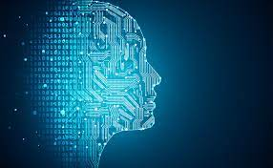

Term Project: APL405, Machine Learning in Mechanics
Hand Gesture Recognition Using SVM
Indian Institute Of Technology, Delhi.
Supervisor:
Professor Souvik Chakraborty
Manan Mittal
2019ME20901

Slide 2
Motivation
Difficulty in understanding sign languages for communication with hearing impared people
Non-contact method enables natural and friendly interaction between human and Machine.
Many pre-existing models are already present which are capable of recognizing gestures, either use hardware devices like data glove and colour markers or are vision based.
Vision based models require special cameras like depth sensors or infrared filter cameras otherwise they suffers from image distortion.
Image Processing with the help of Machine Learning is the new and powerful tool to tackle this problem.
We will build a model which is very efficient and can classify between different Hand Gestures with greater accuracy.

Slide 3
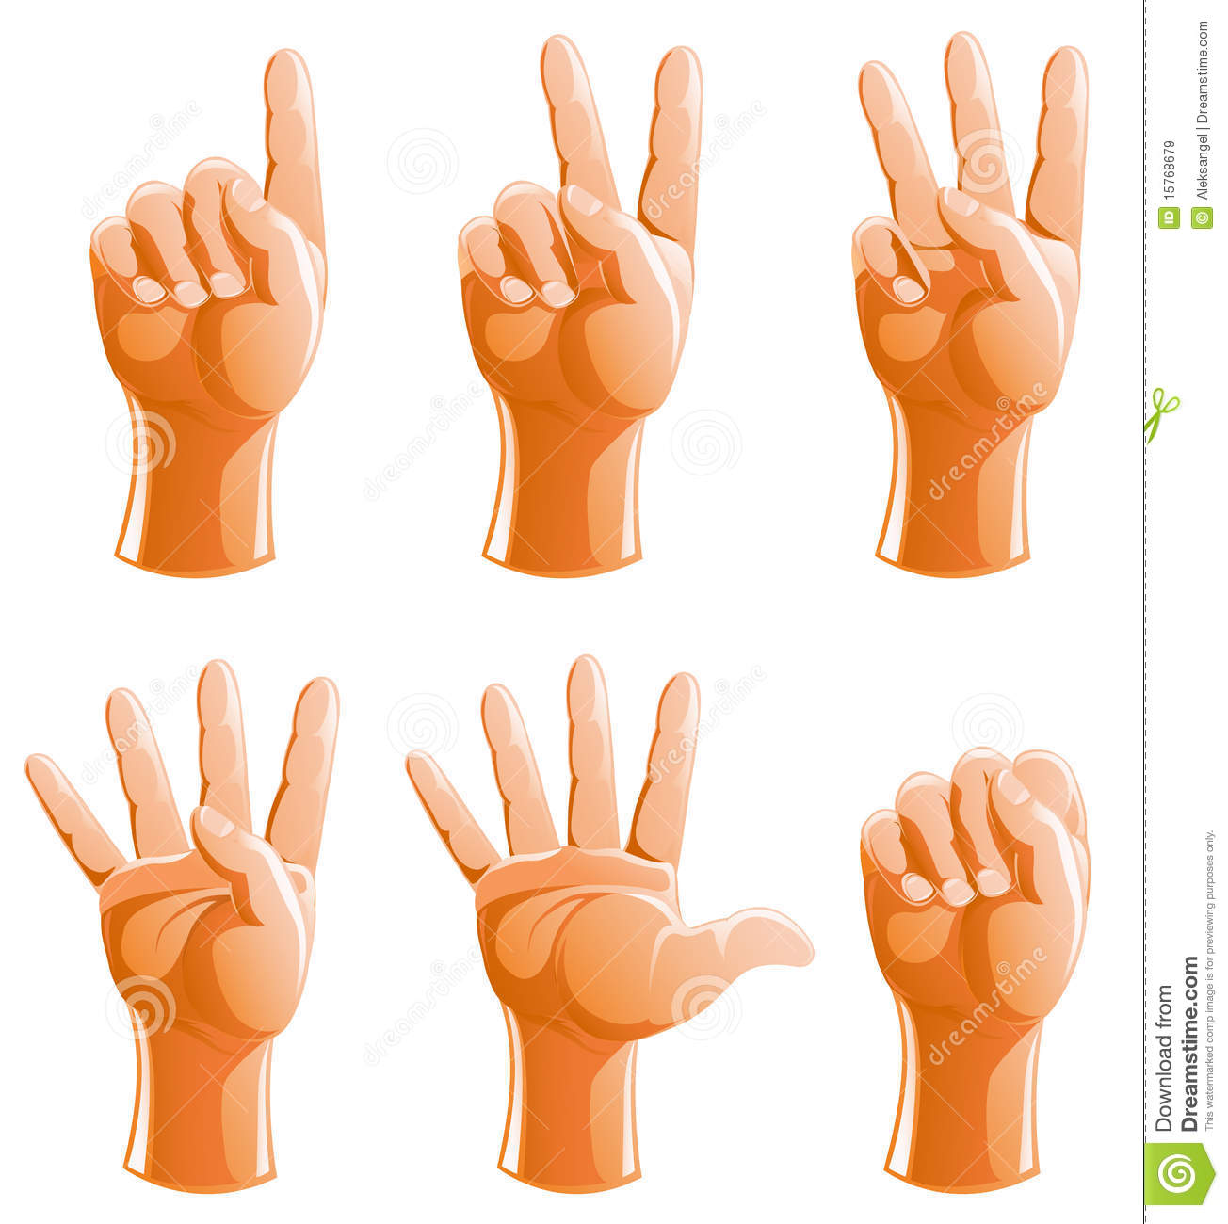
Problem Statement
Taking input from normal webcam and removing noise from images.
Detecting Edges of hand and applying Histogram of Oriented gradients to extract features from it.
Making Dataset that contains labelled images for different gestures. The images need to be taken with different angles and lighting conditions.
Deploying SVM classifier to classify between different gestures.
Using trained model to classify between different gestures from real-time inputs.
1 | 2 | 3 | 4 | 5 | 0

Slide 4
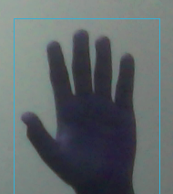
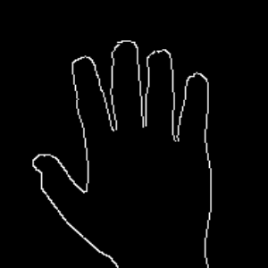
Methodology
Removing Noise
Edge Detection
Extracting Features
Obtaining input images from webcam. Then remove noise from them by cropping it into small area containing hand fist and then applying filters on that.
Resizing image and detecting Edges of Hands using Canny’s Edge Detection.
Extracting features from edge detected image using Histogram of Oriented Gradients and saving each feature as a 2D vector matrix.
56 | ... | ... | 13
... | ... | ... | ...
... | ... | ... | ...
74 | ... | ... | 76
Noise Deducted Image
Edge Detected Image
Feature matrix

Slide 5
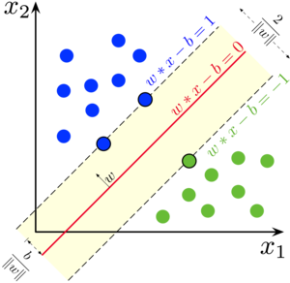
Methodology Continued...
Forming Dataset
Model Training and Testing
Real Time Classifying
Forming dataset by taking inputs from webcam and labelling each image as one of 0,1,2,3,4,5 based on gesture presented in the image. Then dividing dataset into training and testing dataset. We will have about 350 image for each label in training dataset and 100 for each label in testing dataset.
Training OneVsRest type SVM classifier with linear kernel function to perform multiclass classification. We will use training dataset to train our model and after training, test it on testing dataset.
After model training and testing, We will deploy our model to classify real time inputs from webcam and will show predicted label on screen. We will also try to accelerate gesture classification by removing the cases of no object in a frame using contour area comparison.
(Demonstration of this part is shown in video included in later slides)
Image representing SVM classifier

Slide 6

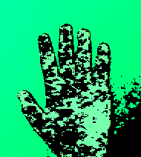
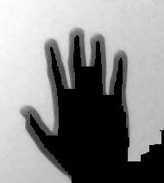

Results
We use various noise reducing techniques like contour retrieval, gaussian-blur, masking with skin colours as threshold. But the best results are obtained when we apply Canny edge detection on converting original images to grayscale images. It automatically detects edges of hand and differentiate between hand and its shadow in a single frame it is also insensitive to distinct colours of hand and background.
1.Original Image | 2.Skin Colour Threshold Image | 3.Skin Colour Masked Image | 4.Canny’s Edge Detected Image

Slide 7

Results Continued...
After training of our model with training dataset we tested our model with testing dataset.
Results for testing is shown below in image.
Discussion on above results:- By above results we can say that overall, our model is giving satisfactory results. For our testing dataset, accuracy for predicting 4 is quiet high which may happen when all the samples in testing dataset lies within the region for that class or we can say that the decision boundaries are made such that they classify gesture 4 accurately but results can be different for other datasets. For gesture 0 and 3 accuracy is low by which we can say that decision boundary is not able to classify these gestures perfectly. Although these results can be different for different datasets and kernel functions. But as we have taken large amount of data for training and testing with different angles of gestures and lighting condition, we can say that our model have less chances of facing sparse data problem.

Slide 8
Demonstration of model in next slide….

Slide 9
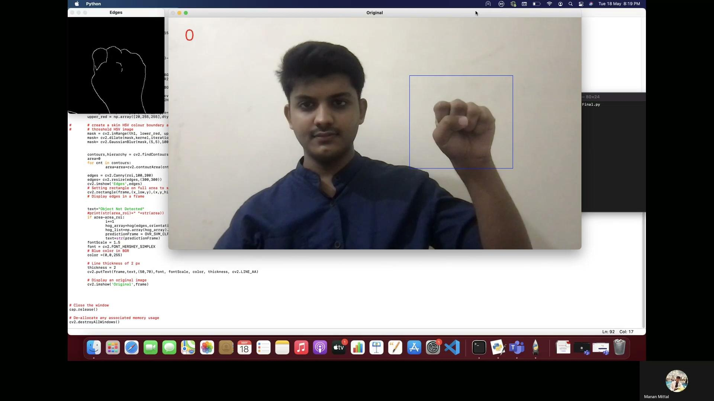
Demonstration of model.
https://drive.google.com/file/d/1pX1X_CTgU1f05GvZpXNEGgq-iI2t7dT-/view?usp=sharing

Slide 10
Discussion After Demonstration...
We applied a method based on contour area to detect whether an object is in frame or not. If there is no object in the frame, the method will not permit input to go for prediction, this will make our model work faster by avoiding model to classify unnecessary inputs. With the demonstration we can say that model is able to correctly recognize 1,2,4 and 5 in a greater frequency than 0 and 3. This observation is consistent with the results that we obtained when we test on static images during testing phase. Also we have to take care that when we run our model we have to take plane background in the area of rectangle shown on image window, this will help our model to classify gestures more accurately.

Slide 11
Discussion
This project recognizes hand gesture offline. So, work can be done for real time purpose like robotics and computer human interaction.
We can deploy this on any computer, even with low to medium quality webcams it works well.
To improve accuracy:-
Special cameras like depth sensor camera and IR sensing camera can be used as it gives more information from an image than an ordinary camera.
We used SVM for multiclass classifications but as we know SVM is deterministic algorithm and is not much accurate for multiclass classifications we can use other classifiers such as RVM, which is more powerful than SVM as it is based on probabilistic algorithm and is superior to SVM in several other way also.
We can also use neural networks and deep learning to obtain better accuracy but implementation of both RVM and neural networks require knowledge of higher-level mathematics and coding.

Slide 12
Conclusion
Area of Hand gesture-based computer human interaction is very vast. This project recognizes hand gesture offline. So, work can be done for real time purpose. Best part of our model is: - We can deploy this on any computer, even with low to medium quality webcams it works well. Hand recognition system can be useful in many fields like robotics and computer human interaction. So, make this offline system for real time will be future work to do.
Accuracy and functionality of Gesture recognition models also depends on external factors like input equipment, background, lighting conditions and many more. Rigorous research has been carried out in the field of image processing to lower these effects and enhance Human-computer interactions in last 20 years. Special cameras like depth sensor camera and IR sensing camera have been developed, that will provide much more information from an image than an ordinary camera, although none of the model can provide us 100% accurate results. But, lots of research has been done to increase accuracy of computer vision-based methods. To continue this momentum, it is clear that further research in the areas of feature extraction, classification methods and gesture representation are required to realize the ultimate goal of humans interfacing with machines on their own natural terms.

Slide 13
References
https://learnopencv.com/histogram-of-oriented-gradients/
https://medium.com/analytics-vidhya/a-gentle-introduction-into-the-histogram-of-oriented-gradients-fdee9ed8f2aa
https://medium.com/@nikatsanka/comparing-edge-detection-methods-638a2919476e#:~:text=Canny%20Operator,then%20the%20ones%20described%20above.
Michahial, Stafford. (2015). Hand gesture recognition using support vector machine. The International Journal Of Engineering And Science. 4. 42.
https://monkeylearn.com/blog/introduction-to-support-vector-machines-svm/#:~:text=A%20support%20vector%20machine%20(SVM,able%20to%20categorize%20new%20text.
S Nagarajan, T S Subashini, “Static Hand Gesture Recognition for Sign Language Alphabets using Edge Oriented Histogram” in the proceeding of IJCA(2013), Vol 82, No 4
S. Naidoo, C.W. Omlin M. Glaser “Vision based Static Hand gesture recognition”, South Africa.

Slide 14
Thank You.

