Slide 1
Turbine Blades and Single Crystal
Qing Wang, Matthias ihme
2018/05/17

Slide 2
Turbine blades introduction Issues

Slide 3
Turbine blades introduction Solution

Slide 4
Cooling of turbine blades

Slide 5
Material of turbine blades

Slide 6
Single crystal turbine blades

Slide 7
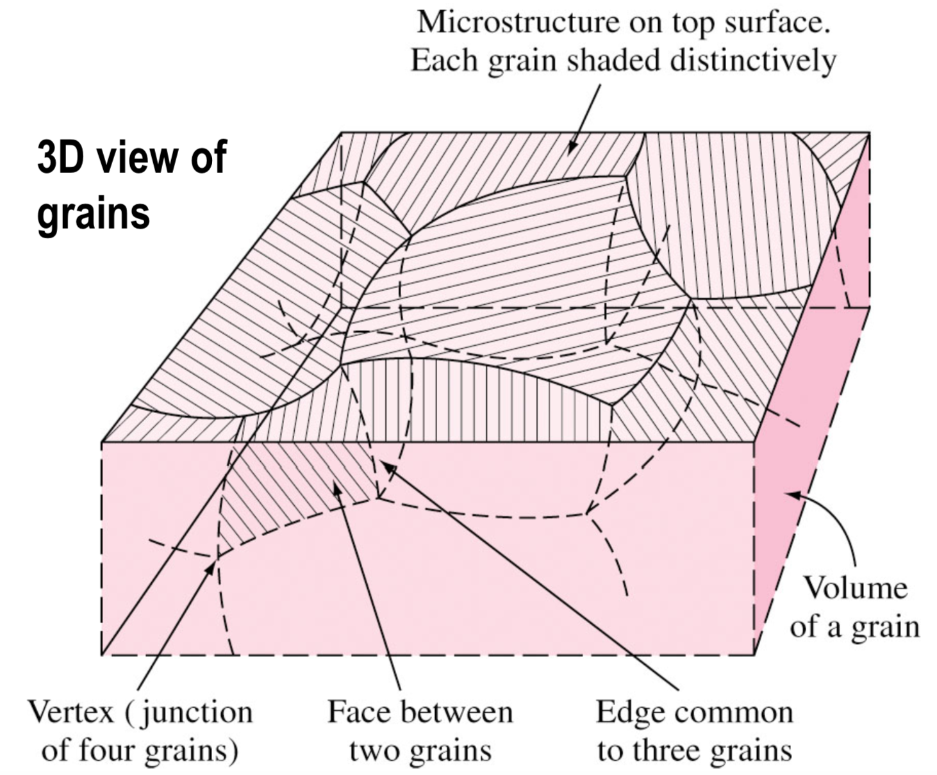
Nucleation and crystallization

Slide 8
Manufacturing of a single crystal blade

Slide 9
Summary

