Slide 1
Borough Prediction
Joseph Feig, Naim El Youssoufi, Muhab Elgamal

Slide 2
Dataset
Dataset: Affordable_Housing_Production_by_Building.csv
This dataset contains information about housing projects in NYC, including 41 features and 6335 rows representing individual projects. There are both numerical and categorical values which provide details on the project’s location, affordability, income units, and other variables.

Slide 3
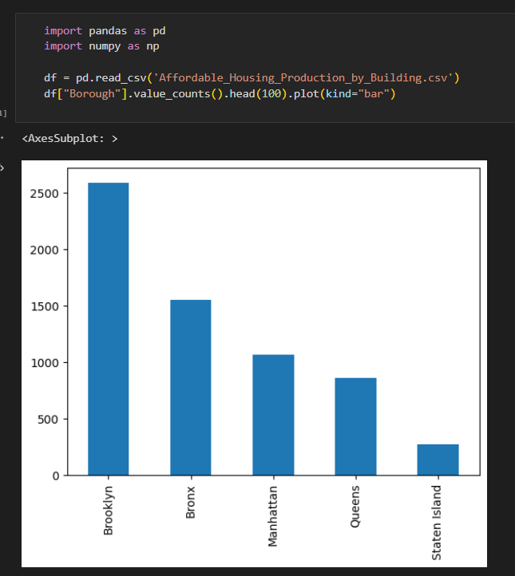
Main Objective
Our main objective is to train two models that can accurately predict the borough of a given housing project based on select features.
Select features: 'NTA', '1-BR Units', 'Middle Income Units', 'Studio Units', 'Total Units'
The project aims to provide insight into the relationship between the features and the boroughs in which the projects are located.

Slide 4
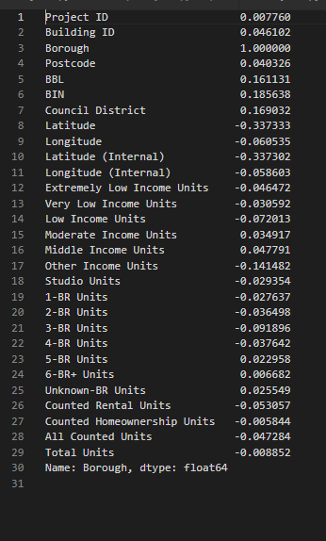
Explain Data
Correlation to Borough
Middle Income Units: 0.047
Studio Units: 0.029
1-BR Units: 0.027
Total Units: 0.008

Slide 5
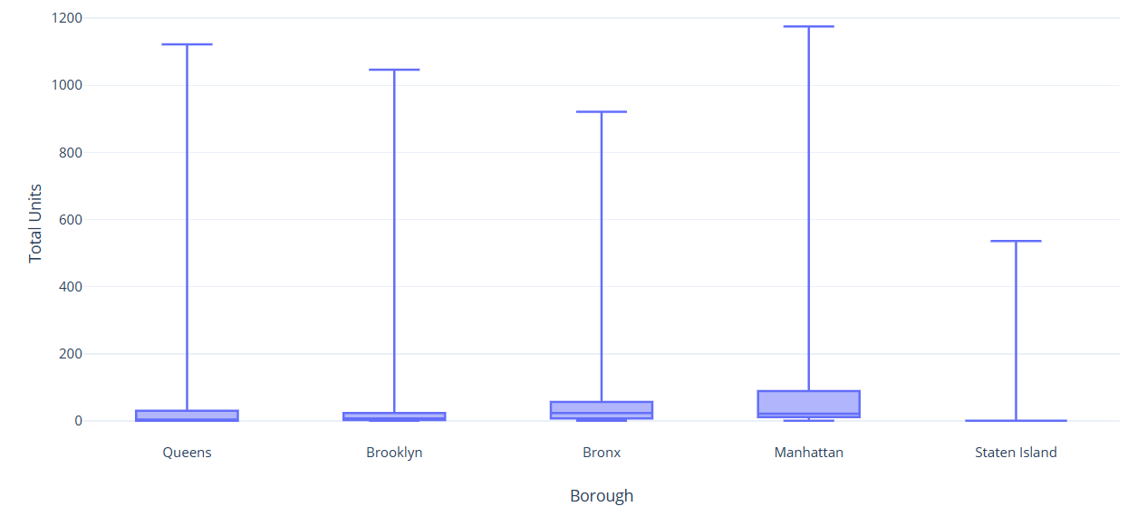
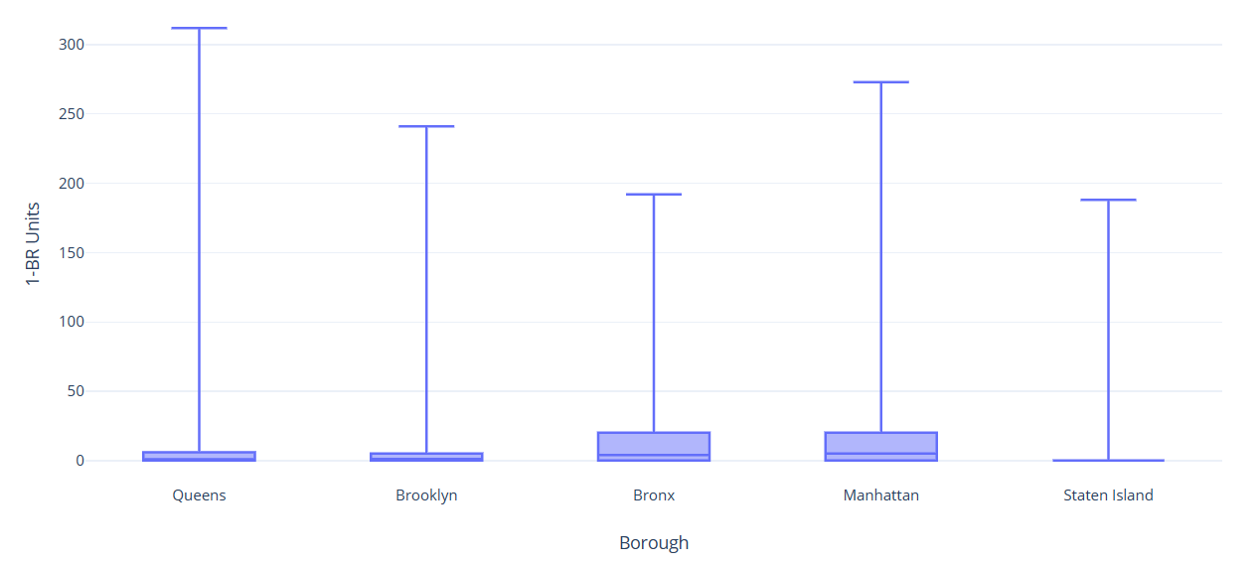
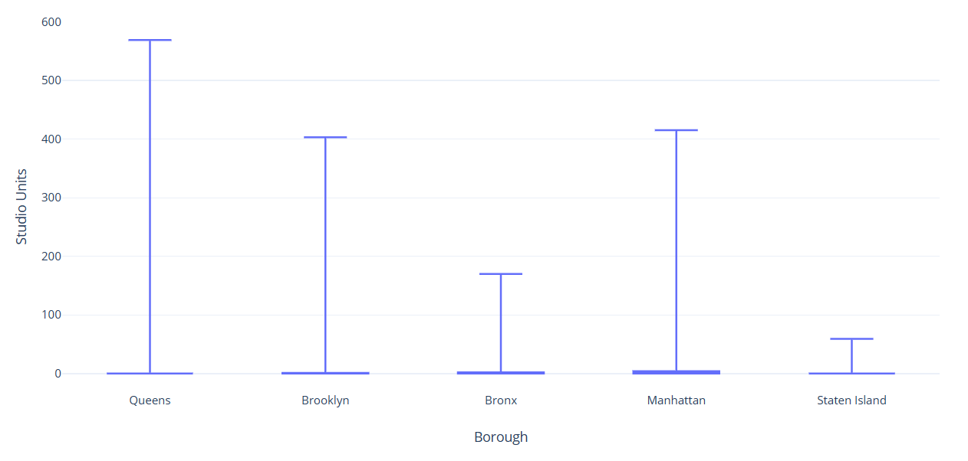
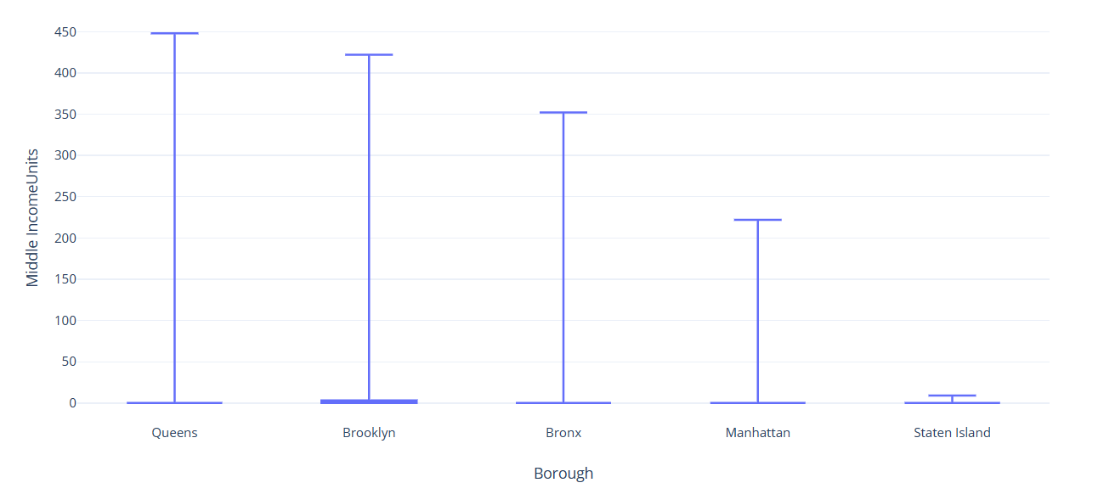
Explain Data
All numerical Box Plot graphs look like this.

Slide 6
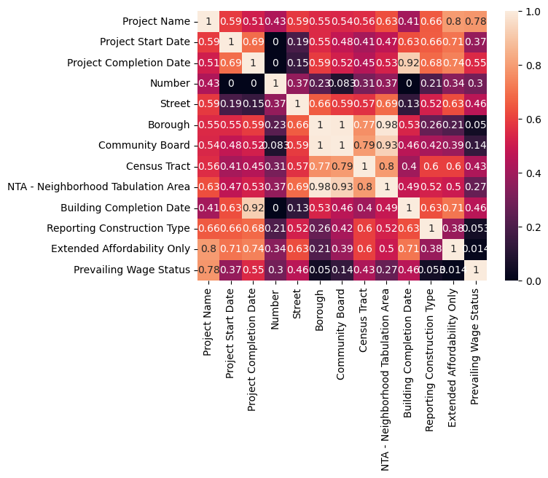
Confusion Matrix to pick Categorical feature

Slide 7
Dataset History and Features
Posted by the Department of Housing Preservation and Development (HPD) in 2016.
Target: Borough (Categorical)
Features used in model training: 'NTA' (Categorical) , '1-BR Units', 'Middle Income Units', 'Studio Units', 'Total Units'
Other Notable Features:
Extremely Low Income Units, Very Low Income Units, Low Income Units, Moderate Income Units, Other Income Units. (All numerical)
Why did we use these features?
Other features were either too random or too similar
Most categorical data had a lot of randomness that couldn't be used to train a model and some numerical data were too uniform.

Slide 8
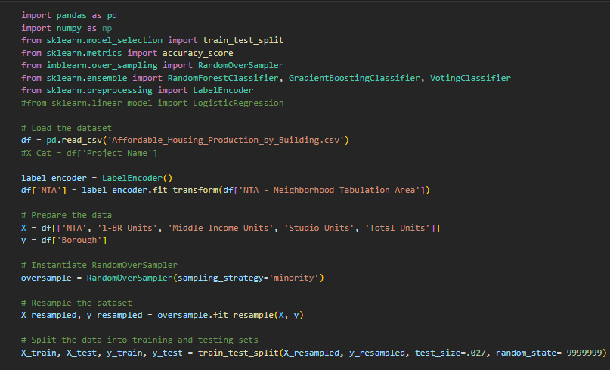
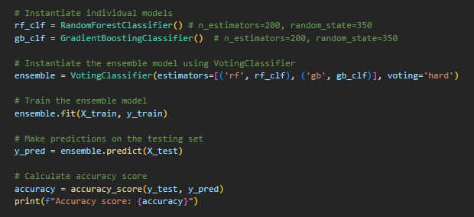
Model 1

Slide 9
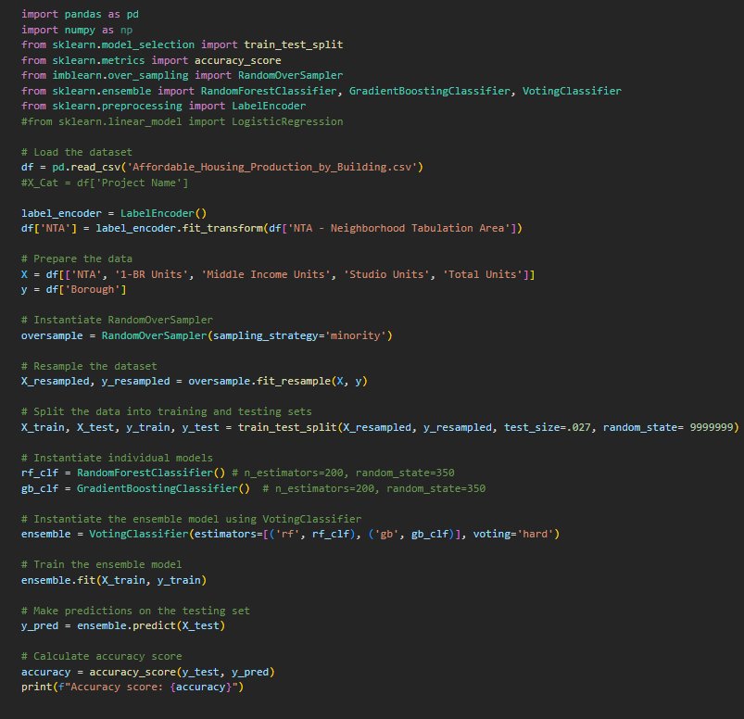
Model 1
Components
Random Over Sampler: Balances the dataset so the model isn’t bias towards certain features. Randomly duplicates instances in the minority class to be equal to the majority.
Random Forest Classifier: Creates multiple decision trees (each trained on a different subset of dataset), then combines their predictions.
Gradient Boosting Classifier: Builds decision trees one after another, improving it more and more based off the previous ones’ errors.

Slide 10
Model 1 cont.
Components
Voting Classifier: Combines the two training models (RandomForestClassifier and Gradient Boosting Classifier) to make a final prediction through combined voting.
LabelEncoder: Transforms categorical values into numerical values to be used by machine learning model.

Slide 11
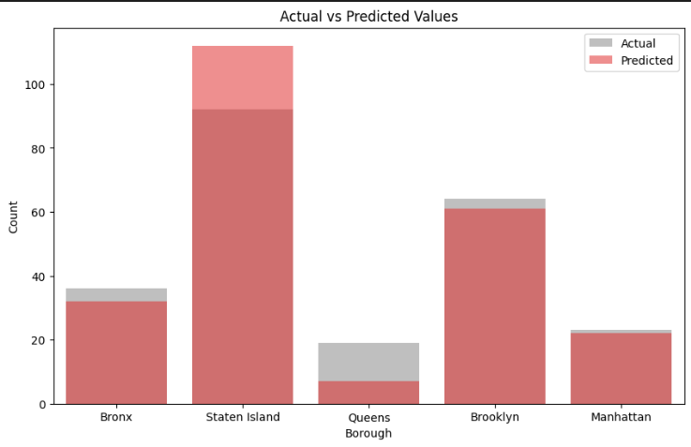
Key Findings from Model 1
Based on the implementation of Model 1, it was found that adding the NTA to the original Units feature significantly improved the accuracy score. The accuracy score for the model was found to be 86.3%, which suggests that the model is performing well in predicting the Borough. The model took 2.5 seconds to run, which indicates that it is a relatively efficient model. Overall, these findings suggest that Model 1 is fairly successful in predicting the Borough based on the input features.

Slide 12
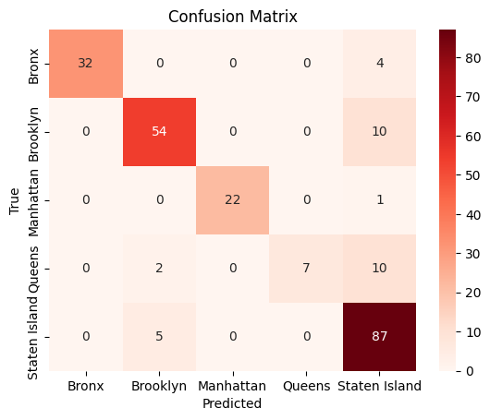
Confusion Matrix of Model 1

Slide 13
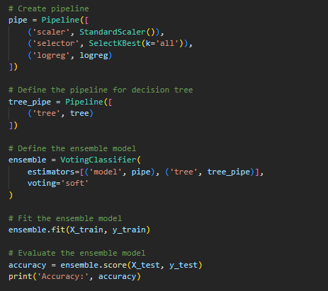
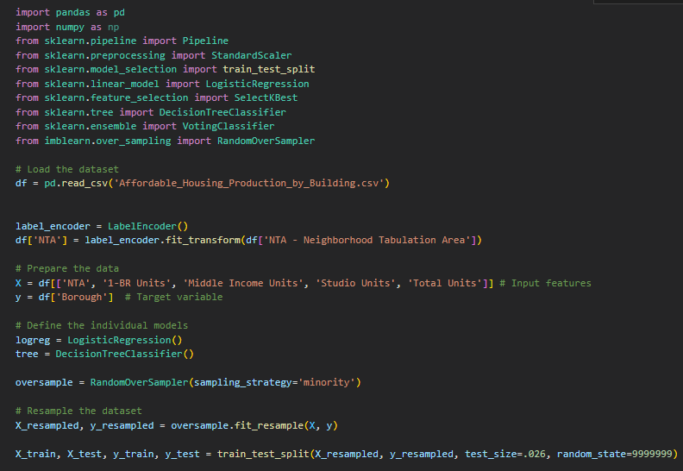
Model 2

Slide 14
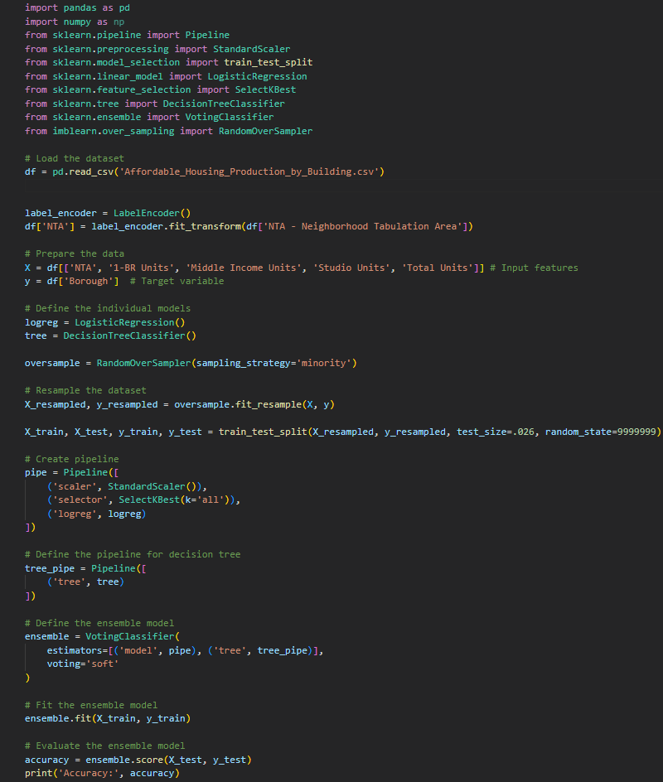
Model 2
Components
Logistic Regression: Predicts the borough based on the relationship with the input features.
Decision Tree Classifier: Splits the dataset into smaller subsets, and then uses each one to create a final prediction. This also deals with both numerical and categorical data, so there is no need to use an encoder.
Pipeline: Created to scale input features, select the best features, and perform logistic regression.

Slide 15
Model 2
Components
Standard Scalar: Scales the features, ensuring each feature contributes equally to the model
Select K Best: Selects the top K features that are most relevant to the target. Helps reduce number of features and improve accuracy.
Random Over Sampler: Balances the dataset.
Voting Classifier: Makes final prediction.
Label Encoder: Not used in this model.

Slide 16
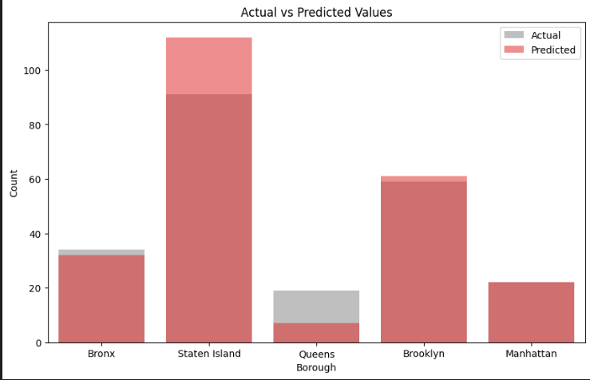
Key Findings from Model 2
While implementing model 2, we learned about preprocessing techniques that can improve the performance of the model by reducing the impact of outliers and selecting only the most relevant features. Our accuracy score was about 88.4%, which is very high, and the model was very efficient, taking only .2s to run. Overall, this model exceeded our expectations.

Slide 17

Confusion Matrix for Model 2

Slide 18
Variations between the models
Model 1:
Uses RandomForestClassifier, GradientBoostingClassifier, and VotingClassifier in combination to create a model
Model 2:
Uses LogisticRegression, DecisionTreeClassifier, and VotingClassifier in combination to create model
Data is preprocessed using StandardScaler and SelectKBest
GOAL
Predict Borough
ACCURACY: 86.3%
ACCURACY: 88.4%

Slide 19
Advantages and Disadvantages
The advantage of the first model is that it is simpler to train and evaluate. It also uses two different types of models which may help in capturing different aspects of the data. The disadvantage is that it does not involve any feature selection or scaling which may negatively impact the performance of the model.
The advantage of the second model is that it uses feature scaling and selection which may improve the performance of the models. The disadvantage is that it involves more steps and is more complex, which may lead to longer creation and evaluation times. Additionally, it may be more difficult to interpret the results due to the additional preprocessing steps involved. Another disadvantage is that using Decision Trees can become very complicated quickly when training on large datasets.

Slide 20
Which bests suites the objective?
According to the accuracy score and run time, Model 2 is slightly better suited for the objective of predicting Boroughs. Also, it uses a more comprehensive preprocessing approach by incorporating a few preprocessing steps in a pipeline before fitting the model. This includes Standard Scaling the data and using SelectKBest to reduce the impact of irrelevant features.
Although Model 2 outperformed Model 1, the difference between that and Model 1’s performance is small. If we consider the difficulty of implementation, Model 1 may perform slightly better since it’s a slightly more simple model and almost performs the same as Model 2 which is a bit more complex.
Also, if we consider that this was based off of a single dataset, Model 1 may perform better on a larger or smaller dataset, but we won’t know for sure since it wasn’t tested on any other size set.
So, going purely off of our results, Model 2 best suites the objective.

