Slide 1
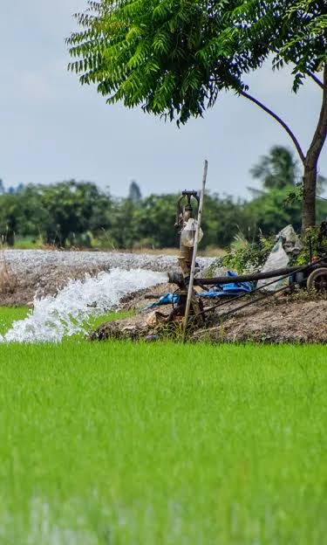
PHOTO SLOT
Wide shot: irrigated paddy or wheat field at dawn
ZINNOVATIO 4.0 · GEN Z INNOVATIONS HACKATHON
Track: AgriTech & Rural Transformation
AquaShift
Water-constrained crop planning and diversification simulator
Simulate crop choices under the competing limits of water, food production and farmer income.
Team: NullPointers
Team Members:
JAIDEEP SINGH
GURNOOR KAUR
SHEKHAR SHARMA
YASHIKA CHANDEL
AYUSH RANA

Slide 2
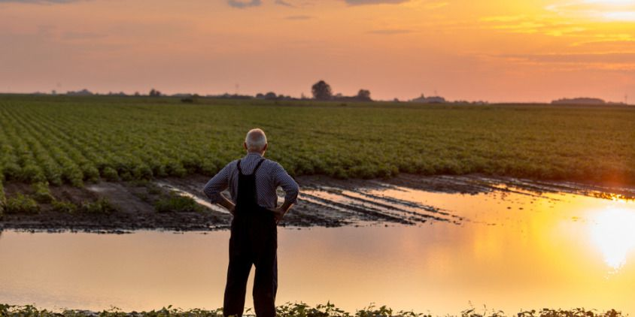
Agriculture has competing constraints, not one problem
Water
PHOTO SLOT
Dry or cracked field beside irrigation canal
Falling groundwater and limited irrigation. Water-hungry crops like paddy strain the same aquifers they depend on.
Food
Food-production requirements must still be met while the crop mix changes.
Farmer income
THE MISSING QUESTION
Farmers cannot switch crops without economic consequences. Any plan must protect livelihoods.
“Given limited water, what should we grow instead, and what will it cost in food and farmer income?”
Today: data → existing tools (advisories, satellite, market) → information. Missing: a decision layer that works under constraints.

Slide 3
How AquaShift works
USER INPUTS
Land
Water budget
Crop choices
Food target
Income target
Rainfall scenario
CORE PIPELINE
1
2
3
4
5
6
Scenario
ML predictor
Optimizer
Stress test
AI insight
Crop plan
Land, water, targets, climate
Yield and water-use effects
Crop allocation with OR-Tools
Finds bottlenecks when targets conflict
LLM explains in plain language
Water, food, income impact
ML predicts
Optimization decides
AI explains
scenario effects on yield and water demand
the allocation under hard and soft constraints
the result. The LLM is never the optimizer.

Slide 4
Constraint stress test: never “infeasible”
EXTREME SCENARIO
STANDARD SOLVER VS AQUASHIFT
BOTTLENECK DIAGNOSIS
Water availability
−80%
Solver says: INFEASIBLE
Water
Critical
Income
High
Income target
+50%
Constraint stress event
AquaShift names the bottleneck and returns the closest feasible plan using soft constraints and slack variables.
Food
Moderate
Food target
+10%
CLOSEST FEASIBLE ALLOCATION (ILLUSTRATIVE)
Paddy · Wheat · Maize · Pulses · Millets
OR-Tools optimization · Soft constraints · Slack variables · Scenario modelling · ML parameter estimation · LLM explanation

Slide 5
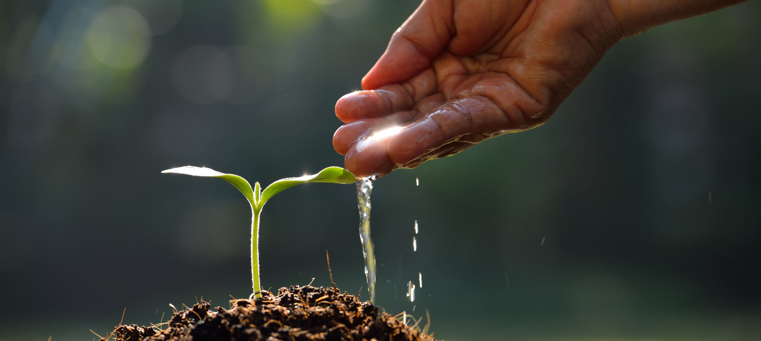
Who it serves, and how we build it
TARGET USERS
PHOTO SLOT
Farmers or FPO members planning together
District planners
FPOs / cooperatives
Agribusinesses
Diversification and water-policy scenarios
Collective seasonal crop planning
Supply planning under climate and water limits
36-HOUR MVP
Data
ML
Optimization
UI
AI explanation
Data: public agricultural statistics, historical weather, crop and agronomic data, synthetic demo data where needed.
2-minute demo: baseline plan → water −20% → optimize → new allocation and impact → extreme scenario → stress test.
Plan crops. Balance water. Protect livelihoods.

