Slide 1
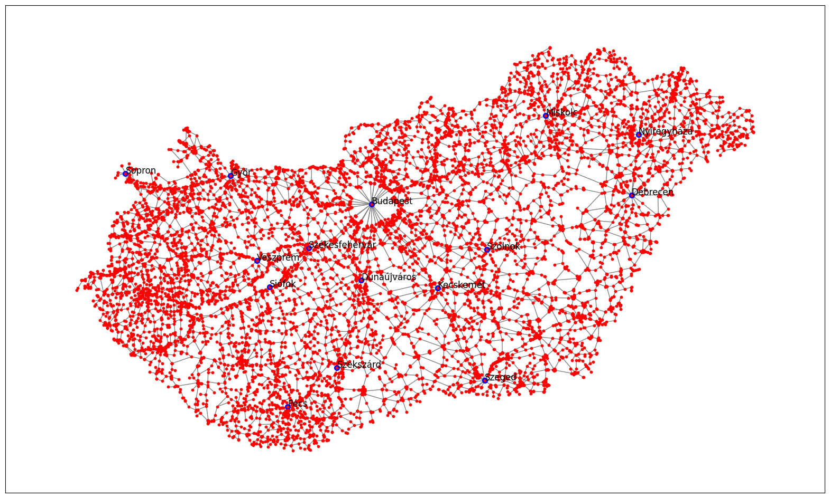
Origin-destination mobility flow inference from traffic data
Hungary
Mihály Hanics, Márton Karsai, Gergely Ódor
CEU DNDS

Slide 2
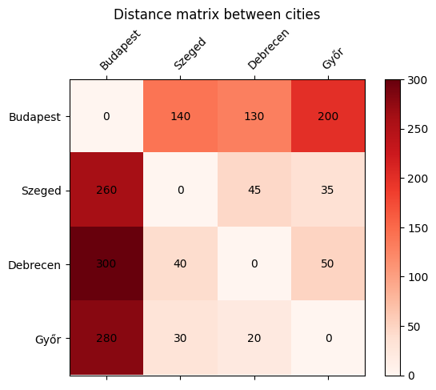
Current methods for ODM estimation
Inter-settlement origin-destination matrix
Origin – destination pairs: For each location pair, the number of people travelling (commuting) between the two places over a time period (e.g. per day) is represented.
Usecases: We would like to use them for epidemic spreading modelling. Common uses include: human mobility and traffic congestion prediction, human behaviour studies.
Challenges: Directly measured data is rare, inferring from certain types of data can raise other concerns (e.g. privacy)
Census data is only collected once over multiple years.
Goal: An alternative way to create Hungary’s O-D matrix with high accuracy and great resolution.
An example for an O-D matrix: rows represent
the origin locations, columns the destinations. The
stored value would equal the commuters inbetween

Slide 3
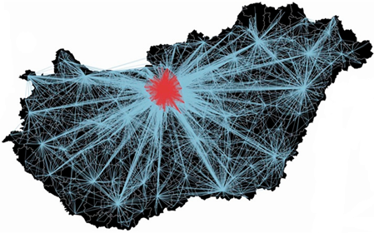
Current methods for ODM estimation
Ground truth data from census
Hungarian Central Statistical Office (KSH) 2016:
Settlement statistics: population, latitude-longitude
Commuting from one settlement to another:
includes commuting to school, and to work
Both datasets include each settlement / pair of settlements where there is at least one commuter.
~3200 settlements, ~93000 pairs (non-zero commution)
Commuting map in Hungary, from self-reported data [1]

Slide 4
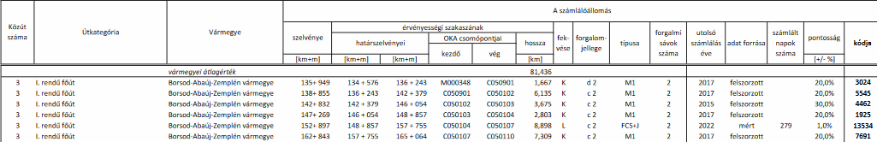
Current methods for ODM estimation
Observational data: Road traffic volume
Hungarian Public Roads 2022:
Nation-wide daily public road traffic measurements, average over a year
Vehicle counts on ~14000 road segments, e.g. highways. Subcategory counts too such as heavy vehicles, bicycles
Geographical data
Some extra information on measurement

Slide 5
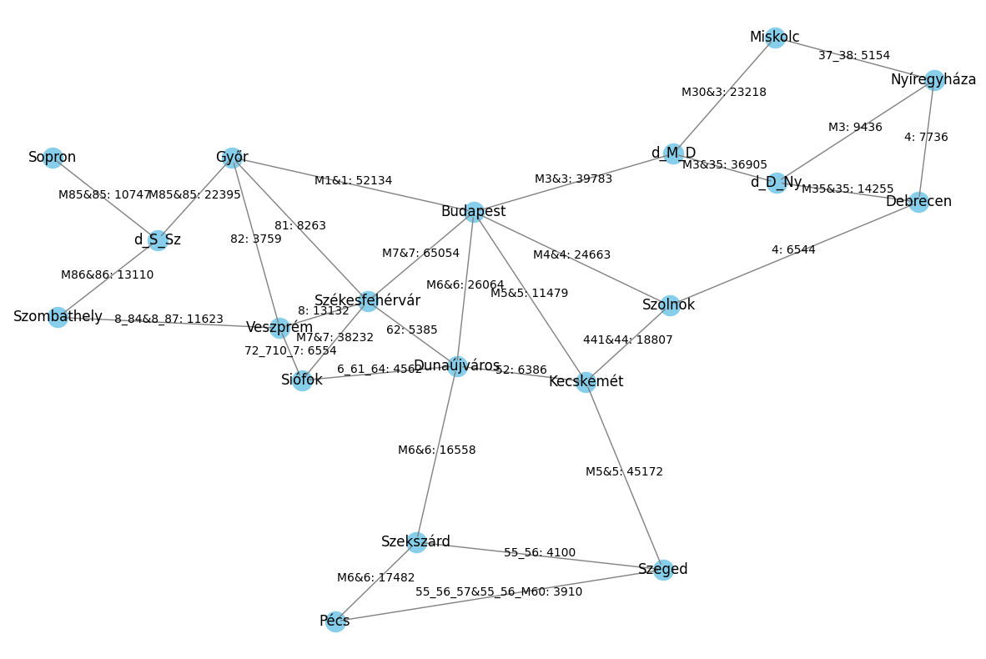
Current methods for ODM estimation
Test network construction
„Proof of concept”
In accordance with the traffic data.
Small network:
16 cities, 3 highway division points
Nodes represent the locations, edges are roads, possibly multiple roads
Weight: The minimum traffic volume on the road segments represented by the edge
Parallel edges may appear between two nodes (e.g. road 4 and highway M4), these are combined into one (sum)

Slide 6
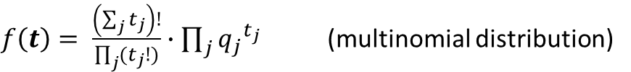


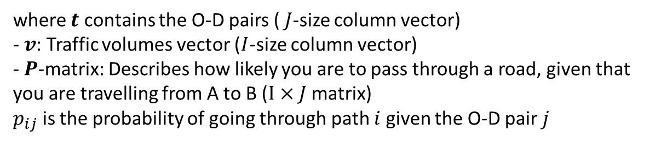



Current methods for ODM estimation
Models - methods
Model 1 - Gravity
Model 2 - Bell
$$T_{ij}=K\frac{m_{i}^{α}m_{j}^{β}}{f(d_{ij})}$$
Other methods optimize an objective function subject to constraints:
$$\max{f\left(t\right)}$$
assuming
$$v=Pt$$
where:
- $T_{ij}$: number of trips from zone $i$ to zone $j$
- $m_{i}^{},m_{j}^{}$relate to the number of trips leaving location $i$ / attracted by location $j$
- $d_{ij}$: the distance between zones i and $j$
- $f$ „deterrence function”: decreasing number of trips as the distance increases
- $K$: constant of proportionality
For us: $f$: power law (exponent estimated), $α=1$, $K$ comes from the total trips sum
where $t$ contains the O-D pairs ($J$-size column vector)
- $v$: Traffic volumes vector ($I$-size column vector)
- $P$-matrix: Describes how likely you are to pass through a road, given that you are travelling from A to B ($I×J$ matrix)
$p_{ij}$ is the probability of going through path $i$ given the O-D pair $j$
The Bell-model maximizes the probability of observing $t$ given probabilities $q$
$f\left(t\right)= \frac{\left(\sum_{j}{t_{j}}\right)!}{\prod_{j}{(t_{j}!)}}∙\prod_{j}{{q_{j}}^{t_{j}}}$ (multinomial distribution)
$q$is estimated by normalizing an initial guess: $q_{j}= \frac{t_{j}^{\sim }}{\sum_{i}{t_{i}^{\sim }}}$
We use the scikit-mobility models to estimate an O-D matrix [2]

Slide 7

Current methods for ODM estimation
P-matrix in practice
Between all pairs of locations, all shortest paths are computed
For each N shortest path, $\frac{1}{N}$ is added to its edges
Works well on this scale

Slide 8
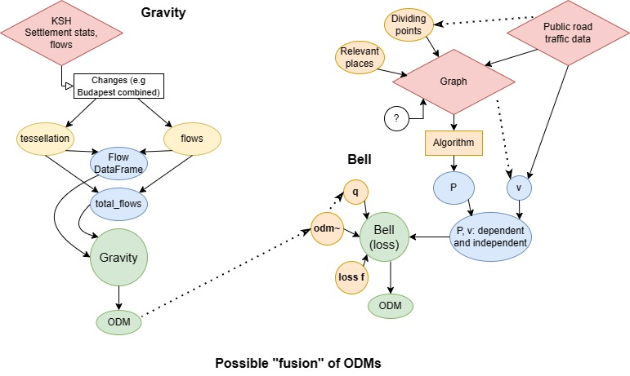
Current methods for ODM estimation
Gravity, Bell models pipeline

Slide 9
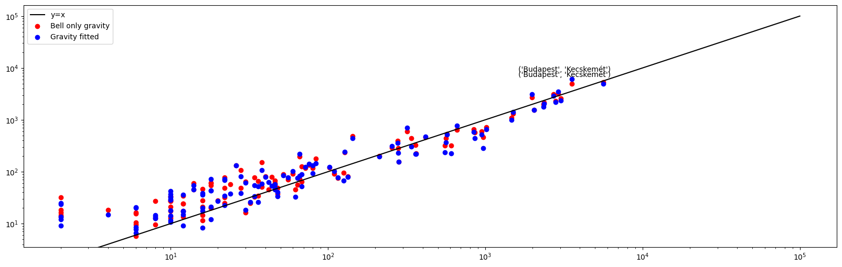
Current methods for ODM estimation
Results on the small graph
 | Corr | MSE | MAE | Relative diff^2 | Better prediction
Gravity | 95.8% | 62479 | ~124 | 1103 | 49
Bell from Gravity | 97.4% | 37298 | ~94 | 1138 | 71

Slide 10
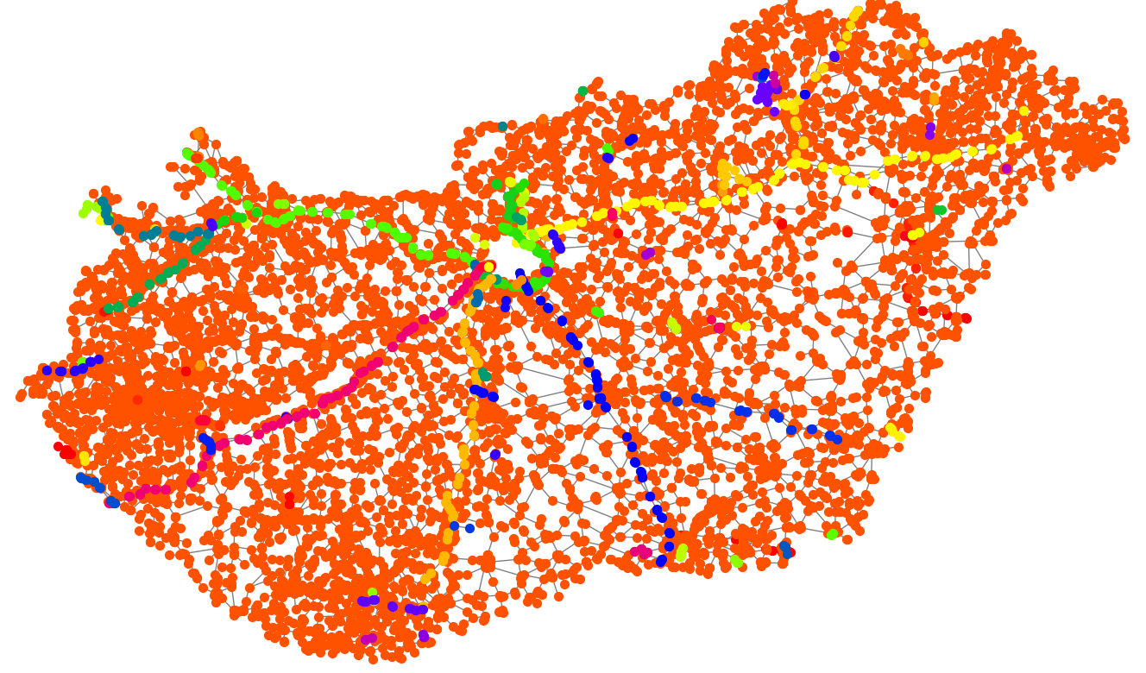
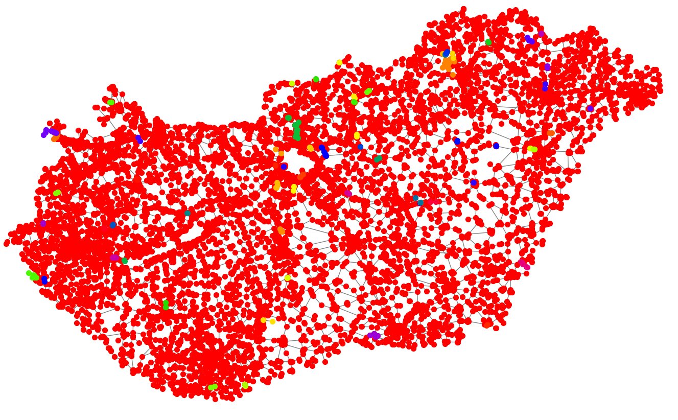

Current methods for ODM estimation
Next steps, future directions
Scale up the network to as large as we can
Issues:
Technical issues e.g. different components (see figures on left)
P-matrix creation
Computation time
Run the analysis for monthly data between 2016 and 2022

Slide 11
References
[1] Ódor G, Czifra D, Komjáthy J, Lovász L, Karsai M. Switchover phenomenon induced by epidemic seeding on geometric networks. Proceedings of the National Academy of Sciences. 2021;118(41):e2112607118. pmid:34620714
[2] Pappalardo, L., Simini, F., Barlacchi, G., & Pellungrini, R. (2022). scikit-mobility: A Python Library for the Analysis, Generation, and Risk Assessment of Mobility Data. Journal of Statistical Software, 103(1), 1–38.
Data:
Nemzeti Adathozzáférési Pont – Magyar Közút Nonprofit Zrt.: Éves keresztmetszeti forgalmi adatok (2022)
https://napportal.kozut.hu/
Központi Statisztikai Hivatal - https://www.ksh.hu/

