Slide 1
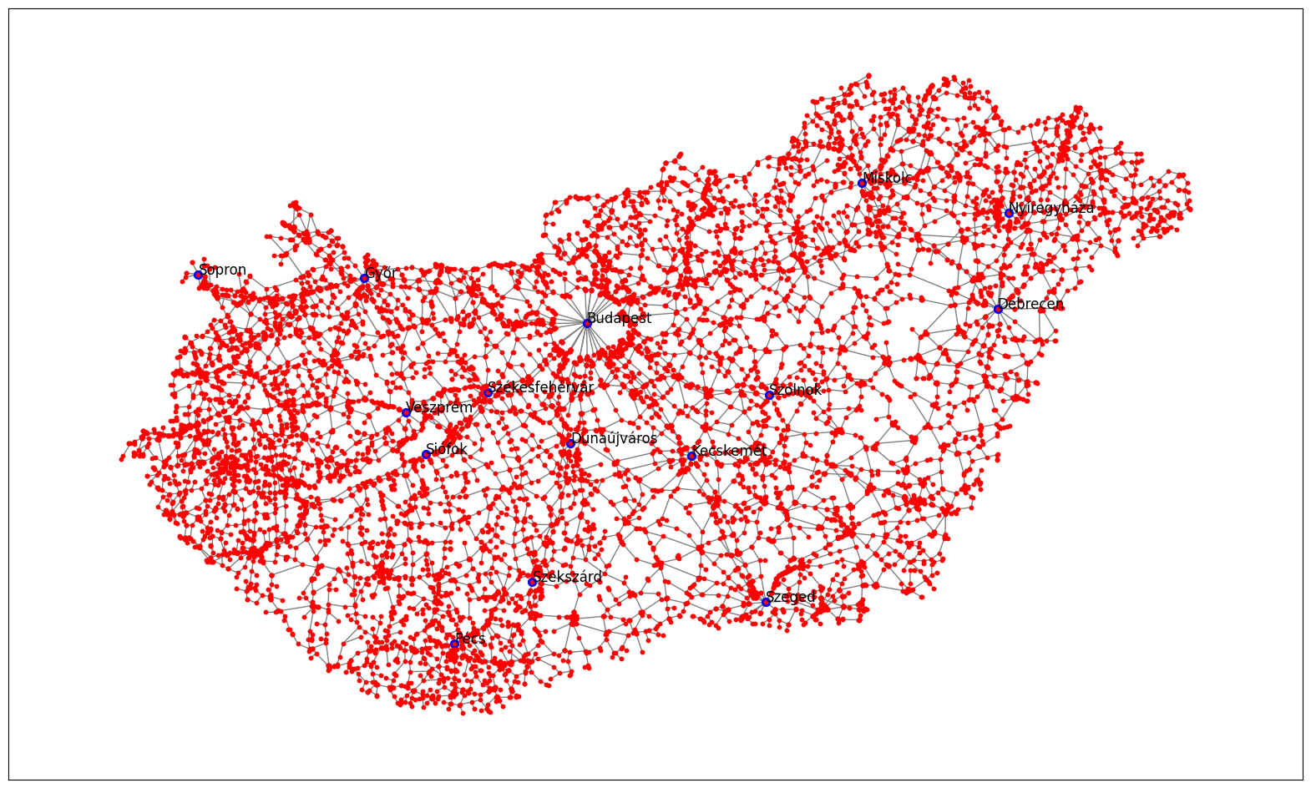
Origin-destination mobility flow inference from traffic data
Hungary
Mihály Hanics
CEU DNDS
Advisors: Márton Karsai, Gergely Ódor

Slide 2
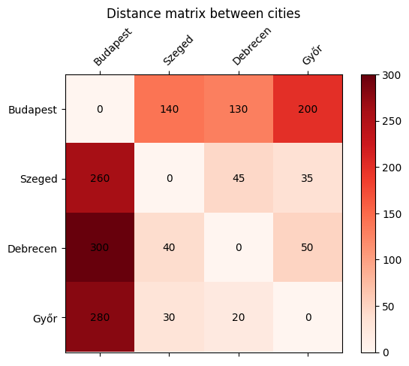
Current methods for ODM estimation
Inter-settlement origin-destination matrix
Problem: We would like to know how many people commute from a Hungarian city/town/settlement to others regularly.
Origin – destination pairs: For each location pair, the number of people travelling (commuting) between the two places over a time period (e.g. per day) is represented.
Usecases: Epidemic spreading modelling (our main interest), human mobility, traffic and traffic congestion prediction, human behaviour studies.
Challenges: Directly measured data is rare, inferring from certain types of data can raise other concerns (e.g. privacy)
Census data is only collected once over multiple years.
Goal: An alternative way to create Hungary’s O-D matrix with high accuracy and great resolution.
An example for an O-D matrix: rows represent
the origin locations, columns the destinations. The
stored value would equal the commuters inbetween

Slide 3
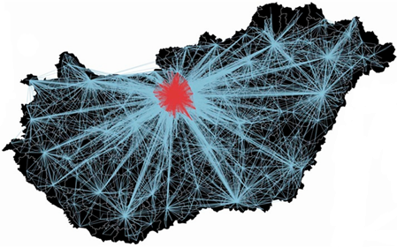
Current methods for ODM estimation
Ground truth data from census
Hungarian Central Statistical Office (KSH) 2016:
Data 1: Settlement statistics: population, latitude-longitude
Data 2: Commuting from one settlement to another:
includes commuting to school, and to work
Both datasets include each settlement / pair of settlements where there is at least one commuter.
~3200 settlements, ~93000 pairs (non-zero commution)
Commuting map in Hungary, from self-reported data [Ódor 2022]

Slide 4
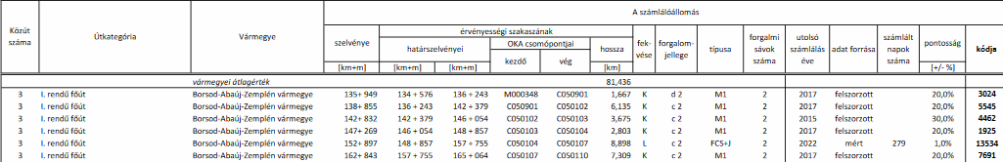
Current methods for ODM estimation
Observational data: Road traffic volume
Hungarian Public Roads 2022:
Nation-wide daily public road traffic measurements, average over a year
Vehicle, heavy vehicle, bicycle counts 14000 road segments, e.g. highways.
Geographical data
Some extra information on measurement

Slide 5
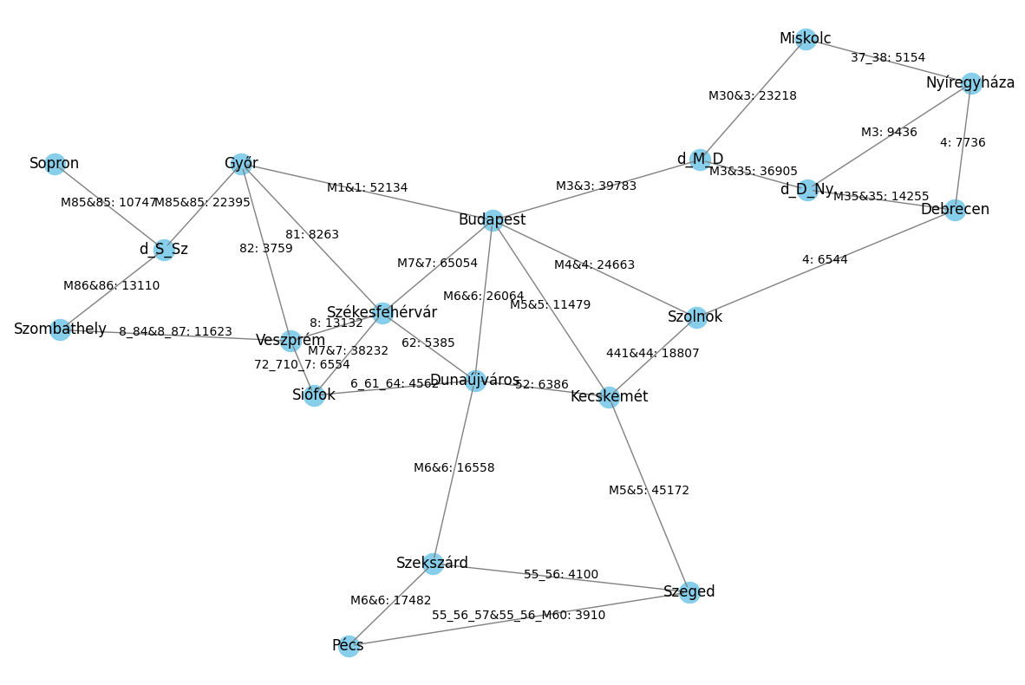
Current methods for ODM estimation
Test network construction
„Proof of concept”
In accordance with the traffic data.
Small network:
16 cities, 3 highway division points
Nodes represent the locations, edges are roads, possibly multiple roads
Weight: The minimum traffic volume on the road segments represented by the edge
Parallel edges may appear between two nodes (e.g. road 4 and highway M4), these are combined into one (sum)

Slide 6
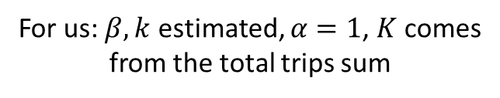
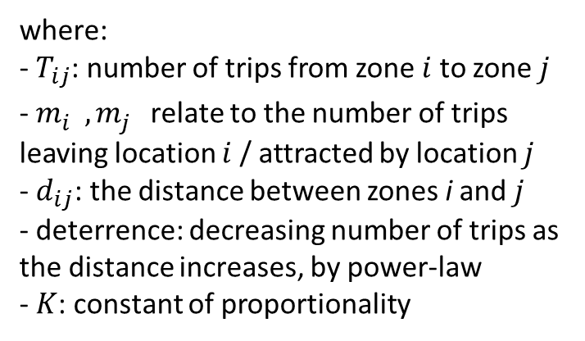

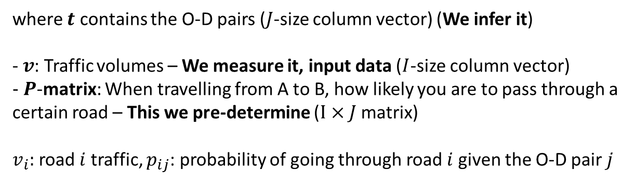


Current methods for ODM estimation
Models - methods
Gravity [Parsons 1960]
Bell [Bell 1983]
$$T_{ij}=K\frac{m_{i}^{α}m_{j}^{β}}{{d_{ij}}^{k}}$$
Other methods optimize an objective function subject to constraints:
$$\max{f\left(t\right)}$$
assuming
$$v=Pt$$
where:
- $T_{ij}$: number of trips from zone $i$ to zone $j$
- $m_{i}^{},m_{j}^{}$relate to the number of trips leaving location $i$ / attracted by location $j$
- $d_{ij}$: the distance between zones i and $j$
- deterrence: decreasing number of trips as the distance increases, by power-law
- $K$: constant of proportionality
where $t$ contains the O-D pairs ($J$-size column vector) (We infer it)
- $v$: Traffic volumes – We measure it, input data ($I$-size column vector)
$− P$-matrix: When travelling from A to B, how likely you are to pass through a certain road – This we pre-determine ($I×J$ matrix)
$v_{i}:$ road $i$ traffic, $p_{ij}$: probability of going through road $i$ given the O-D pair $j$
For us: $β, k$ estimated, $α=1$, $K$ comes from the total trips sum
Bell-model: maximizes the probability of observing $t$ given initial probabilities
We use the scikit-mobility models to estimate an O-D matrix [Pappalardo 2022]

Slide 7
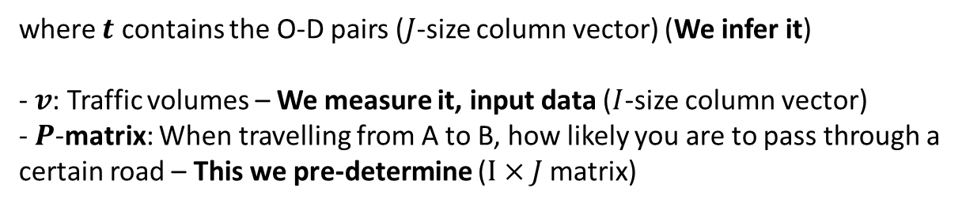
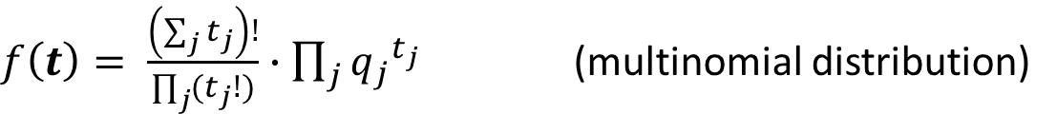
Current methods for ODM estimation
Models - methods
Gravity [Parsons 1960]
Bell [Bell 1983]
$$T_{ij}=K\frac{m_{i}^{α}m_{j}^{β}}{{d_{ij}}^{k}}$$
Other methods optimize an objective function subject to constraints:
$$\max{f\left(t\right)}$$
assuming
$$v=Pt$$
where:
- $T_{ij}$: number of trips from zone $i$ to zone $j$
- $m_{i}^{},m_{j}^{}$relate to the number of trips leaving location $i$ / attracted by location $j$
- $d_{ij}$: the distance between zones i and $j$
- deterrence: decreasing number of trips as the distance increases, by power-law
- $K$: constant of proportionality
where $t$ contains the O-D pairs ($J$-size column vector) (We infer it)
- $v$: Traffic volumes – We measure it, input data ($I$-size column vector)
- $P$-matrix: When travelling from A to B, how likely you are to pass through a certain road – This we pre-determine ($I×J$ matrix)
Bell-model: maximizes the probability of observing $t$ given probabilities $q$
$f\left(t\right)= \frac{\left(\sum_{j}{t_{j}}\right)!}{\prod_{j}{(t_{j}!)}}∙\prod_{j}{{q_{j}}^{t_{j}}}$ (multinomial distribution)
For us: $β, k$ estimated, $α=1$, $K$ comes from the total trips sum
We use the scikit-mobility models to estimate an O-D matrix [Pappalardo 2022]

Slide 8
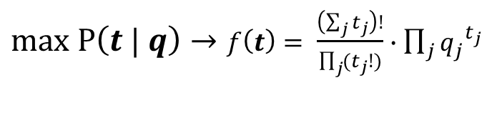









Bell-model in practice
Optimization:
$$\max{f\left(t\right)}$$
assuming
$$v=Pt$$
Bell:
$max P\left(t | q\right)→f\left(t\right)= \frac{\left(\sum_{j}{t_{j}}\right)!}{\prod_{j}{(t_{j}!)}}∙\prod_{j}{{q_{j}}^{t_{j}}}$
assuming multinomial distributions
$q:$ Estimated by normalizing an initial guess: $q_{j}= \frac{t_{j}^{\sim }}{\sum_{i}{t_{i}^{\sim }}}$
$P:$ Shortest paths - Between all pairs of locations, all shortest paths are computed.
For each of the N shortest paths between two locations, $\frac{1}{N}$ is added to a path’s edges
Some constraints in practice conflict -> use them as loss (L1 mostly)
$$\left(\begin{aligned}\begin{aligned}\begin{matrix}⋯ & 0 & ⋯ \\ & ⋮ & \\ ⋯ & 0.5 & ⋯\end{matrix} \\ \begin{matrix} & ⋮ & \\ ⋯ & 0.5 & ⋯\end{matrix}\end{aligned} \\ \begin{matrix}\text{⋰} & ⋮ & ⋱\end{matrix}\end{aligned}\right)$$
$$0.5$$
$$0.5$$
$$0.5$$
$$0.5$$

Slide 9
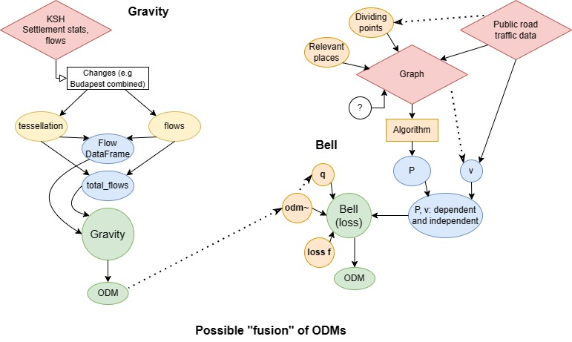
Current methods for ODM estimation
Gravity, Bell models pipeline

Slide 10
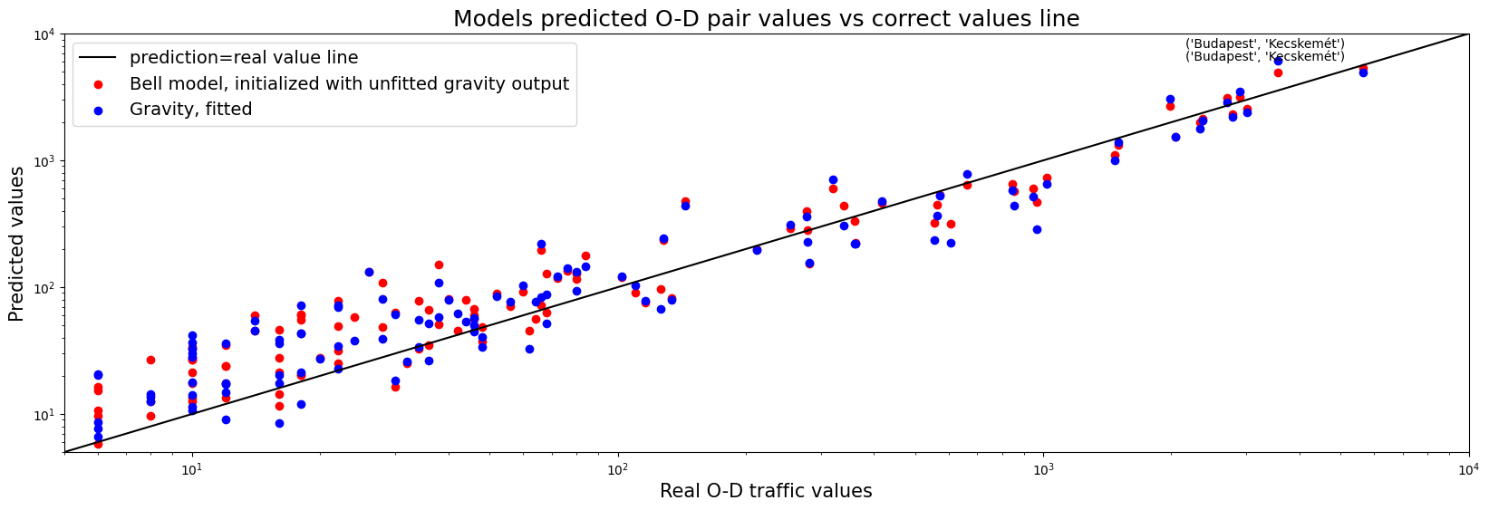
Current methods for ODM estimation
Results on the small graph
 | Correlation | MSE | MAE | Relative diff^2 | Better prediction
Gravity | 95.8% | 62479 | ~124 | 1103 | 49
Bell from Gravity | 97.4% | 37298 | ~94 | 1138 | 71
Bell model improves on the initial model
This is true for the gravity model, but other tested models: entropy min/max. Superior especially in large O-D values.

Slide 11
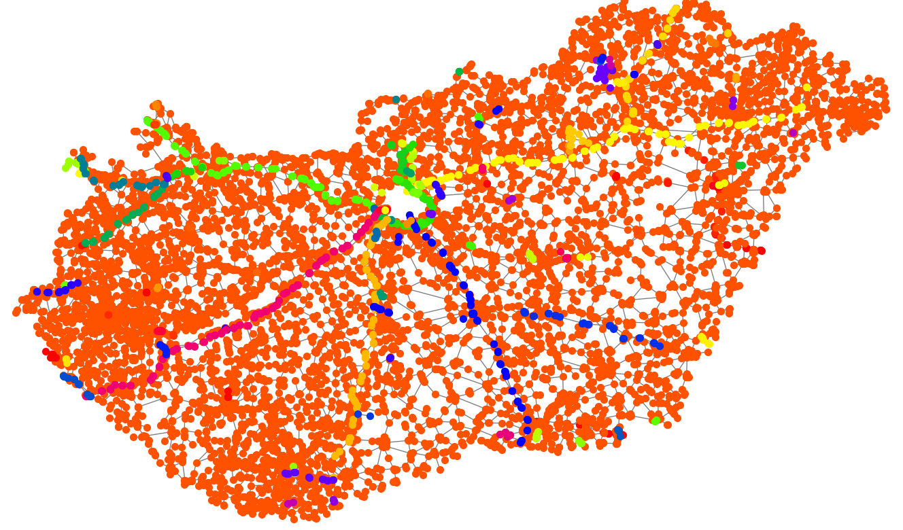

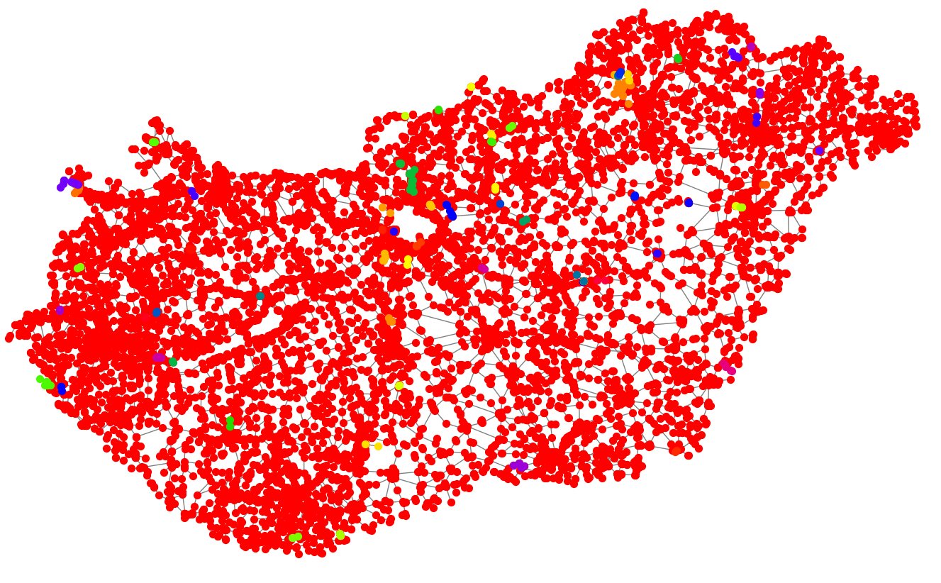

Current methods for ODM estimation
Next steps, future directions
Scale up the network to as large as we can: all roads, more settlements
Issues:
Technical issues e.g. different components (see figures on left)
The connected network from adding new edges and combining nodes.

Slide 12
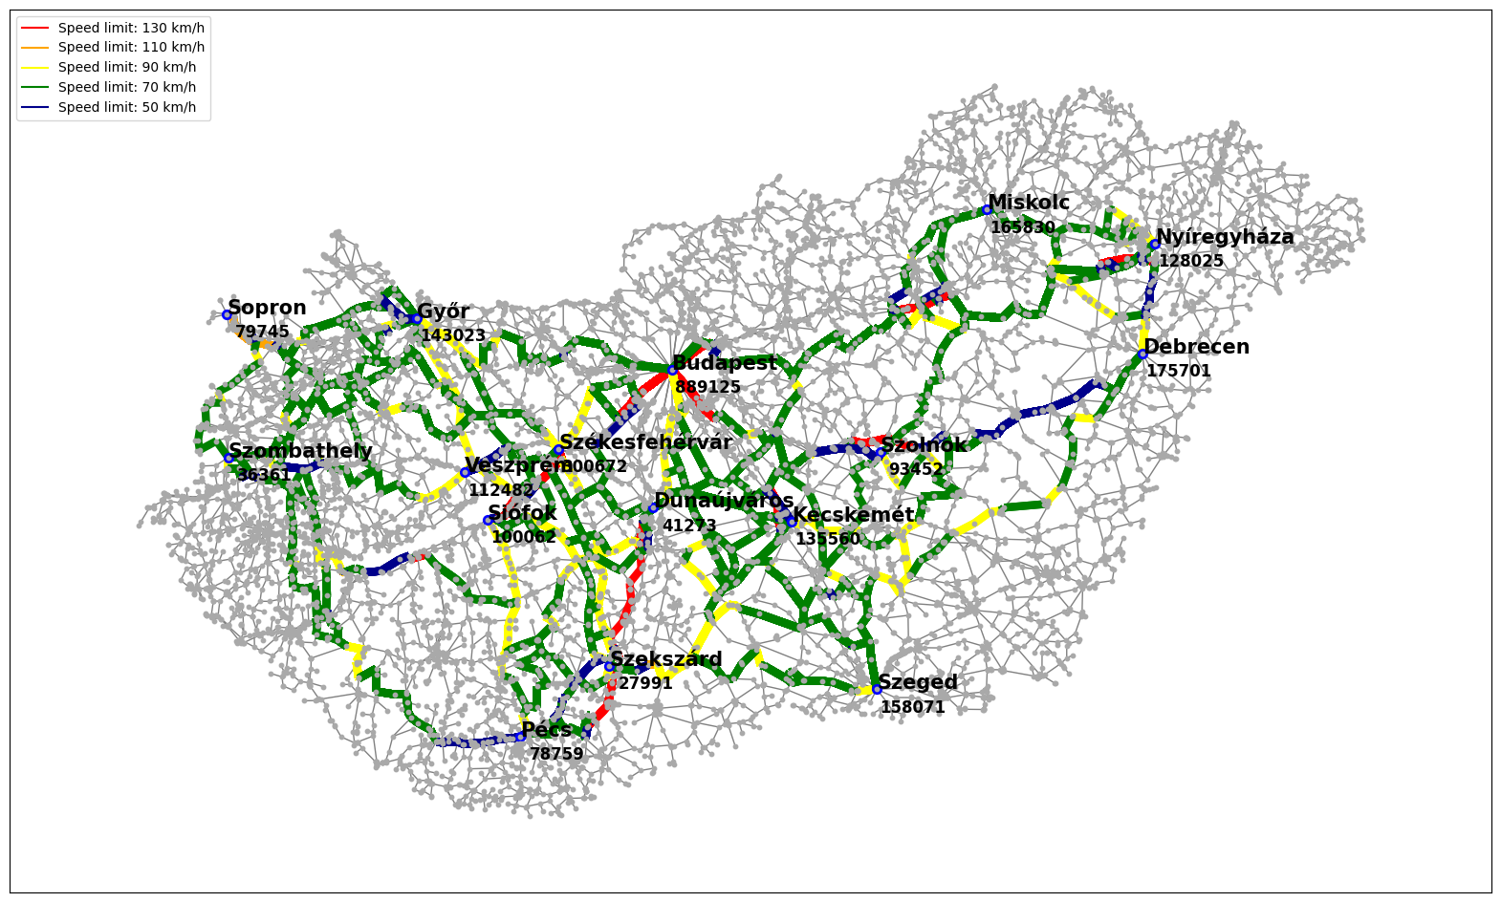
Current methods for ODM estimation
Next steps, future directions
Scale up the network to as large as we can: all roads, more settlements
Issues:
P-matrix creation: shortest path works weakly + we need multiple found paths

Slide 13
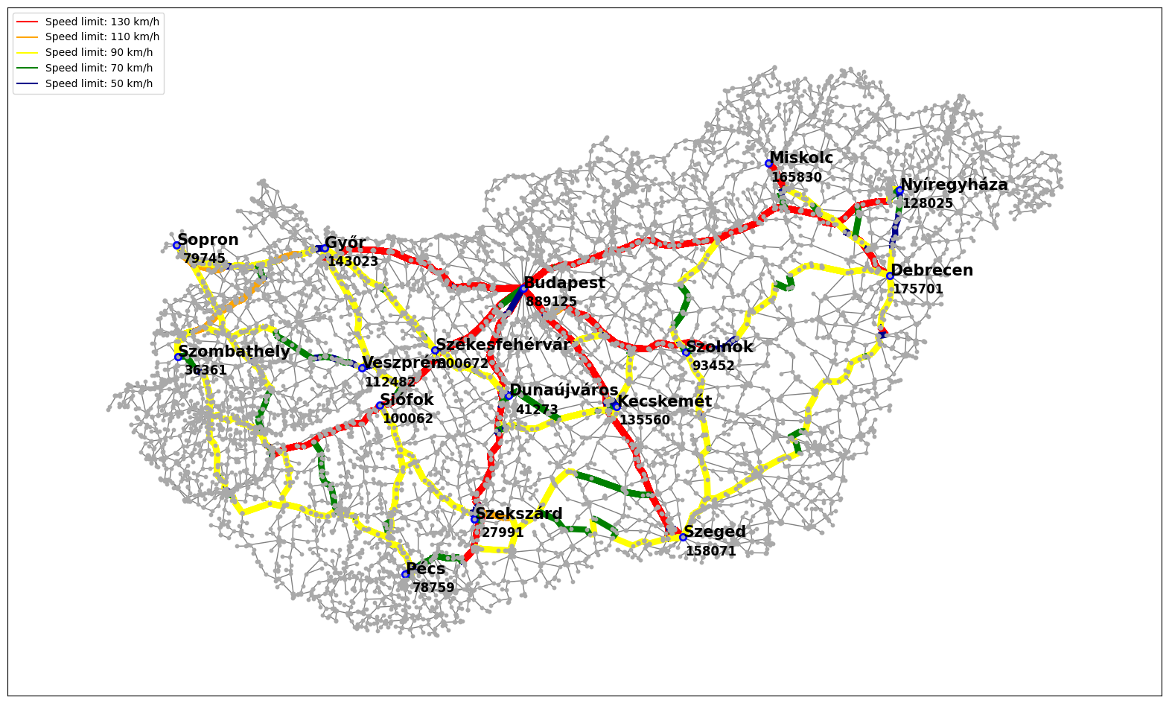
Current methods for ODM estimation
Next steps, future directions
UPDATE:
Shortest time routes seem to work well.
One issue that came up is that now the used roads are „too crowded”-> low O-D value predictions

Slide 14
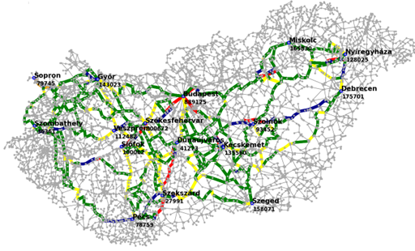
Current methods for ODM estimation
Next steps, future directions
Scale up the network to as large as we can: all roads, more settlements
Issues:
Computation time: optimization ~46 sec for 16 locations, grows fast with more locations
Network creation: finding intersections took 25 mins, overall procedure 30+ mins
Run the analysis for monthly traffic data between 2016 and 2022

Slide 15
References
[Ódor 2021] Ódor G, Czifra D, Komjáthy J, Lovász L, Karsai M. Switchover phenomenon induced by epidemic seeding on geometric networks. Proceedings of the National Academy of Sciences. 2021;118(41):e2112607118. pmid:34620714
[Pappalardo 2022] Pappalardo, L., Simini, F., Barlacchi, G., & Pellungrini, R. (2022). scikit-mobility: A Python Library for the Analysis, Generation, and Risk Assessment of Mobility Data. Journal of Statistical Software, 103(1), 1–38.
[Parsons 1960] Parsons, Christopher R. ‘Do Migrants Really Foster Trade’. The Trade-Migration Nexus, a Panel Approach 2000 (1960).
[Bell 1983] Bell, M. G. (1983). The estimation of an origin-destination matrix from traffic counts. Transportation Science, 17(2), 198-217.
Data:
Nemzeti Adathozzáférési Pont – Magyar Közút Nonprofit Zrt.: Éves keresztmetszeti forgalmi adatok (2022)
https://napportal.kozut.hu/
Központi Statisztikai Hivatal - https://www.ksh.hu/

