Slide 1

Team Number 5 Team America (alt. name): Team America Workout Central Ryan Lin, Bryan Herrera, Seth Furman, Daniel Ekiss

Slide 2

Project Goal
Create an application to help users learn how to exercise efficiently. The application may also provide users with information to workouts that they have never heard of before. Images can show users how to do each exercise. In order to increase the simplicity and ease of use for the application, only buttons and titles will be in the menu and submenus. Our application is unique because users can access it anywhere.

Slide 3
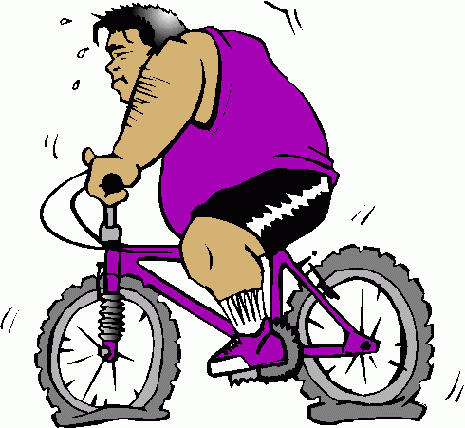
Done So Far
So far we have completed a menu and submenu for the exercises.
Also, we categorized each exercise to the body parts they are
specific for such as upper body, legs, and core.

Slide 4
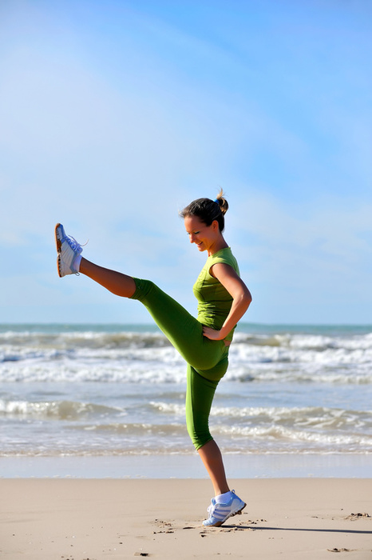
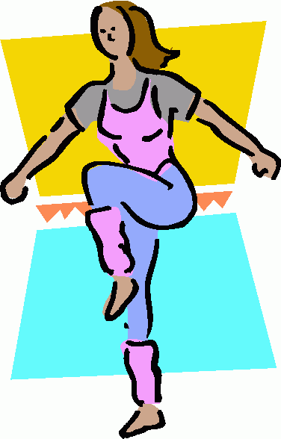
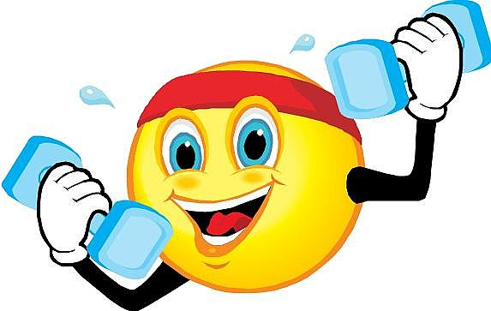
Expect Done By End
The fully released application will have text segments to guide users through respective workouts. The application will not include video segments or graphs to assist users. However, the text-based documents will feature a variety of images to clarify how to complete individual exercise activities.

Slide 5
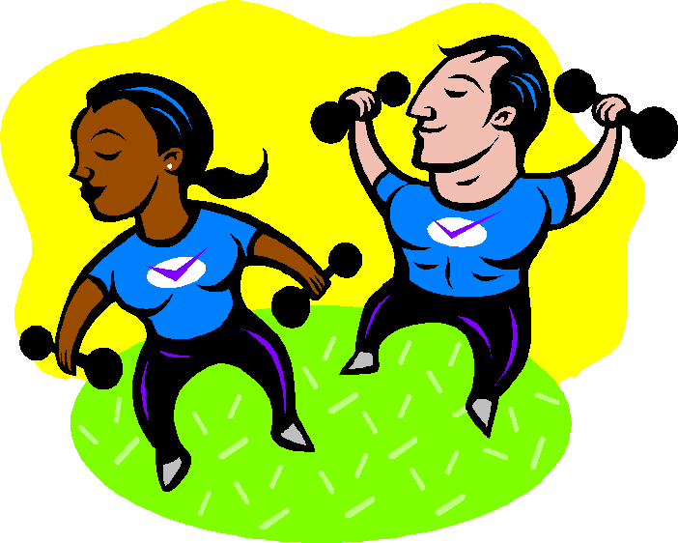
“Full Version”
The full version of the application will utilize the included Xcode default user interfaces. The application will include core exercises, along with upper and lower body to workouts. The tips section will tell users stretches and what to bring when exercising.

