Slide 1

Group # 05 Team America Workout Central Ryan Lin, Bryan Herrera, Seth Furman, Daniel Ekiss
Mobile App Development (iOS)

Slide 2

Project Goal
Our intention is to create an application that helps users learn how to exercise efficiently, and provides them with a simple mechanism to track their fitness.
The application may also provide users with information to workouts that they have never heard of before, and hopefully will inspire users to increase their physical activity. (A current problem in the US and Worldwide)
Images will show users how to do each exercise, and will be accompanied by written instructions.
Our application is unique because it will provide an extremely simple user interface for the casual iPhone user.

Slide 3

Troubles We have had
ERRORS: We’ve encountered numerous errors within the Xcode environment ranging from forgetting a single semicolon ‘;’ to misusing entire methods (aka functions) and concepts. The majority of the builds that we have created have failed in one way or another on multiple occasions due to these errors, which depending on the importance and complexity may be very difficult and frustrating to resolve.

Slide 4
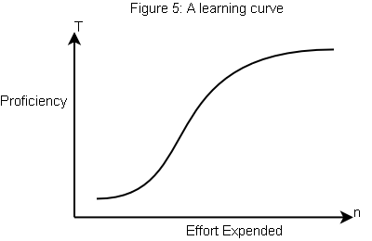
Successes We’ve had
In spite of our troubles with Xcode we’ve been able to create a foundation for the basis of our App.
The Learning Curve: Using Xcode and Objective C was very challenging at the beginning. However, we have begun to progress beyond the initial and painfully slow stages of the learning curve. We are currently making slow, but steady progress in our application, and our confidence level has risen to a reasonable degree.

Slide 5
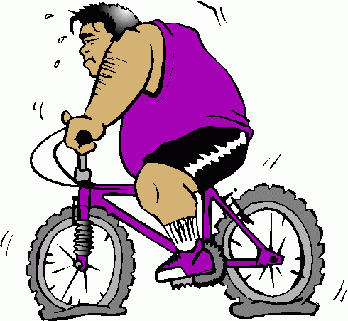
Done So Far
So far we have completed a menu and submenu for the exercises. Also, we categorized each exercise to the body parts they are specific for, such as upper body, legs, and core.
We have begun creating a “Workout Queue”, which will allow users to add exercises to an editable list and edit information related to that exercise (ie reps, time exercised, distance traveled).
Also, we’ve begun to create an alphabetized user interface table view.

Slide 6
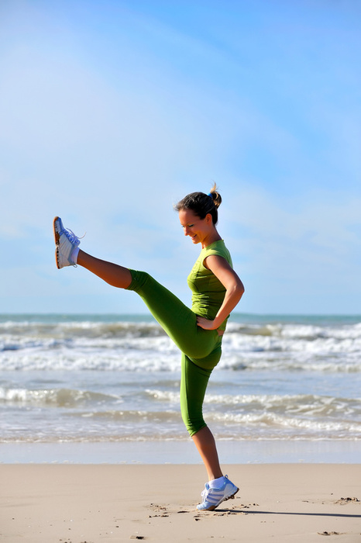
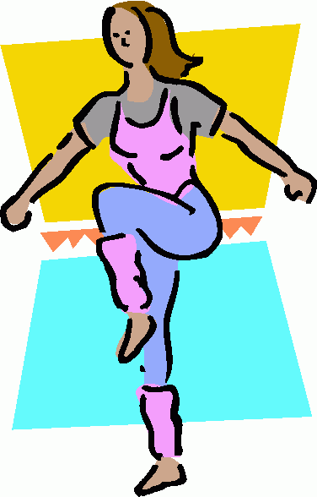

Expect Done By End
The fully released application will have text segments to guide users through respective workouts. The application will not include video segments or graphs to assist users. However, the text-based documents will feature a variety of images to clarify how to complete individual exercise activities. We also expect to create the previously mentioned “Workout Queue”, which (time permitting) may incorporate some of the integrations in the following slide (ie Added labels and fields, data logs, progress tracking integration, etc.)

Slide 7
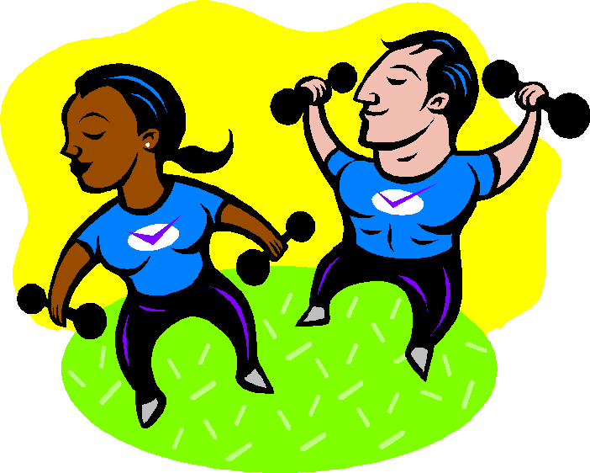
“Full Version”
The full version of the application will utilize the included Xcode default user interfaces. The application will include core exercises, along with upper and lower body workouts. There will be a tips section that provides users with stretches and recommended items to bring with them when exercising. There will also be an integrated progress tracker, which will take information recorded in the workout queue and graph it in several different types of charts. This will include a graphic view of the entire human body from multiple angles (accessible via a tab interface along the bottom of the screen). This diagram will include highlighted muscle groups with colors assigned based on the frequency with which the user has logged (acquired through the workout queue) exercising those specific muscle groups. The workout queue will contain added features to display the pertinent data entered in the workout in a label alongside the item in the table view so the user will not need to access the view in order to check their previously entered information. Previously entered information in the aforementioned view will be stored in a scrollable table so that the user can view stored data logs.

Slide 8
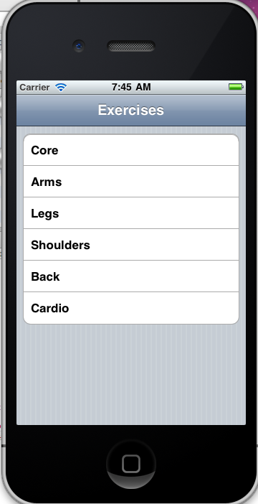
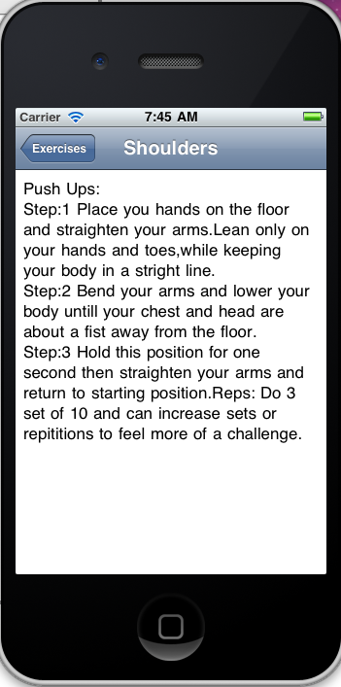
Pictures of our Prototype

