Slide 1
Recipe Rambler
Siddarth Naidu
John Bonanno
Ben Kim
Alexandra Ward
Matt Reyes

Slide 2
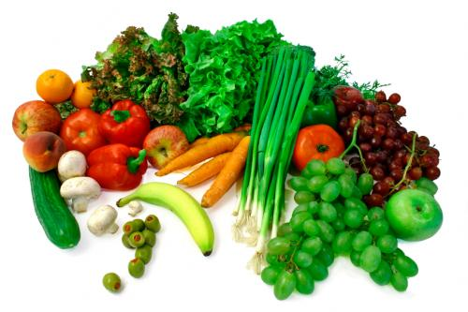
Why recipe rambler
We strive to enable users to envision many prospective meals based upon the ingredients they find in their fridge
By providing instant results an artificial instinct of a master chef is emulated as the user seamlessly interfaces his refrigerator with the recipes found in the database of their iPhone

Slide 3
How will we do it
We will allow the user to filter recipes by not only their ingredients, but also possible categories such as the time it would take to prepare and cook the recipe, whether the meal will be breakfast, lunch or dinner, and also by the difficulty it would take to prepare the meal.
This will hopefully lower the amount of times that the chef gives up on their meal, whether it be tossing their burnt burger into the waste basket or compromising an omelet for scrambled eggs.
Also, hopefully new cooks will be inspired to attempt cooking as our easier recipies are easily

Slide 4
In action…

Slide 5
In conclusion
While our database of recipes and the functionality of the application is still growing,

