Slide 1

SE 207 01 Human-Computer Interaction
Gestalt & Parc principles HW
Meaad Farag Bayuosef
Examining and Redesigning of website
https://www.flipkart.com

Slide 2
Introduction:
We analyzed the https://www.flipkart.com website and found some design errors according to Gestalt & Parc principles that made it difficult for the user to use.
We will correct these errors based on Gestalt & Parc principles.
Gestalt principles:
  Law of Similarity
  Law of Proximity
  Law of Symmetry
  Law of Continuity
  Law of Closure
  Law of Common Fate
  Law of Figure and Ground
Parc principles:
  Proximity
  alignment
  repetition
  contrast

Slide 3
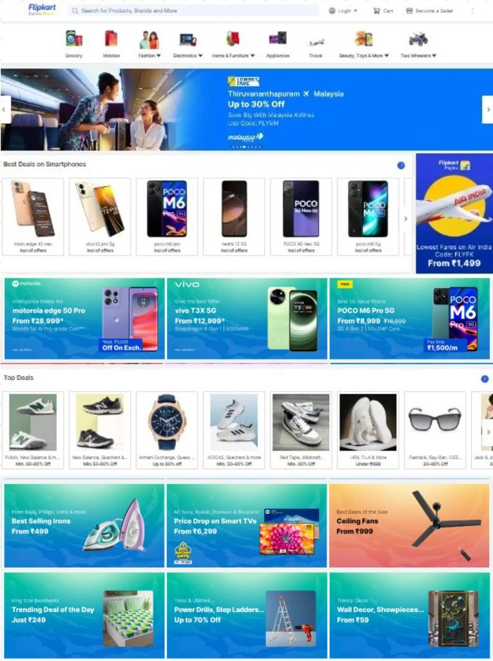
First: redesign as Gestalt principles:
Law of Similarity
The original layout lacked uniformity, making sections appear disjointed and harder to process. We redesigned it by grouping similar items together with consistent framing, creating a unified and organized appearance. This helps users quickly identify related content and navigate the site intuitively.
Before:

Slide 4
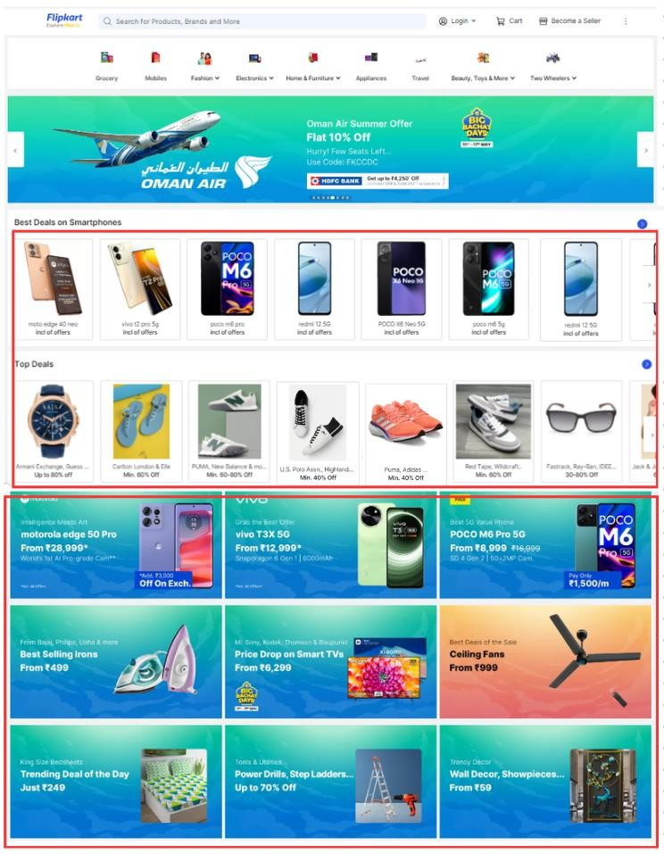
After:

Slide 5
2) Law of Proximity
The same previous example of the law of similarity applies here as well since similar elements should be proximate to each other.
Before:
After:

Slide 6
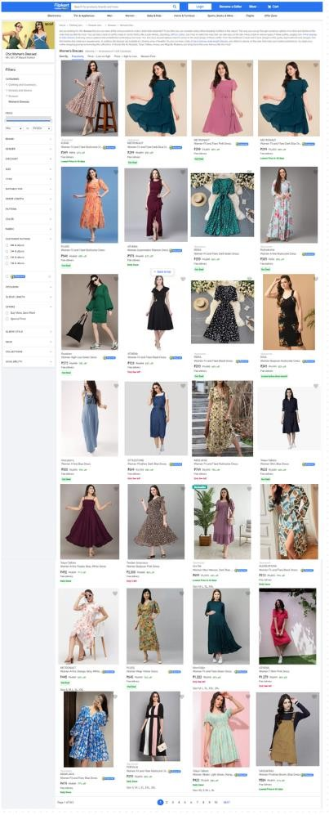
3) Law of Symmetry
During our analysis of the site, we noticed that when accessing most of the different product sections, the pages did not apply the law of symmetry due to the excessive length of the pages resulting in the left side of the site appearing disproportionately empty.
to solve this issue, we made the decision to create more subpages and make the site shorter. Instead of constantly scrolling down past the left menu, content now flows to the next menu page, which effectively reduces the amount of empty white space. Below is an example of one of the pages before and after the redesign. This procedure applies to all pages of the site that have the same problem.
Before:

Slide 7
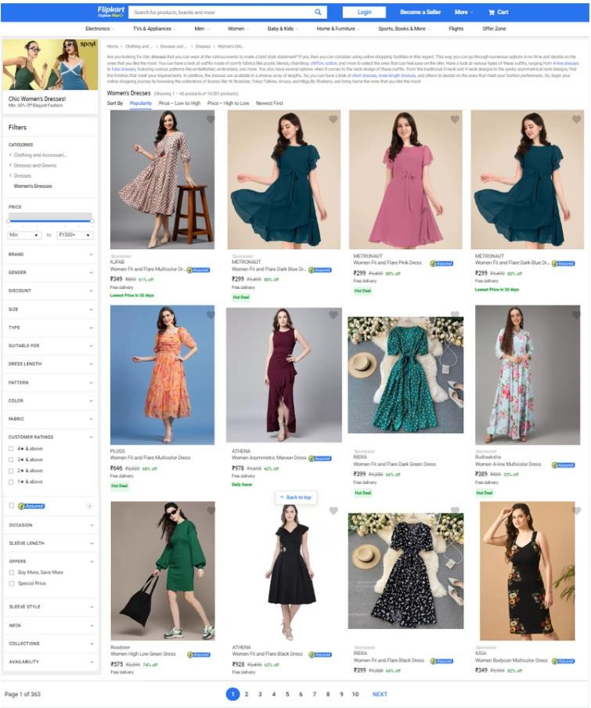
After:

Slide 8
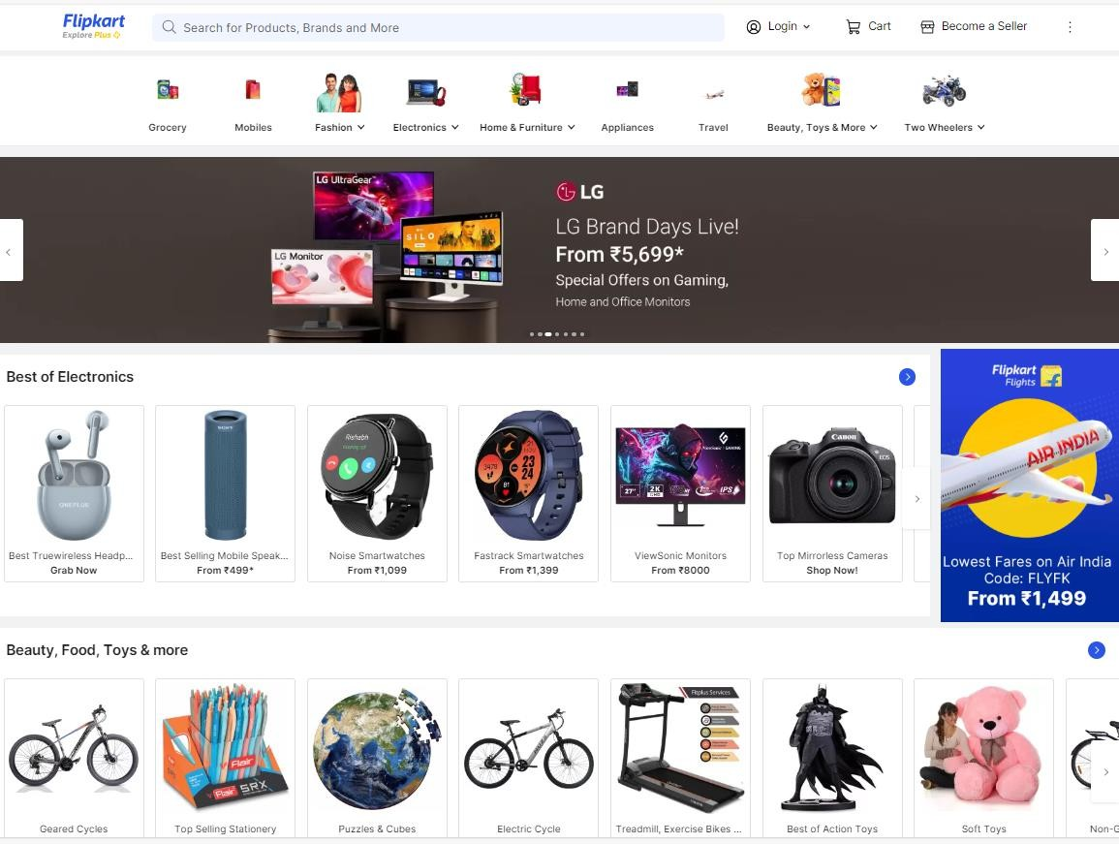
4) Law of Continuity
We did not spot any mistakes about Law of Continuity.
5) Law of Closure
In the images of the menus , the layout lacks clear visual boundaries, making it harder for users to perceive a unified structure.
we redesign to fix, circular frames around the menu items create distinct boundaries, This use of circles helps guide users' attention more effectively and improves the overall visual structure of the site.
Before:

Slide 9
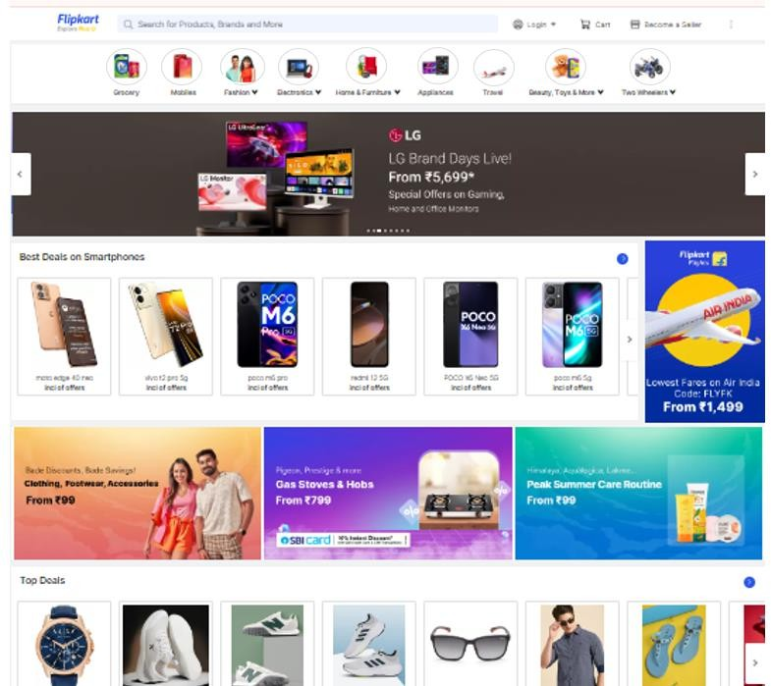
After:

Slide 10
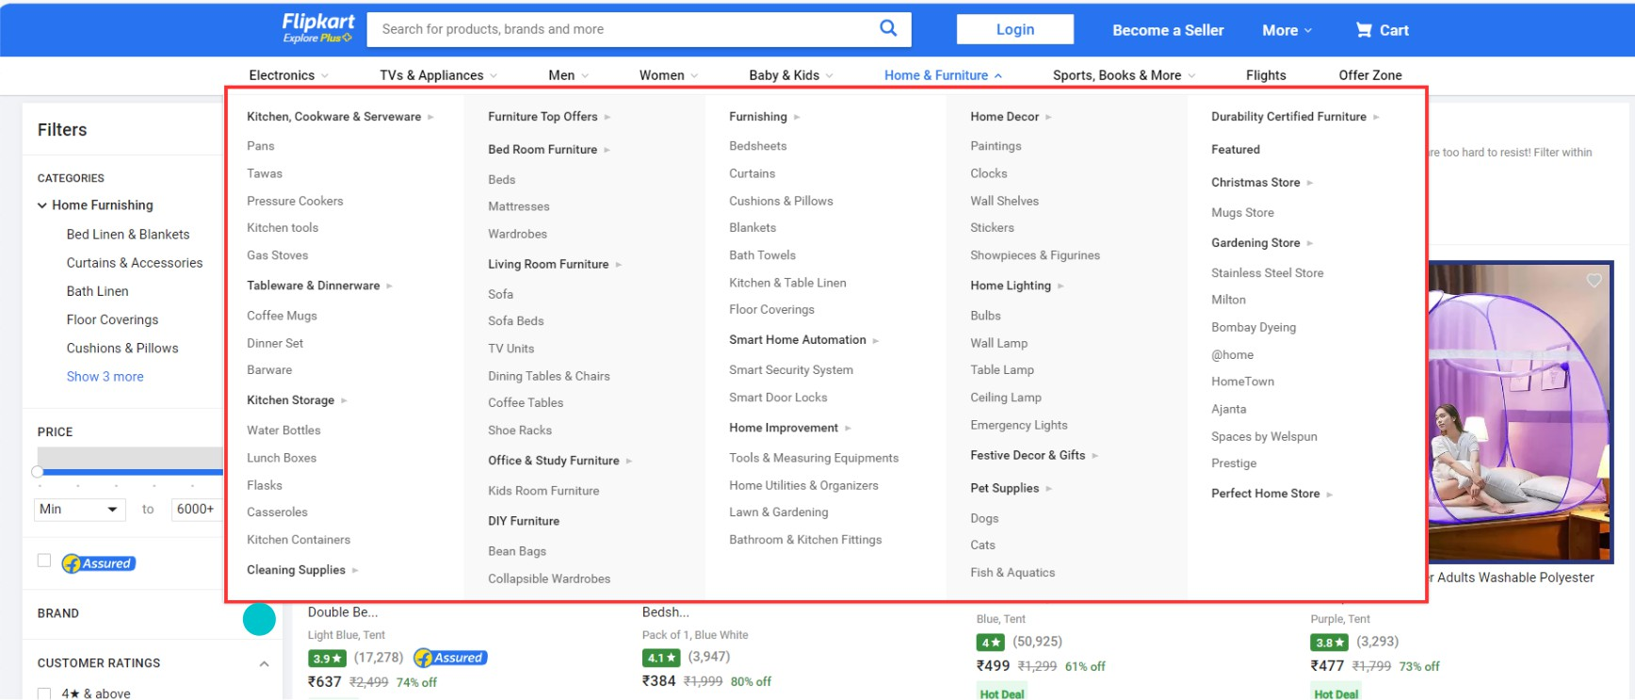
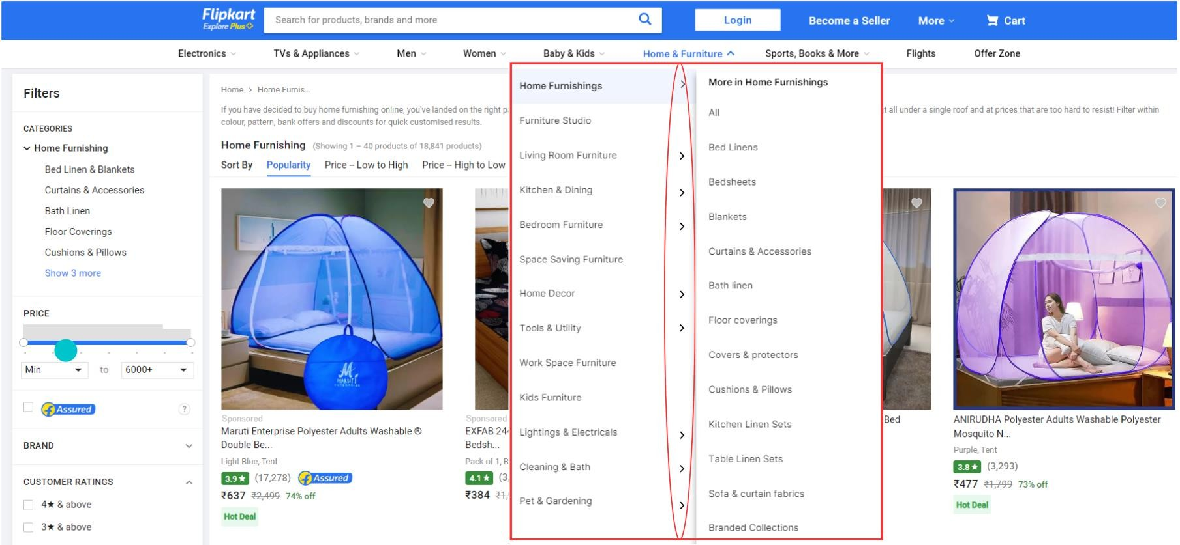
6) Law of Common Fate
Before:
Previously, pressing the arrows had no effect and they pointed to the right, with menus below titles, complicating navigation. The redesign applies the Law of Common Fate by ensuring interactive elements, like arrows, trigger expected actions and align with user interactions. By expanding submenus to the side instead of below the title, the design creates a consistent motion and visual flow, making it easier for users to follow the hierarchy and perceive related items as a cohesive group. This improves navigation, usability, and overall user experience
After:

Slide 11
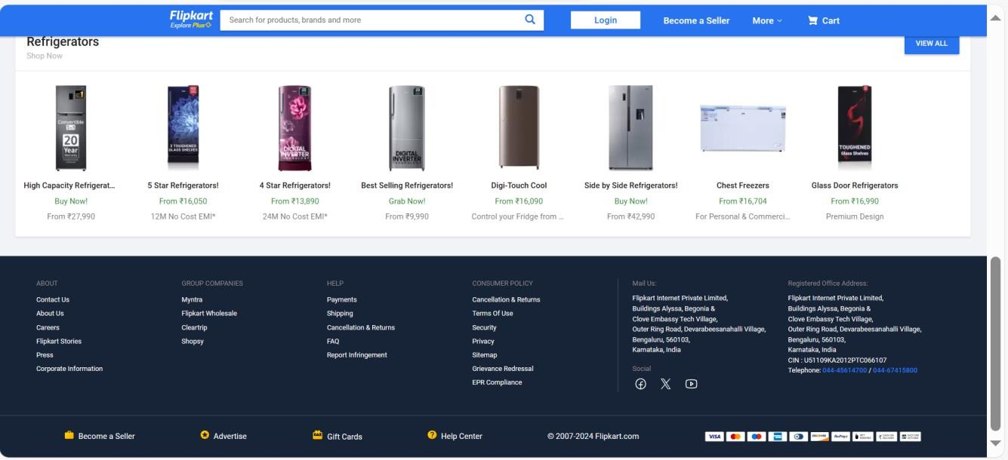
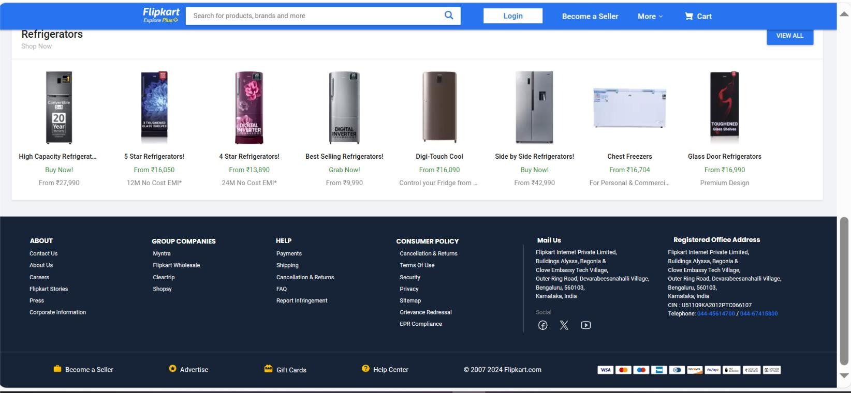
Before:
7) Law of Figure and Ground
having gray menu titles on a black background that makes the text unclear does violate the Law of Figure and Ground. According to this principle, the figure (in this case, the menu titles) should be distinct and easily separable from the ground (the black background). If the text is unclear due to insufficient contrast, it fails to stand out as the figure, making it difficult for users to focus on and read the menu titles. Ensuring good contrast between the figure and the ground is essential for maintaining clarity and usability in design.
We have redesigned and using a light color for the menu titles and making them in a thick font to make them stand out as titles and be clear for user
After:

Slide 12
Second: redesign as Parc principles:
1) Proximity
What we mentioned early about Proximity in Gestalt principles applies here also.
2) alignment
In website homepage , the layout is cluttered with misaligned elements, creating a chaotic appearance and making it difficult for users to follow the content flow.
We redesign to make the design aligns elements consistently into clear rows and columns. This alignment enhances visual hierarchy and organization, guiding users' eyes smoothly through the content and improving overall navigation and user experience.

Slide 13

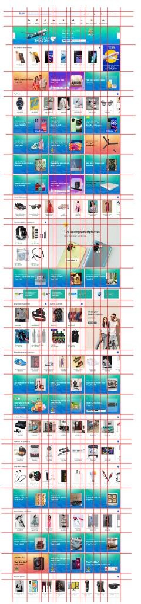
Before:

Slide 14

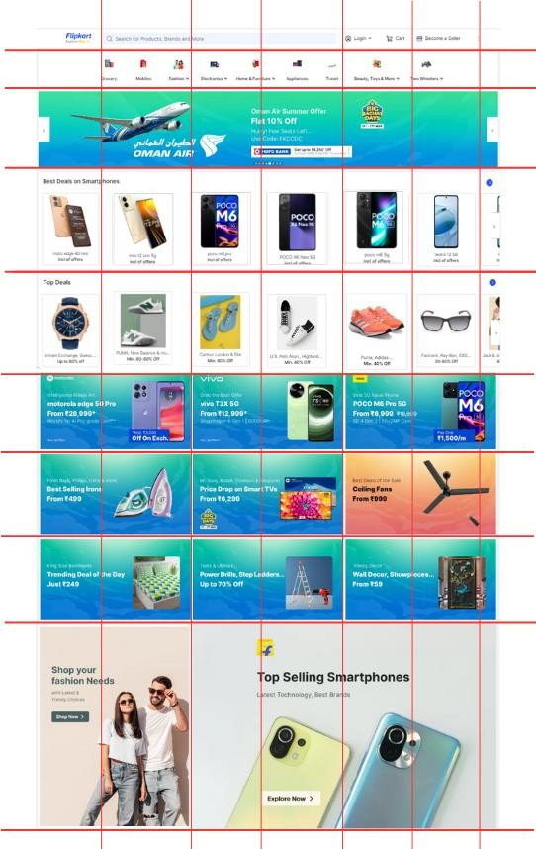
After:

Slide 15

3) repetition
Repetition creates visual harmony and enhances the structure of the content, making it easier for users to understand and navigate the site. Consistent design elements tie sections together, improving the overall user experience. On this page of the site, we see that there is a difference in the design of a section similar to other sections on the same page, which is the (Upcoming Sales) section. The design and font color of the section differ from similar sections, and we have redesigned the design and applied the rule of repetition.
Before:

Slide 16

After:

Slide 17
4) contrast
The PARC principle of Contrast emphasizes making elements distinct to enhance readability and visual interest.
The same example that we mentioned previously in Gestalt principles in Law of Figure and Ground applies here as well because If menu titles are gray on a black background, this low contrast makes the text hard to read, violating the principle. we improve readability and adhere to the contrast principle, use a white color for the text, ensuring it stands out clearly against the black background.
Before:
After:

Slide 18
Thank you

