Slide 1
Voice Activated Home Automation
Under the supervision of
Mr. T.S. Roy
Assistant Professor
Department of Instrumentation and Control Engineering
Presented by
Abhay Kumar(15/IC/01)
Abhijeet Prasad(15/IC/02)
Ajay Kumar(15/IC/04)
Akanksha Kumari(15/IC/06)
Babul Raj(15/IC/17)
Dipti Roy Choudhary(15/IC/23)

Slide 2
Introduction
The concept of Home Automation is gaining popularity as it helps in reducing human effort and errors and thus increasing the efficiency.
With the help of Home Automation system, we can control different appliances like lights, fans, TV, AC etc.
Additionally, a home automation system can also provide other features like security, alarms, emergency systems etc. can be integrated.
It is implemented using Arduino UNO, Bluetooth and a smart phone.

Slide 3
Table of Contents
Arduino
Circuit Diagram
Components Required
Components Description
Working of the Project
Applications

Slide 4
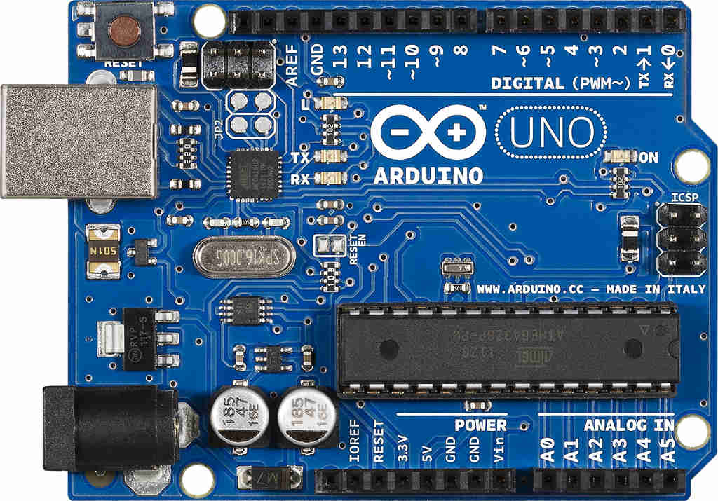
Arduino UNO
The UNO has14 digital input/output pins, 6 analog inputs , a USB connection, a power jack and a reset button.
It can either be connected to a computer with a USB cable or battery to get started.

Slide 5
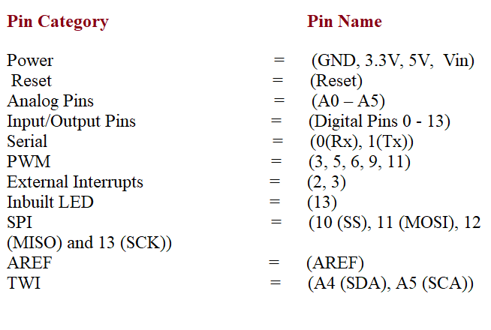
Arduino Pin

Slide 6
Components Required
Arduino UNO – 1
HC – 05 Bluetooth Module – 1
Smart Phone or Tablet – 1
2N2222 NPN Transistor – 4
12V Relay – 4
1 KΩ Resistor – 4
1N4007 PN Junction Diode – 4
Power Supply
Connecting Wires
Breadboard (Prototyping Board)
AMR_VOICE-App for transmitting voice to Bluetooth

Slide 7
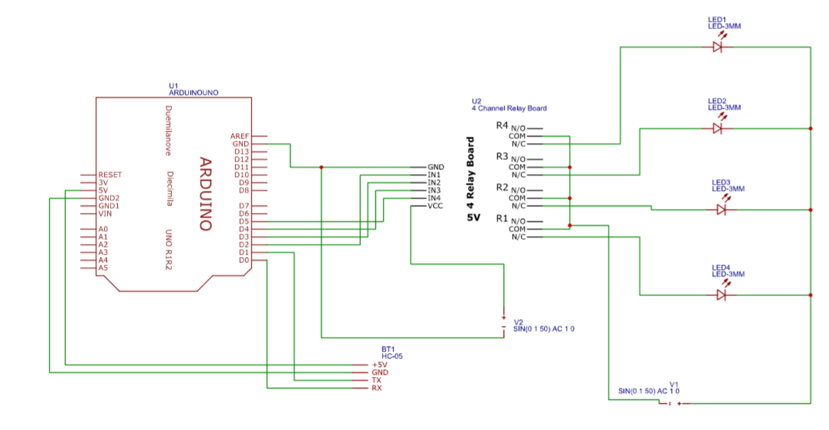
Circuit Diagram
Firstly the bluetooth module is connected to the arduino.
Since UART protocol is used by bluetooth , “software serial” library is used to define Rx and Tx pins of arduino as per requirement of the user.
Then the individual input of relays are connected to the arduino.
For verification of the functioning we can connect small loads to the relays

Slide 8
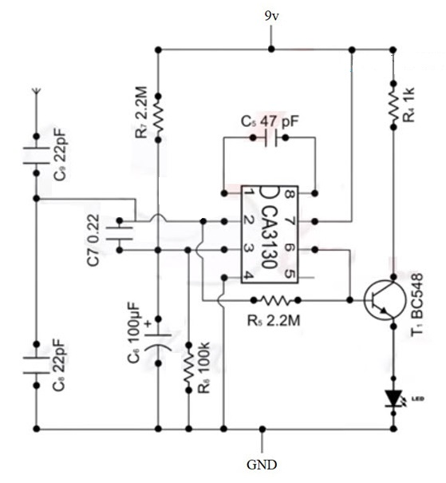
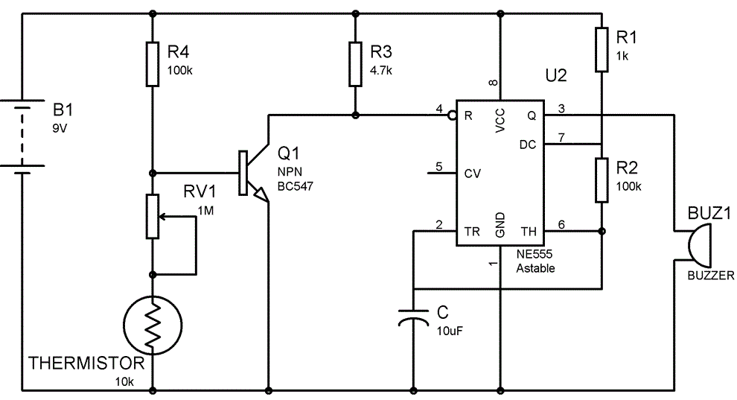
Circuit Diagram
Mobile Detector
Fire-Alarm

Slide 9
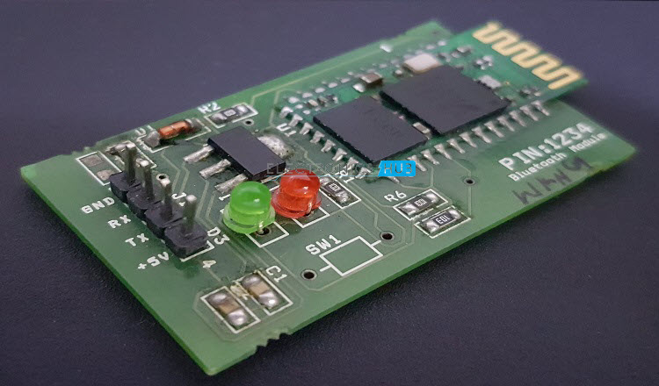
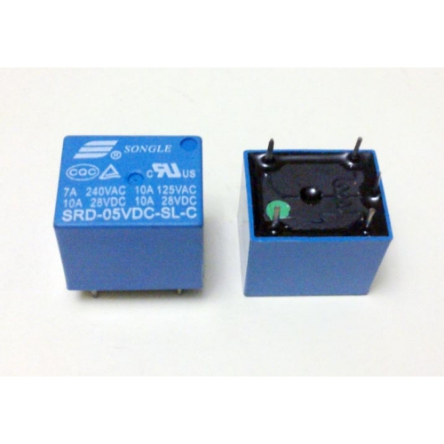
Components Description
HC-05 BLUETOOTH
It is used for wireless communication.
In this module, there are pins for VCC(5V),GND,TX and RX, and it can be interfaced using UART protocol with a default baud rate of 9600 bps.
RELAY
It has been used to convert small currrent transistor circuit with a large current AC circuit.

Slide 10
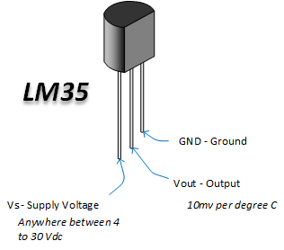
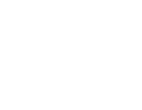
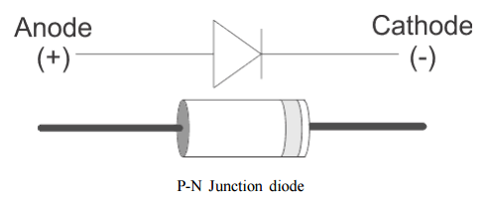
2N2222 NPN TRANSISTOR
It is a common NPN BJT used for general purpose low power amplifying or switching applications.
PN Junction Diode
It is a type of rectifier diode used as a one way check valve.
This diode only allows electrical current in one direction to flow.
They are used to convert AC power to DC.

Slide 11
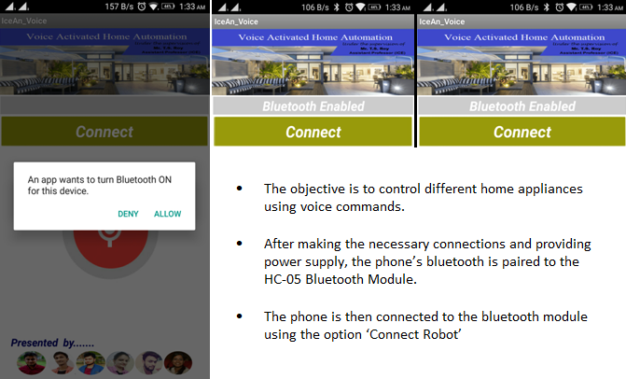
Working of the Project

Slide 12
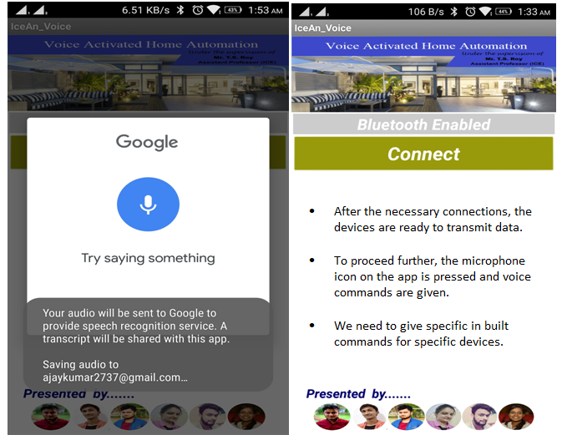

Slide 13
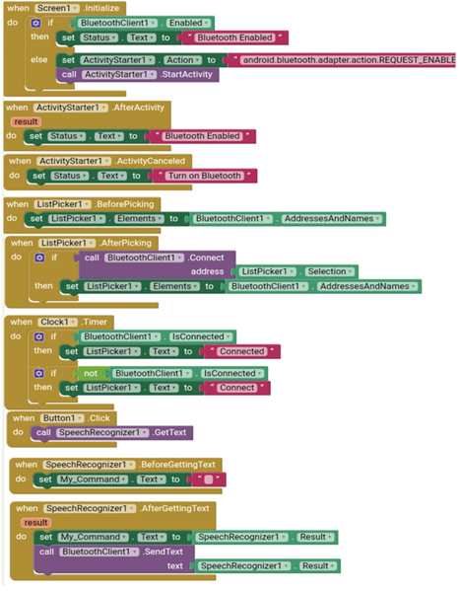
A P P C O D I N G

Slide 14
Applications
The Voice Activated Home Automation system will help us control different loads (electrical appliances) with simple voice commands.
This kind of system is very useful for people with disabilities.
Further, the project can be expanded by adding different sensors (light, smoke, etc.).

Slide 15
Conclusion
Through this presentation, we are portraying the layout of the procedure in which we would conduct our project
For the next few months we will be designing the circuit as per the requirement, our main motto being as simple as the circuit can be.
Next we will first start from simple home appliances such as LEDs to verify that our circuit design is appropriate.
The major components of our project will be the bluetooth device which needs to be specific and only bluetooth HC 05 has to be used and the arduino.
Our essential aim is to design a simple and user friendly model such that it can be easy to handle by any age group

Slide 16
Reference
Websites
www.electronicshub.com
www.researchgate.net
www.circuitdigest.com
Books
Exploring Arduino: Tools and Techniques for Engineering Wizardry

Slide 17
Thank You

