Slide 1
Modeling Unmanned Aerial Swarms Using Unreal Game Engine and AirSim Simulator
Presented By: Naimah-Joy Chapman, Elijah Keck, Dillion Mead, and John Mueller

Slide 2
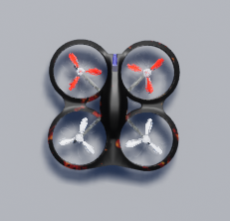
Outline
Introduction
Objectives
FAA Right-of-Way Rules
Design Considerations
System Design
Demonstration Videos
Challenges and Lessons Learned

Slide 3
Introduction
Unmanned Aerial Vehicles in Practice:
Controlled within Visual Line of Sight (VLOS) by human pilot
Operating environment is dangerous
Flight restricted by distance and time
Marketability of Autonomy:
Does not need human pilot
Beyond VLOS
Can fly within any environment with reduced risk
Flights can be less restricted

Slide 4
Introduction
Subset of Autonomy - Collision Avoidance
Mid-air collisions are undesirable
Autonomous systems don’t have same faculty as humans
Truly autonomous flight must have guaranteed operation
Why a simulation?
Project budget of $0!
Easy to execute multiple tests
Nearly no risk involved

Slide 5
Objectives
Implementation of Autonomous Collision Avoidance System
Object Detection
Lidar sensor primary
Camera secondary
Transform data for evaluation
Collision Detection
Ascertain distance of obstacles
Evaluate obstacle distance
React within avoidance radius
Initiate collision avoidance
Restart collision detection
Avoidance Behavior
FAA Right-of-Way Rules
Make right turn maneuver
Mission Pathing
Save list of waypoints
Identify next unvisited waypoint
Orient UAV to Path heading
Call move commands
Mark waypoints as visited

Slide 6
FAA Right-of-Way Rules
“When a rule of this section gives another aircraft the right-of-way, the pilot shall give way to that aircraft and may not pass over, under, or ahead of it unless well clear”
Small UAV always yield to other aircraft types
Head-On Approach
Converging
Overtaking
Formations of Aircraft
“Rules and Regulations/ Right-Of-Way.” CFI Notebook. https://www.cfinotebook.net/notebook/rules-and-regulations/right-of-way (accessed Apr 06, 2022).

Slide 7
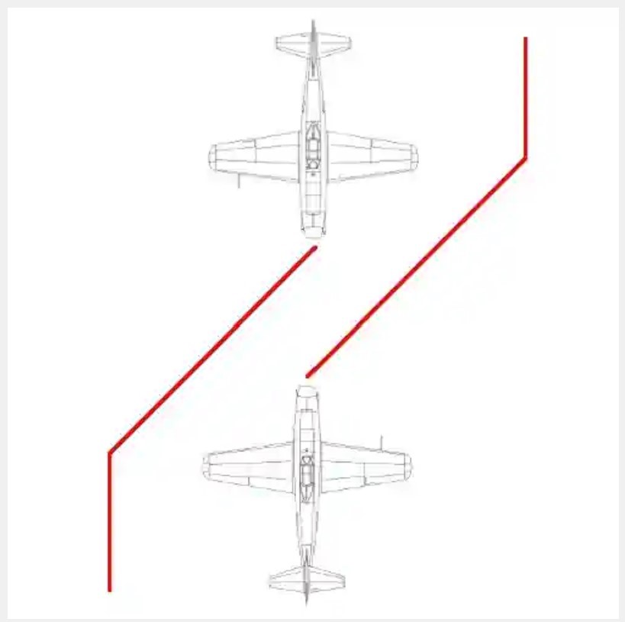
Head-On Approach
Neither aircraft have right of way
Both must avoid to right

Slide 8
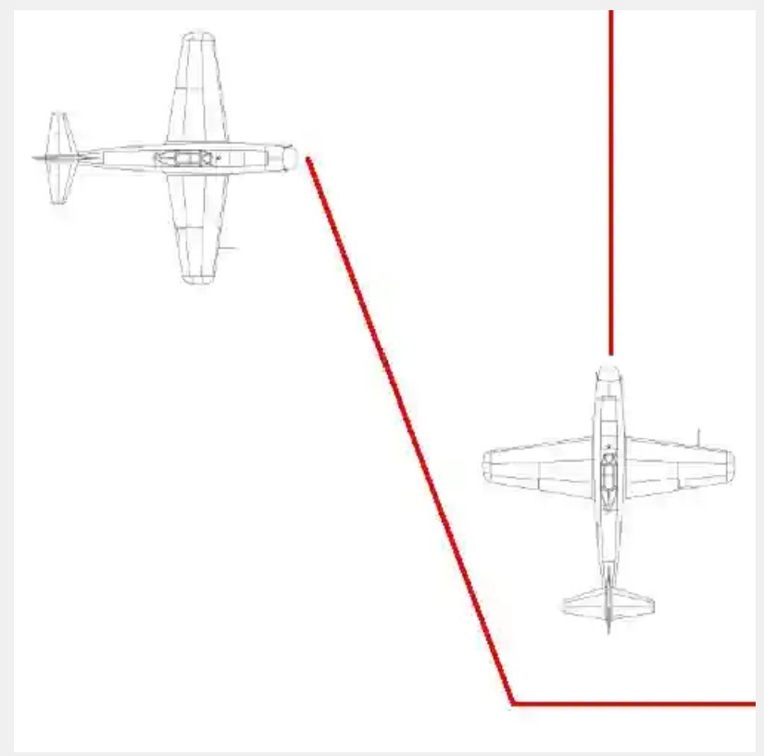
Converging
Aircraft to “Right” has right of way
“Left” aircraft must avoid to right and pass behind other aircraft.

Slide 9
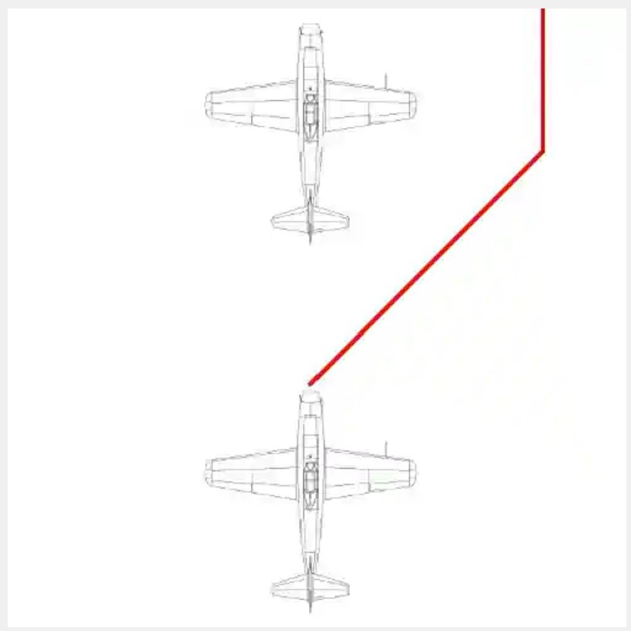
Overtaking
Aircraft in front has right of way
Rear aircraft must pass on right

Slide 10
Design Considerations
Assumptions
Sensors for detection are oriented in the direction of movement
There is no interference with the sensors
UAV will only move in a forward direction
There are no adversarial actors
Any non-autonomous UAV are controlled with known parameters
Only small UAV aircraft in environment
No landing or water scenarios
Dependencies
Microsoft AirSim Simulator
Unreal Engine 4
Visual Studio 2019
Utilizes Python Environment
Design Constraints
Limited to Unreal Engine 4 & AirSim environments

Slide 11
System Design

Slide 12
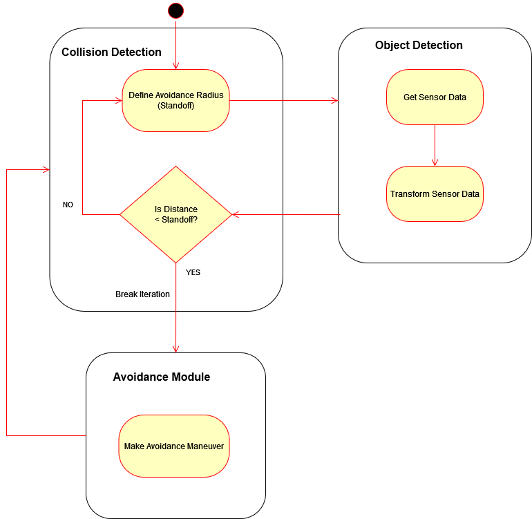
Collision Avoidance System

Slide 13
Avoidance Behavior

Slide 14
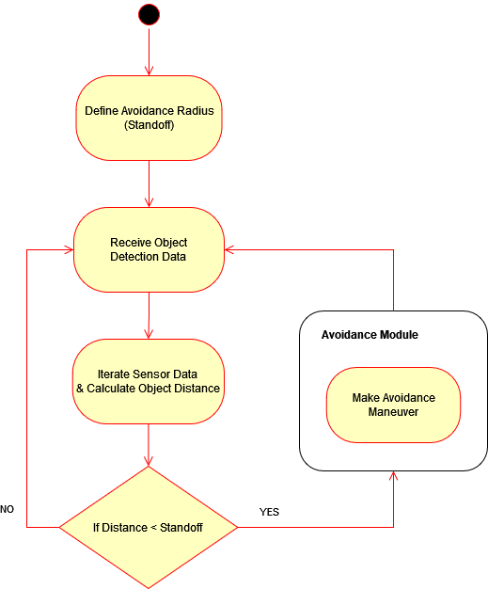
Collision Detection

Slide 15
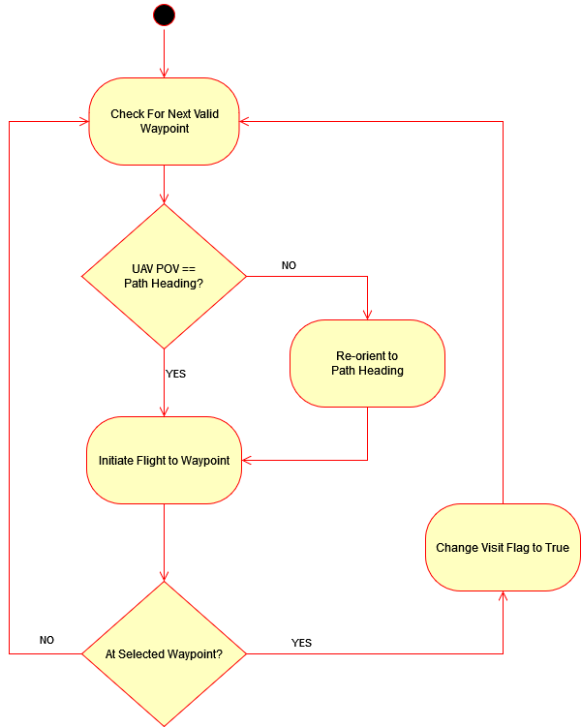
Mission Pathing

Slide 16

Demonstration

Slide 17
Demonstration
Notes:
Start at :30

Slide 18
Demonstration
Notes:
Start 1:05

Slide 19
Position Plot

Slide 20
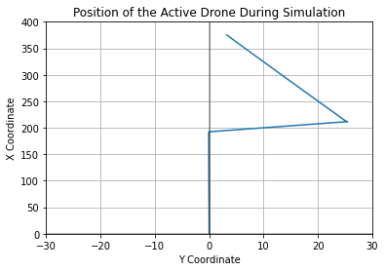
Position Plot

Slide 21
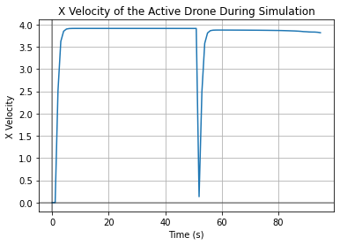
X Velocity Plot

Slide 22
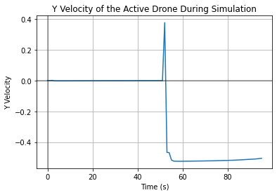
Y Velocity Plot

Slide 23
Challenges and Lessons Learned
Python classes passing objects through multiple classes is different than we initially thought
Data structure for coordinate data differs between Lidar and agent kinematics
Multi-agent behavior is difficult to solve
AirSim appears at times to be non-deterministic
NED sucks (lul)

Slide 24
Thank You
Questions?

