Slide 1
Modelling Unmanned Aerial Swarms Using Unreal Game Engine and AirSim Simulator
Presented By: Naimah-Joy Chapman, Elijah Keck, Dillion Mead, and John Mueller

Slide 2
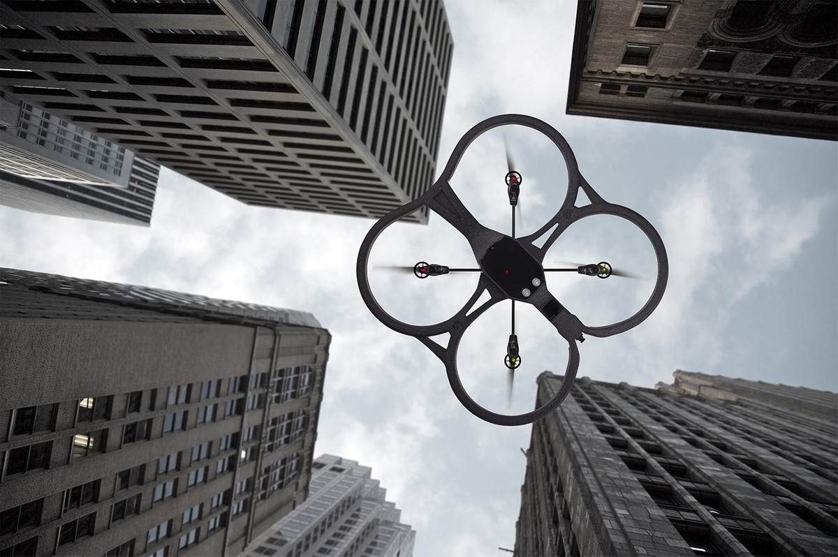
Introduction
Our product is a unified swarm of Unmanned Aerial Vehicles.
Our system is a simulation built on Unreal Engine 4 and Microsoft’s AirSim Simulator.
Purpose: To minimize danger to human operators while gathering data near environments such as volcanoes and wildfires.

Slide 3
Background
Benefits:
Safer for Data Collectors
Easy to Manage Aerial Swarm
Fast Deployment
Easier to Reach Difficult Terrain
Goal:
Autonomous Behavior
Object Detection
Collect Data from the Environment
Measure Volumes of Objects
Measure Surrounding Temperature
Measure Air Chemistry

Slide 4
Aerial Swarm in Flight
Notes:
Represents the robustness of the swarm, useful for continued functioning through dangerous situations

Slide 5
Measuring Object

Slide 6
Thank You

