Slide 1
Modelling Unmanned Aerial Swarms Using Unreal Game Engine and AirSim Simulator
Presented By: Naimah-Joy Chapman, Elijah Keck, Dillion Mead, and John Mueller

Slide 2
Introduction
This system uses Unreal Engine AirSim Simulator to simulate UAVs in a realistic three-dimensional environment. The UAV swarm will be autonomous with a unified behavior. The mission is to be able to collect data from its environment.
Benefits:
Safe use in dangerous environments
Easy to use autonomously
Perfect for time constrained missions
Minimizes human error
Allows user to focus on other aspects

Slide 3
Previous Work
Lidar implemented on individual UAV
Objects within range detected
Collision Detection
Executes continuously
Initiates Avoidance Module
Swarm Pathing
Executes continuously
Mark waypoint as visited

Slide 4
Design Considerations
Assumptions
Camera Sensor is oriented in the direction of movement
Lidar Sensor is oriented in the direction of movement
There is no interference with the sensors
UAV will only move in forward direction
There are no adversarial actors
Only small UAV
No landing or water FAA Right of Way scenarios
Dependencies
Microsoft AirSim Simulator
Unreal Engine 4
Visual Studio 2019
Utilizes Python Environment
Design Constraints
Limited to Unreal Engine 4/ AirSim environments

Slide 5
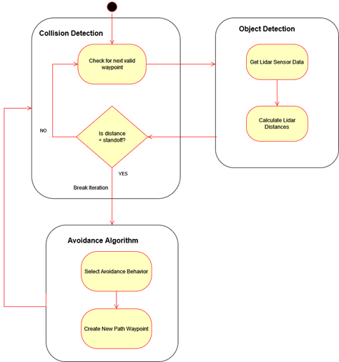
Collision Avoidance System

Slide 6
FAA Right of Way Rules
Collision Avoidance Behavior
Head-On Approach
Overtaking Approach
Converging Approach

Slide 7
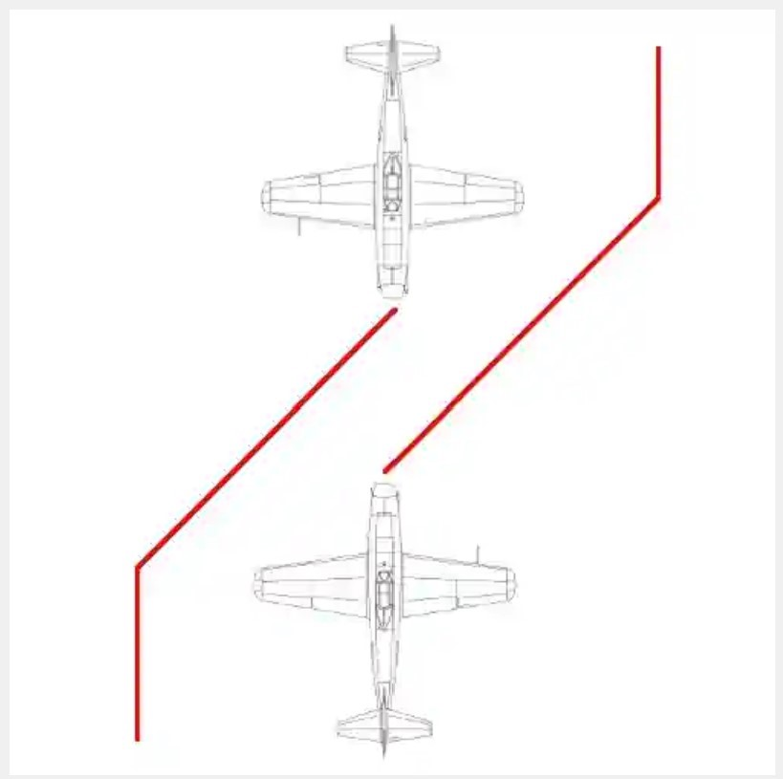
Head-On Approach

Slide 8
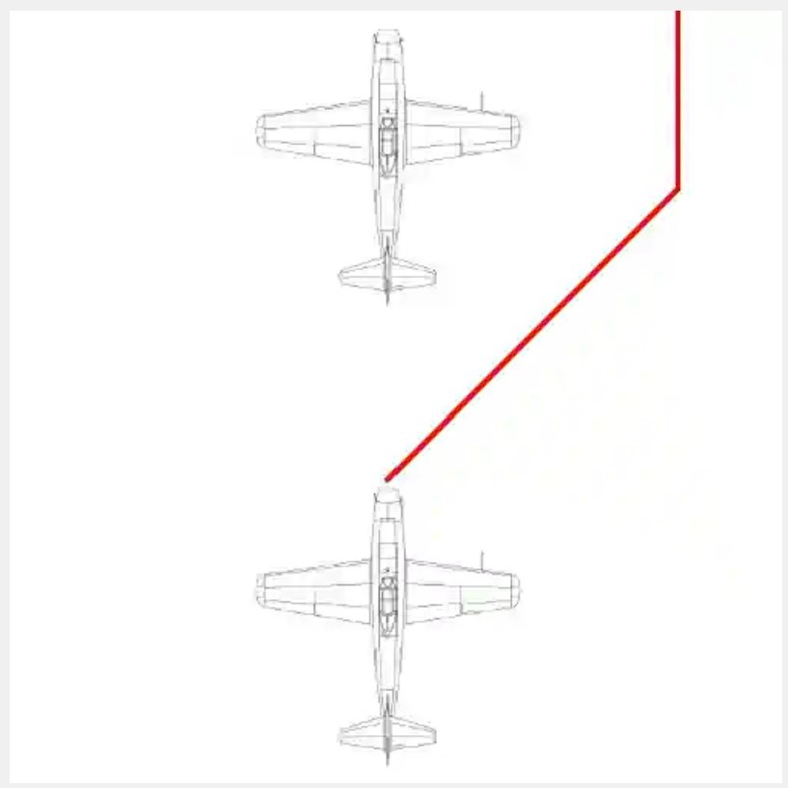
Overtaking Approach

Slide 9
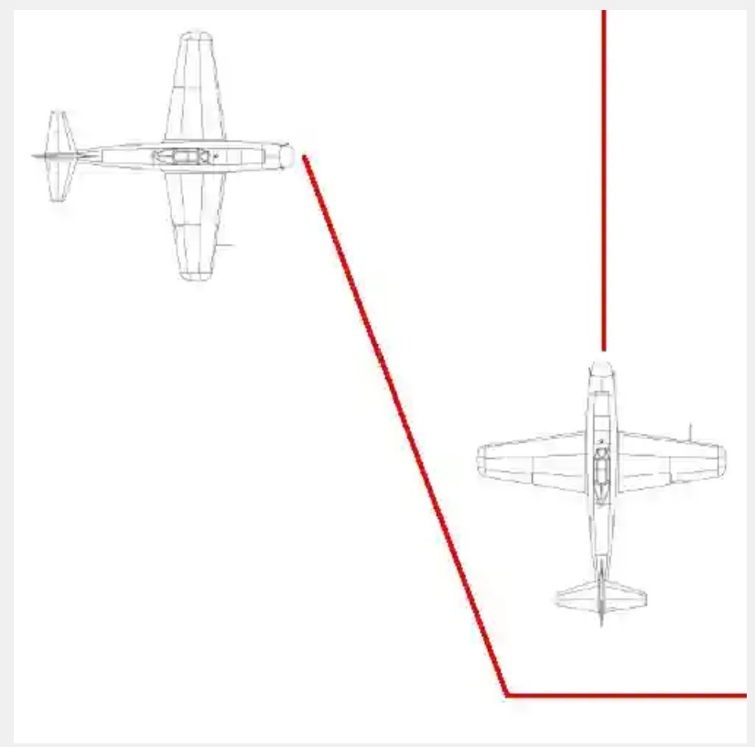
Converging Approach

Slide 10
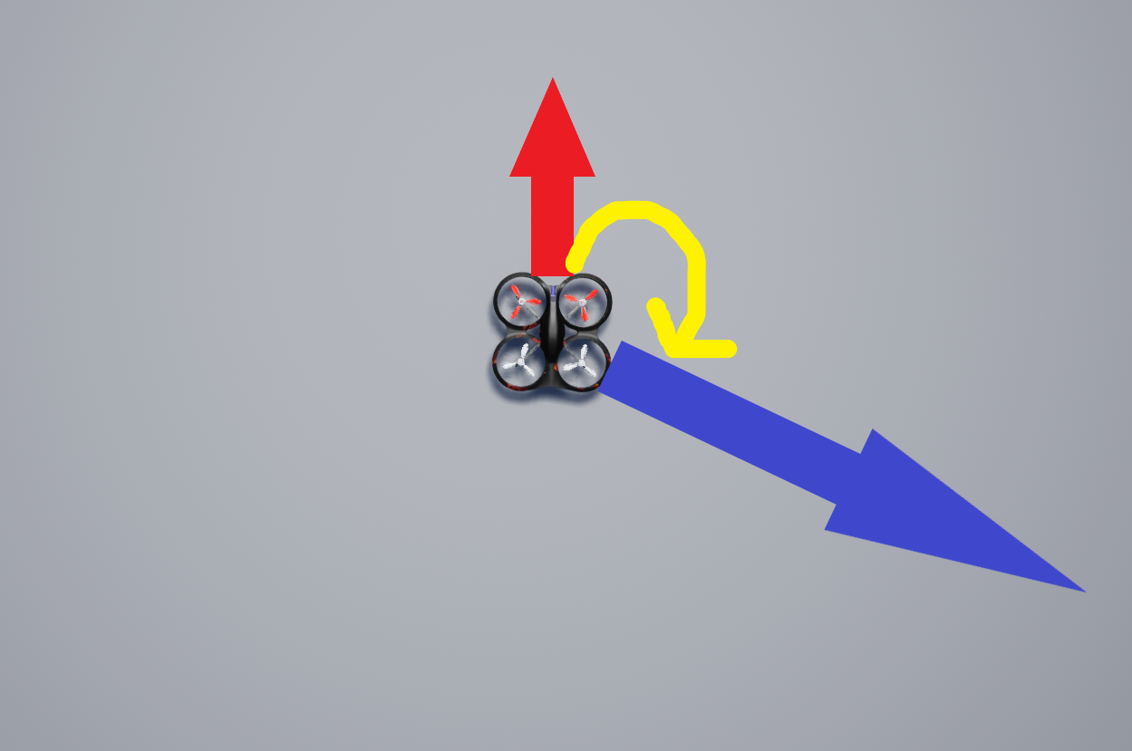
UAV Movement & Heading

Slide 11
Demonstrations

Slide 12

Turn Towards Waypoint

Slide 13
Right Turn Avoid

Slide 14
Overtaking

Slide 15
Converging

Slide 16
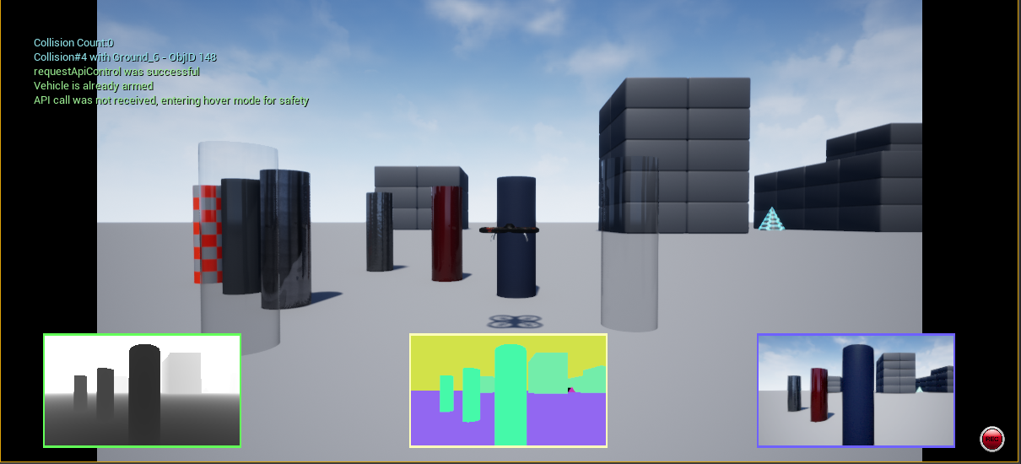
Camera Sensor

Slide 17
Lessons Learned
Multiple drones actors may need multiple “clients” to handle their behavior
The increase of sensors greatly affects performance
Limited options with additional sensor

Slide 18
Sprint Timeline

Slide 19
Sprint 1 Promised
Sprint 1 Completed
Project Timeline
Implement Lidar Sensor
Object Detection
Collision Detection
Executes continuously
Initiates Avoidance Module
Swarm Pathing
Executes continuously
Moves swarm to next unvisited waypoint
Mark waypoints as visited
Lidar implemented on individual UAV
Objects within range detected
Collision Detection
Executes continuously
Initiates Avoidance Module
Swarm Pathing
Executes continuously
Mark waypoint as visited

Slide 20
Sprint 2 Promised
Sprint 2 Completed
Project Timeline
Fix AirSim msg_pack bug
Fix UAV avoidance movement response
Implement iteration & comparison of distance array
Implement right turn avoid maneuver
Implement right-of-way rules
Fixed AirSim msg_pack bug
Fixed UAV avoidance movement response
Included vector calculation
Implemented iteration & comparison of distance array
Implemented right turn avoid maneuver
Implemented right-of-way rules

Slide 21
Sprint 3 Goals
Increase size of swarm
Implement collision avoidance on each UAV
Run multitude of simulation scenarios
Use scenario data for statistical analysis

Slide 22
Thank You
Any Questions ?

