Slide 1
Modelling Unmanned Aerial Swarms Using Unreal Game Engine and AirSim Simulator
Presented By: Naimah-Joy Chapman, Elijah Keck, Dillion Mead and John Mueller

Slide 2
Introduction
The aerial swarm will be autonomous with a unified, cohesive behavior. The aerial swarm will employ a collision avoidance algorithm that will allow the swarm to maneuver around objects while collect data from a three dimensional environment.
Benefits:
Easier to manage swarm with autonomy
Users allowed to focus on aspects other than piloting
Safer for use in dangerous situations
Easier for use in time constrained missions

Slide 3
Previous Work
Created Swarm of UAV as singular entity
Formed Swarm into formations based on No. of UAV using VSEPR geometries
Implemented movement method for Swarm in formation
Implemented 3-Dimensional object measurement

Slide 4
Design Considerations
Assumptions
Minimum of 3 drones in swarm to measure and detect an object
Measure objects are solid and uniform
Lidar Sensor is oriented in the direction of movement
UAV will only move in forward direction
There are no adversarial actors
Dependencies
Microsoft AirSim Simulator
Unreal Engine 4
Visual Studio 2019
Utilizes Python Environment
Design Constraints
Limited to Unreal Engine 4/ AirSim environments

Slide 5
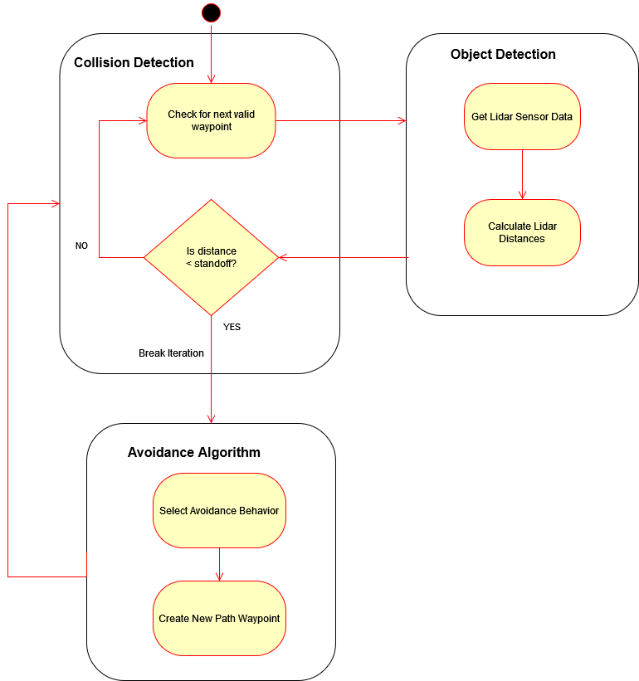
Collision Avoidance System

Slide 6
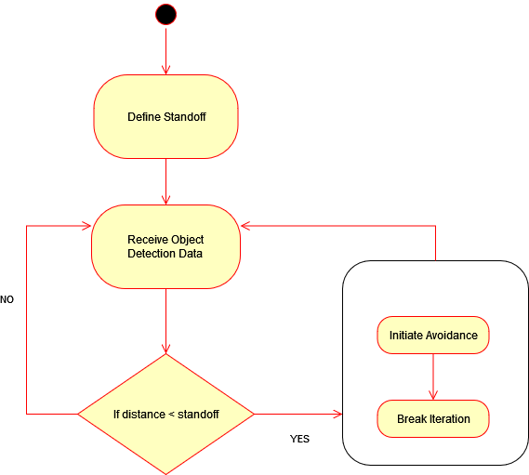
Collision Detection Module

Slide 7

Object Detection Module

Slide 8

Avoidance Algorithm

Slide 9
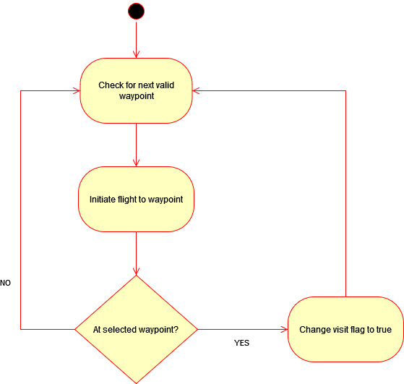
Pathing Module

Slide 10
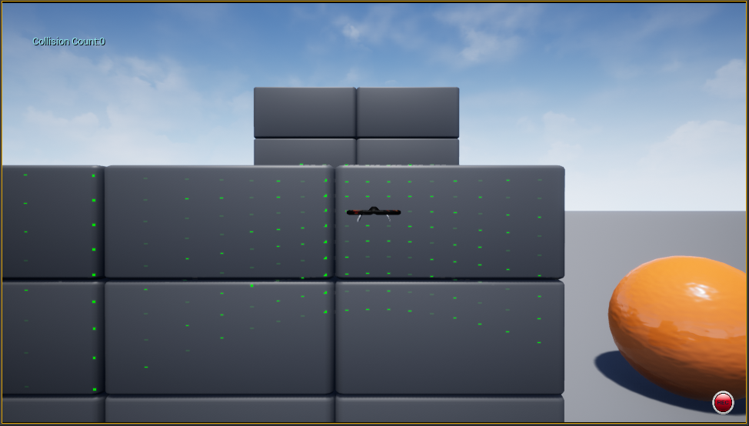
Lidar Detecting an Object

Slide 11
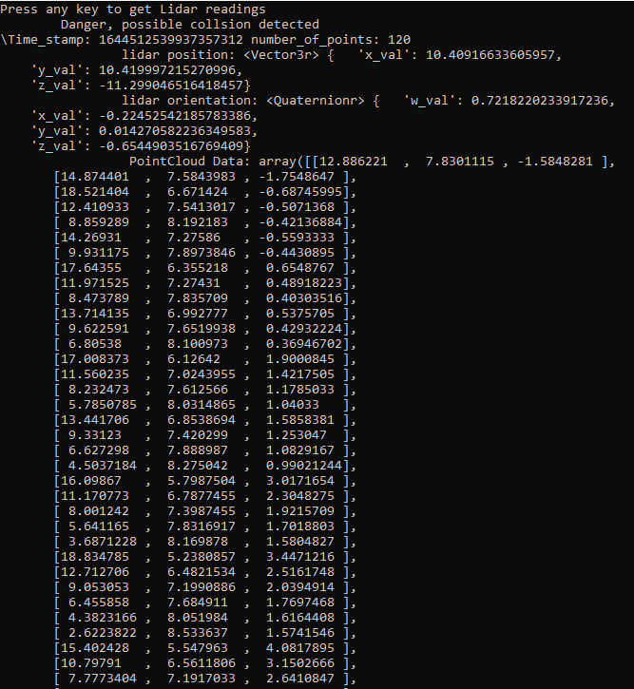
Lidar Readings
PointCloud Data

Slide 12
Demonstration
Live demo on lab computer

Slide 13
Lessons Learned
Data structure for coordinate data differs between Lidar and agent kinematics
Python classes passing objects through multiple classes is different than we initially thought
AirSim message packs need to be handled for errors
Start Integration testing earlier

Slide 14
Project Timeline
Sprint 1 Promised
Implement Lidar Sensor
Object Detection
Collision Detection
Executes continuously
Initiates Avoidance Module
Swarm Pathing
Executes continuously
Moves swarm to next unvisited waypoint
Mark waypoints as visited
Sprint 1 Completed
Lidar implemented on individual UAV
Objects within range detected
Collision Detection
Executes continuously
Initiates Avoidance Module
Swarm Pathing
Executes continuously
Marks waypoint as visited

Slide 15
Project Timeline
Sprint 2
Fix AirSim msg_pack bug
Fix UAV avoidance movement response
More complex collision avoidance behavior
Increase precision of Object Detection
Sprint 3
Increase size of swarm
implement collision avoidance on each UAV
Run multitude of simulation scenarios
Use scenario data for statistical analysis

Slide 16
Thank You
Any Questions?

