Slide 1
Modelling Unmanned Aerial Swarms Using Unreal Game Engine and AirSim Simulator
Presented By: Naimah-Joy Chapman, Elijah Keck, Dillion Mead, and John Mueller

Slide 2
Table of Contents
Introduction
Project Vision
Design Considerations
System Architecture
Sub-System Design
Demo Videos
Lessons Learned
Project Road Map

Slide 3
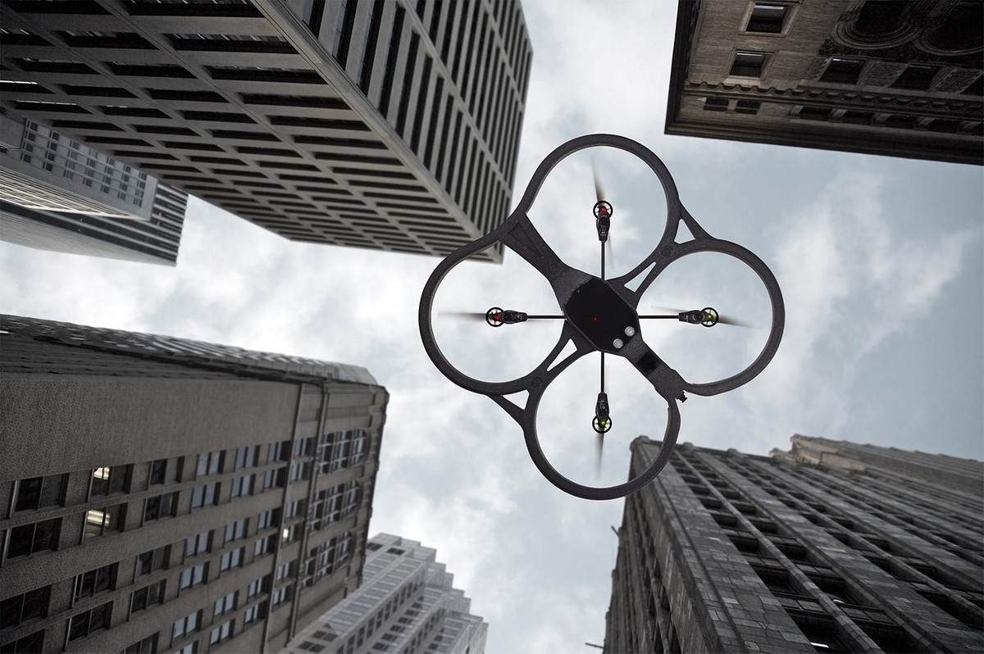
Introduction
The aerial swarm will be autonomous with a unified, cohesive behavior that will be able to collect data from a three dimensional environment. For this project our product owner is Professor Akbas.
Benefits:
Safer for use in dangerous situations
Easier for use in time constrained missions
Faster to deploy

Slide 4
Project Vision
Simulation of UAV
UAVs communicate between each other
Position
Activity status
Moves within a three dimensional environment
Collects data to calculate volume
Irregular objects (plume of smoke)
Regular objects (cube)
Reports to ground station

Slide 5
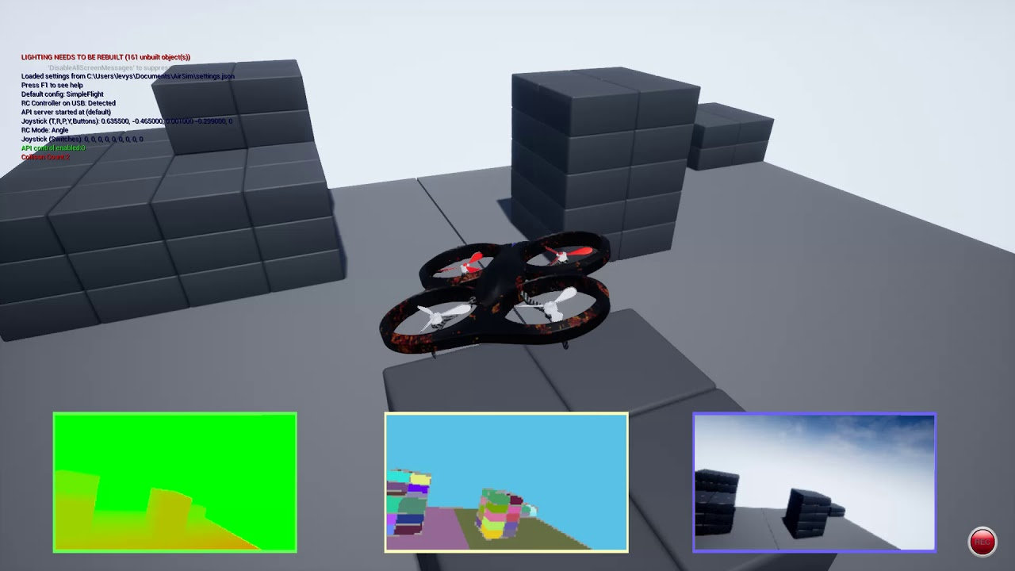
Design Considerations
Assumptions
Minimum of 3 drones in swarm to measure an object
Measured objects are solid and uniform
No objects in swarm path
No collision in object measurement
Dependencies
Microsoft’s AirSim Simulator
Unreal Engine 4
Visual Studio 2019
Python based instead of C++
Design Constraints
Limited to Unreal Engine 4 environment
Collisions/object constrained

Slide 6
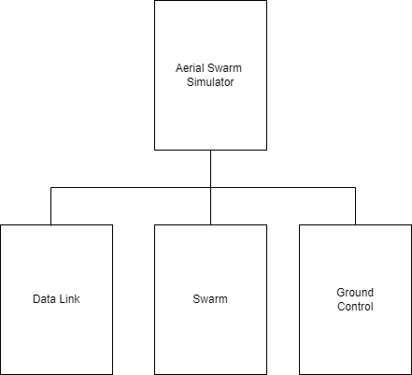
System Architecture (High to Low)

Slide 7
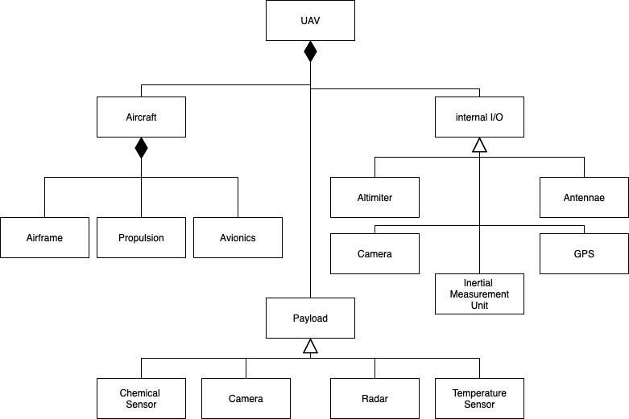
Sub-System Design - Swarm

Slide 8
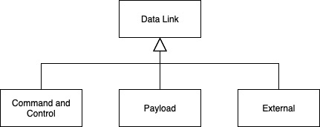
Sub-System Design - Data Link

Slide 9
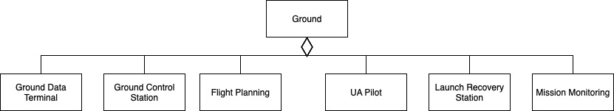
Sub-System Design - Ground Control

Slide 10
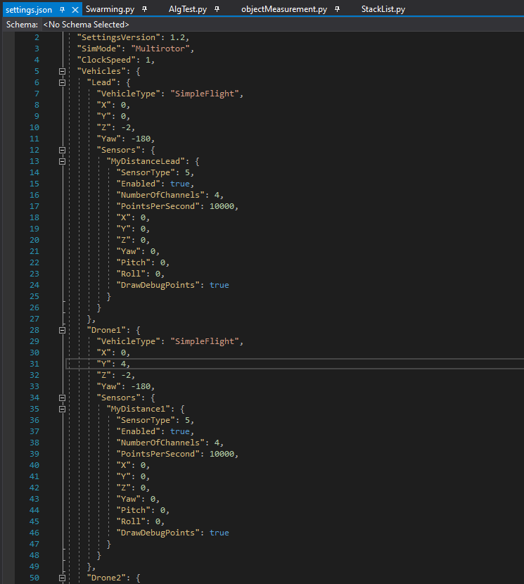
Settings File

Slide 11

Swarming Formation
Notes:
Starts with settings json, drones are generated, system detects the number of drones, takes off, formulates swarm based off of drone number, utilizes VSEPR geometries

Slide 12
Swarm Unified Flight
Notes:
Shows the drone formation in dynamic flight situation, lead transmits position and actor drones use lead’s position to make a waypoint to move to to keep formation, this is the main way that swarms will traverse the environment

Slide 13
Drone Loss Contingency
Notes:
Represents the robustness of the swarm, useful for continued functioning through dangerous situations

Slide 14
Object Measurement

Slide 15
Challenges Faced and Lessons Learned
Collaboration
Increase in productive in-person meetings
Communication
Communication hub (I.E Discord)
Meeting Deadlines
Set mini-deadlines to help meet end-goal
Steep “economy of scale”
Utilize online resources (I.E videos and papers)
Design versus implementation
Temper our design
Reinventing the wheel
Utilize available tools in Airsim

Slide 16
Project Road Map
Must Have
Object Detection – Sprint 4
Collision avoidance
Dimension id (volume measurement)
Swarm Autonomy – Sprint 5
Pathing on mission
Task completion
Ground Control Station – Sprint 4
Swarm data display
Object Measurement – Sprint 4
Complex objects
Want to Have
Agent Based Aerial Swarm – Sprint 5
Individual agent jobs and behaviors
Ground Control Station
Dynamic mission tasking – Sprint 5
Saving data – Sprint 6
Nice to Have
Environment Measurement – Sprint 6
Additional sensors

Slide 17
Thank You
Questions?

