Slide 1
SEMINAR - II Dysarthria Speech Classification (using Glottal Features)
Presented by Aditya Anand (20CS60R24)
Under the guidance of Prof. K. S. Rao
PHD Mentor: Ms. Madhu Keerthana

Slide 2
Contents:
What is Dysarthria Speech and ways to detect it?
Features for training and Classification.
Glottal Feature Extraction.
Acoustic Feature Extraction.
Classification reports.
Sequential Forward Feature Selection.
K –Fold Cross Validation.
Support Vector Machines.
Deep Neural Networks.
Coded Telephone Speech.
Challenges in CTS and its Classification reports.
Conclusion.
References.

Slide 3
What is Dysarthria?
A neuro–motor disorder.
Generally a result of either a neurological injury or disease.
Source: XpertDox
Signs and Symptoms
Slow and Slurred speech.
Rapid Speech difficult to understand.
Inability to whisper/speak louder.
Uneven speech volume.
Difficulty in moving facial muscles/tongue.

Slide 4


Detection of Dysarthria
By Speech – Language Pathologist.
Costly and Laborious.
Prone to biases due to experience.
Data-driven Model:
Requires dysarthria speech database.
Maps speech features to labels (dysarthria/healthy).
Inexpensive, less time consuming but still prone to minor statistical and probabilistic biases.

Slide 5
Speech Features for Training
Acoustic Features: Features related to sound.
Frequency, Pitch, Contour(variation), noise, etc.
openSMILE can be used to extract these.
Glottal Features: Features related to glottis.
Source signals and waveforms.
Can be extracted using GIF (Glottal Inverse Filtering).
Mix of Both.

Slide 6
Classification Ideology
Dysarthria Speech Database
LABELS
Speech
Utterances
Glottal Features
Acoustic Features
Feature
Selection
Accuracy
Label
Predictions
Labels: Dysarthria or healthy
Classifier
(SVM)
Comparison
Updated Parameters based on mismatch for Learning

Slide 7
Classification Ideology
Sequential Forward Feature Selection (SFFS)
To avoid the risk of over-fitting, as (generally) size of acoustic/glottal features is huge.
Evaluation: K – Fold cross validation.
Separate classifiers are trained:
reduced & non-reduced feature sets for openSMILE, glottal features and their combination.
For Non-words, words and sentences.
SVMs are widely used in pathological speech classification as the give consistent performance even for small amount of speech data (other techniques Like DNNs requires large amount data for proper training).

Slide 8


Sequential Forward Feature Selection
Select the best feature (based on some criteria/score) and add it to the list of features.
Till a threshold is reached, do
pair that selected feature(s) with every other feature and select the best pair.
Feature 1 | Feature 2 | … | Feature n
… | … | … | …
$$best_{(1)}=max⁡(score\left(f_{i}\right))$$
Feature 5
…
$$best_{(2)}=\max\left(score\left(f_{5},f_{i}\right)\right)where i≠5$$
Feature 5 | Feature 2
… | …
$best_{(3)}=\max\left(score\left(f_{5},f_{2},f_{i}\right)\right)where i≠5$ and $i≠2$

Slide 9
K –Fold Cross Validation
Divide the entire training data into K-equal parts (data entries might be selected at random).
Keep one part for validation and the rest K-1 part for training for K times.
Entire data
Part 1
Part 2
For ‘ i ’ from 1 to K:
val_data = Part ‘ i ’
train_data = combine(all Parts except ‘ i ’)
Part 3
…
Part K

Slide 10
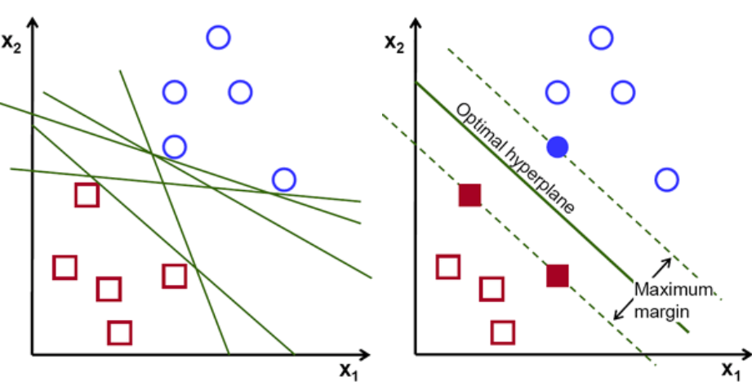
Support Vector Machine
Supervised ML Model.
It has two variants – Classifier and Regressor.
It classifies data based on a separating hyperplane.
Image Source: Google Images

Slide 11
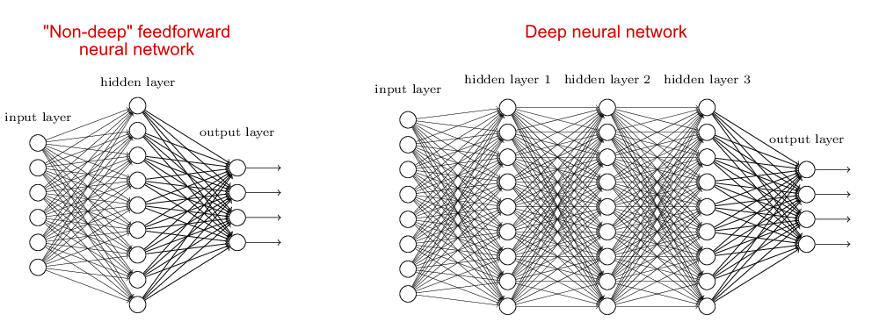
Deep Neural Networks
A deep neural network (DNN) is an artificial neural network (ANN) with multiple layers between the input and output layers.
The adjective ‘deep’ refers to huge number of hidden layers.
ANNs were inspired by information processing and communication in biological systems.
Image Source: Google Images

Slide 12
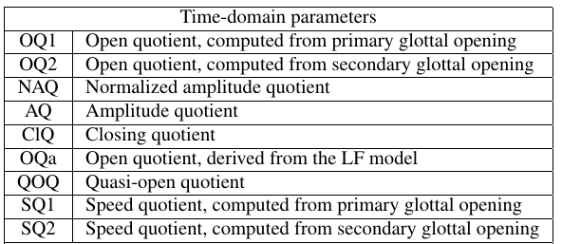
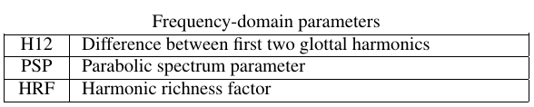
Glottal Feature Extraction
QCP Analysis gives us the glottal flow which helps us to extract time & freq. domain glottal features.
Glottal Flow Waveform
Time & Freq. domain Features
APARAT Toolbox
Src: Ref 1 (Nonavinakere Prabhakera et al, Dysarthric speech classification using glottal features )

Slide 13
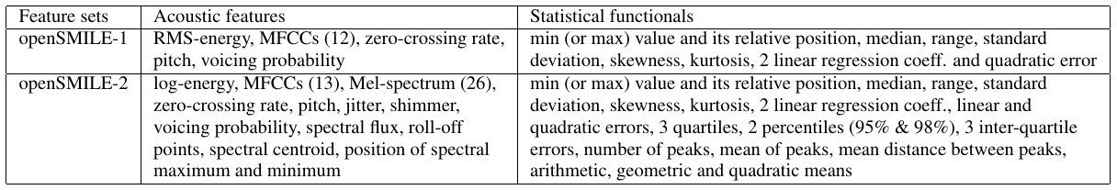
Acoustic Feature Extraction
Extracted using openSMILE
Free open-source feature extraction toolkit.
Baseline Featureset in openSMILE for Dysathria Speech Classification:
INTERSPEECH 2009 Emotion Challenge feature set
384 features ( [16 AF+16 D] x 12 SF ).
The large openSMILE emotion feature set
6552 features ( [56 AF + 56 FOD + 56 SOD] x 39 SF )

Slide 14
Dysarthria Speech Database
TORGO database:
It Contains speech recordings from seven patients.
3F and 4M.
And speech recordings from seven healthy control speakers.
3F and 4M.
Age - 16 years to 50 years.
Speech signals in three categories, namely non-words, words and sentences.

Slide 15
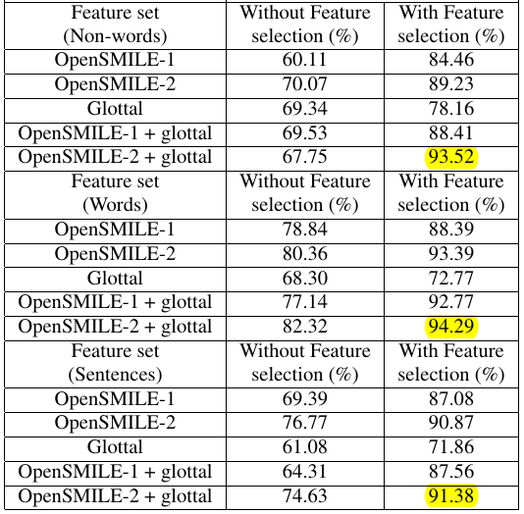
Classification Accuracy
Based on Ref. 1 : Nonavinakere Prabhakera et al, Dysarthric speech classification using glottal features

Slide 16
Coded Telephone Speech
General Scenario:
Coded Telephone speech (CTS):
One layer encoding
Coded using the AMR-NB and AMR-WB codecs.
Dysarthria Speech Database
Voice /
Speech
Digitally recorded
Dysarthria Speech Database
Voice /
Speech
Telephone
encoding
Digitally recorded

Slide 17

Challenges in CTS
The system should be capable of handling varying speech degradation conditions.
E.g.: coding, transmission errors, band-pass filtering, and varying background environments.
Conventional GIF methods are highly sensitive to even slight distortions in the input speech signal.
Using Deep Neural Networks in a supervised manner to extract glottal features.
A third set of parameters might be needed.
PCA based parameters.

Slide 18
Classification Ideology for CTS
Dysarthria Speech Database
LABELS
Speech
Utterances
Glottal Features
Using QCP
Acoustic Features
Feature
Selection
Accuracy
Glottal Features
Using DLL
Label
Predictions
Classifier
(SVM)
Comparison
Labels: Dysarthria or healthy
Updated Parameters based on mismatch for Learning

Slide 19
Another Dysarthria Speech Database
 | TORGO | UA-speech
#Patients | 7 (3F,4M) | 15(4F,11M)
#Healthy | 7(3F,4M) | 13(4F,9M)
Age | 16 to 50 years | 18 to 58 years
Speech signals | Non-words, words and sentences | Only words
Pathological speech processing becomes a challenging task due to very small number of samples.

Slide 20
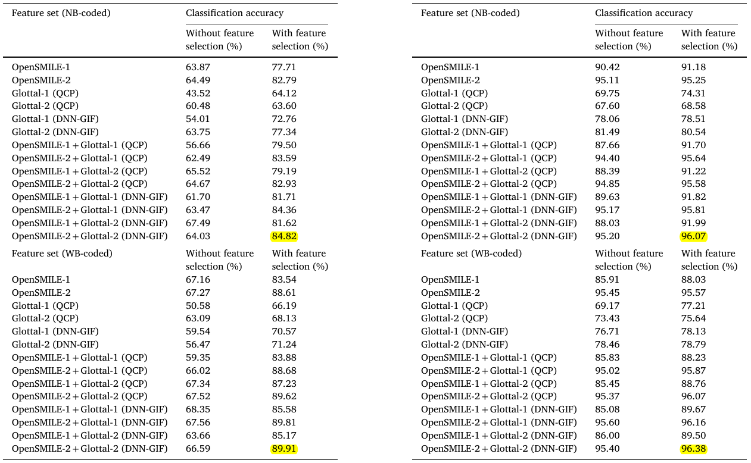
Observations for CTS
Based on Ref. 2 : Nonavinakere Prabhakera et al, Dysarthric speech classification using glottal features

Slide 21
Conclusion
Use of Glottal Features has significantly improved the classification accuracies in all the cases we have seen.

Slide 22
References
N.P. Narendra et al, “Dysarthric speech classification using glottal features computed from non-words, words and sentences” - Proceedings of Interspeech, 10.21437/Interspeech.2018-1059.
N.P. Narendra et al, “Dysarthric speech classification from coded telephone speech using glottal features” - Speech Communication 110 (2019) 47–55.
Manu Airaksinen et al,“Quasi closed phase analysis for glottal inverse filtering” – Research Gate Conference Paper, August 2013.

Slide 23
Thank You!

