Slide 1
TRENDING TOPICS ON WIKIPEDIA
PRESENTED BY:
SOMOSHREE DATTA (20CS60R05)
PRATIBHA SINGH (20CS60R12)
ADITYA ANAND (20CS60R24)
YOGESH PORWAL (20CS60R52)
GUIDED BY:
PARAMITA DAS

Slide 2
MOTIVATION
The size of Wikipedia dumps in any language version, especially English, is huge and the crowd visiting the pages is significant.
Hence to understand the viewership, broadly the attention dynamics of readers around the globe, one needs to know the trending topics in Wikipedia at a given time frame/time instance.
Therefore, to provide an automatic solution for finding the temporal behaviour of trending topics, we are going to implement the following two research papers:
A graph-structured dataset for Wikipedia research - Nicolas Aspert, Volodymyr Miz, Benjamin Ricaud, Pierre Vandergheynst
[1903.08597] A Graph-structured Dataset for Wikipedia Research (arxiv.org)
What is trending on Wikipedia? Capturing trends and language biases across Wikipedia Editions - Volodymyr Miz, Joëlle Hanna, Nicolas Aspert, Benjamin Ricaud, Pierre Vandergheynst
[2002.06885] What is Trending on Wikipedia? Capturing Trends and Language Biases Across Wikipedia Editions (arxiv.org)

Slide 3
INTRODUCING THE PROBLEM STATEMENT
The problem statement can be divided into two main parts/components:
1. Proposing an efficient data structure to make requests and access subnetworks of Wikipedia pages and categories.
2. Proposing an automatic evaluation and comparison of the browsing behavior of Wikipedia readers and extracting the most trending topics on Wikipedia over any chosen period of time.

Slide 4
DATA COLLECTION
Wikimedia Foundation, the organization that hosts Wikipedia, makes the web activity records and the hyperlinks structure of Wikipedia publicly accessible either through an API or through database dump files.
Dumps are huge and takes a long time for researchers to load and filter them as per their need.
For the case of API, the number of queries and the response size are very limited.
The hyperlink network structure and the viewership statistics (pagecounts) of Wikipedia articles have attracted significant attention from the research community.
Hence, the authors have focussed on designing a database that allows one to query this hybrid data structure conveniently.

Slide 5
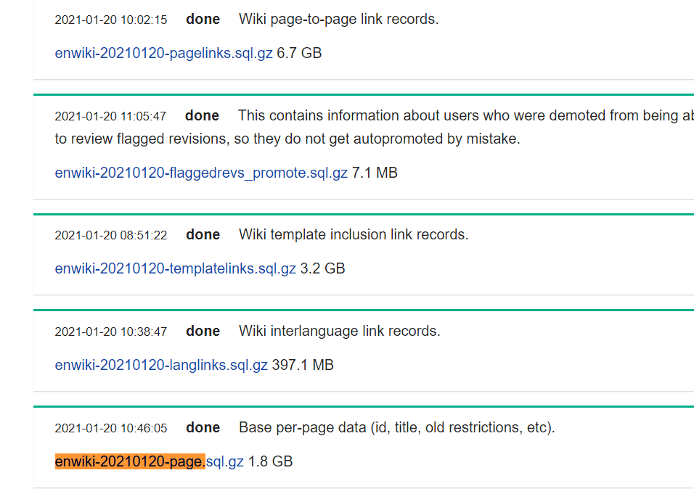
A SCREENSHOT SHOWING THE WIKI DUMP SIZES OF THE YEAR 2021

Slide 6
CONTRIBUTIONS
All were involved in setting up the environment with compatible versions of softwares and plugins. Also, pre-processing of large SQL wikipedia dumps were done by all.
Pratibha Singh | Neo4j graph database deployment that contains information about pages and the categories that they belong to. Extracted subgraph for the month of Feb 2021 for further processing. Also analysed the ground truth with the results that we got.
Aditya Anand | Pre-processed raw pagecounts and deployed the pagecounts database into Cassandra. Applied tf-idf keyword extraction algorithm to find the trending topics for Feb 2021.
Yogesh Porwal | Applied Louvain community detection algorithm on the extracted subgraph. Did graph visualization on Gephi and analyzed graph structure.
Somoshree Datta | Chose top 5 communities based on their sizes. Wrote code scripts that computed the pageview scores of each node in these communities using the pagecounts data that was deployed in Cassandra earlier.

Slide 7
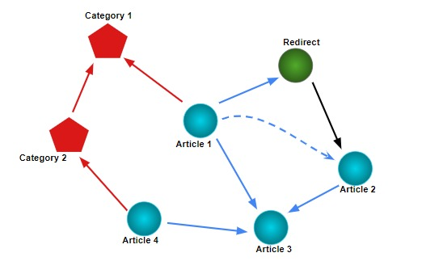
BUILDING A GRAPH-BASED SOLUTION – A GRAPH DATABASE
Present a graph data-structure that simplifies access to Wikipedia data dumps and its viewership statistics.
Wikipedia articles form the nodes of the graph.
Hyperlinks pointing to different pages form the directed edges between the nodes.
Categories of Wikipedia articles are also structured as nodes in the graph.
Hyperlinks are present in each article pointing to the categories they belong to.
Redirect pages were removed from our dataset by redirecting the hyperlinks to point to the correct article.

Slide 8
Implementation..

Slide 9
WORK-FLOW
ddd
1
Environment Setup
ddd
2
SQL dumps download
3
ddd
Graph database deployment
4
ddd
Community detection Algorithm
ddd
5
Extraction of Trending Topics

Slide 10
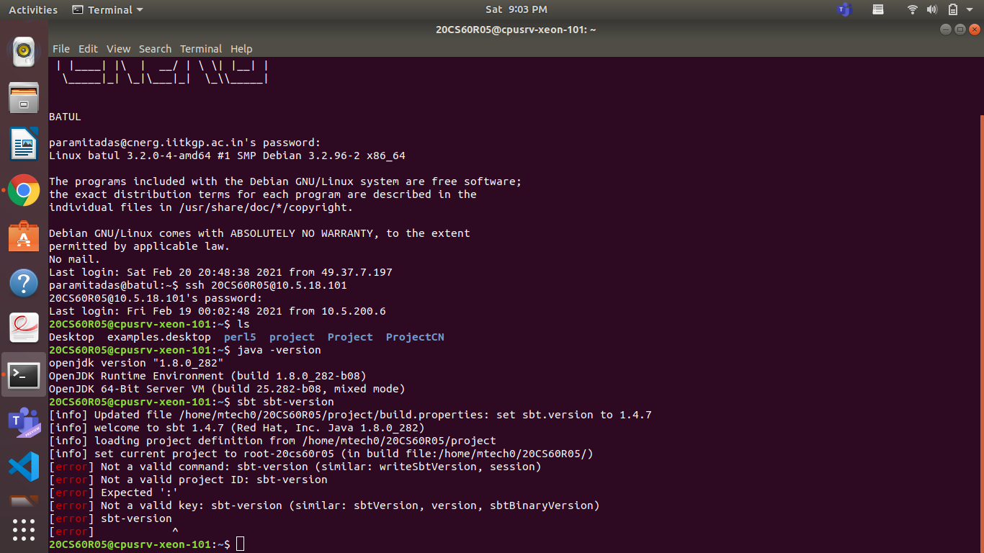
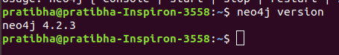
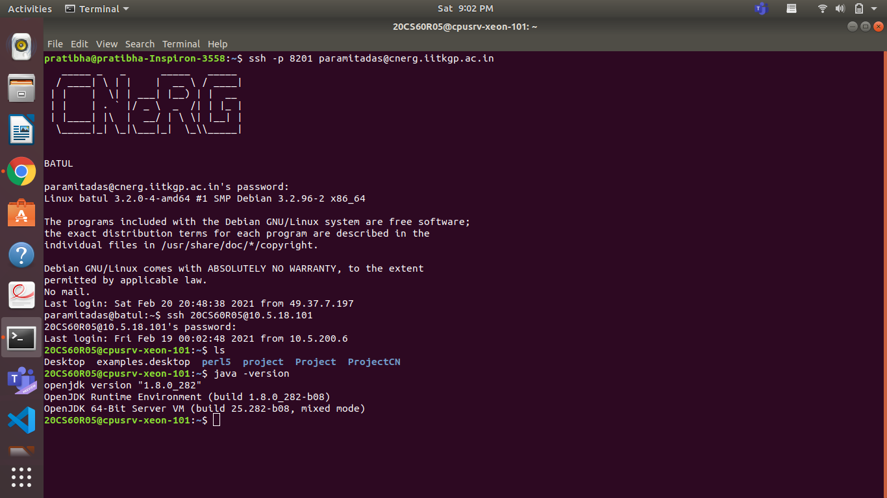
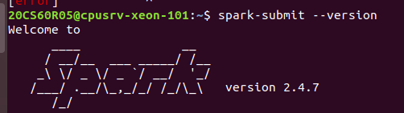
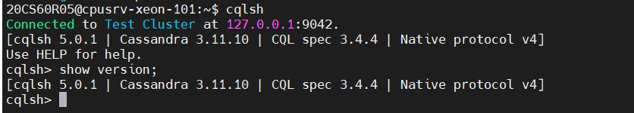
ENVIRONMENT SETUP
JDK 8
SBT
Spark
Neo4j
Cassandra

Slide 11

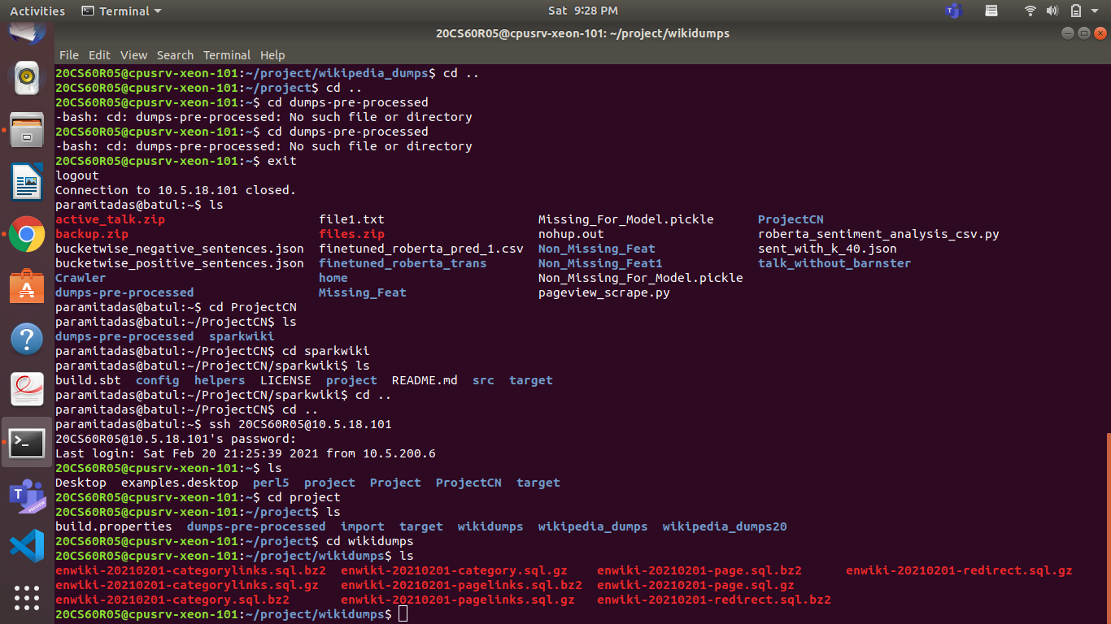
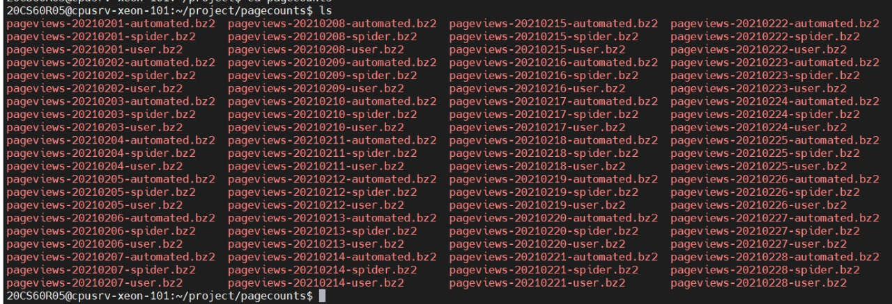
WIKIPEDIA SQL DUMPS
Step 1: Downloaded the latest wikipedia dumps : 01 Feb 2021
enwiki-20210201-categorylinks.sql.gz (2.9GB)
enwiki-20210201-category.sql.gz (27MB)
enwiki-20210201-pagelinks.sql.gz (6.8GB) 11GB approx
enwiki-20210201-page.sql.gz (1.9GB)
enwiki-20210201-redirect.sql.gz (136MB)
Step 2: Converted the above data format(.sql.gz) to .sql.bz2 for further processing in spark.
Step 3: Downloaded the pageview count data:

Slide 12
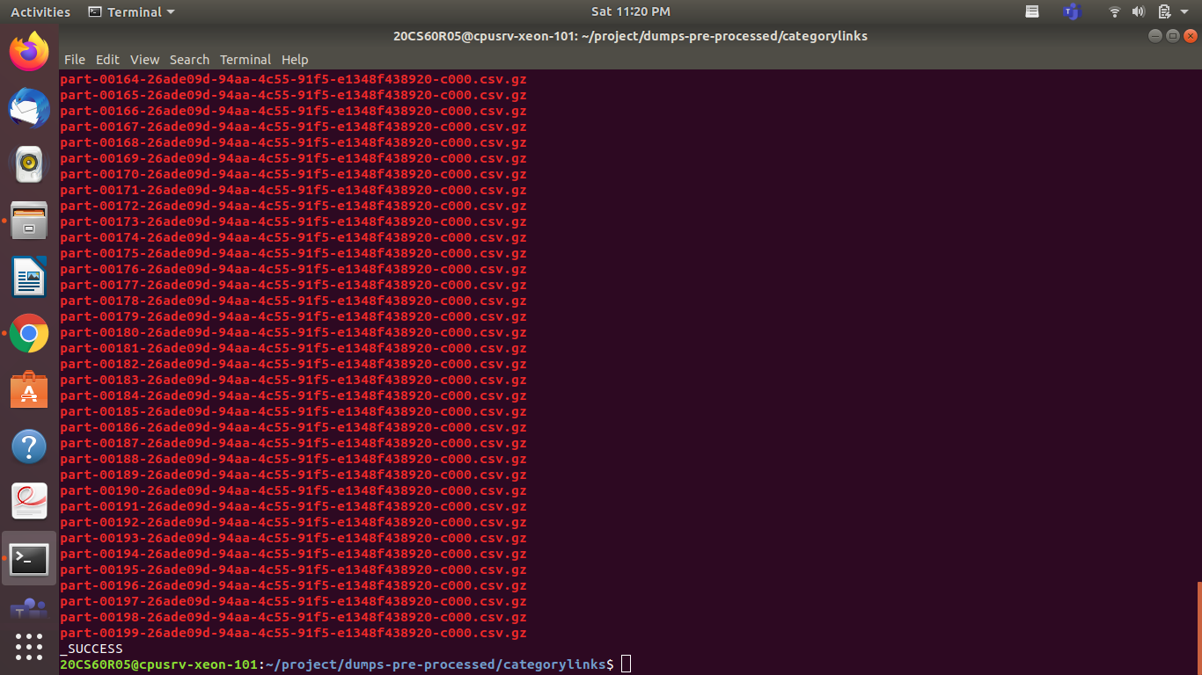
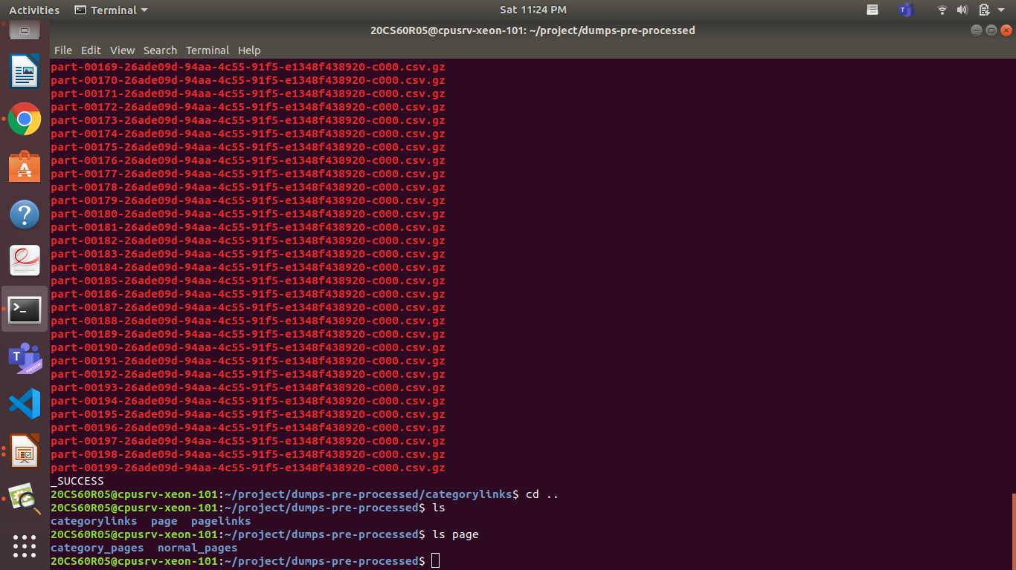
GRAPH DATABASE DEPLOYMENT
Step 1: Pre-processing
Preprocessed the Wikipedia dumps using “spark-submit” command.
spark-submit changed .sql.bz2 file format to .csv.gz format.
spark submit divided the whole data set in following category:

Slide 13
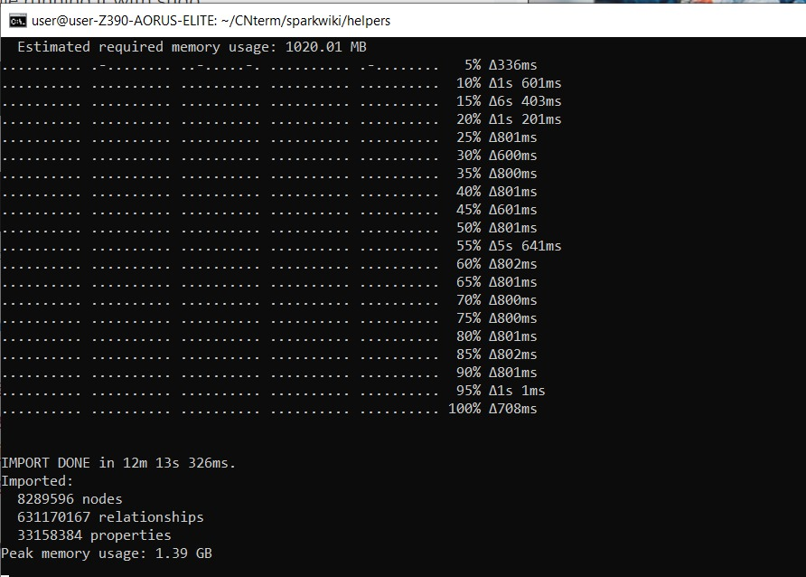
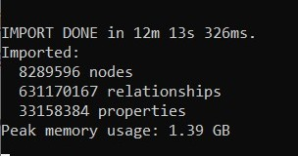
GRAPH DATABASE DEPLOYMENT
Step 2: wikipedia.db database creation in Neo4j
Created wikipedia.db database in Neo4j using “dbms.active_database” command
Import the preprocessed files in Neo4j by running a script
Result after database creation:

Slide 14
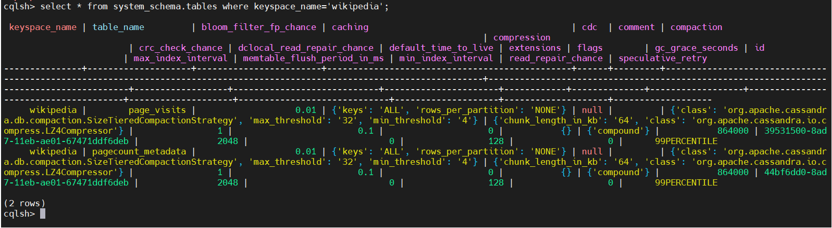
GRAPH DATABASE DEPLOYMENT
Step 3: Pagecounts deployment in Cassandra database
Created a keyspace named as “wikipedia” in Cassandra database.
This keyspace comprises of two tables: page_visits and pagecount_metadata
These tables provide information regarding the pagecounts and visit times of the numerous pages and articles in wikipedia.

Slide 15
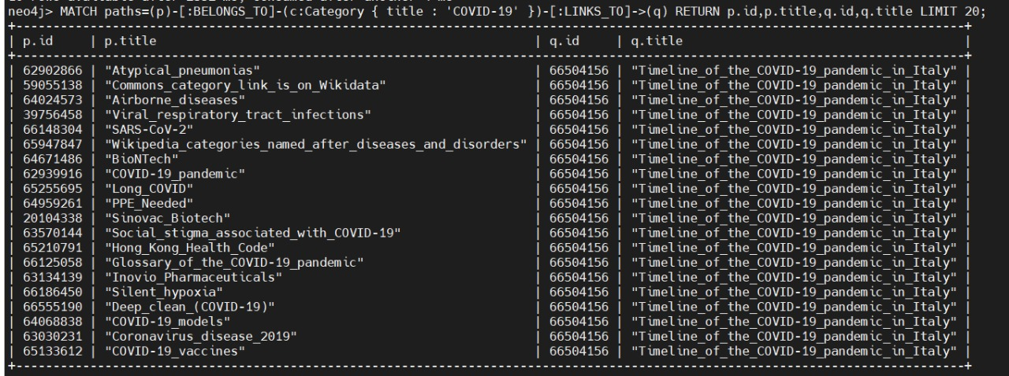
Extraction of Subgraph
We extracted a subgraph from the original graph since processing the entire graph wasn’t feasible due to its enormous size, i.e. almost 8.2M nodes and 631M edges.
The subgraph was extracted for the WikiProject COVID-19 which is dedicated to Wikipedia’s coverage of SARS-Cov-2 virus, COVID-19 and the COVID-19 pandemic.
The extracted subgraph comprises of 16,203 nodes and 57,294 edges.

Slide 16
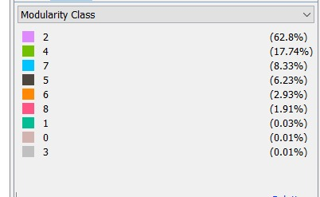
Community Detection Algorithm
Applied Louvain community detection algorithm to find communities in the extracted subgraph
We found the following 9 communities in our subgraph with modularity score 0.4926:
Note that 5 communities(2,4,7,5,6) contain 98% of the total nodes

Slide 17
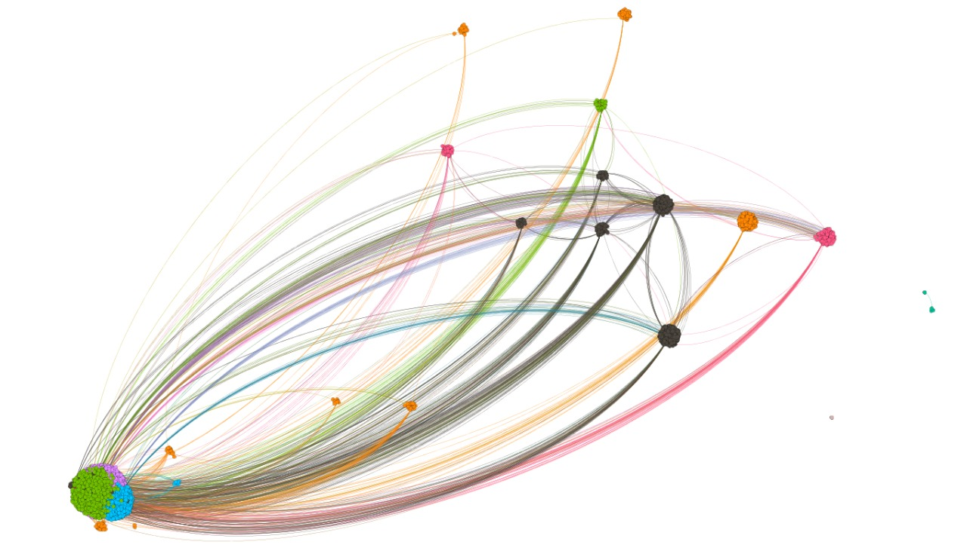
Graph visualization of the communities for extracted subgraph
2
4
7
5
6
8
1
0
3

Slide 18


Page-view score calculation
Took top-5 communities based on the size which comprises 98% of the total nodes
Calculated pageview score for each node belonging to top-5 communities using following way:
Calculate ‘f’ for each node which denotes the fraction of the edges connected to that node in the community where d_{i} denotes the degree of node i and m denotes the total number of edges in the community that the node belongs to.
Calculate pageview score P for each page(node) where f_{i}=f-value of node i and p_{i} =pageview count of node i
Calculated mean and standard deviation of pageview scores for each community
Discard nodes from each community whose pageview score lie outside +/- 1 SD of their mean
Pick up the top k’ nodes from each of the 5 communities along with their titles in order to build a corpus so as to find the trending topics for the month of feb 2021.

Slide 19
Ranking Words
Let P and T denote page ids and titles of the nodes present in the edge-list of the extracted subgraph respectively.
Let P* denote nodes whose pageview scores are in the range of 1 standard deviation away from the mean pageview scores for each of the 5 selected communities.
Dictionary
Key: Word
Value: TF-IDF Scores
Sort
Descending order of value
P*
P T
P* == P
Split T to words
Get TF-IDF scores for each word
Save
to
File
YES
NO
Ignore

Slide 20
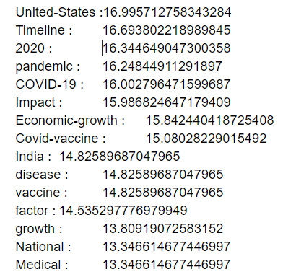
A Glimpse of the Saved file

Slide 21
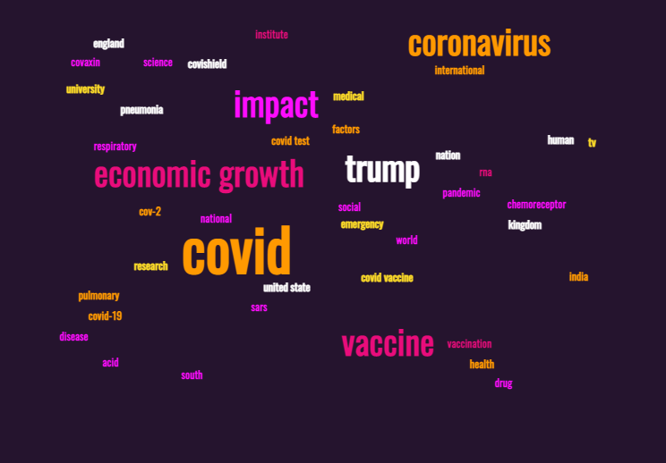
TRENDING TOPICS WORD-CLOUD

Slide 22
Mid-Sem Presentation Q&A
How will you validate the trending topics that you got?

Slide 23
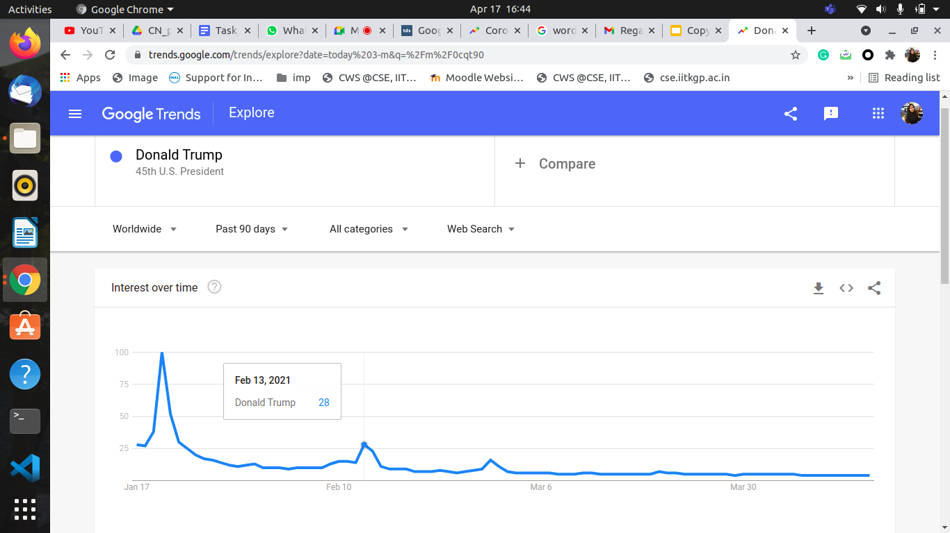
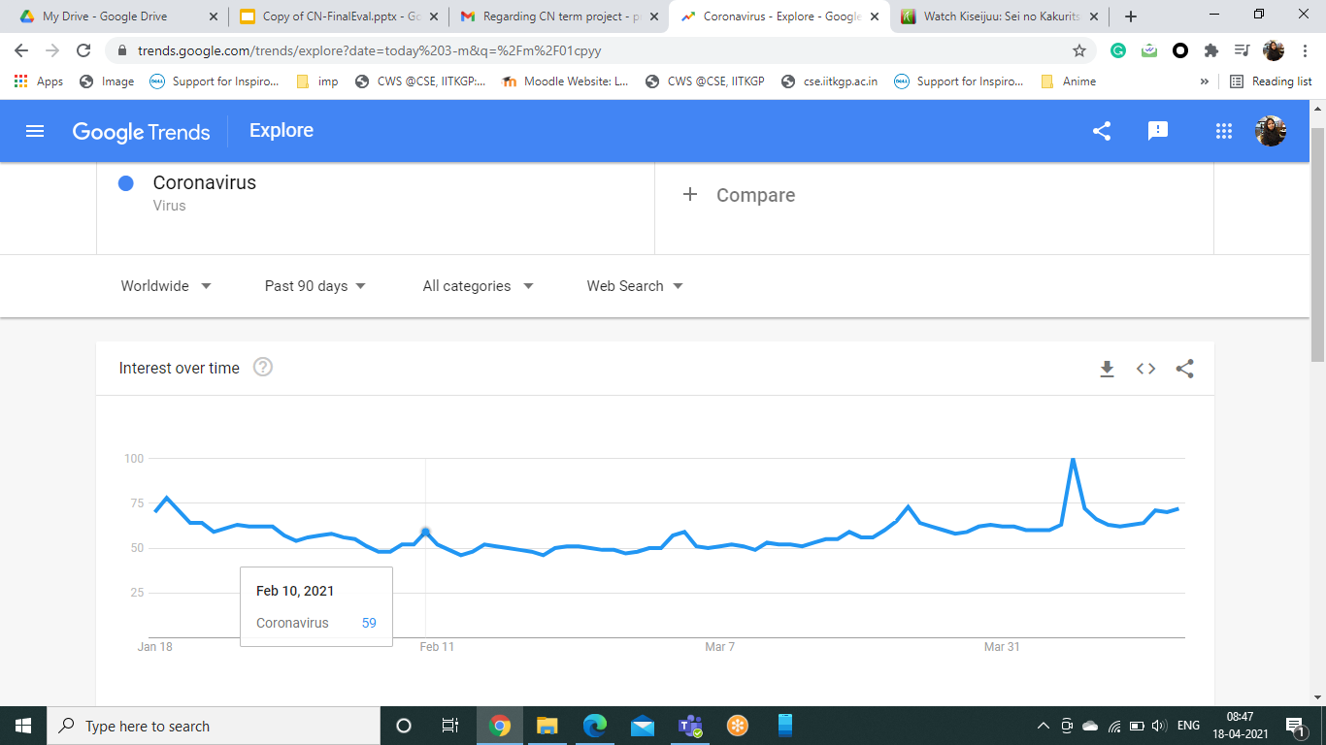
Trending Topic Validation
Compared the trending topics that we got from the top 5 communities that were detected previously, with Google Trends for the month of February 2021 using the Google Trends API.

Slide 24
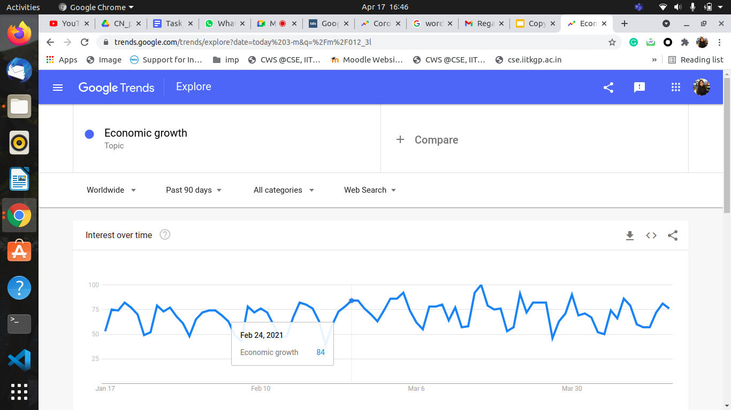
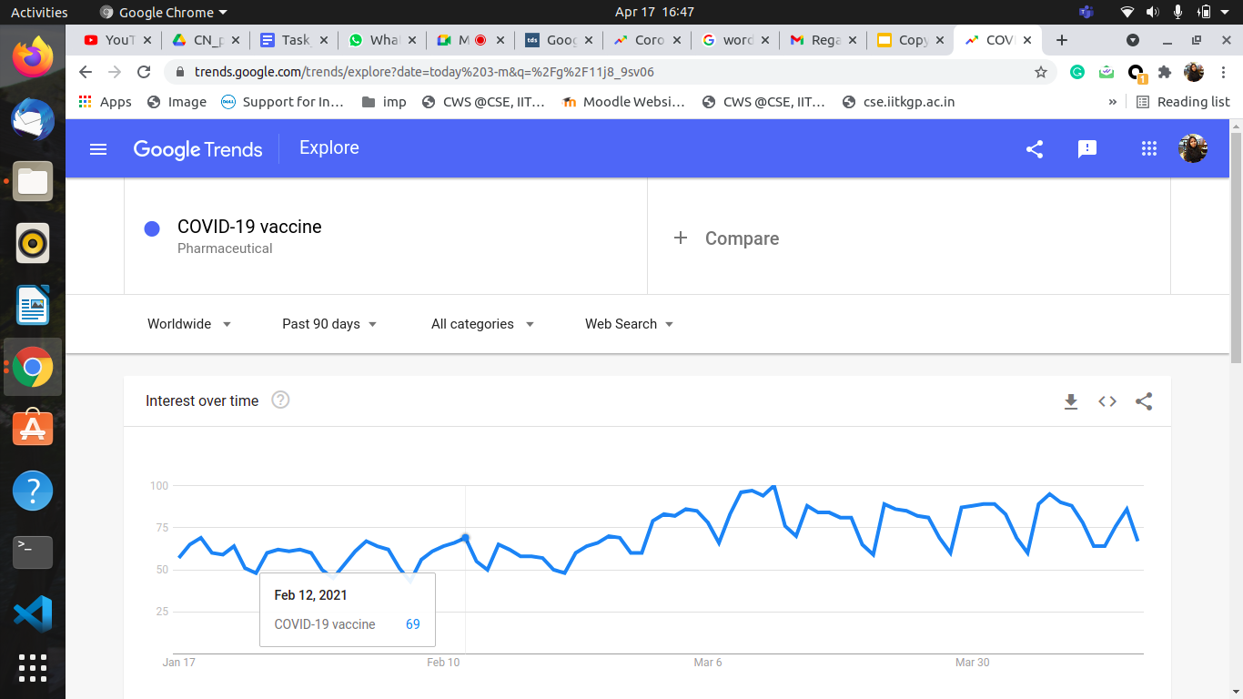

Slide 25
Scope for Improvements
Combining Wikipedia Topic Extraction with NLP:
Using Named Entity Recognition (NER)
to extract the keywords in a better way and then applying TF-IDF for ranking.
Using N-grams where N = 1 to 5 (say)
for Each N-grams calculate the TF-IDF and keep them in decreasing order of values.
Select the top K N-grams based on some threshold.
Showing Temporal Trends
comparing the trends of previous months/years with the current trends obtained by us.

Slide 26
THANK YOU!

