Slide 1
MTP - PART 1 PRESENTATION 15-11-2021
Comparative link prediction of disease comorbidity regarding COVID-19 using Knowledge Graph
Presented by Aditya Anand (20CS60R24).
Under the Guidance of Prof. K. Sreenivasa Rao.
PhD Mentor: Sir Saikat Biswas.

Slide 2
Contents
Introduction.
Disease Comorbidity.
Knowledge Graph.
About our work.
Proposed Idea for building KG.
My Contributions.
Data collection and Preprocessing
Construction of Subgraphs
Joining Subgraphs
Our Built KG
Extracting Triples
Embedding and feeding it to LSTM
Conclusion and Future Work.

Slide 3
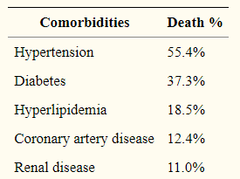
INTRODUCTION
1.1. What is Disease Comorbidity?
Simultaneous presence of one or more disease(s) along with a primary disease.
A patient suffering from co-morbid diseases possesses more mortality risk than with a disease alone.
Fig. 1: Snapshot from the paper “Comorbidity and its impacts”[R1].

Slide 4
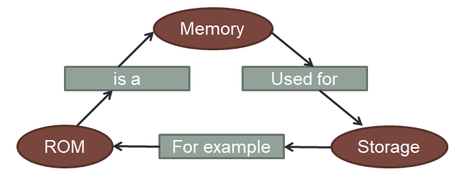
INTRODUCTION
1.2. What is Knowledge Graph(KG)?
A graph, KG = (E, R) that stores knowledge in the form of entities(E) and relations(R).
Nodes represents entities and Edges between them represents their relation.
It is used/stored in the form of triplets: <head, relation, tail>
For Example:
<ROM, is_a, Memory>, <Memory, used_for, Storage>, etc..

Slide 5
INTRODUCTION
1.3. What is this work all about?
An attempt to better predict comorbidity.
By building a Knowledge Graph using data of diseases, genes, ontologies, symptoms, etc..
As each knowledge can be represented in the form of triplets; triplets were first extracted from our built KG.
Our main goal here is to train models with the triplets of KG, such that the model acts as an alias of our KG.
INPUT: Embedded KG triplets.
OUTPUT: A model representing an instance of our KG.
The model can be then used to better predict comorbidity, by taking diseases as input and throwing chances of comorbidity(mortality) as output.

Slide 6
INTRODUCTION
1.3. What is this work all about?
Build a KG
(using necessary subgraphs)
Generate Triplets
Embedded Triplets
From
Entities
and
relations
Perform Word Embedding
Training Input
Learning MODEL

Slide 7
2. Proposed Idea for building KG
The following 6 subgraphs need to be created and merged together to form our required KG:
Diseases Subgraph: To get associations between diseases.
Gene Subgraph: To get interactions between Genes.
As genes impacts diseases and we are focused towards disease comorbidities, these two subgraphs acts as the base of our KG.

Slide 8
2. Proposed Idea for building KG
Gene Ontology (GO) Subgraph: To better understand gene interactions.
GO: Information about biological processes, cellular locations and molecular functions of a gene.
Variants Subgraph: For understanding the SNP variants(< 0. 01% Mutation) of diseases and genes.
To the base of our KG, GO subgraph and Variants subgraphs were merged to obtain our KG.
Human Phenotype Ontology(HPO) Subgraph: Shows standard abnormalities in diseases w.r.t. genes.
Symptoms Subgraph: Contains disease to symptoms relation.
HPO and Symptoms subgraph were added to further strengthen our KG.

Slide 9
3. My contributions
3.1. Data Collection and Preprocessing
BioGrid
Stores all Bio-medical interactions dataset.
UniProtKB
Database for Protein Sequence and Functional Information.
Gene with their Ontologies
COVID - Gene Interaction
Gene - Disease Connection
Kaggle Datasets
Free Machine Leaning Datasets.
Gene - Disease - Variants
Disease and Symptoms
HPO - Gene Dataset

Slide 10
3. My contributions
3.1. Data Collection and Preprocessing
All data collected, were present in Tab-Separated Values(.TAB3) format, was parsed.
Only necessary columns were extracted form each dataset:
COVID GENE INTERACTION DATASET: Entrez ID and Names of the Interactors(genes).
COVID GENE (30 Datasets) + ALL GENE_GENE Interactions, extracted only for Homosapiens.
Gene Ontology Dataset: Gene ID and Ontology ID.
Disease Dataset: Disease ID and Gene ID.
COVID DISEASE + ALL DISEASE Connections.
Variant Dataset: Disease ID, Gene ID and SNP Variant ID.
Symptoms Dataset: Disease Name and All the Symptoms column.
Human Phenotype Dataset: HPO ID and GENE ID.

Slide 11
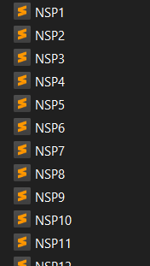
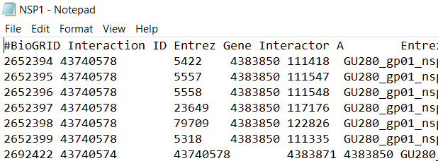
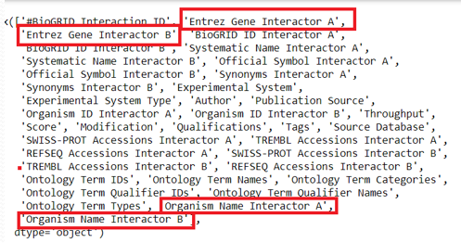
3. My contributions
3.1. Data Collection and Preprocessing

Slide 12

3. My contributions
3.2. Construction of Subgraphs
COVID-GENE Subgraph
We preprocessed the CG dataset such that each instance represents two interactors/genes.
Applied MCL to get clusters out of the the dataset.
Nodes being interactors/genes and edges being interaction.
We identified Covid Gene with Gene Organism Names == “SARS COV 2”.
Total 11 Covid Genes were there in 2 clusters.

Slide 13
3. My contributions
3.2. Construction of Subgraphs
COVID-GENE Subgraph (Continued)
Now, to retain most information at the same time to make the graph sparse (reduce complexity), we thought of a spanning tree approach.
To build spanning tree out of clusters, we wanted to start with the most central node(s).
We tried Betweenness Centrality, Page-Rank Centrality and HITS Centrality.
IDEA: In the clusters containing COVID Genes, if a centrality measure detects covid nodes to be the most central nodes, then that centrality measure will serve our purpose for all other clusters.
Betweenness Centrality outperformed the other two.

Slide 14
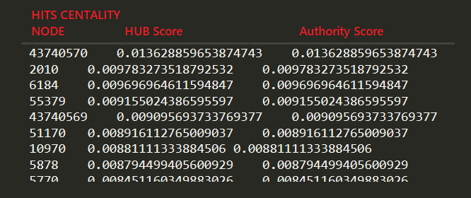
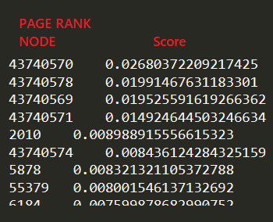
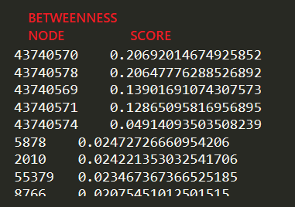
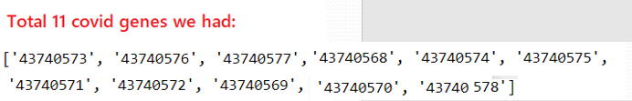
3. My contributions
3.2. Construction of Subgraphs
COVID-GENE Subgraph (Continued) - Sorted in Descending order.

Slide 15
3. My contributions
3.2. Construction of Subgraphs
COVID-GENE Subgraph (Continued)
Now, what if the centrality value of two or more nodes are the same (or too close like 0.39999… and 0.39998…).
We applied a concept of binning the nodes in cluster graphs based on the centrality values, with a bin size of 0.1.
Bin Size = 0.1;
NODE | Bet. Cent. Score
X | 0.320000
Y | 0.310000
Z | 0.290000
0.1 | 0.2 | 0.3 | 0.4 | 0.5 | 0.6 | 0.7 | 0.8 | 0.9 | 1.0
- | Z | X,Y | - | - | - | - | - | - | -
Choose the nodes in the topmost bin as the most central node(s).

Slide 16
3. My contributions
3.2. Construction of Subgraphs
COVID-GENE Subgraph (Continued)
Based on the chosen central nodes, spanning trees were generated for each cluster graph.
Join all spanning trees to form the COVID - GENE Subgraph.
Since, clusters may/may not be overlapping, so joining of clusters has two cases:
CASE A: Clusters are overlapping.
Simply merge the clusters based on union of edges and union of nodes.

Slide 17
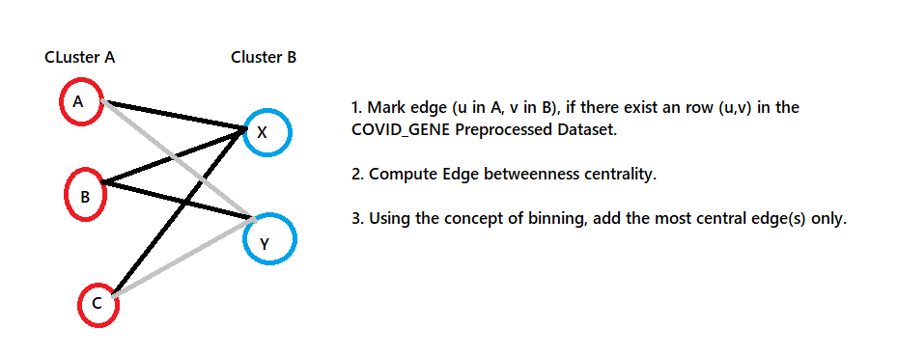
3. My contributions
3.2. Construction of Subgraphs
COVID-GENE Subgraph (Continued)
CASE B: Non-overlapping/disjoint clusters.
This is how the COVID_GENE SUBGRAPH was formed.

Slide 18
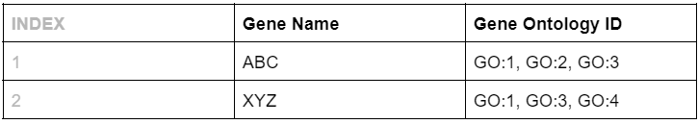
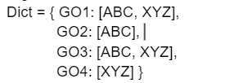
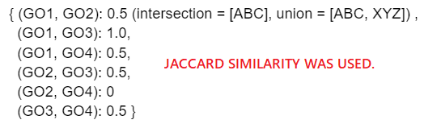
3. My contributions
3.2. Construction of Subgraphs
2. For Gene Ontology Subgraph:
We did not need to apply MCL:
We don’t have any COVID GENE here.
We know which centrality measures suits the best.
We applied a widely used technique in Computational Biology to compute similarity.

Slide 19
3. My contributions
3.2. Construction of Subgraphs
2. For Gene Ontology Subgraph:
Created a graph with the GO ‘X’ and GO ‘Y’ as nodes, and an edge connects these nodes iff their Jaccard Similarity Score > 0.
Now, obtain spanning tree from the above graph based on most central node(s) using binning of betweenness centrality score.
3. For all other subgraphs:
All other subgraphs(Disease, Variant, HPO and Symptoms) were created in the exact same manner as GO Subgraph.

Slide 20
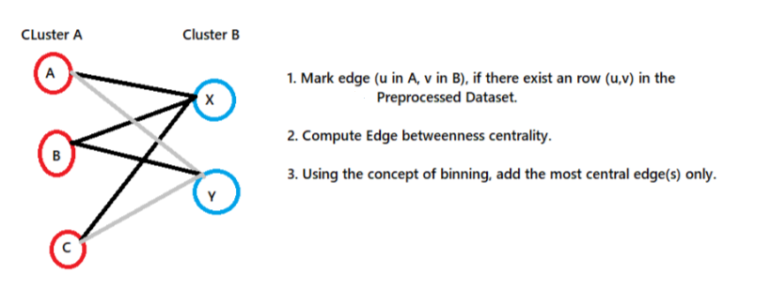
3. My contributions
3.3. Joining Subgraphs
Subgraphs are never overlapping unlike the MCL clusters of Covid-Gene Subgraph.
Hence, we are only left with one choice.

Slide 21
3. My contributions
3.4. Our Built KG (Logical Design)
Dis_Dis
GO_GO
Disease
Gene Ontology
Gene_Gene
Gene_Dis
Dis_Gene
Gene_GO
Covid Gene
Dis_Sym
Sym_Sym
HPO_HPO
Sym_Dis
GO_Gene
Var_Dis
Symptoms
Dis_Var
HPO
HPO_Gene
Gene_HPO
Gene_Var
Var_Gene
Variant
Var_Var

Slide 22
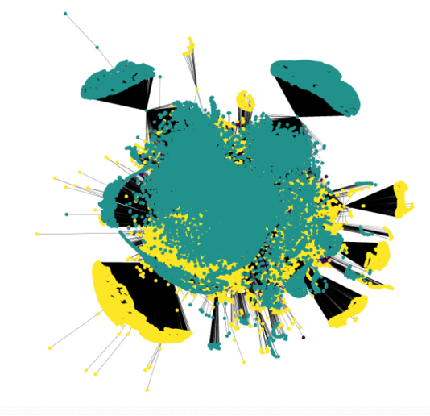
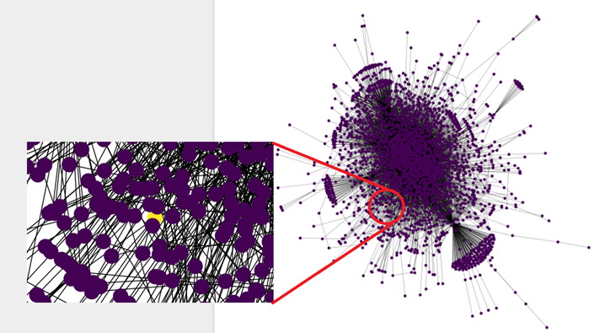
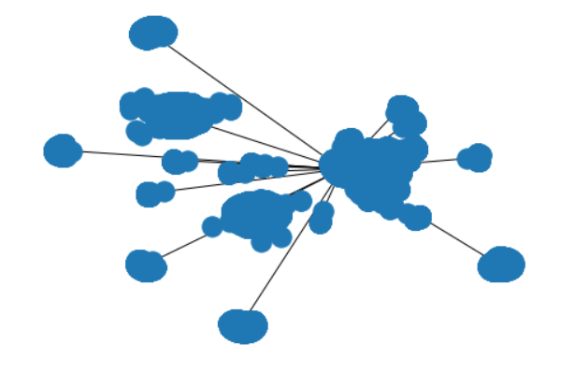
3. My contributions
3.4. Our Built KG (NetworkX 2D-plot)

Slide 23
3. My contributions
3.5. Extracting Triplets
Suppose from the KG we got a random edge, (X, Y) and we want to convert this to a
KG triple <head, relation, tail>.
Here the links are bidirectional, hence two triples will be created from an edge.
<X, typeOf(X) + ‘_’ + typeOf(Y), Y> and <Y, typeOf(Y) + ‘_’ + typeOf(X), X>
E.g.: Edge from the KG = (12992, C09976).
Let us assume 12992 is a node from the COVID-Gene Subgraph and C09976 is a node from the Disease Subgraph.
So, our triples will be <12992, Gene_Dis, C09976> and <C09976, Dis_Gene, 12992>.
In this way, all the triplets were derived from the graph.
Total #triplets = 839, 696 from KG having 419, 848 edges and 70, 392 nodes.
The graph (built using many subgraphs), like any other graph, consists of nodes and edges.
Problem: Identification of nodes. -> How to Know the typeOf(X)?
E.g.: Node ‘X’ belongs to which of the 6 subgraphs? Is it Gene, GO, Disease, Variant, Symptoms or HPO?

Slide 24
3. My contributions
3.5. Extracting Triplets
Keeping the above issue in mind. The Graph was built accordingly and nodes were identified as shown below.
Nodes in ______ Subgraph | Identification
Covid - Gene | Integer Value.
Gene Ontology | Starts with ‘GO’ followed by numerical value.
Disease | Starts with ‘C’ followed by numerical value.
HPO | Starts with ‘HP’ followed by numerical value.
Variant | Starts with ‘rs’ followed by numerical value.
Symptoms | Everything else (alphabetical + symbolic).

Slide 25

3. My contributions
3.6. Embedding and feeding to LSTM Model
All the triplets we obtained from KG are valid (with output label = 1).
So, our triplets Dataset looked like…
We applied word2vec Embedding on these triples and fed to an LSTM model.
Head | Relation | Tail | Label
1222 | Gene_Dis | C002928 | 1
C002827 | Dis_Var | rs002281 | 1

Slide 26
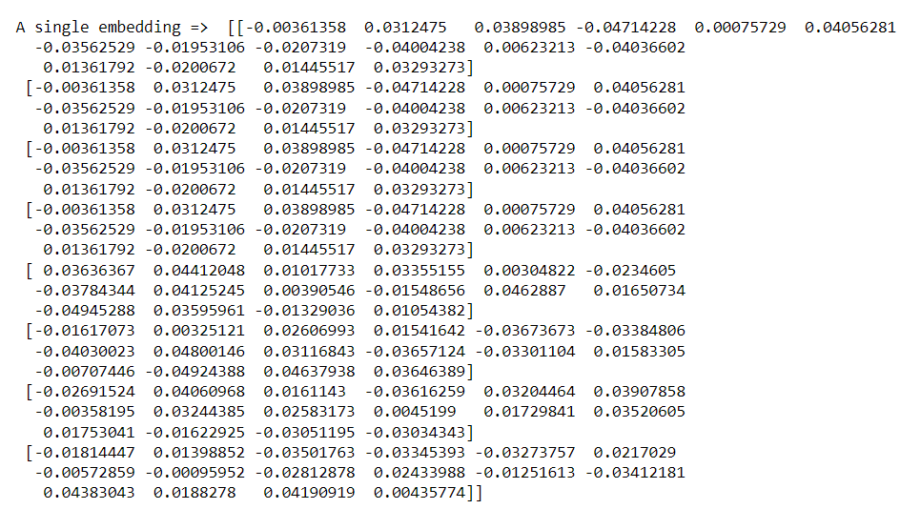
3. My contributions
3.6. Embedding and feeding to LSTM Model
E.g.: Triplet = <1299, Gene_Dis, C789888>

Slide 27
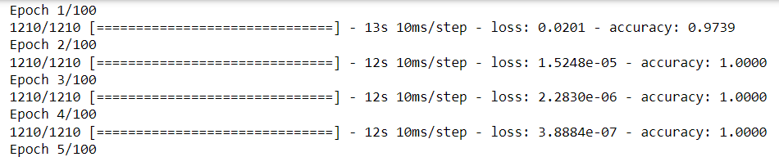
3. My Contributions
3.6. Embedding and feeding to LSTM Model
Specifications of our LSTM Model:
Sequential Model with Single LSTM Layer with 50 neurons.
Activation Function: ‘RELU’.
Optimiser: ‘ADAM’.
Loss Function: ‘MSE’.
Performance Metric: ‘Accuracy’.
We applied 10-Fold Cross Validation. And in each fold, we had 60% Training Data, 20% Validation and 20% Testing Data.

Slide 28
4. Conclusion and Future Work
As KG Triplets are just composed of nodes(entities) and edges(relations), we only have positive instances of data.
Hence, the learning is biased.
Pollute data with negative instances.
Other upcoming works for comparative study:
Associate weights to the edges of KG.
Try Different Embedding techniques.
Try Different Learning Models.
Also, we will try to incorporate drugs in the KG, such that based on related diseases, overlapping ontologies and biological functions, most suitable alternative for drugs can be found out.

Slide 29
References
1. Saikat Biswas, et al, “Relation Prediction of Comorbid Diseases Using Knowledge Graph Completion”. – IEEE 2019.
2. Rui wang, et al, “Analysis of SARS-CoV-2 mutations in the United States suggests presence of four substrains and novel variants” – NATURE 2021.
3. Zhen Wang, et al, “Knowledge Graph Embedding by Translating on Hyperplanes” – AAAI Conference 2014.
4. Liu Qiao, et al, “Knowledge Graph Construction Techniques” - Journal of Computer Research and Development 2016.
5. Mohommad Ali Moni, et al, “COMOR: a software for disease comorbidity risk assessment” - Journal of Clinical Bioinformatics 2014.
6. Adekunle Sanyaolu, et al, “Comorbidity and its Impact on Patients with COVID-19” – NATURE 2020.

Slide 30
Thank You.

