Slide 1
















Workflow
With
IoT
Build a Minimum Water Fountain
Mead Lai, meadlai@qq.com
2023 April
Notes:
This is a demostration about workflow and IoT

Slide 2





The History Of Internet
Pre - Internet
Internet of Content
Internet of Services
Internet of People
Internet of Things
1
2
3
4
5
Telephone, Fax, Mail
Blog, News, Portal
eShop, Email
Twitter, Facebook…
Car, Watch, Home Smart…
Notes:
Link: https://en.wikipedia.org/wiki/History_of_the_Internet

Slide 3
Internet of Things
What is IoT?
Connected Devices – things
Collect Information – input
Apply Actions - output
INTERNET
OF
THINGS
Notes:
https://aws.amazon.com/what-is/iot/
https://azure.microsoft.com/en-us/solutions/iot/

Slide 4










Scope of IoT
Cloud Service
Networking & Protocol
Device Management
Security
Edge AI
Sensor: Visual, Audio, Space
…
Example of IoT
Connected Homes
Smart Cities
Agriculture IoT
…
Notes:
https://aws.amazon.com/what-is/iot/
https://azure.microsoft.com/en-us/solutions/iot/

Slide 5

















STUDY CASE: WATER FOUNTAIN
Idea
Minimum Water Fountain
Design & Develop
ESP-32, pump, electromagnetic relay
Deployment
MQTT server, Weather service, Camunda server
Testing
Local test: use UDP instead of MQTT
Notes:
https://www.wikihow.com/Make-a-Water-Fountain

Slide 6
WHY ESP32
01
Cheap
12 ~ 20 RMB
04
Bluetooth
BT4.2 Convenience
Nearby Accessibility
CHEAP
ENERGY
EASY
ESP32 CHIP
High Level of Integration
SOP with minPCB, buildin antenna
02
Easy
IDF, Aduino, MicroPython
Platformio
05
INTEGRATION
WIFI
BLUE
TOOTH
03
WIFI 2.4GHz
Networking TCP, UDP
06
Ultra-Low Power Consumption
Dynamic power scaling
Notes:
https://docs.espressif.com/

Slide 7






WHY CAMUNDA?
MicroService
01
Micro-Service
Supports embedded and standalone service
System
Out-of-Box, Web Modeler, Admin
04
IoT
System
02
IoT Connect
With Service Task.
Deployment Easy
Easy to upgrade and changes
05
Camunda
Workflow
Deployment
03
Business Rule
Decision table DMN
Business Rule
Human Task
Review and approval by users
06
Human Task
Notes:
https://docs.camunda.org/manual/7.19/

Slide 8



SHOW TIME
Software: MicroPython & Thonny
https://micropython.org/
https://thonny.org/
01
MicroPython
02
Hardware: ESP32 & Rely & Pump
https://docs.espressif.com/
IOT
03
Camunda: Controller
https://docs.camunda.org/
ESP32
Notes:
https://micropython.org/
https://thonny.org/

Slide 9
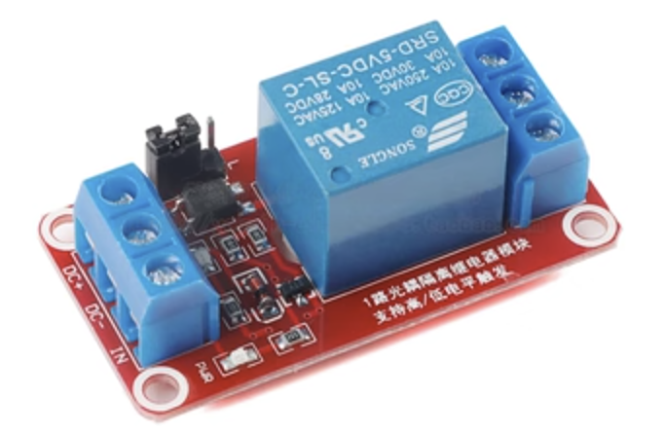
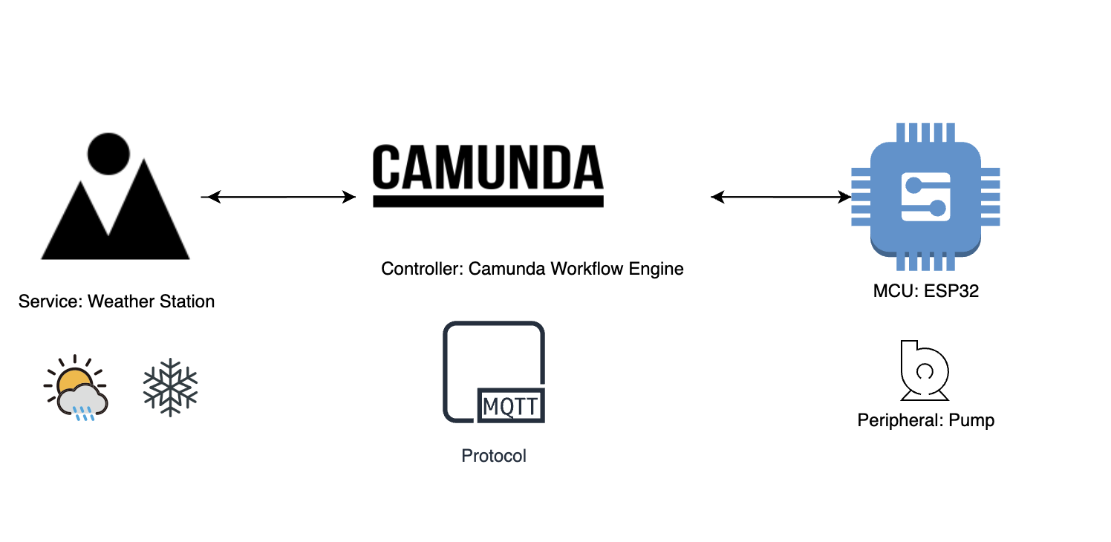
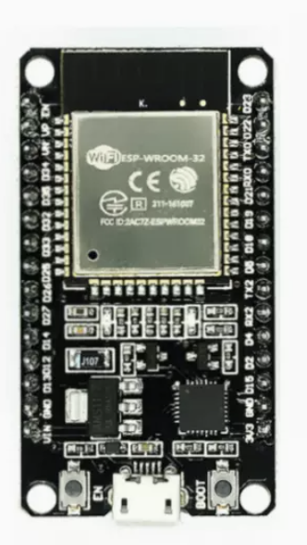
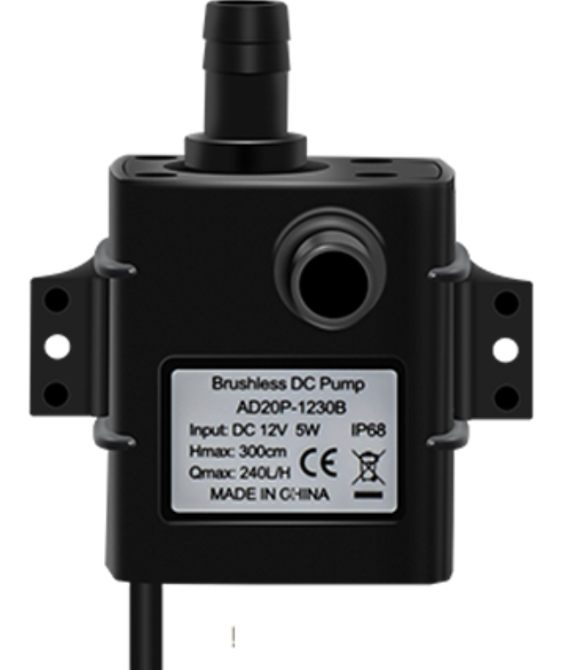
ARCHITECT DIAGRAM
Notes:
https://www.te.com/usa-en/products/relays-contactors-switches/relays.html

Slide 10
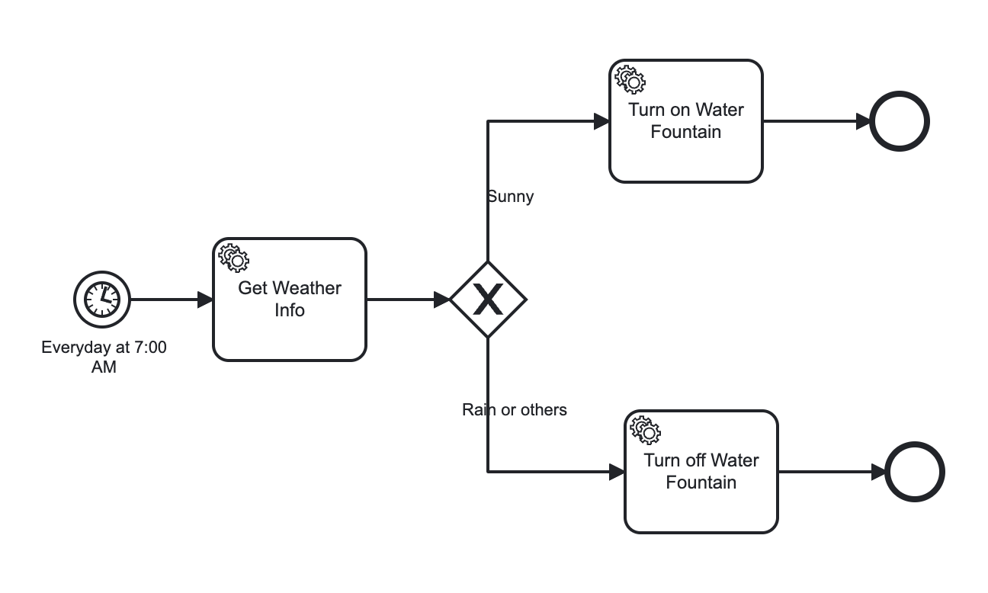
WORKFLOW LOGIC
Notes:
https://docs.camunda.org/manual/7.19/
http://www.quartz-scheduler.org/documentation/quartz-2.1.7/tutorials/tutorial-lesson-06.html
https://www.baeldung.com/cron-expressions

Slide 11
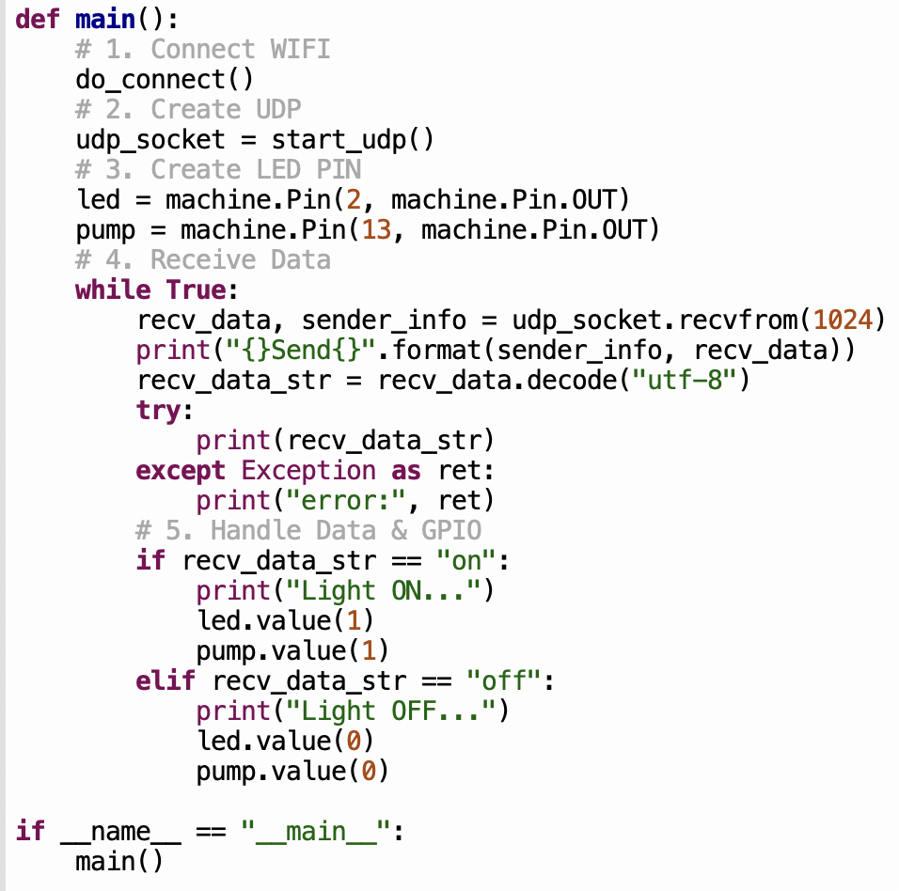
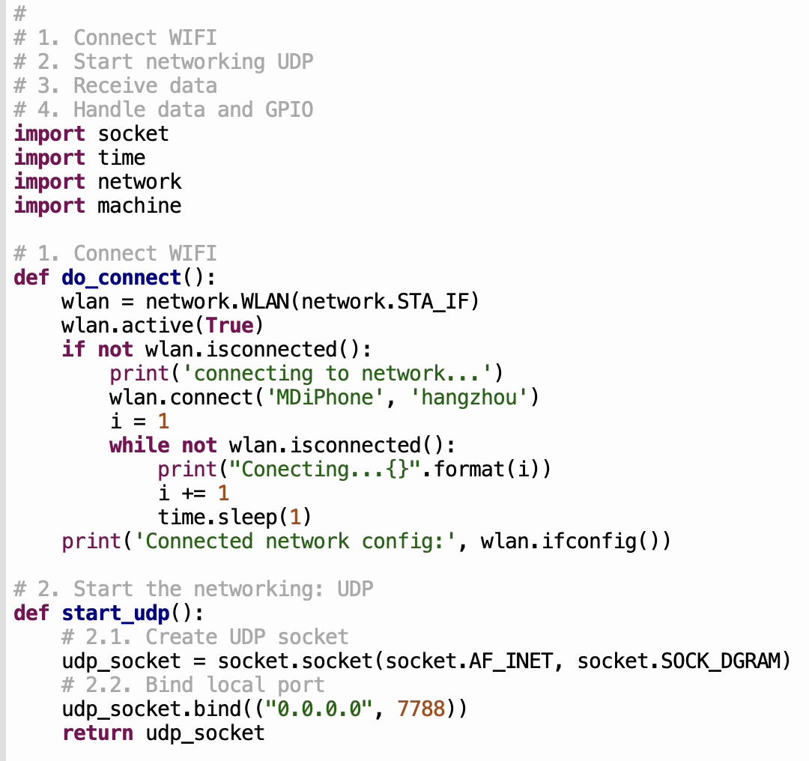
EPS32 MCU CODE
Notes:
https://docs.micropython.org/en/latest/wipy/tutorial/wlan.html
https://docs.micropython.org/en/latest/library/socket.html

Slide 12
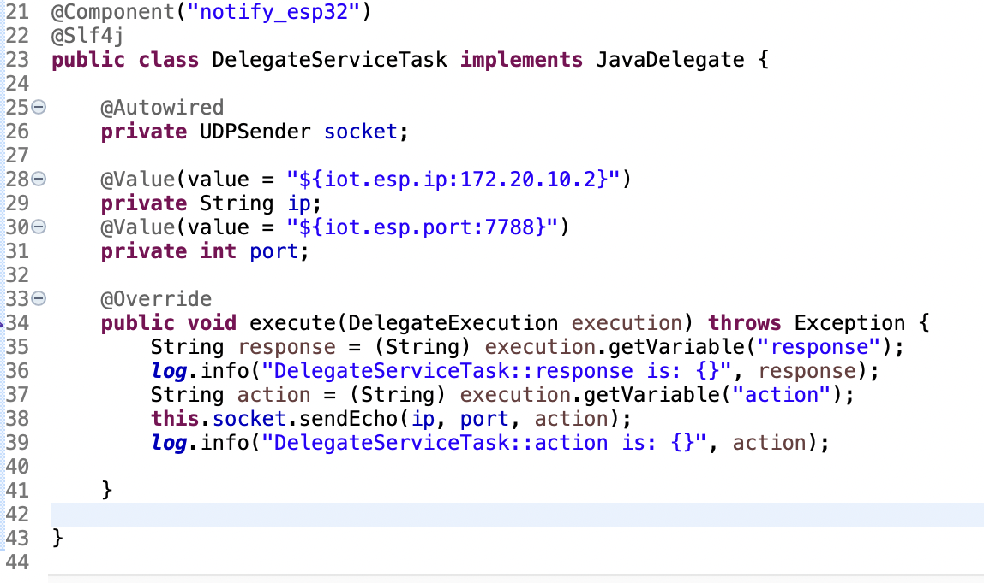
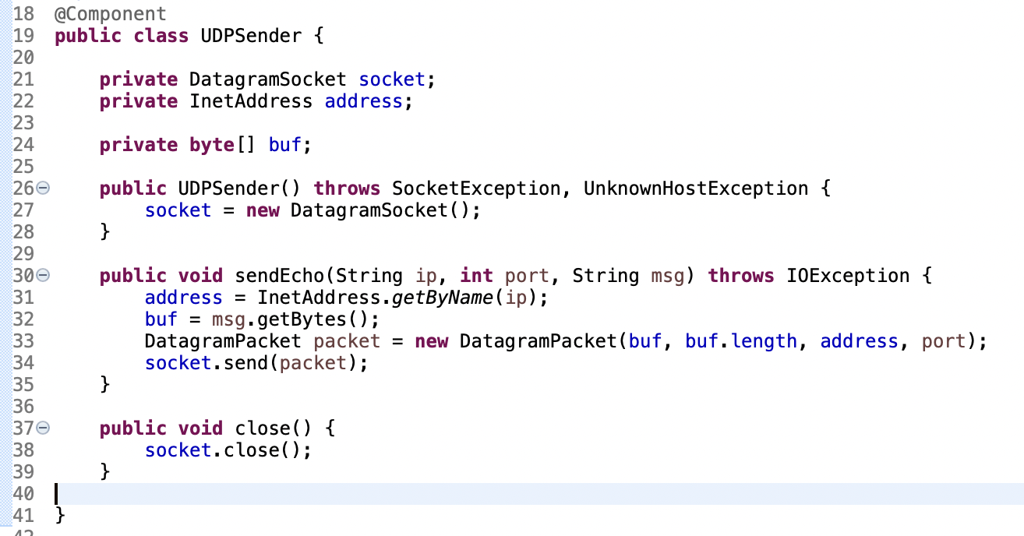
SERVICE TASK CODE
Notes:
https://docs.camunda.org/manual/7.19/reference/bpmn20/tasks/service-task/

Slide 13





THANK YOU FOR YOUR TIME !
RESOURCE
Git Repository: https://github.com/meadlai/workflow-iot
ANY
QUESTIONS

