Slide 1




Walmart Sales Analysis 2026: Executive Overview
A strategic review of fiscal year 2026 performance and future growth
opportunities.

Slide 2




Executive Summary
Strong Revenue Growth
FY26revenueshit $713billion,a5.6% YoY increase, fueled by
Walmart U.S. and significant global eCommerce expansion.
Enhanced Profitability
Operating income rose 10.8%, a testament to improved margins and strategic business mix adjustments.
Omnichannel & Membership Power
programs (Walmart+, Sam9s Club) are key drivers of sustained profitability and customer loyalty.
Walmart's strong omnichannelpresence andgrowing membership

Slide 3

Sales Trends Overview
Global & Club Growth
Walmart U.S.
Performance
International salesjumped
Comp sales (excluding fuel) climbed 4.6%.
Driven by robust transaction
growth at +2.6%.
Supported by an average
ticket increase of +2.0%.
7.5% (constant currency), influenced by events like
Flipkart's Big Billion Days.
Sam9s Club U.S. saw a 4.0%
rise in comparable sales,
bolstered by omnichannel
capabilities and expanding
membership.

Slide 4

Top Performing Categories
Grocery: Continues asthe dominant segment,demonstrating stable
growth, amplified by fresh produce and an expanding private label selection.
Health & Wellness: Experienced accelerated growth, reflecting a
broader consumer trend toward personal well-being products.
General Merchandise: Saw significant gains, particularly in electronics
and home improvement sectors.
For detailed insights into category-level sales and margin trends,
refer to the "Product Performance" sheet charts.

Slide 5


Regional Performance Highlights
U.S. Market: Led overall growth with strong comparable sales and a substantial digital contribution, adding ~520 basis points to comparable sales.
International Markets: Presented a
mixed landscape. Robust growth was
observed in India (driven by Flipkart)
and Mexico.
Conversely, markets like China and
Canada required strategic
adjustments to their operational
formats.
Sam9s Club U.S.: Successfully
expanded its membership base and
further strengthened its omnichannel
sales presence, ensuring consistent
performance.

Slide 6

Seasonal Sales Patterns
Q4 FY26Surge:Revenue soaredto$190.7billion (up5.6%), reflecting
the robust demand during the holiday season and effective promotional strategies.
Flipkart's Impact: The Big Billion Days event significantly influenced
international revenue timing, creating notable sales spikes in Q3/Q4
Membership Boost: Global membership fee income experienced a
healthy 15.1% growth, primarily driven by seasonal promotions and
new sign-ups.

Slide 7
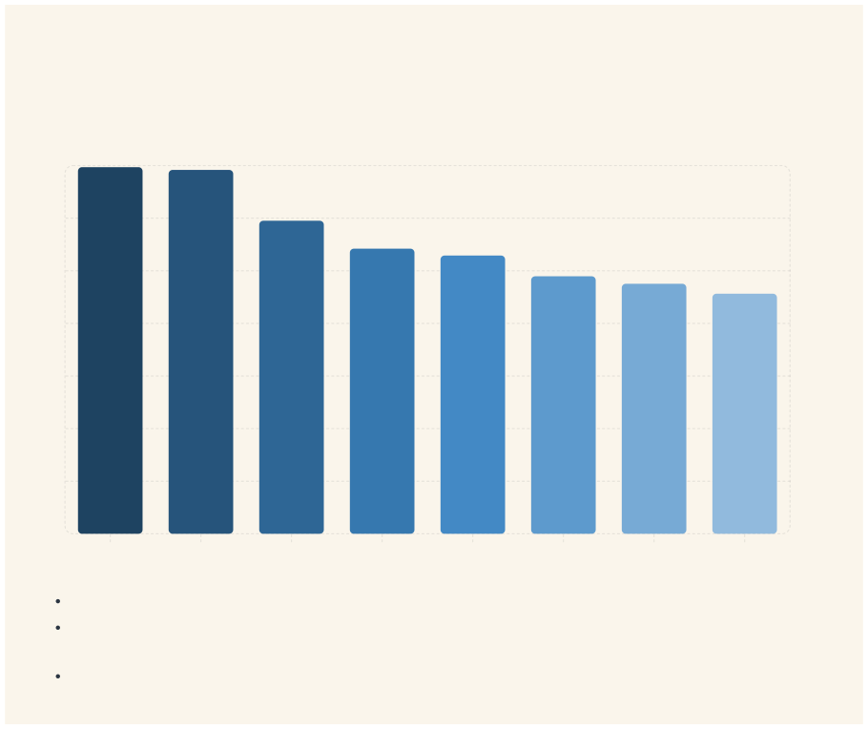
Key Insights from Product Performance
Analyzing the detailed product performance charts reveals critical trends driving Walmart's success and profitability.
Total Revenue 14k
12k
10k
8k
6k
4k
2k
0
Smar tphone
TV
Laptop
Fridge
Washing Mac&
Headphones
Camera
Tablet
Product Name
Profitability Drivers: High-margin categories and digital sales channels are increasingly critical to overall profitability. Efficient Operations: Improved inventory management strategies have successfully reduced holding costs, even amidst robust
sales growth.
Optimized Product Mix: A strategic shift towards private label and exclusive brands continues to enhance overall margins.

Slide 8
Challenges and Risks
Inflationary Pressures
Regulatory Landscape
Uncertainties from tariffs, trade policies, and evolving drug pricing legislation impacting operational costs.
Competitive Environment
Risingcostsandconstrained consumer spending, particularly in lower-income segments.
Thedynamicretaillandscapedemands
continuous innovation and agile supply chain management.

Slide 9

Strategic Recommendations
Digital Acceleration: Intensify investments in digital platforms and omnichannel capabilities to fully
capitalize on growing eCommerce
demand.
Membership Expansion: Grow high-
margin membership programs and
expand the Walmart Connect
advertising platform for increased
engagement.
Product Optimization: Refine the
product mix, emphasizing private
label and health & wellness categories
to boost margins.
Data-Driven Decisions: Utilize
insights from product performance
data to continuously improve
inventory management and
promotional strategies.

Slide 10

Conclusion & Next Steps
Strong Performance
Future Focus
Sustained success in FY27 will hinge on continued commitment to technology,
superior customer experience,
and strategic investments.
Walmart'sFY26 results underscore robust growth and healthy margin expansion
despite dynamic retail
conditions.
Actionable Insights
Ournext stepinvolvesadeep dive into product performance charts to
pinpoint specific opportunities for targeted growth initiatives.

