Slide 1
Applying HLS to FPGA Data Preprocessing in the Advanced Particle-astrophysics Telescope
Presenter: Meagan Konst
Advisor: Roger Chamberlain

Slide 2
Agenda
Introduction
Background and Related Work
Accelerated Algorithms
HLS Implementation
Conclusion and Future Work
Q+A Session

Slide 3
Introduction

Slide 4
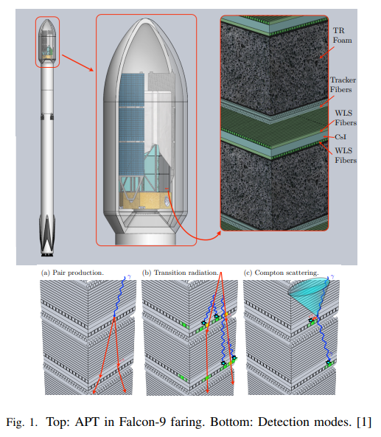
APT Overview

Slide 5
APT Overview
Goal: Capture cosmic rays and tell devices on Earth where to look to collect additional data

Slide 6
APT Hardware Pipeline
Wavelength-shifting Fibers
ALPHA ASICs
ADC BUFFER
FPGA
CPU

Slide 7
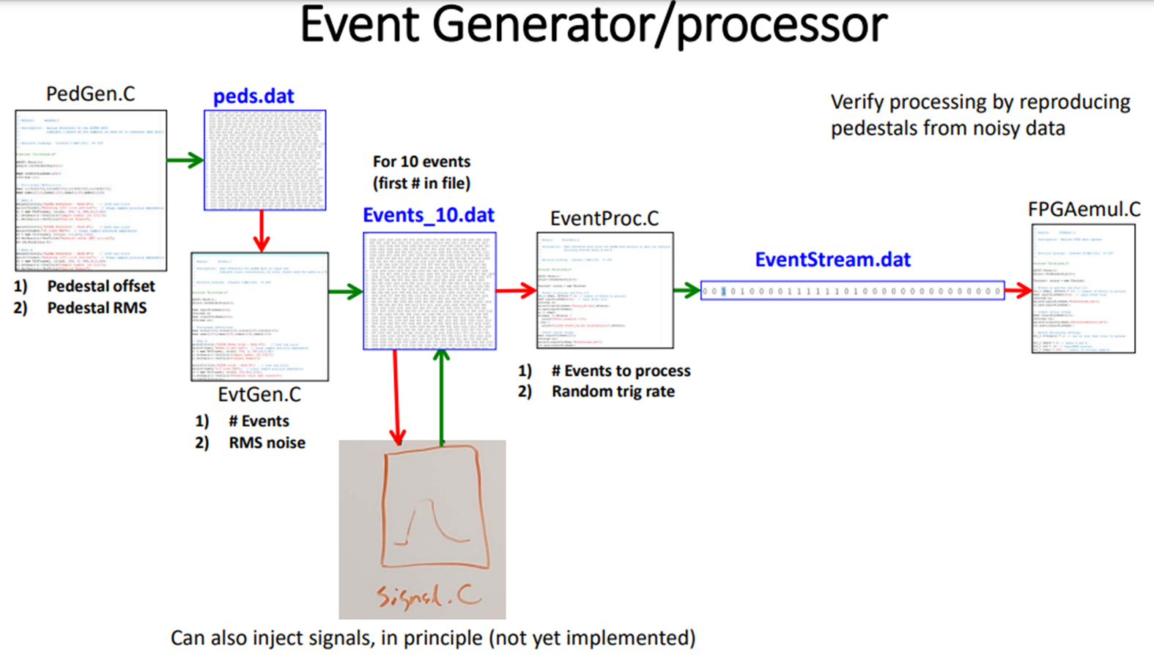
Input Data Generation
Originally Developed by Gary’s Group, modified and fleshed out by Marion with data models from the Italian group

Slide 8
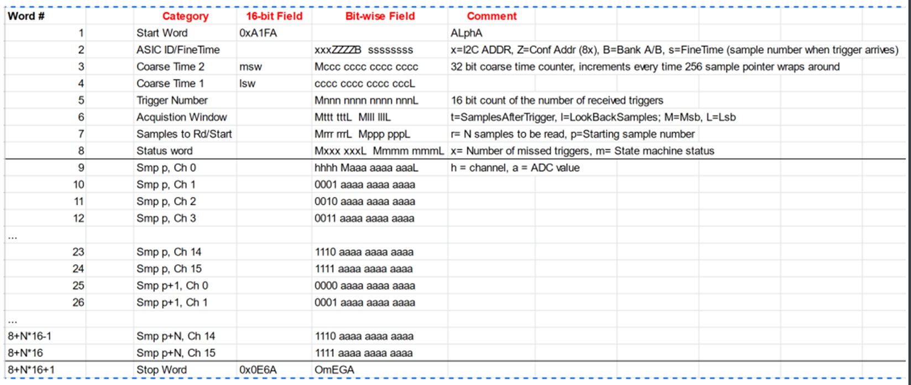
Input Data Packet
2 ADC Buffer Banks, A sample is collected every 10 ns, one Bank can be read while the other is filled, sent to the FPGA when a trigger occurs

Slide 9
Data Preprocessing
Pedestal: Constant Capacitive Noise of an ADC Buffer Slot
Pedestal Subtraction
Integral: Sum of a signal over time to collect total energy produced by an event

Slide 10
Integral Types
Key: Blue: Pre-Signal Noise Purple: Main Signal Green: Tail Red: Whole Window
ADC Counts
Trigger
Time

Slide 11
Background and Related Work

Slide 12
FPGA Design Approaches
Hardware Description Languages (HDLs)
Steep Learning Curve
Prone to User Error
Difficult to Debug
High-Level Synthesis (HLS)
Allows Software Engineers to program FPGAs using software languages such as C/C++ and OpenCL C

Slide 13
Related Work
HLS Portability from Intel to Xilinx –Zhili Xiao
Naïve Porting required lots of modifications and had terrible performance
Lots of optimization techniques applied and still not as performant
Transformations of High-Level Synthesis Codes for High-Performance Computing –Johannes de Fine Licht
Gave a 3.5 hr talk on current best practices and iterative optimization techniques for improving performance

Slide 14
Vitis Host and Kernel
Host
Kernel
Create an OpenCL Environment
Initialize Inputs as Memory Buffers
Run the kernel
Read and Process Outputs
FPGA Module where algorithms are implemented
Communicates with Host over a specified interface (AXI for now)
Notes:
AXI: Advanced eXtensible Interface, ARM bus-protocol

Slide 15
Loop Types
Imperfect
Semi-Perfect
Perfect
Similar Performance

Slide 16
Imperfect Loops
for (variable bounds) {
operations
for (variable bounds) {
operations
}
operations
}
Operations outside innermost loop
Variable Loop Bounds

Slide 17
Semi-Perfect Loops
for (variable bounds) {
for (constant bounds) {
operations
}
}
Variable loop bounds in only the outermost loop

Slide 18
Perfect Loops
for (constant bounds) {
for (constant bounds) {
operations
}
}
Can Require Conditional Execution in the innermost loop

Slide 19
Accelerated Algorithms

Slide 20
SW Interface Functions
data_packet_dat_to_struct
peds_dat_to_arrays
write_output
write_header
write_integrals
struct_to_json
add_to_json
add_samples_to_json
(Host)

Slide 21
SW Interface Functions
struct_to_json
packet.json
data_packet
data_packet_dat_to_struct
EventStream.dat
data_packet
HW
write_output
integrals
output.txt
all_peds
peds_dat_to_arrays
peds.dat

Slide 22
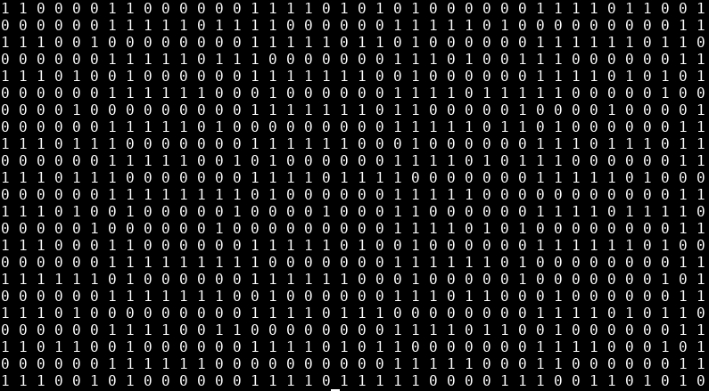
data_packet_dat_to_struct
Functionality: Takes generated input signals and produces a data_packet struct
(input)
EventStream.dat

Slide 23
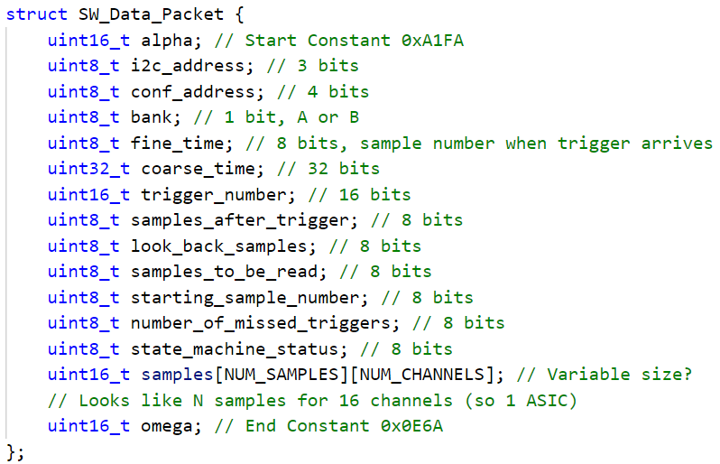
data_packet_dat_to_struct
Functionality: Takes generated input signals and produces a data_packet struct
(output)
SW_Data_Packet

Slide 24
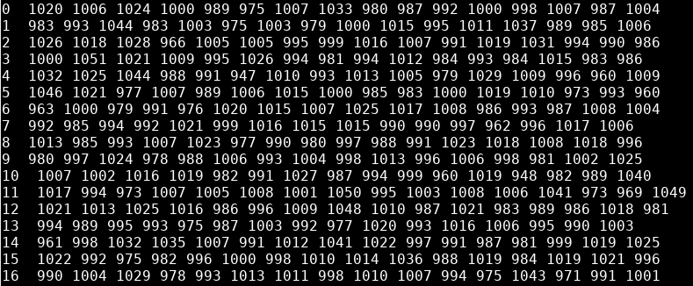
peds_dat_to_arrays
Functionality: Takes generated pedestal values and produces a 3D array of them
(input)
peds.dat

Slide 25
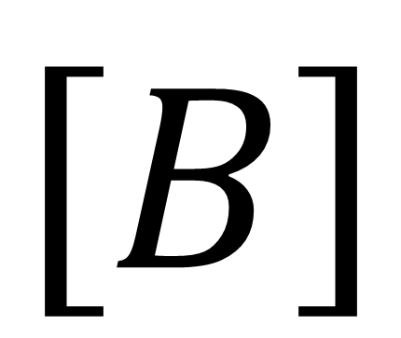

peds_dat_to_arrays
Functionality: Takes generated pedestal values and produces a 3D array of them
$$\left[A\right]$$
CHANNEL NUMBER
SAMPLE NUMBER
$$\left[B\right]$$
CHANNEL NUMBER
(data structure)
SAMPLE NUMBER

Slide 26
peds_dat_to_arrays
Functionality: Takes generated pedestal values and produces a 3D array of them
(output)

Slide 27
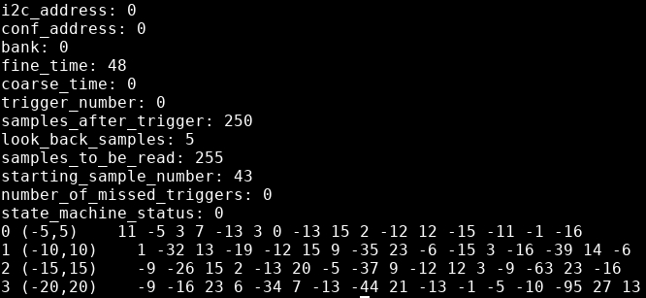
write_output
Functionality: Takes header information, integrals, and their bounds and produces a text file
Header Info
Integrals
(output)
output.txt

Slide 28
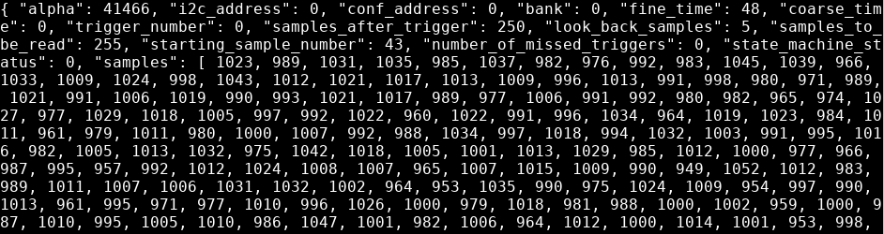
struct_to_json
Functionality: Takes data_packet struct and creates a JSON file for debugging purposes / data dump
(output)
packet.json

Slide 29
HW Functions
ped_subtract
Removes pedestal noise through subtraction
integral
Takes an integral over a specified time interval whose bounds are trigger-relative
(Kernel)

Slide 30
ped_subtract
Executed for all 16 Channels, 256 Samples Each
0
255
SAMPLES
Starting Sample Number
-
0
255
PEDESTALS
0
255
RESULTS

Slide 31
integral
Executed for all 16 Channels
ped_subtract results
ped_subtract results
+
+
end
start
+
+
OR
+
end
+
+
start
+
Bounds are Trigger-Relative

Slide 32
HLS Implementation

Slide 33
Compilation Times
sw_emu: ~1min
Functional Correctness
hw_emu: ~30min
Cycle Accuracy
hw: ~3hr
Place and route -> bitstream

Slide 34
Performance Goals
Frequency
Latency
Area
Power

Slide 35
Main Statistics Collected
Timing Information
Target Frequency: 300 MHz
Estimated Frequency: 411 MHz
Latency Information (Goal: 2.56 μs)
Cycles and Seconds
Best, Average, and Worst
Area Information
Counts and Percent Utilization
FF, LUT, DSP (not used), BRAM, URAM (not used)
ASIC Count Estimate (Goal: 12)
Power Consumption (Only Available from HW Runs)
Notes:
Explain Target / Estimated Frequency, Define Abbreviations, say explicitly that fewer resources is better

Slide 36
Disclaimers
Experiments were conducted on the CloudLab u280 board (UltraScale)
Percent Utilization Numbers were calculated for our target board (XC7K325T-2FFG900C) (Kintex-7)
Samples and Pedestals are both stored in external memory (HBM)
Reported Statistics are for the entire Kernel

Slide 37
Iterations
Naïve Approach
Added Tripcount Numbers
ped_subtract optimizations
Attempt to Fix Memory Access Issue
Semi-Perfect ped_subtract loop
Perfect ped_subtract loop
integral optimizations
Forced Perfect integral loop
Perfect integral loop with combined logic
Perfect integral loop with ternary operators
Attempted to Remove False Dependence
Removed False Dependence with proper temp buffer

Slide 38
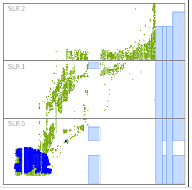
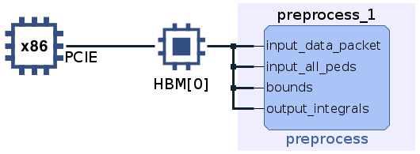
Naïve Approach
Warnings: Memory Port Contention in ped_subtract and integral loop could not be flattened
Latency: No numbers since loops had variable bounds
Vitis
FFs | % Util | LUTs | % Util | BRAM | % Util | ASICs
14853 | 3.644 | 39600 | 12.14 | 66 | 0.4120 | 8

Slide 39
Naïve Approach
Ran on the CloudLab Machine (u280)
Clock Frequency: 286 MHz
Average Power Consumption (W)
10.591
Cycles | Time | Times Slower Than Goal
84370 | 0.295 ms | 115
HW Run
FFs | % Util | LUTs | % Util | BRAM | % Util | ASICs
21416 | 5.254 | 10309 | 3.161 | 25 | 0.1561 | 19

Slide 40
Added Tripcount Numbers
Undefined Iterations -> Worst-case Iterations
Set min=1 and max=256 (NUM_SAMPLES)
Same Warnings and Numbers
Cycles | Time | Times Slower Than Goal
40533 | 0.135 ms | 53

Slide 41
ped_subtract optimizations

Slide 42
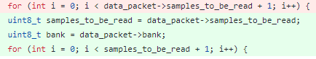
Attempt to Fix Memory Access Issue
Accessed data_packet fields once instead of on each loop iteration
Did not resolve Memory Warnings
The numbers remained the same

Slide 43
Semi-Perfect ped_subtract loop
Resolved Memory Warnings for ped_subtract
Moved pedestal indexing logic to the innermost loop
Semi-Perfect because outermost loop still has variable (data_packet->samples_to_be_read) bounds
Cycles | Time | Times Slower Than Goal
42582 | 0.142 ms | 55
FFs | % Util | LUTs | % Util | BRAM | % Util | ASICs
10278 | 2.522 | 22753 | 6.978 | 52 | 0.3246 | 14

Slide 44
Perfect ped_subtract loop
Made an assumption that we will always read the full memory buffer (256 samples)
Gives us more accurate latency numbers (no longer need Tripcount pragma) but not much change otherwise
FFs | % Util | LUTs | % Util | BRAM | % Util | ASICs
10261 | 2.517 | 22737 | 6.973 | 52 | 0.3246 | 14

Slide 45
integral optimizations

Slide 46
Disclaimer
Integral is assumed to have variable bounds
If the bounds were constant, a different optimization approach would be taken

Slide 47
Forced Perfect integral loop
Before
After
if
for
for
else
for
for
for
for
for
if
if
if
else
if
Notes:
Conditions: BEFORE: if (end >= start) {} else {} AFTER: if (NUM_SAMPLES idx = 0) {initialize} if (end >= start) {if (within those bounds)} else {if (within those bounds)}

Slide 48
Forced Perfect integral loop
II=137!!! Exploded, did NOT map well without further optimizations / re-arranging
Memory Violations on Integral ports now
Takes up much less space, but is ridiculously slow
Cycles | Time | Times Slower Than Goal
2331359 | 7.770 ms | 3035
FFs | % Util | LUTs | % Util | BRAM | % Util | ASICs
4648 | 1.140 | 7097 | 2.176 | 24 | 0.1498 | 45

Slide 49
Perfect integral loop with combined logic
Before
After
for
for
if
if
if
else
if
for
for
if
if
Notes:
Conditions: AFTER: if (NUM_SAMPLES idx = 0) {initialize} if (within bounds) {accumulate}

Slide 50
Perfect integral loop with combined logic
Consolidated if-else statements into one if condition
Did not resolve warnings
Same Latency Numbers, Took up less space
FFs | % Util | LUTs | % Util | BRAM | % Util | ASICs
4517 | 1.108 | 6965 | 2.136 | 24 | 0.1498 | 46

Slide 51
Perfect integral loop with ternary operations
Replaced if statements with ternary operations
Did not resolve warnings
Slight improvement in Latency and Area
Cycles | Time | Times Slower Than Goal
2314699 | 7.715 ms | 3014
FFs | % Util | LUTs | % Util | BRAM | % Util | ASICs
4468 | 1.096 | 6987 | 2.143 | 24 | 0.1498 | 46

Slide 52
Attempted to Remove False Dependence
Functionally Incorrect! Labeled a True Dependence as False
I created a temporary variable but not a temporary buffer, need both (WAR dependence)
Resolved Warnings
Latency significantly improved, using more FFs than LUTs
Cycles | Time | Times Slower Than Goal
21499 | 71.656 μs | 28
FFs | % Util | LUTs | % Util | BRAM | % Util | ASICs
7140 | 1.752 | 6432 | 1.973 | 24 | 0.1498 | 50

Slide 53
Removed False Dependencies with proper temp buffer
This approach requires a temporary buffer that is written to the output at the end of execution
Functionally Correct
Huge hit to Area
Cycles | Time | Times Slower Than Goal
21382 | 71.266 μs | 28
Vitis
FFs | % Util | LUTs | % Util | BRAM | % Util | ASICs
8242 | 2.022 | 18821 | 5.772 | 52 | 0.3246 | 17

Slide 54
Removed False Dependencies with proper temp buffer
Ran on the CloudLab Machine (u280)
Clock Frequency: 280 MHz
Much Slower than predicted in hw_emu
Also takes up less area than predicted
Average Power Consumption (W)
8.639
Cycles | Time | Times Slower Than Goal
87640 | 0.313 ms | 122
HW Run
FFs | % Util | LUTs | % Util | BRAM | % Util | ASICs
14058 | 3.449 | 6817 | 2.091 | 22 | 0.1373 | 28

Slide 55
Conclusion and Future Work

Slide 56
Naïve vs. Current Approach
Naïve Approach
Current Approach
Integral Loop Iterations: Dependent on Integral Bounds
Less Latency
More Area
More Power
Integral Loop Iterations: 256 per Channel
More Latency, but not as much of an increase as would be expected due to iteration increase
Less Area
Less Power

Slide 57
Conclusion
Naïve Approach took a fair amount of re-arranging to get something Vitis-compatible and functionally correct
Applying HLS Optimizations is not straightforward
Main Issues:
Memory Port Contention
Functional Correctness when applying pragmas
Trade-off between Latency and Area
Perfect Loops are just the starting point for HLS Optimization

Slide 58
Future Work
Create custom variable types to get more accurate numbers
Bitmasks
Dataflow Pipeline
Vectorization
Memory Burst Accesses
Add Other Algorithms to FPGA
Centroiding
Zero Suppression
Multi-event detection
Data Compression
Use Vitis HLS to create an IP that can be treated as a black box

Slide 59
Q+A Session
Notes:
If we put the pedestals in BRAM, it’ll be 2x16x256x12 = 98,304 bits -> 96 Kb so with current model -> 0.7366 % Utilization so not the bottleneck

