Slide 1

ggplot2
BIOS 611: Introduction to Data Science
Instructor Matt Biggs

Slide 2
Overview of today
Logistics:
Remember no class on Monday because of Labor day!
Ggplot—plotting in R

Slide 3
Review
Git and Github
git clone <URL to new project>
git pull
git add .
git commit -m “Description of changes”
git push
--------------------------
Reminders:
A git repository is just a directory on your computer where you do work.
Git tracks changes when you “add” and “commit”
You push changes to the remote repository on GitHub

Slide 4
Objectives
Students will understand the basic syntax of ggplot and be able to produce plots in R using ggplot

Slide 5
The Syntax of ggplot
The “gg” in ggplot stands for “Grammar of Graphics”
The simplest way to describe the “grammar” of “ggplot” is that it is founded in layers.
Rather than talk, let’s show…
scripts/intro2ggplot.R

Slide 6
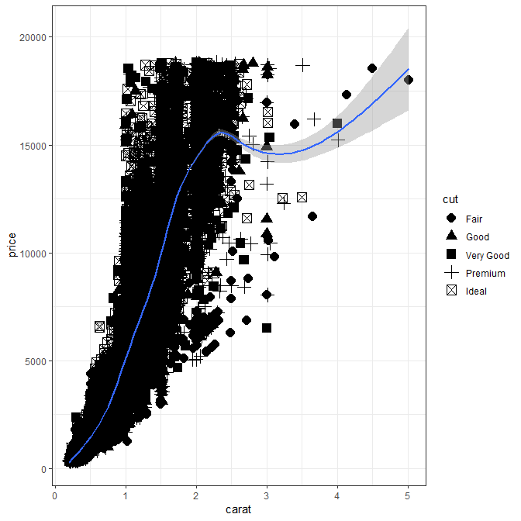
The Syntax of ggplot
First, open a blank R script in RStudio
Load ggplot2: library(ggplot2)
View the diamond data set: diamonds
Make our first ggplots
Check out all the possible “geoms”

Slide 7
QUIZ

Slide 8
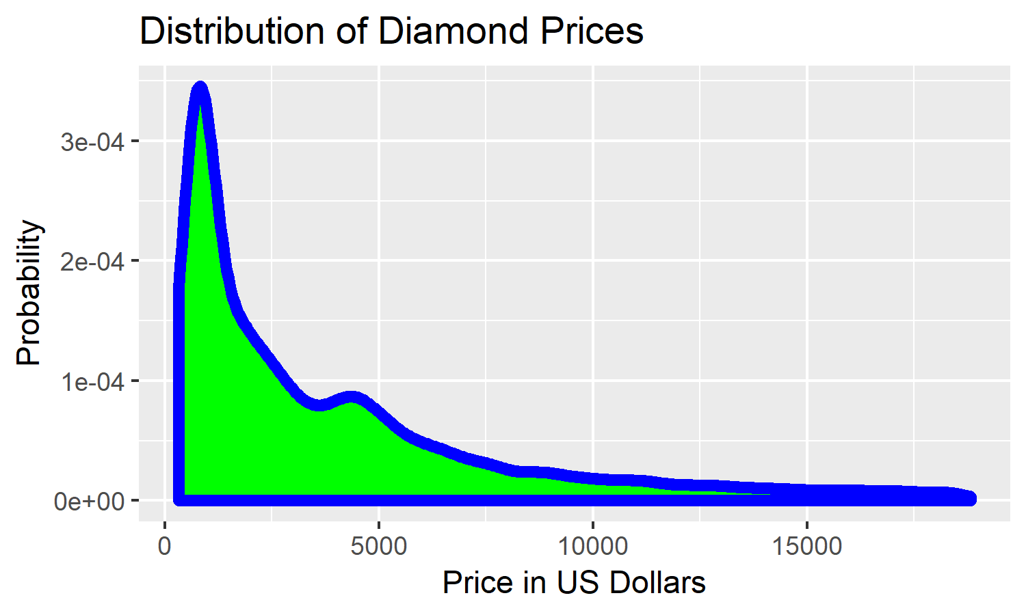
In-class practice
Create a folder in your homework Git repository called “class_examples”. Create an R script called “ggplot1_inclass_demo.R” in the folder.
Re-create the figure to the right
Hint: geom_density()
Save the figure as “diamonds_price_dist.png” with height = 3 and width = 5, in the “class_examples” directory.
Push everything to GitHub

