Slide 1
Parking violations
April 16, 2020

Slide 2
Open Parking and Camera Violations
DB as of May 2016, updated daily
50.2M Rows x 19 Columns
Plate
State
License Type
Summons
Issue Date
Violation Time
Violation
Judgment Entry Date
Fine Amount
Penalty Amount
Interest Amount
Reduction Amount
Payment Amount
Amount Due
Precinct
County
Issuing Agency
Violation Status
Summons Image

Slide 3

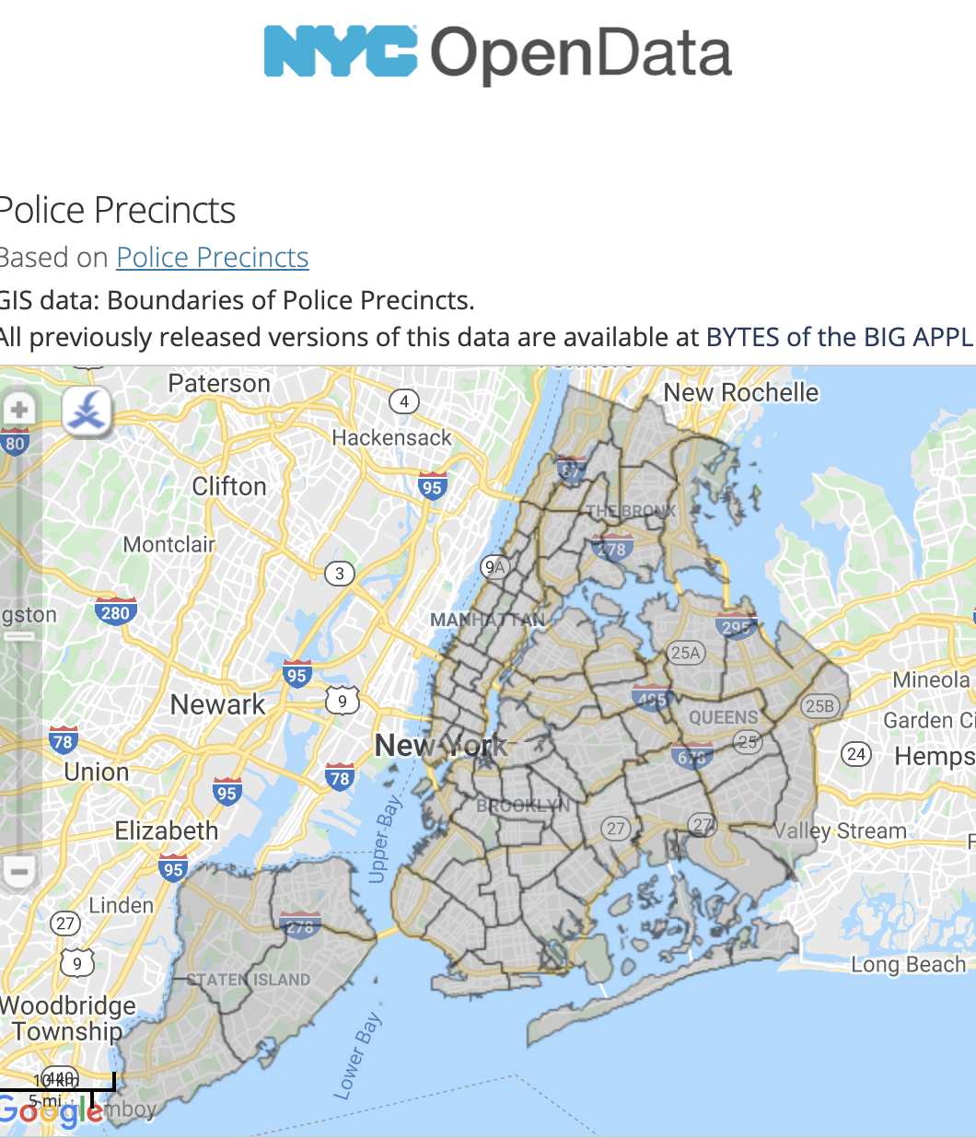
Exog

Slide 4
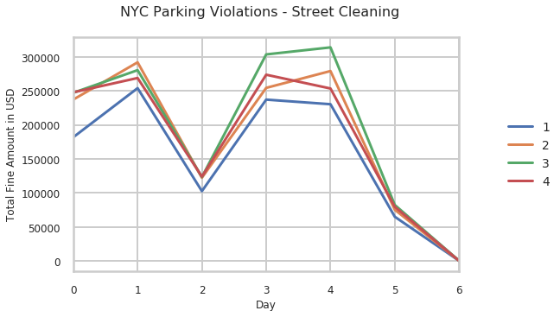
Weekday x Quarter

Slide 5
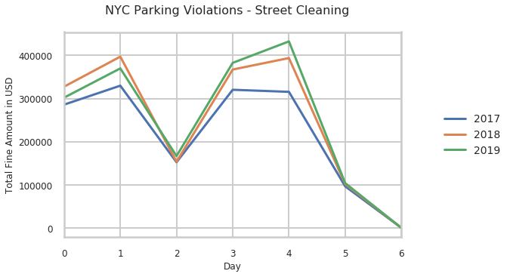
Weekday x Year

Slide 6
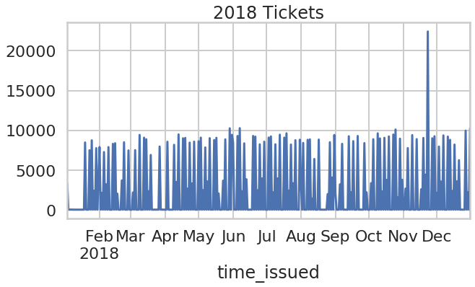
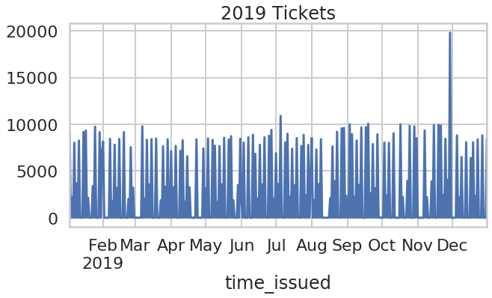
Fine Amount
Summary Black Friday 2017 Total Fines:
$991k
Black Friday 2018 Total Fines:
$1048k
Black Friday 2019 Total Fines:
$931k
Notes:
Summary Total Fines: $235.4m Total Amount Due: $48.8m Total Payment Amount: $48.8m

Slide 8
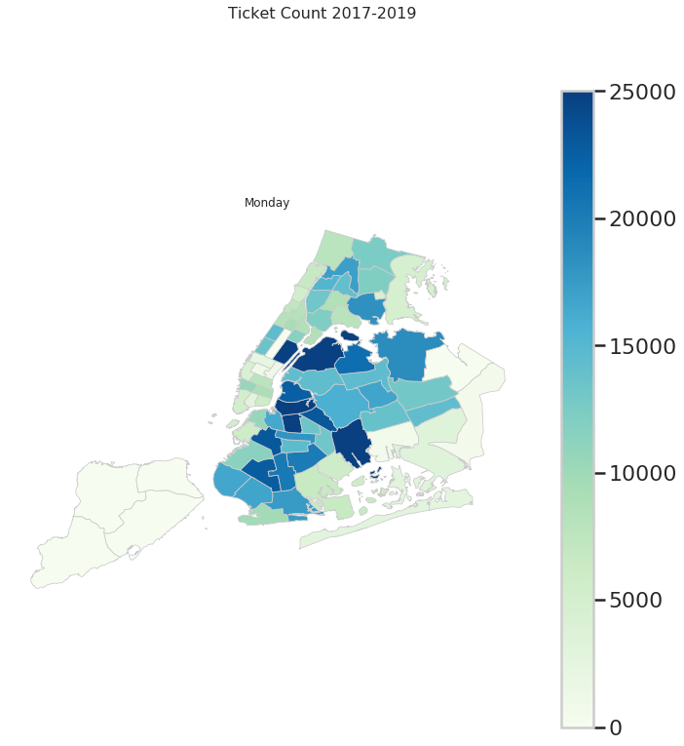
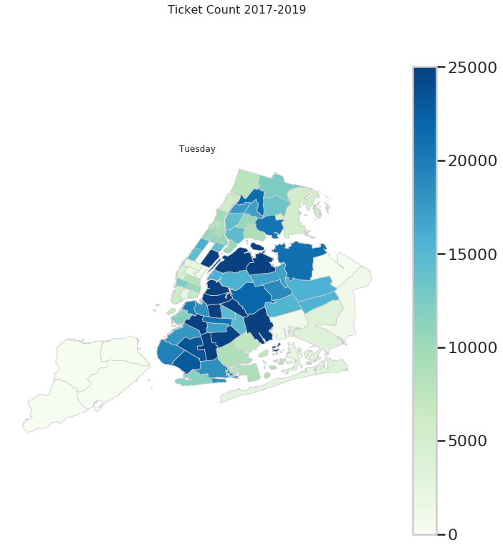



Exog

Slide 9
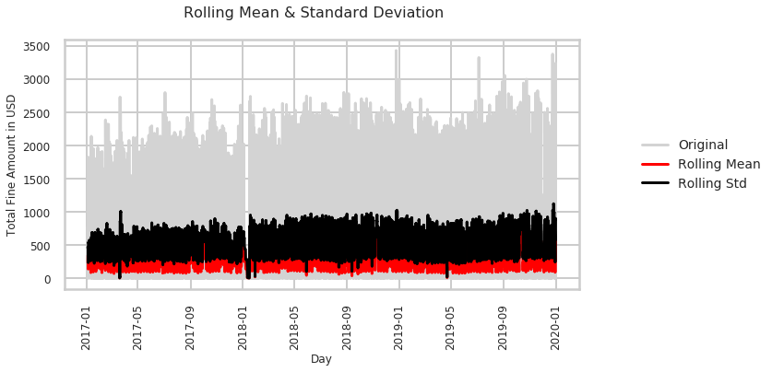
Stats

Slide 10
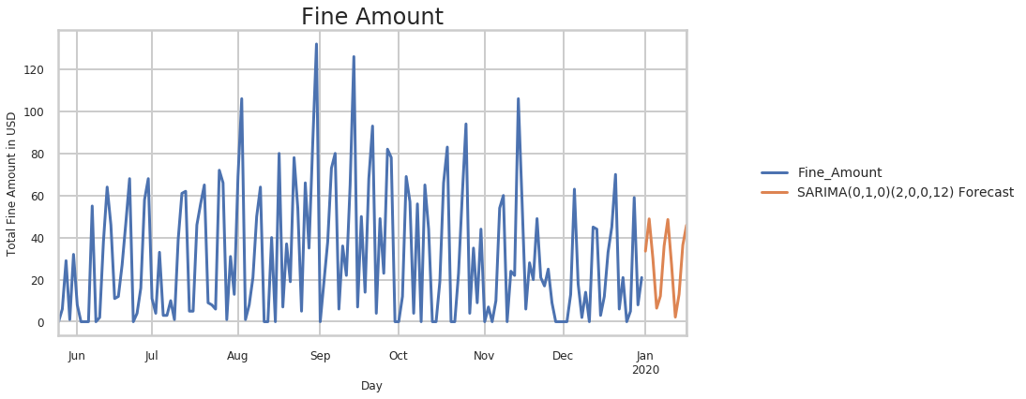

Slide 11
Thank you

Slide 12
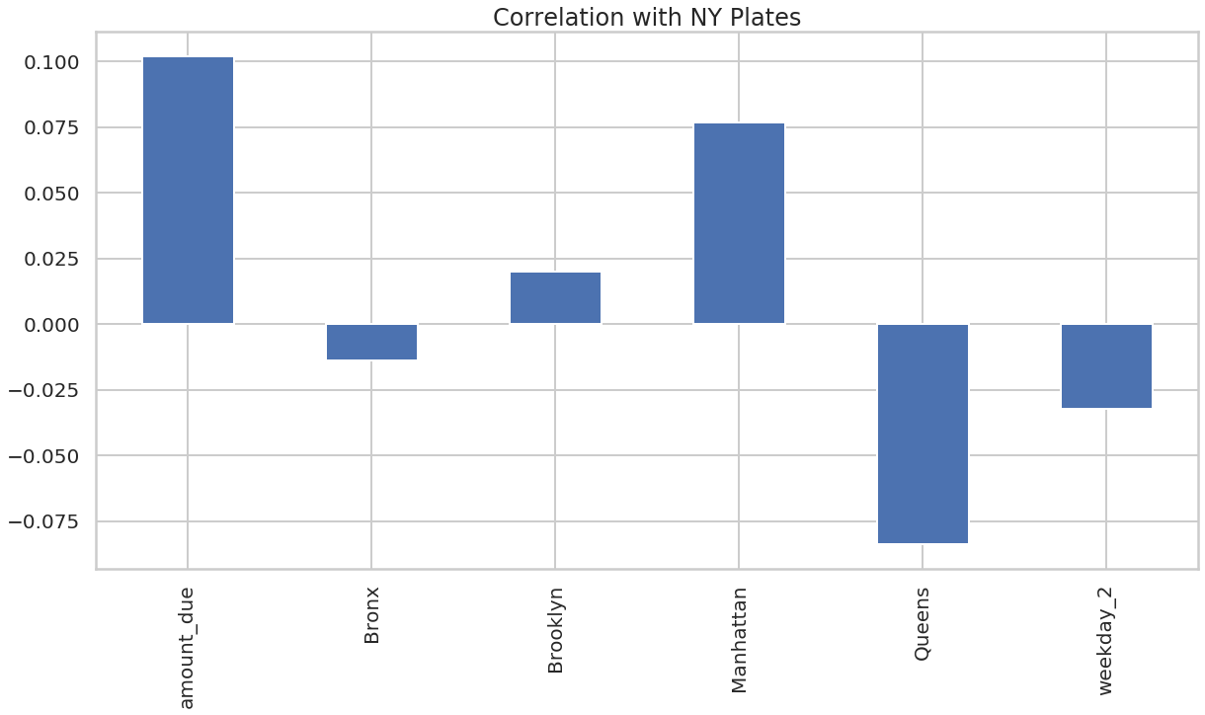
Accuracy: 0.806667 F1: 0.066851

