Slide 1
Credit Risk Analysis
Machine Learning - Hackathon
Meaga Varsha Ramakrishnan

Slide 2
TOC
Introduction
Dataset Information
Methodology
Modeling Platform
Exploratory Data Analysis and Pre-processing
Feature Engineering
Modeling and Discussions
Model Summary - (attached google sheet link)
Conclusion

Slide 3
INTRODUCTION

Slide 4



Dataset information - SOURCE
Credit Risk in Fintech Industry.docx
train_loan_data.csv
test_loan_data.csv
test_results.csv

Slide 5
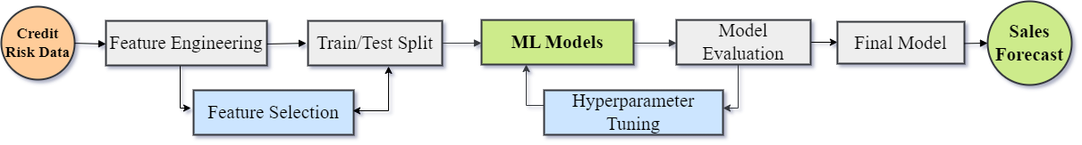
METHODOLOGY

Slide 6

MODELING PLATFORM
Platform : Google Colab
Runtime Type : TPU

Slide 7
EXPLORATORY DATA ANALYSIS

Slide 8
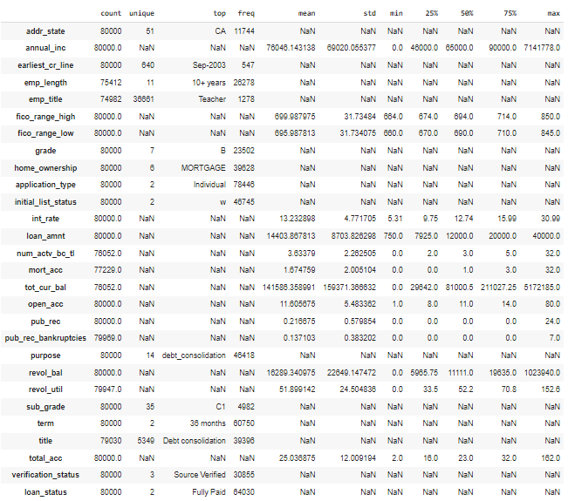

Slide 9
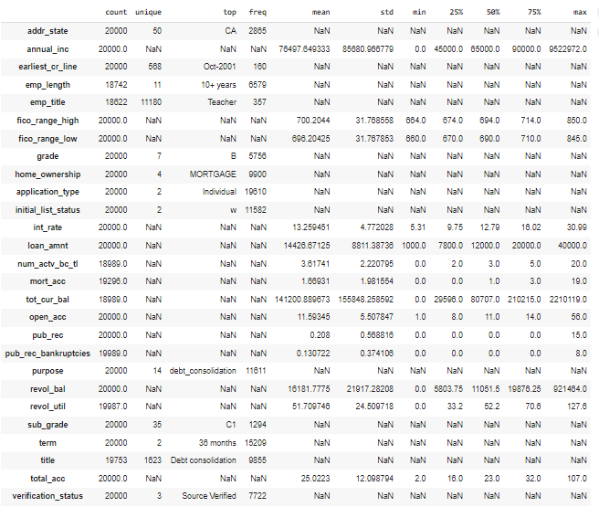

Slide 10
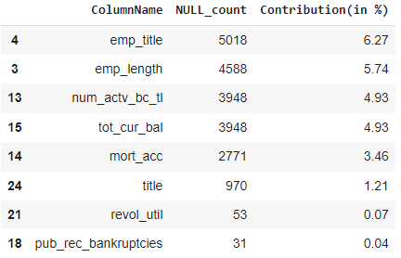
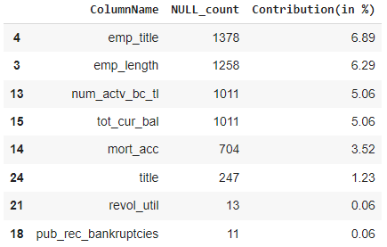
NULL Contributions
Row-wise NULL contributions are also evaluated
Train - 76 rows with 5 null values in the same row
Test - 76 rows with 5 null values in the same row

Slide 11
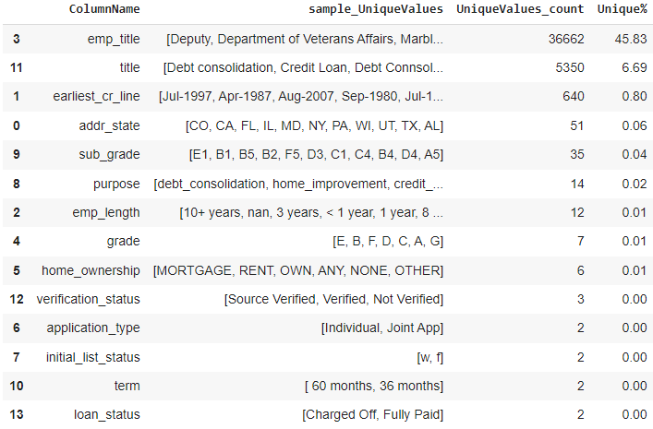
Unique Value Distribution - train

Slide 12
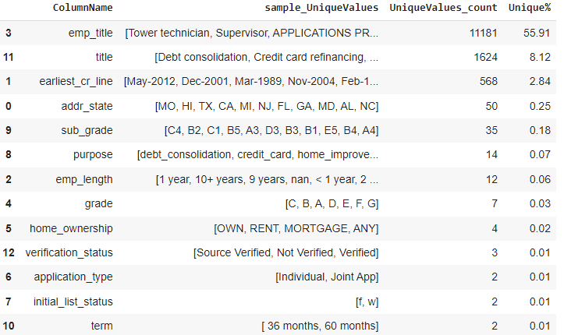
Unique Value Distribution - test

Slide 13
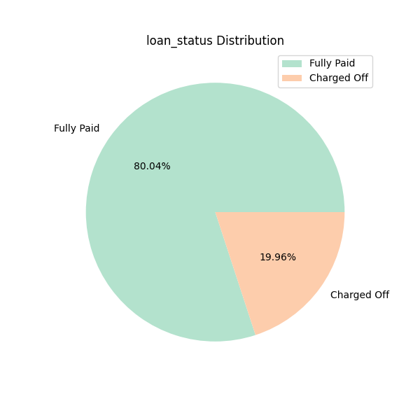
Unique Value Distribution - tARGET
Indicates the Dataset is IMBALANCED

Slide 14
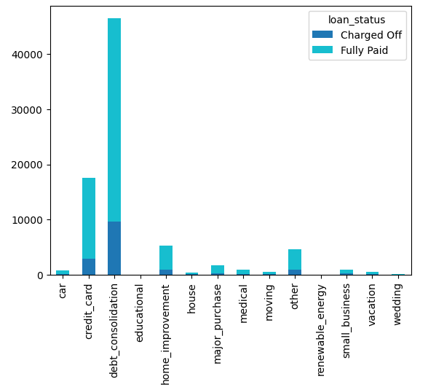
Other Plots

Slide 15
Feature Engineering

Slide 16


Dropping Columns - High Cardinality
The following columns are dropped as they are Highly Cardinal (has more Unique values)
emp_title
title

Slide 17
KNN-IMPUTER Code Snippet
def impute_null_values_using_knn_imputer(df, column_to_be_imputed, column_type, columns_to_be_considered, n_neighbors=3):
knn_imputer = KNNImputer(n_neighbors=n_neighbors)
data_to_impute = df[columns_to_be_considered+[column_to_be_imputed]]
# print('Value Counts (before imputation) : \n',data_to_impute[columns_to_be_considered].value_counts(dropna=False))
value_counts_df_before = data_to_impute[column_to_be_imputed].value_counts(dropna=False).rename_axis('unique_values').reset_index(name='count_before_imputation').sort_values(by=['unique_values'])
value_counts_df_before['unique_values'] = value_counts_df_before['unique_values'].fillna('NaN').astype('str')
knn_imputer.fit(data_to_impute)
imputed_data = knn_imputer.transform(data_to_impute)
imputed_data = pd.DataFrame(imputed_data, columns= data_to_impute.columns)
if column_type=='int':
df[column_to_be_imputed] = imputed_data[column_to_be_imputed].astype(int)
else:
df[column_to_be_imputed] = imputed_data[column_to_be_imputed]
# print('Null Counts (after imputation) : \n',df[columns_to_be_considered].value_counts(dropna=False))
value_counts_df_after = df[column_to_be_imputed].astype('float').astype('str').value_counts(dropna=False).rename_axis('unique_values').reset_index(name='count_after_imputation').sort_values(by=['unique_values'])
value_counts_df = value_counts_df_before.merge(value_counts_df_after, on=['unique_values'], how='left')
value_counts_df['no_of_values_imputed'] = value_counts_df['count_after_imputation'] - value_counts_df['count_before_imputation']
if column_type=='int':
display(value_counts_df)
return df

Slide 18
earliest_cr_line_year
Converting the Month-Year format earliest_cr_line column to earliest_cr_line_month (Month) and earliest_cr_line_year (Year) separately
Dropping the earliest_cr_line column
data['earliest_cr_line_year'], data['earliest_cr_line_month'] = pd.DatetimeIndex(data['earliest_cr_line']).year, pd.DatetimeIndex(data['earliest_cr_line']).month
data = data.drop(columns = 'earliest_cr_line')
data.head(3)

Slide 19
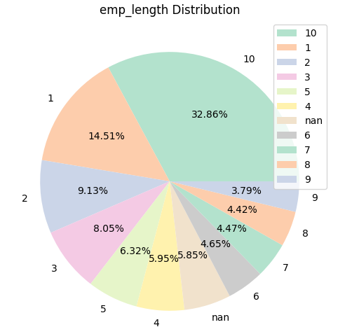
emp_length
The emp_length columns values are suffixed with ' years', so splitting the column based on this siffix.
Replacing the following to maintain a standard format:
10+ years : 10 years
1 year : 1 years
< 1 year : 1 years
data['emp_length'] = data['emp_length'].replace({'10+ years': '10 years', '1 year':'1', '< 1 year':'1 years'}).str.split(" years",n=1, expand=True)[0]

Slide 20
emp_length
NULL values are imputed using KNN-Imputer
emp_len_imputed = impute_null_values_using_knn_imputer(data,
column_to_be_imputed='emp_length',
column_type = 'int',
columns_to_be_considered=['annual_inc', 'earliest_cr_line_year', 'loan_amnt'],
n_neighbors=3)

Slide 21
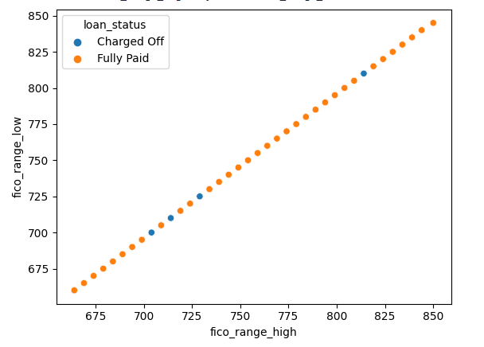
fico_range_high , fico_range_low
There exists a straight-forward linear relationship between these two columns
So, creating ‘fico_range_average’, average column out of these and dropping these 2 columns
emp_len_imputed['fico_range_average'] = (emp_len_imputed['fico_range_low'] + emp_len_imputed['fico_range_high']) / 2
fico_range_avg = emp_len_imputed.drop(columns=['fico_range_low', 'fico_range_high'])

Slide 22
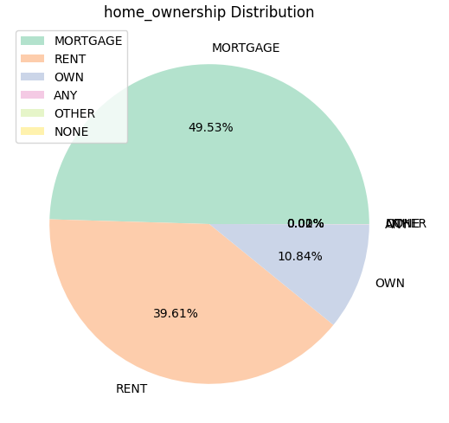
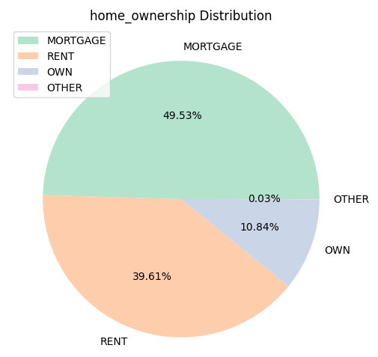
home_ownership
The following pre-process should be done:
The NaN value is indicated as NONE
'ANY' and 'OTHER' values are combined to 'OTHER'
NONE is imputed with the mode value

Slide 23
Num_actv_bc_tl, mort_acc, tot_cur_bal, revol_bal, revol_util
The NaN values in these columns are imputed using KNN-Imputer
actv_bc_tl = impute_null_values_using_knn_imputer(fico_range_avg,
column_to_be_imputed='num_actv_bc_tl',
column_type='int',
columns_to_be_considered=['loan_amnt', 'fico_range_average'],
n_neighbors=3)
mort_acc = impute_null_values_using_knn_imputer(actv_bc_tl,
column_to_be_imputed='mort_acc',
column_type='int',
columns_to_be_considered=['loan_amnt', 'fico_range_average', 'num_actv_bc_tl'],
n_neighbors=3)

Slide 24
term
The following replacements are done:
‘ 60 months’ - 60
‘ 36 months’ - 36
na_filled['term'] = na_filled['term'].replace({' 60 months': 60, ' 36 months': 36}).astype(int)
na_filled['term'].dtype

Slide 25
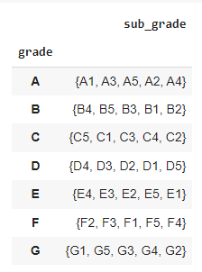
Grade and sub_grade
This table shows that the grade and sub_grade columns are related.
So, updating the sub_grade column with
numeric value
na_filled['sub_grade'] = na_filled['sub_grade'].str[-1].astype(int)
na_filled['sub_grade'].unique()

Slide 26
ENCODING
Ordinal Encode: grade, initial_list_status
One-Hot Encode: addr_state, home_ownership, application_type, purpose, verification_status

Slide 27
MODELING and DISCUSSIONS

Slide 28
Functions Created - scaling, sampling
def scale_data(data, scaler=StandardScaler()):
scaler.fit(data)
data_scaled = scaler.transform(data)
return data_scaled
def sampling_data(X_data, y_data, sampling_type='oversampling'):
if sampling_type=='oversampling':
sampler = RandomOverSampler()
else:
sampler = RandomUnderSampler()
X_sampled, y_sampled = sampler.fit_resample(X_data, y_data)
return X_sampled, y_sampled

Slide 29
Functions Created - Train-Test split
def split_data(df, target_col, train_size=0.75, random_state=0):
print('Train Test Split...')
print('Target Column :', target_col)
print(f"Train-Test Size : {train_size},{round(1-train_size, 1)}")
X = df.drop(columns=str(target_col))
Y = df[target_col]
# display(X)
return train_test_split(X, Y, train_size=train_size, stratify=Y, random_state=random_state)

Slide 30
Functions Created - get data for modeling
This function fetches the relevant modeling as per the parameters(scaling, sampling, features)
def get_data_for_modeling(data_and_hack_test, target_col, important_features, model,scaling, sampling, sampling_type):
data, hack_test, hack_results = data_and_hack_test
print(target_col in hack_test.columns.tolist())
if len(important_features)==0:
important_features = data.columns.tolist()
important_features_for_test_data = data.drop(columns=target_col).columns.tolist()
else:
list(set(important_features)).append(target_col)
data = data[list(set(important_features))]
hack_test = hack_test[list(set(important_features_for_test_data))]
X_train, X_test, y_train, y_test = split_data(data,target_col,train_size=0.7 )
print("Scaling : ", scaling)
if scaling==True:
X_train, X_test, hack_test = scale_data(X_train), scale_data(X_test), scale_data(hack_test)
else:
X_train, X_test, hack_test = X_train, X_test, hack_test
print("Sampling : ", sampling)
if sampling==True:
print("Type : ", sampling_type)
if sampling_type=='oversampling':
X_train, y_train = sampling_data(X_train, y_train, sampling_type='oversampling')
else:
X_train, y_train = sampling_data(X_train, y_train, sampling_type='undersampling')
else:
sampling_type = None
return X_train, X_test, y_train, y_test, hack_test

Slide 31
Functions Created - applying models
def applying_model(data_and_hack_test, target_col, base_model_name, model=None, important_features=[], scaling=False, sampling=True, sampling_type='oversampling'):
""" The model is passed as parameter, for GridSearchCV """
X_train, X_test, y_train, y_test, hack_test = get_data_for_modeling(data_and_hack_test, target_col, important_features, model,scaling, sampling, sampling_type)
if important_features==[]:
feature_selection = False
print('Training the model with the best parameter...')
model.fit(X_train, y_train)
print('Best Estimator : ')
print(model.best_estimator_)
else:
feature_selection = True
print('Predicting results...')
train_pred = model.predict(X_train)
test_pred = model.predict(X_test)
hack_test_pred = model.predict(hack_test)
model_accuracy_info.append([base_model_name, f'Scaling-{scaling}, Sampling-{sampling}({sampling_type}), FeatureSelection-{feature_selection}', round(accuracy_score(y_train, train_pred), 4), round(accuracy_score(y_test, test_pred),4), round(accuracy_score(hack_results, hack_test_pred),4), round(f1_score(y_train, train_pred),4), round(f1_score(y_test, test_pred),4), round(f1_score(hack_results, hack_test_pred),4) ])
print(model_accuracy_info[-1])

Slide 32
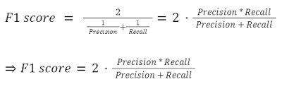
MODEL SUMMARY
https://drive.google.com/file/d/1jOfqEZXHhgj2zV3X5cXuhaHvRHtFYnJm/view?usp=share_link
The evaluation metric is F1 score

Slide 33
CONCLUSION

Slide 34
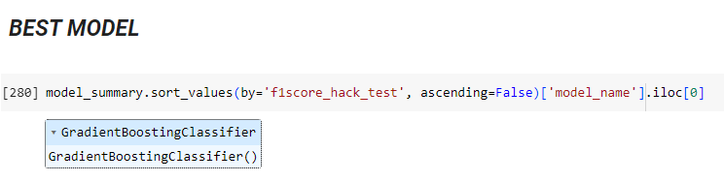
F1 Score of the best model : 0.4324

Slide 35
THANK YOU

