Slide 1
Uber Request Fulfilment, Problem-Driven Exploratory Analysis
DSCD 611: Programming for Data Scientists 1- Final Project
Notes:
[Sources]
- Uber Request Data.csv (provided in project materials)
[/Sources]

Slide 2
Problem framing & research questions
Research questions (answered with data)
Why this matters
What proportion of requests are completed vs unmet, and what is the dominant failure mode?
At which hours is the demand, supply gap (Requests − Completed) maximal?
Do outcome rates differ by pickup point (City vs Airport)?
Are there recurring weekday×hour hotspots for unmet demand?
Unmet requests (Cancelled or No Cars Available) indicate service failure; riders are unable to secure trips, suggesting supply–demand misalignment. Using exploratory data analysis, we identify key operational bottlenecks and propose practical, evidence-based interventions to reduce these failures.
EDA focus: descriptive analysis + actionable recommendations (no model training required by rubric)
Notes:
[Sources]
- Uber Request Data.csv (provided)
[/Sources]

Slide 3
Dataset & preparation
Dataset snapshot
The dataset contains 6,745 ride requests across 14 columns, including key variables such as;
Request id,
Pickup point,
Driver id,
Status,
Request timestamp,
Drop timestamp.
The timestamp fields appear in mixed formats and therefore require robust parsing (day-first with a fallback strategy). Missing values in the Driver id and Drop timestamp are expected for unmet requests and are treated as operationally meaningful rather than data errors.
Completed = Status == Trip Completed
Unmet = Cancelled OR No Cars Available
Demand (per hour) = #requests
Supply (per hour) = #completed trips
Gap = Demand − Supply
Hotspots = weekday×hour cells with high unmet counts
Key definitions
Preparation: parse timestamps → engineer hour/weekday → compute status indicators & gap metrics
Notes:
[Sources]
- Uber Request Data.csv (provided)
[/Sources]

Slide 4
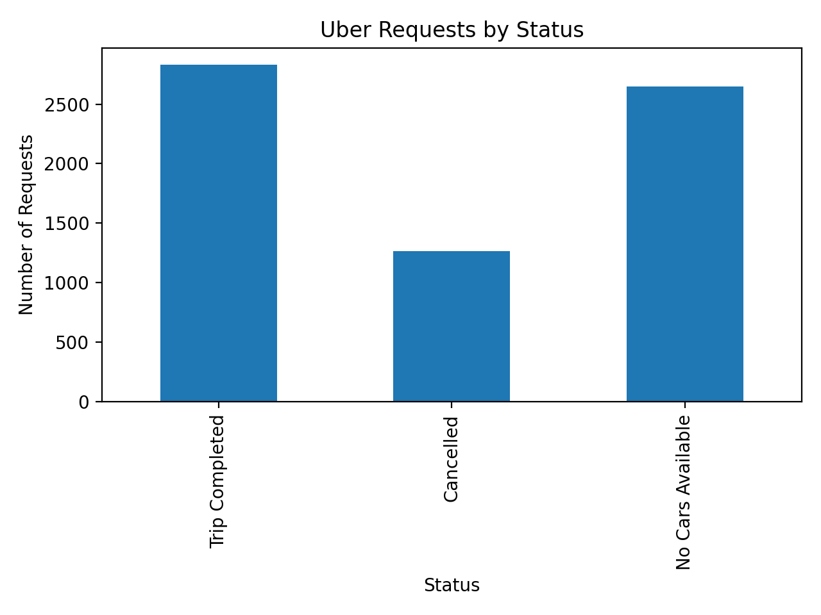
Completed vs unmet requests
What proportion of requests are completed vs unmet, and what is the dominant failure mode?
Status distribution (counts)
Key numbers
Completed: 2,831 (41.97%)
Cancelled: 1,264 (18.74%)
No cars: 2,650 (39.29%)
Interpretation
Unmet demand is large and splits into:
• “No Cars Available” → supply shortage
• “Cancelled” → behavior / wait-time / matching issues
Next: locate when & where unmet demand concentrates.
Q1 output establishes baseline service reliability and failure modes
Notes:
[Sources]
- Uber Request Data.csv (provided)
[/Sources]

Slide 5
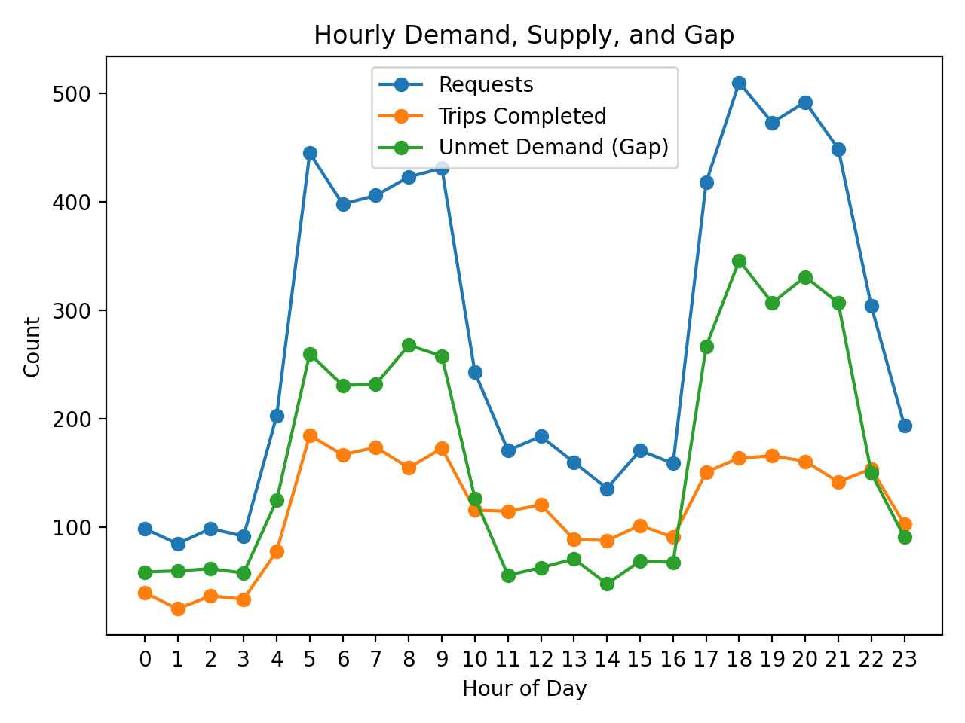
When is the demand–supply gap highest?
At which hours is the demand, supply gap (Requests − Completed) maximal?
Peak gap
Hour: 18:00
Gap: 346 requests
Evening hours (18–21) dominate the gap.
Top gap hours (gap)
18:00 → 346
20:00 → 331
21:00 → 307
19:00 → 307
8:00 → 268
Q2 identifies the highest-impact time windows for driver incentives/scheduling
Notes:
[Sources]
- Uber Request Data.csv (provided)
[/Sources]

Slide 6
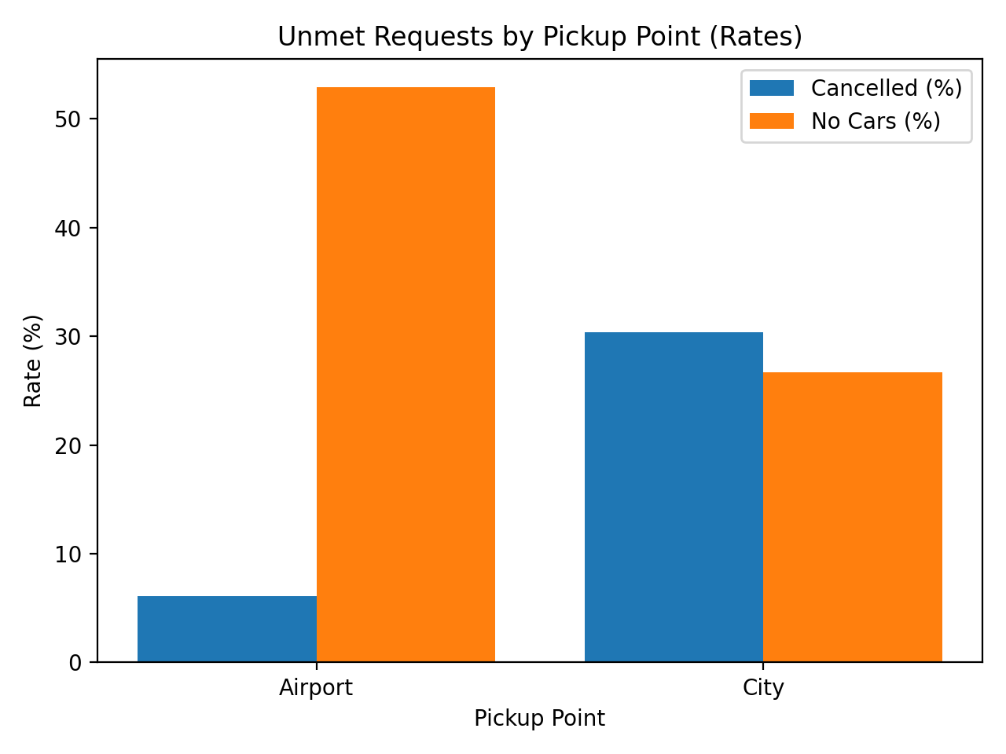
City vs Airport: different failure modes
Do outcome rates differ by pickup point (City vs Airport)?
Rates (% of requests) — focus on failure modes
Airport
No Cars: 52.90% (dominant)
Cancelled: 6.11%
Completion: 40.98%
→ Suggests supply shortage at airport.
City
Cancelled: 30.40% (dominant)
No Cars: 26.72%
Completion: 42.89%
→ Suggests cancellation/wait-time issues.
Q3 shows interventions should differ by pickup point (airport supply vs city cancellation reduction)
Notes:
[Sources]
- Uber Request Data.csv (provided)
[/Sources]

Slide 7
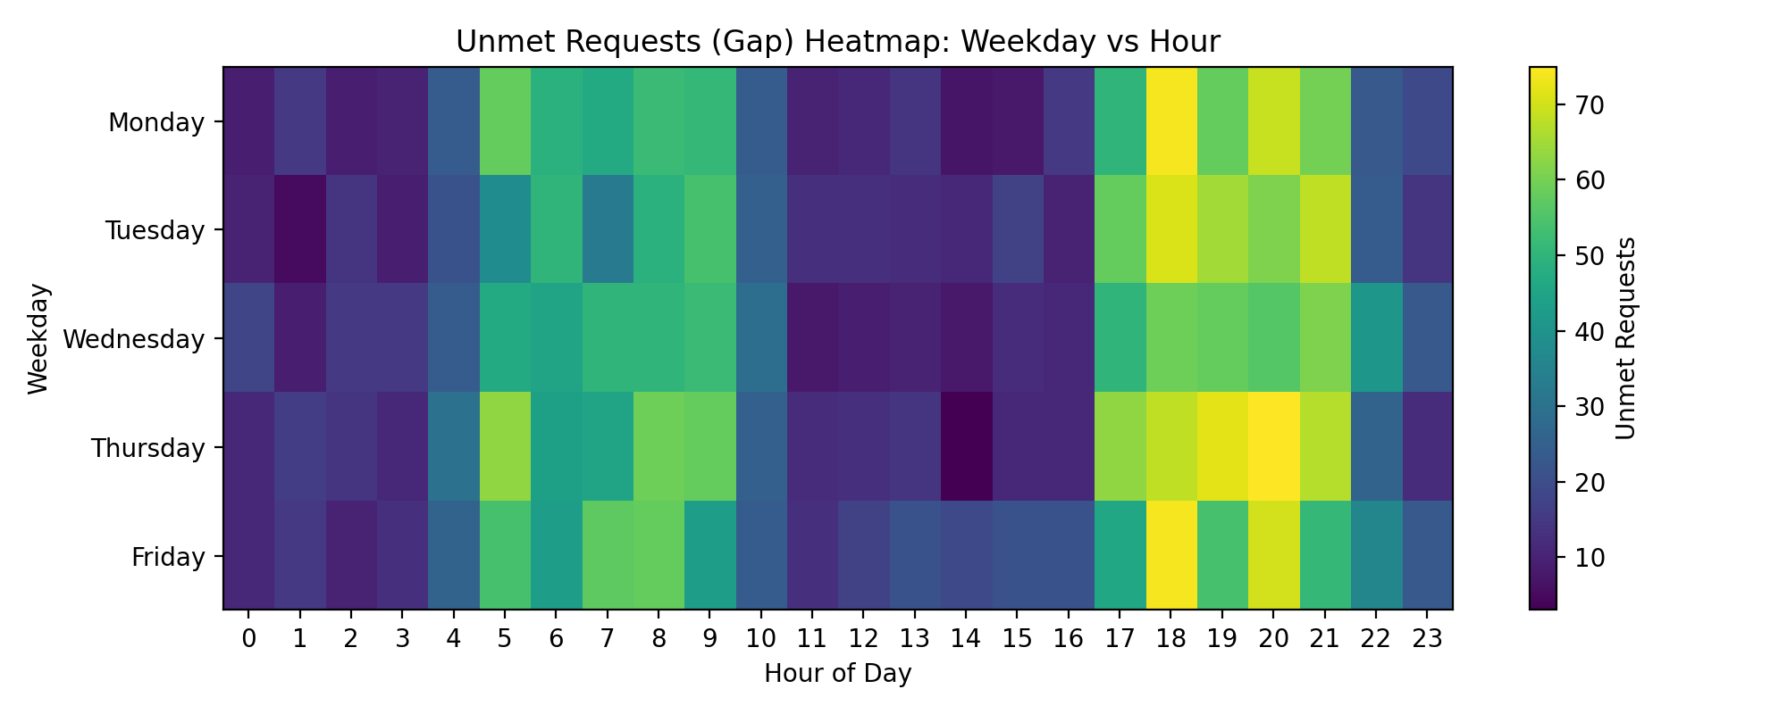
Recurring hotspot windows (weekday × hour)
Are there recurring weekday×hour hotspots for unmet demand?
Peak gap day
2016-07-14 → gap 823
Top hotspot cells (unmet)
Thu at 20:00 → 75
Mon at 18:00 → 74
Fri at 18:00 → 74
Thu at19:00 → 72
Pattern: weekday evenings (18–21) dominate.
Q4 highlights predictable hotspot windows → plan supply/incentives in advance
Notes:
[Sources]
- Uber Request Data.csv (provided)
[/Sources]

Slide 8
Recommendations & next steps
Summary
Actionable recommendations
Implement time-targeted incentives and/or surge mechanisms during peak-gap windows, prioritising the highest-gap hours.
Introduce airport staging/queue management and airport-specific incentives to reduce No Cars Available outcomes.
Reduce cancellations by focusing on wait-time reduction, including matching improvements and driver rebalancing during high-cancellation periods.
Establish ongoing monitoring and evaluation, tracking status distributions, hourly gaps, and weekday–hour hotspots over time, and assessing intervention impact using pre/post comparisons.
Limitations and future work
Taken together, the findings, it indicate that unmet demand is both substantial and systematically patterned. The predominance of No Cars Available outcomes suggests that insufficient driver supply is the primary operational constraint. Moreover, the temporal analyses demonstrate that the demand–supply mismatch is concentrated within peak periods, rather than being evenly distributed across the day. Finally, the marked differences between pickup points imply that a single uniform policy is unlikely to be optimal; instead, interventions should be location-specific, combining airport-focused supply management (e.g., staging, queuing, and targeted incentives) with cancellation-reduction strategies in the city (e.g., improving matching efficiency, reducing wait times, and enhancing ETA accuracy).
Thank you — questions?
Notes:
[Sources]
- Uber Request Data.csv (provided)
[/Sources]

