Slide 1
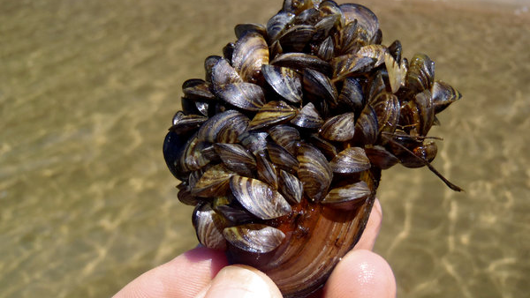
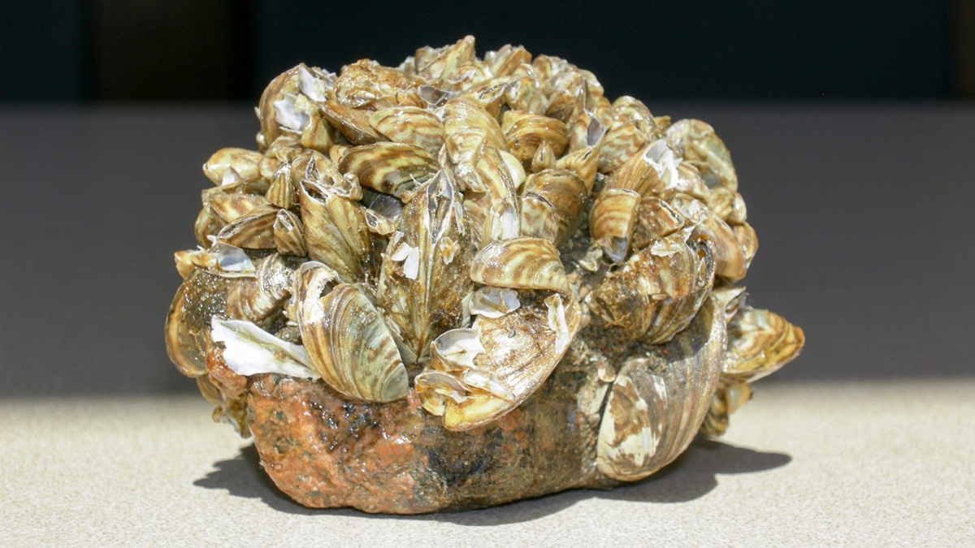
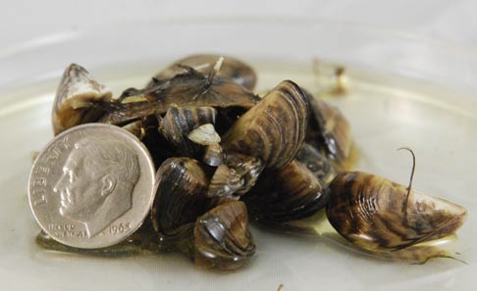
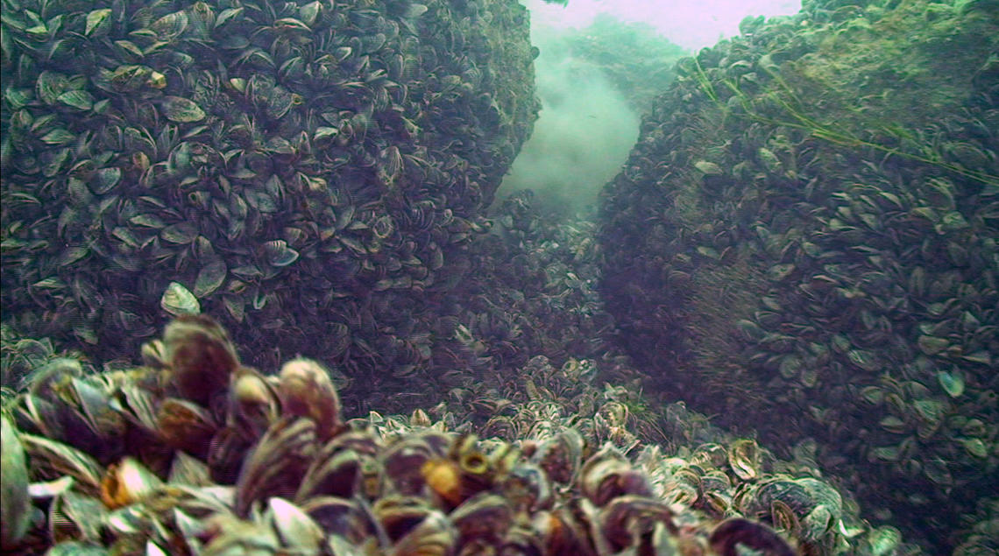
TITLE
Meaghan Winder
March 9, 2020

Slide 2
eDNA Surveys
Plankton Tow Surveys
Lake
Lake
Sample Site
…
Sample Site
Sample Site
…
Sample Site
Plankton Tows
Plankton Tows
Sample
…
Sample
Sample
…
Sample
Microscopy
Microscopy
…
…
…
…
PCR replicate
PCR replicate
PCR replicate
PCR replicate
PCR replicate
PCR replicate
PCR replicate
PCR replicate

Slide 3
Occupancy Models
Assumptions?
or maybe I don’t need this slide at all?

Slide 4
References
https://dbw.parks.ca.gov/?page_id=28996
https://www.nps.gov/articles/zebra-mussels.htm
https://www.usgs.gov/media/images/large-boulders-dreissenid-mussels-detroit-river

