Slide 1


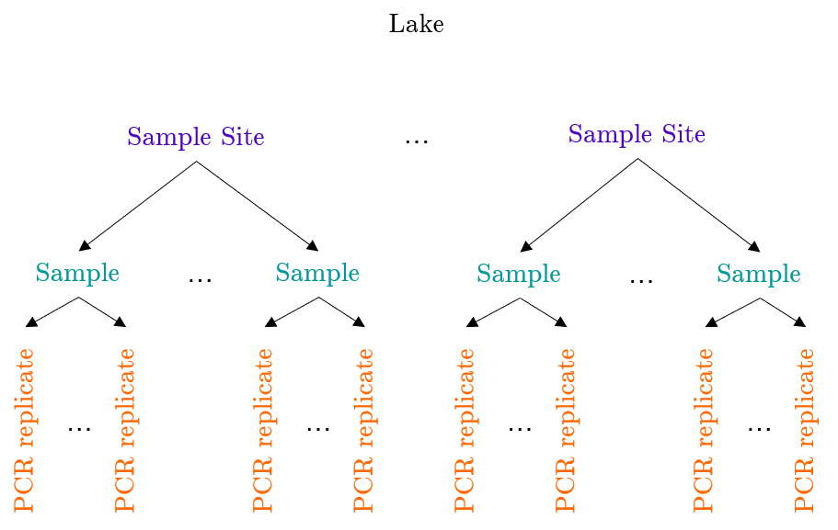
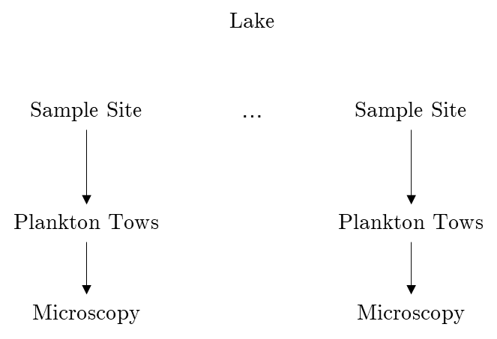
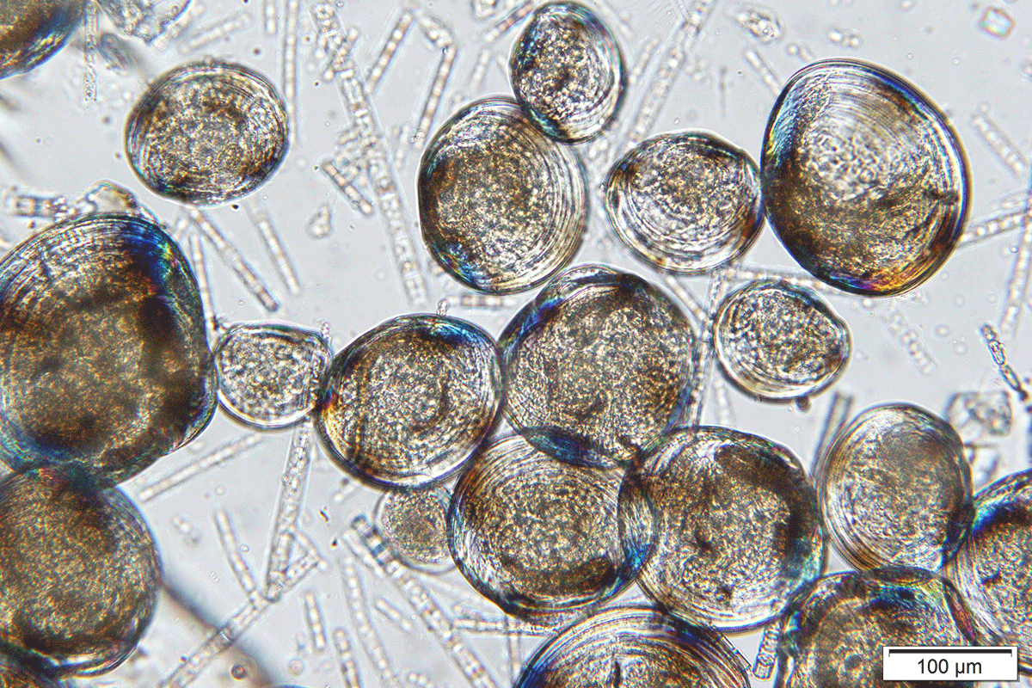
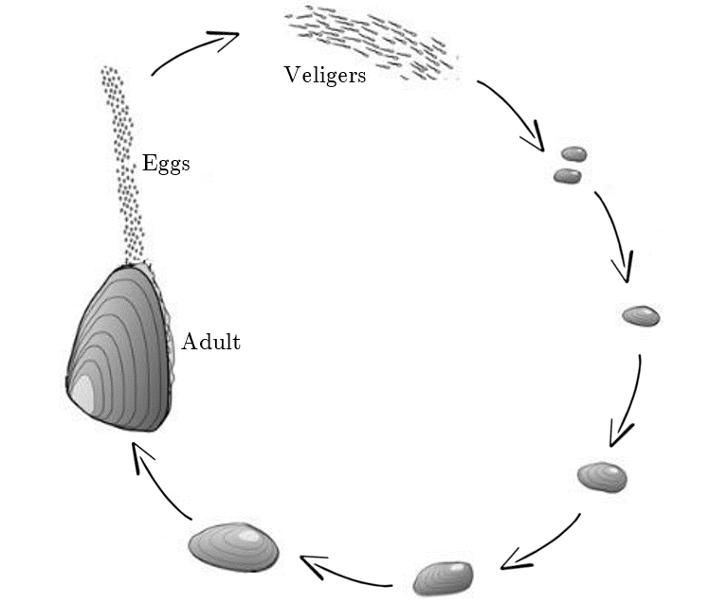
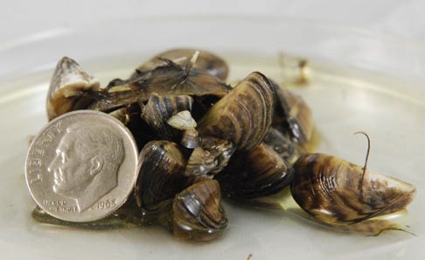
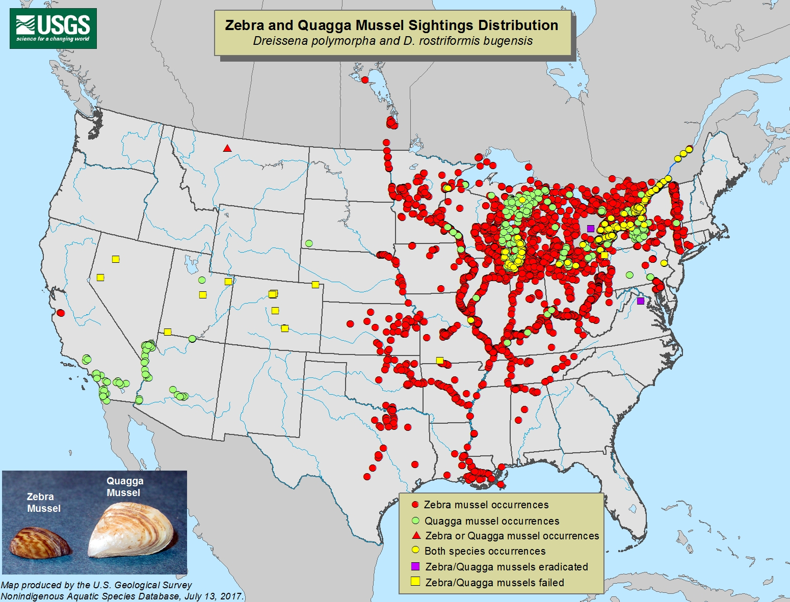

Multi-scale occupancy modeling of dreissenid mussels: a comparison of eDNA and plankton tow survey methods
Meaghan Winder
Dr. Andrew Hoegh
Motivation
Multi-scale Occupancy Model for eDNA Surveys
Plankton Tow Surveys
Hundreds of millions of dollars spent annually on control and mitigation efforts
Change the water body ecosystem
Most often moved to uninfested waters by humans
Once an population is established, there is not much that can be done in terms of eradication
Early detection can provide 3-5 years advanced notice to plan and install necessary technologies
$$Z_{i }\sim Bernoulli(ψ_{i})$$
$ψ_{i}$: probability that eDNA is present at the $i^{th}$site
$z_{i}$: latent occupancy state at the site level
$$A_{ij}|z_{i} \sim Bernoulli(z_{i}θ_{ij})$$
$θ_{ij}$: conditional probability that eDNA is present in the $j^{th}$ sample from the $i^{th}$ site,
given eDNA is present at the site
$a_{ij}$: latent occupancy state at the sample level
$$Y_{ij}|a_{ij} \sim Binomial(K_{ij}, { a}_{ij}p_{ij})$$
$p_{ij}$: conditional probability of detection of eDNA in each replicate of the $j^{th}$ sample
collected at the $i^{th}$ location, given that eDNA is present in that sample
$Y_{ij}$: the number of the $K_{ij}$ replicates from the $j^{th}$ sample collected at the $i^{th}$
location that contain eDNA
Research Question
How do the detection probabilities and false negative rates compare for the two early detection methods?
Data
Presence:
Target species occupies the region and is detected
Absence:
Target species does not occupy the region or occupies the region and is not detected
Detection Probability:
Probability of detecting the target species if it is present
Acknowledgments
Adam Sepulveda, U.S. Geological Survey, Northern Rocky Mountain Science Center

