Slide 1

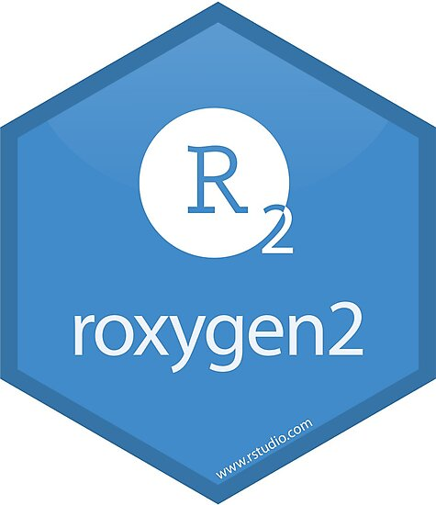




Creating R packages By Alex Ilich
To install example package use command
devtools::install_github(“ailich/testpackage”)

Slide 2
Why Create an R Package?
Easy access to all your functions
Can load all your functions with library(packagename)
Easier to use
Help documentation
Easy to update
Update it in the package and now it’s updated in all your scripts
Version control
Git/github integration
Easy to share
Others can install the latest version of your package using devtools::install_github(“username/package”) if it is a public repository

Slide 3

OK, that sounds great, but I’m not a software developer
Creating a package in base R can be a daunting task
You need to set up the file structure correctly, manage dependencies, deal with this weird thing called the NAMESPACE, document code properly, etc
Luckily as with all things R, THERE’S A PACKAGE FOR THAT

Slide 4
Actually, there’s 3 packages
The 2 Big ones
roxygen2 – Package that allows you to use a special syntax that simplifies package creation and allows for more automation of package creation
devtools – The one you will call most of the time to create and update your package. Reads Roxygen comments to automatically update your function.
Main functions:
create() – create package file structure
document()- writes function documentation and updates the NAMESPACE file from roxygen comments
check() – See if there’s any problems with your R package
install() – installs your R package
Also useful
usethis – Contains some helpful functions. Can make doing certain things easier.

Slide 5
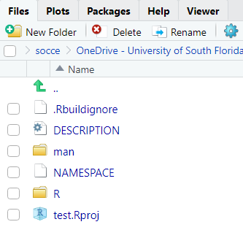
File Structure
devtools::create()
R Directory –Where all your functions will live
man- Contains the help documentation files for each function
DESCRIPTION – contains information about the package and its dependencies
NAMESPACE - ¯\_(ツ)_/¯
Luckily roxygen2 and devtools handle this automatically

Slide 6
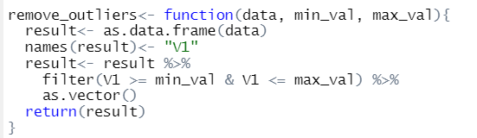
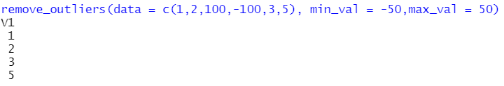
Simple Function
Simple function to remove values greater than a maximum value and less than a minimum value
Coded in a “dumb” way to include dependencies

Slide 7
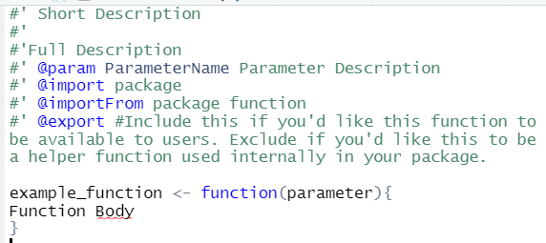
Roxygen Syntax
Roxygen comments start with #’
Important Tags
@param – function parameter/argument
@import – used to import a package dependency
@importFrom- used to import a specific function from another package
@export – specifies that you’d like this function to be available to the user
@examples – examples of how to use the function
@return – tells the user what the output of the function is

Slide 8
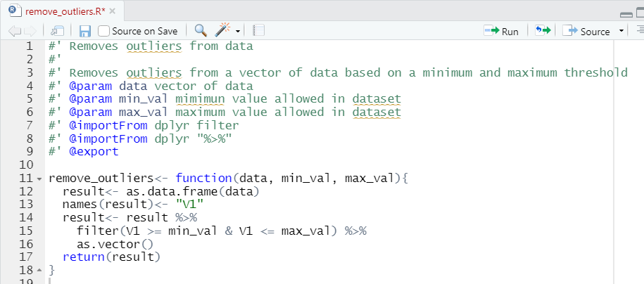
Simple Function
Our function
Roxygen2 Template
Save each function as an R script in the “R” directory with the file name matching the function name
Pro-tip: Highlighting the function and then using Control + Shift + Alt + R will automatically set up the roxygen comment structure and will fill in the parameters

Slide 9
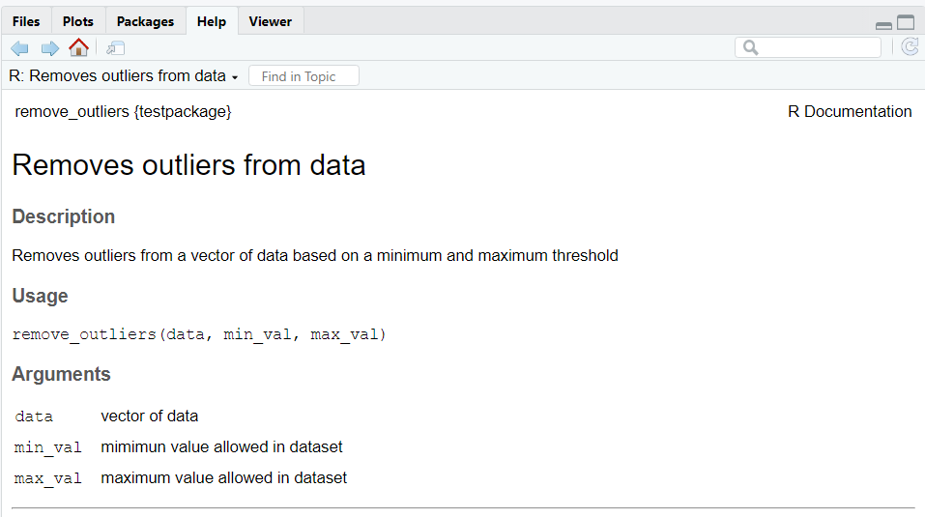

Simple Function
What do those tags actually do?
Allow for automation with devtools::document()
The document function will automatically update the NAMESPACE file, and will create markdown styled documentation for each function in the man directory

Slide 10
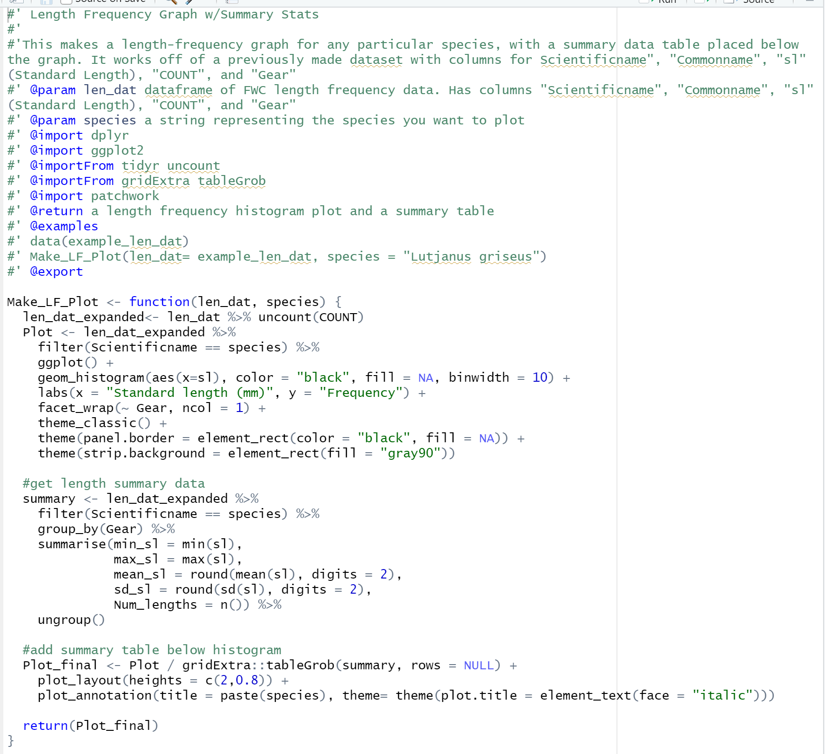
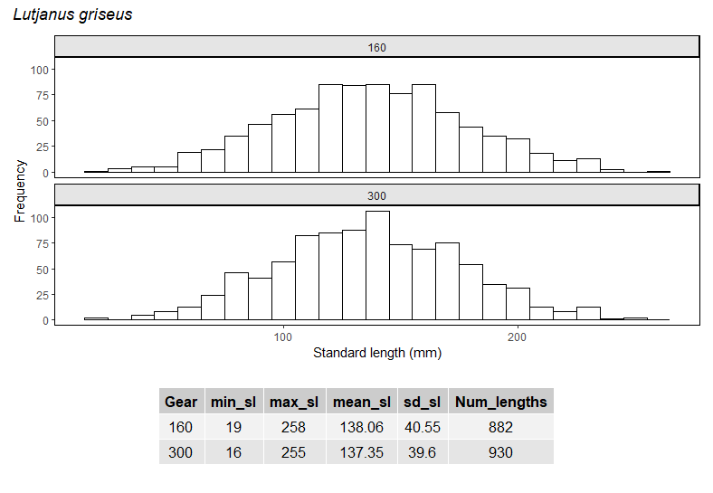
Complicated Function

Slide 11
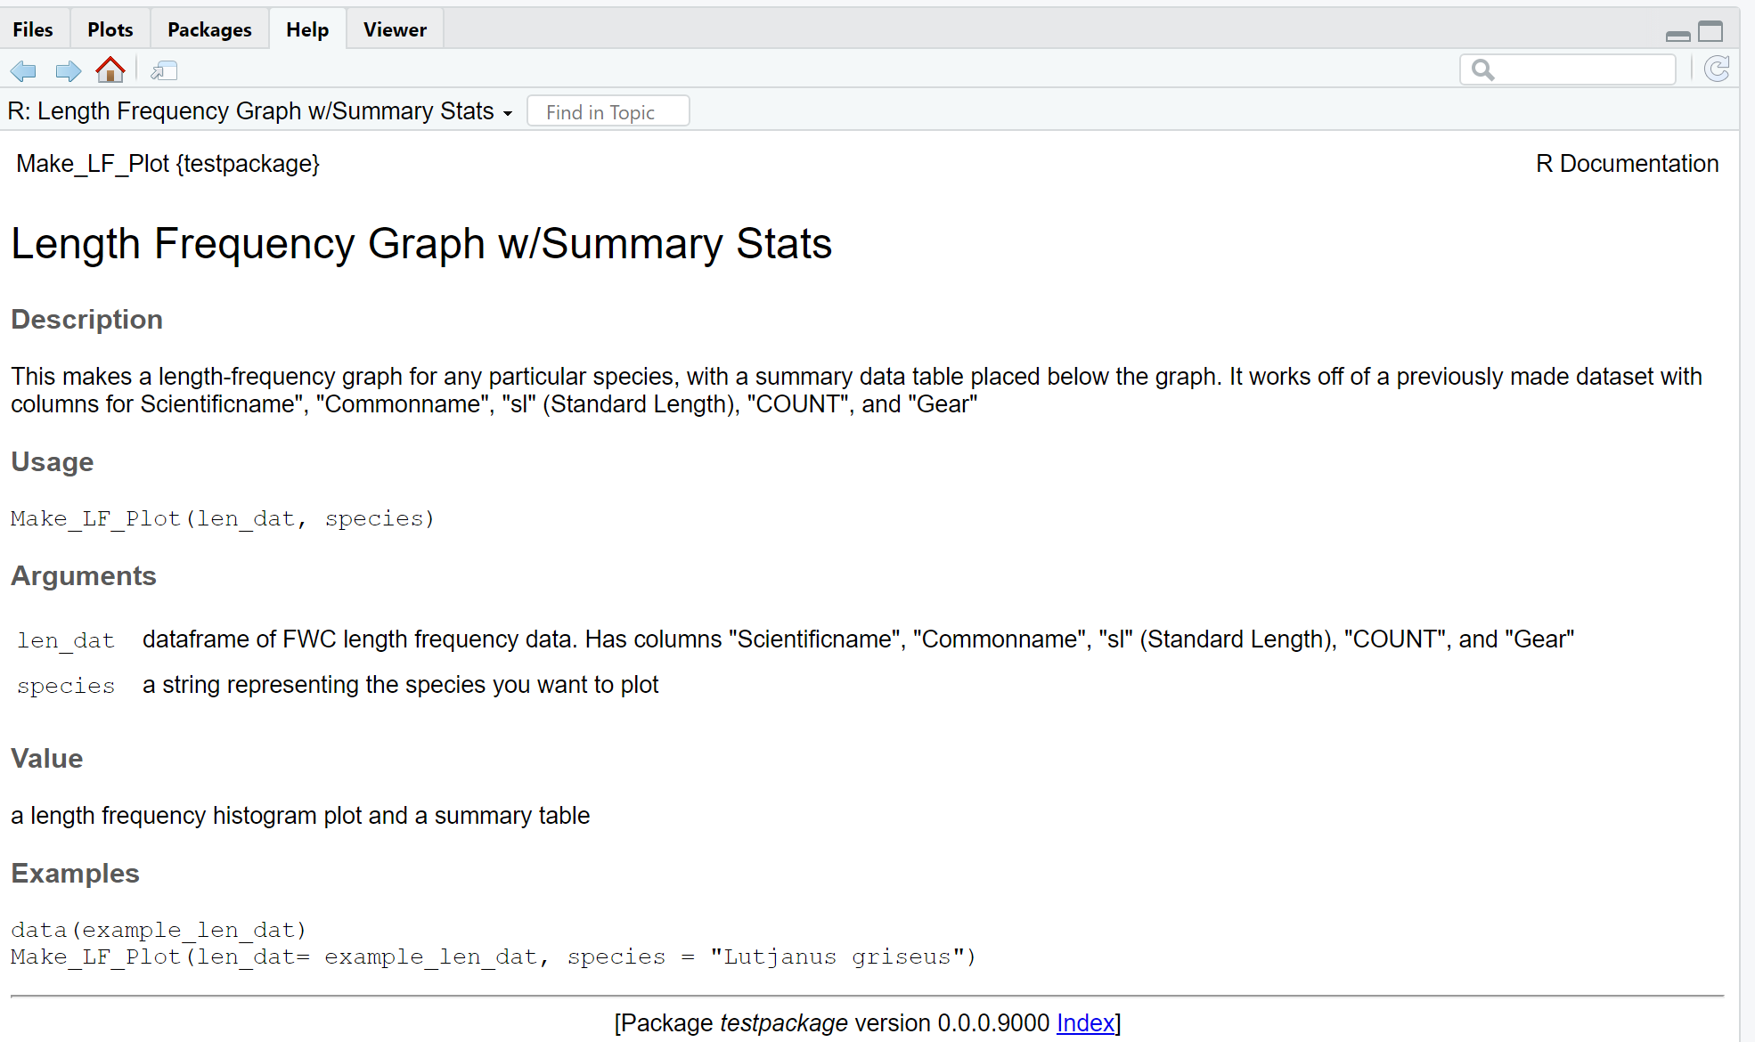
Complicated Function

Slide 12
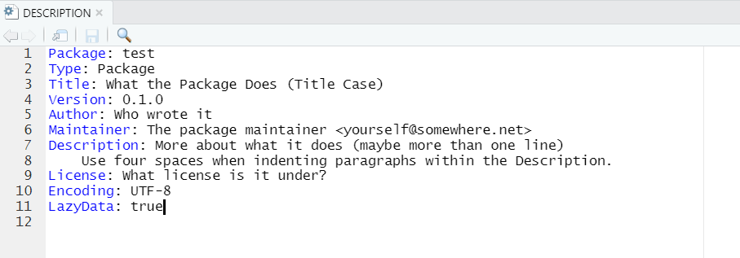
Description File
By default looks like this after running devtools::create()
You can add information about the package to this file, and need to specify package dependencies

Slide 13
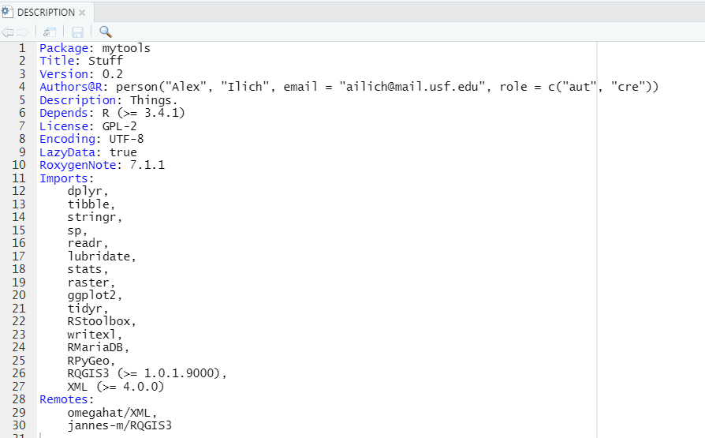
Example Description File
Add package dependencies under “Imports”
There are other ways (e.g. Suggests & Depends) to specify dependencies, but Imports has become best practice
Can do manually by typing in package name OR by using the usepackage function e.g.
usethis::usepackage(“dplyr”, type = “Imports”, min_version=NULL)
Can specify package versions (specify >= a specific version rather than an exact version)
Can also specify packages from github under the Remotes section, or can automatically be done using usethis::use_dev_package

Slide 14

The Namespace
Deals with what packages/functions are imported and which functions are exported by your package (and other things)
roxygen2 and devtools automatically update the NAMESPACE
Rule #1: NEVER EDIT THE NAMESPACE

Slide 15
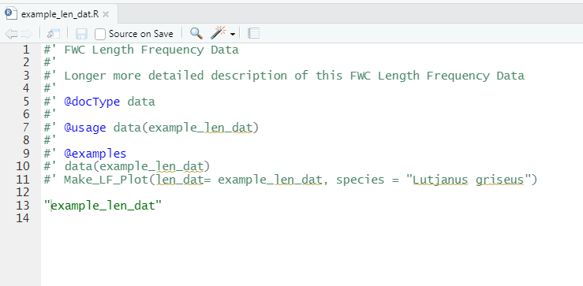
Data
Create a “data” folder
Read data into R and format it the way you want
Use “save” function to save that variable as a .RData file in the data directory
Create a documentation file for the dataset in the R directory with the functions
Works much like function documentation but need to include:
#' @docType data
Instead of the function body you just have the name of the data object in quotes

Slide 16
Useful Tips and Warnings
Remember to reinstall your package after making changes. Then restart R (control+ shift + F10), and then reload the package to have the updated version loaded.
Don’t change the purpose of a function or its default arguments b/c then your old scripts won’t run the same way (or at all) if you go back to them
Might help to start all functions in a package with a prefix for ease of finding (e.g. all functions in the simple features (sf) package start with “st_”
help(package=“packagename”) to see all functions and data, as well as their descriptions and links to their full documentation
Importing multiple packages in a single function can result in naming conflicts if they have functions with the same name. Best practice is to only import 1 full package and use importFrom for other functions.
It’s also best practice to use package::function syntax, which can be useful for determining which dependencies you need to specify.
Including helper functions – Keep in a separate “.R” file without the @export tag OR keep them in same “.R” file but above the exported function.

Slide 17
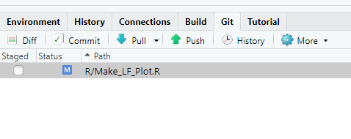
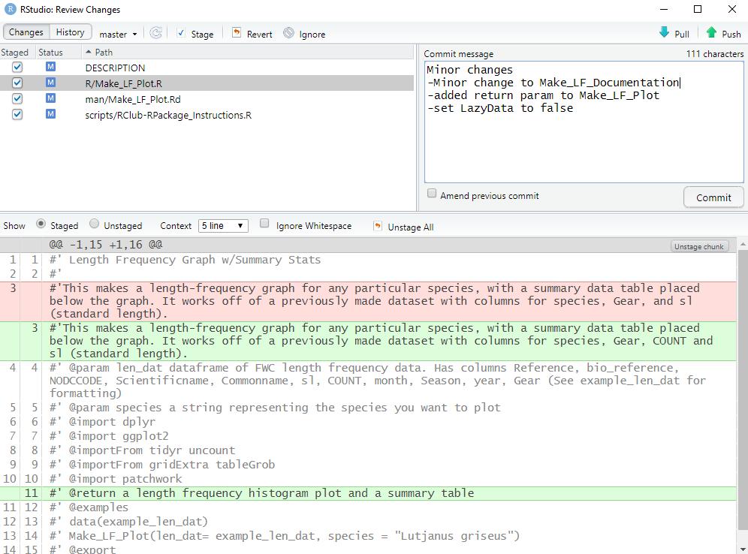
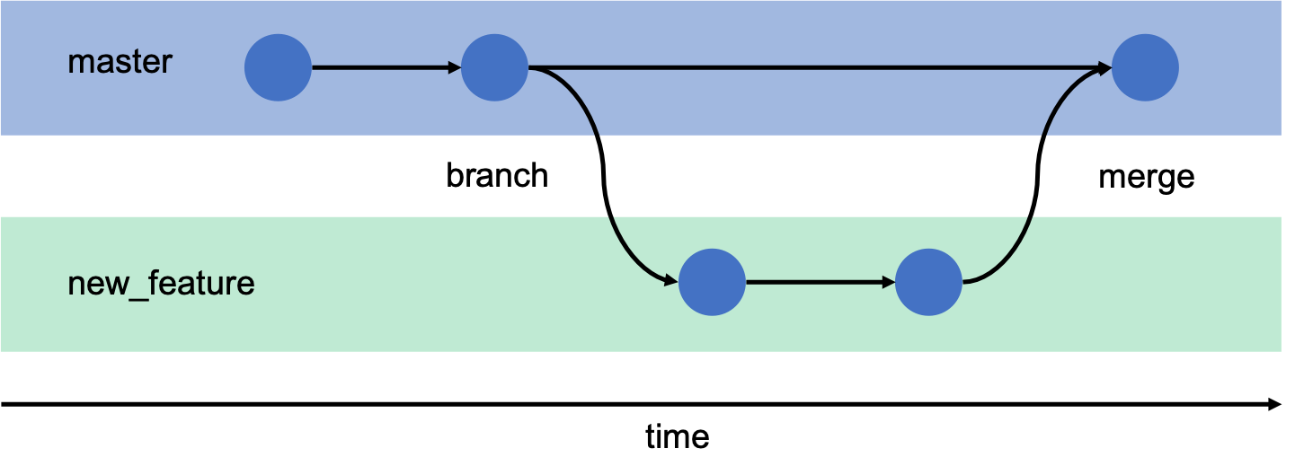
Additional Topics: Version Control
Git – a version control software
Saves the history of all files in the git repository after each “commit” and tracks the differences between versions.
Allows you to see how things have changed and revert to an older version if need be
Good for small plain text files (e.g. R scripts)
Command Line Program
Github - Online cloud storage that syncs with your local git repository
Easily shareable since online
Provides an extra backup
Web interface, so you can click around and see history rather than using command line
Rstudio provides integration with git and github without need for using the command line
Basic git commands
Commit – Kind of like save but for a git repository. Any time you commit, that means that later on you can revert back to that version.
Pull – You “pull” down the latest changes to the files down from the cloud (github) to your local computer
Push – You send or “push” your committed edits to the cloud
Diff – See the difference between 2 versions
Advanced Commands
Branch – If your experimenting with different ways to do something you may create a separate branch in the repository, and then merge it back with the main branch later if it works
Checkout – Tells git which branch you’d like to work on

Slide 18
Random Things That May Come Up
Dependencies from non-CRAN, non-github sources
https://cran.r-project.org/web/packages/devtools/vignettes/dependencies.html
Invite others to collaborate on your git repository
https://help.github.jp/enterprise/2.11/user/articles/inviting-collaborators-to-a-personal-repository/
You want to share your package with your coworkers but not make it public
https://docs.github.com/en/github/creating-cloning-and-archiving-repositories/about-repositories
https://support.rstudio.com/hc/en-us/articles/115000239587-Sharing-Internal-R-Packages
You want to import the pipe operator (%>%) but not the entire package
importFrom magrittr “%>%” or importFrom dplyr “%>%”
You already made a package and now you want to load it to github
usethis::use_git() #Initialize git repository if you haven't already
usethis::browse_github_token() #Should open web browser. Click "Generate token"
usethis::use_github(private = TRUE, auth_token = "PasteTokenHere")

Slide 19
Additional Resources
R packages Book: https://r-pkgs.org/index.html
NCEAS R Packages Tutorial: https://nceas.github.io/oss-lessons/creating-r-packages/creating-r-packages.html
Git/Github/R: http://r-pkgs.had.co.nz/git.html
Happy Git and Github for the UseR: https://happygitwithr.com/

